Slide 1
Clarity 9.0
What‘s new

Slide 2
What Is new in Clarity 9.0?
Improvements of the Integration Algorithm – new algorithm Wave based on previous Experimental
Batch dialog redesign, improved handling of calibration during reprocessing
Improvements in Audit Trail
Clarity design adjusted to the Windows 11 environment
A new option Move down after Enter in Sequence Table to support barcode readers
Updated SW upgrade policy including paid upgrades of major versions
New and updated control modules
WHAT‘S NEW / OVERVIEW

Slide 3
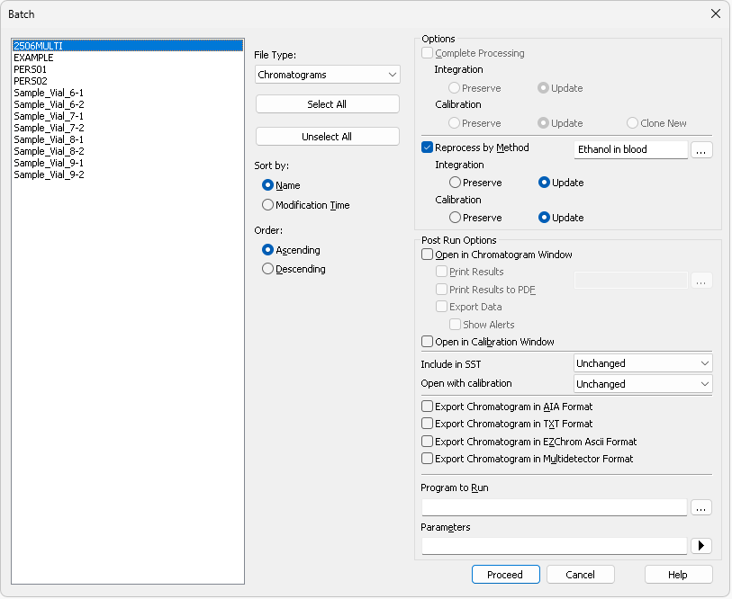
Batch Dialog
Options regrouped to reflect the real workflow
Calibration cloning from Batch issue fixed
WHAT‘S NEW / BATCH DIALOG

Slide 4
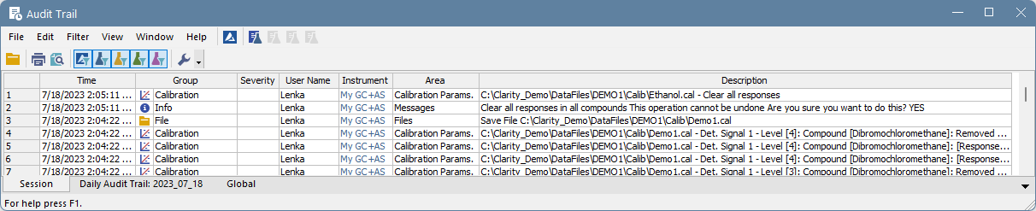
Audit Trail
Logging of system messages and pop-up windows improved
It now contains info about the instrument and user
WHAT‘S NEW / IMPROVEMENTS IN AUDIT TRAIL

Slide 5
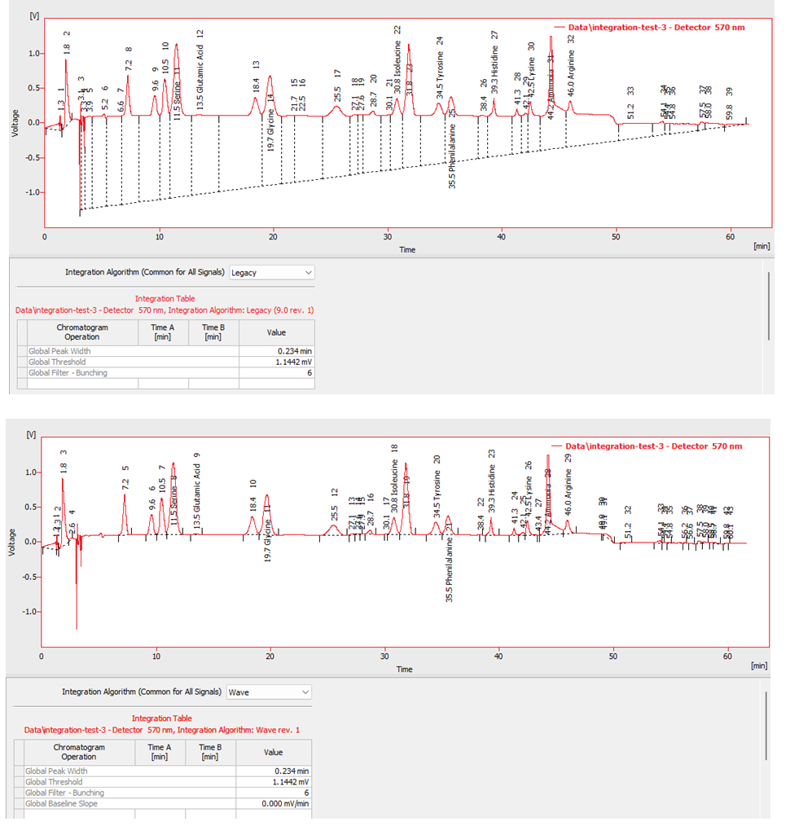

integration algorithm - WAVE
New Wave Integration Algorithm based on previous Experimental algorithm
  In most cases, integration using just Global Parameters and Integration Interval works better
Selection of Integration Algorithm moved to the Integration tab
Legacy
Wave
For more details refer to Clarity 9.0 vs 8.8 manual available at https://www.dataapex.com/download/manuals
WHAT‘S NEW / IMPROVEMENTS OF INTEGRATION ALGORITHM

Slide 6
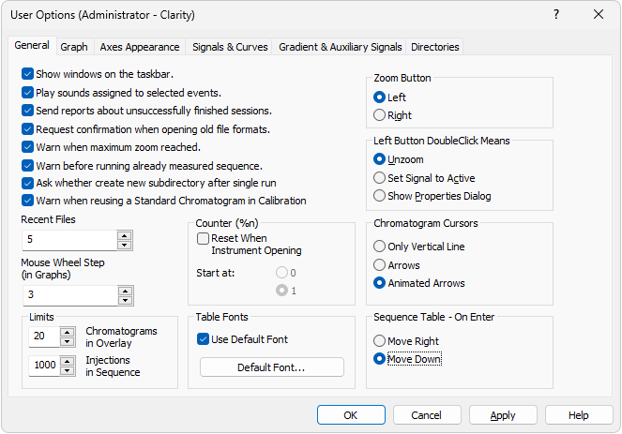
Barcode reader support in sequence table
The Sequence Table - On Enter option defines where the focus moves in the Sequence table after pressing Enter:
Move Right – default option
Move Down – used for barcode readers emulating keyboard
WHAT‘S NEW / MOVE DOWN AFTER ENTER OPTION

Slide 7
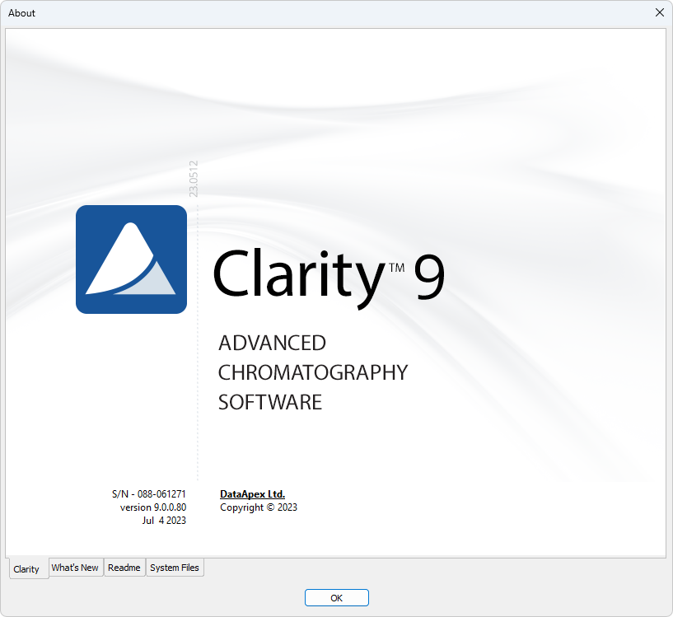
Updated SW upgrade policy
New software license comes with free upgrades one-year period
Major versions – upgrade
  Change of the version number is before the dot - A.b.c.d
  Includes the change of the user code
  Are paid (unless the user is entitled to one-year free upgrade)
Minor versions – update
  Change of the version number is after the first dot - a.B.C.D
  Free of charge
We sell and provide support only for the latest version of Clarity
For more details refer to https://www.dataapex.com/product/upgrade
WHAT‘S NEW / CLARITY PAID UPGRADE

Slide 8
Other improvements and fixed bugs
Fixed MS Search and NIST libraries result differences caused by sending the wrong spectral range from Clarity to NIST
Improvements in the behavior of Fraction Collectors
Better handling of method version to prevent memory exhaustion
New warning when method size exceeds the limit
… and a lot more
WHAT‘S NEW / OTHER IMPROVEMENTS AND FIXED BUGS
Notes:
.

Slide 9
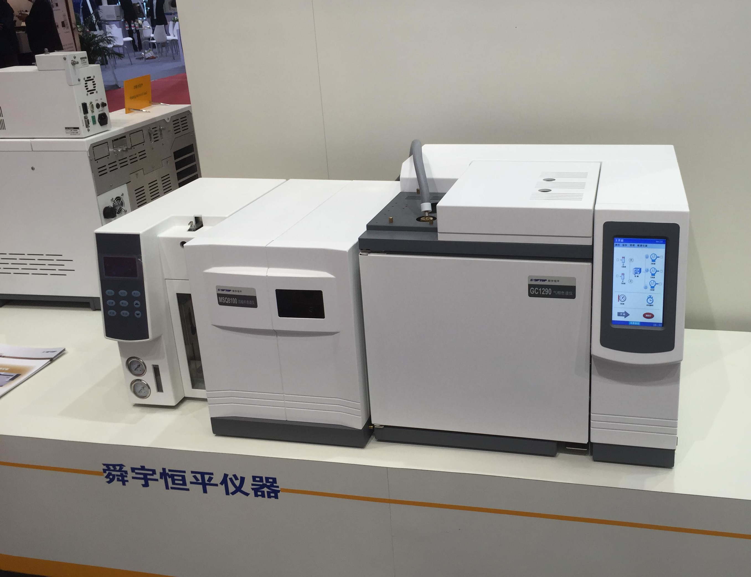
New control modules
HTA 2000H, 2000HT, 2100H
QuadroCore MCore
Shanghai Sunny Hengping Scientific Instrument GC-MS
... and many control modules have been updated and improved, for more see https://www.dataapex.com/version_history
WHAT‘S NEW / NEW AND UPDATED CONTROL MODULES
Notes:
.

Slide 10
Thank you for your ATTENTION

