Slide 1
Regulated environment
In clarity

Slide 2



regulated environment - Legal boundaries
Referred to in various legislations
Clarity end-user organization must be aware of legislation applicable for it
Example of related guidelines
  Title 21, Part 11 – Code of Federal Regulations (21 CFR Part 11)
  EudraLex – Chapter 4, Annex 11
  CFDA Pharmaceutical GMP, Appendix 2
  …other individual national guidelines
REGULATED ENVIRONEMNT / LEGAL BOUNDERIES

Slide 3


ACHIEVING COMPLIENCE
Follow the principle of ALCOA for all your data:
  Attributable – to a specific person and his/her actions
  Legible – for reviews, audits or regulatory inspections
  Contemporaneous – record of when data was created, and data is timestamped
  Original – kept in the same format as when created
  Accurate – records are correct and include “whole truth”
A compliance with the directives can be achieved only by a combination of the respective software capabilities, overall system settings and use of standard operational procedures as properly defined by the end user organization.
REGULATED ENVIRONMENT / ACHIEVING COMPLIENCE

Slide 4
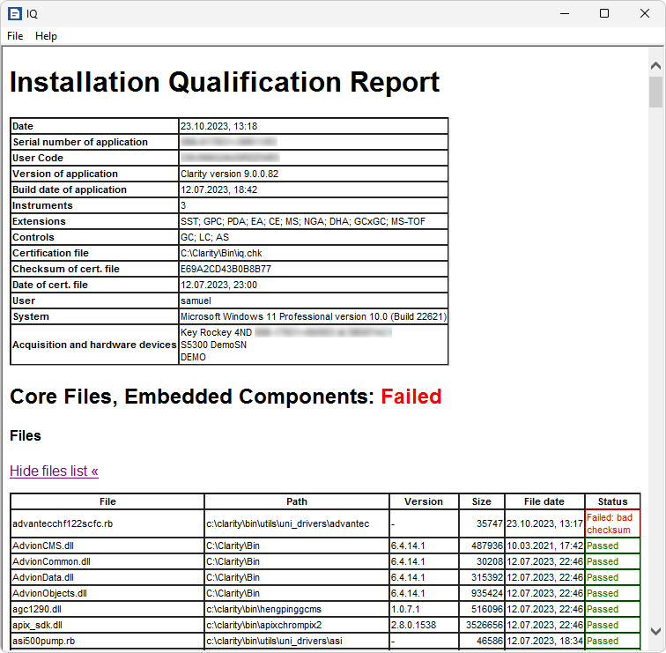
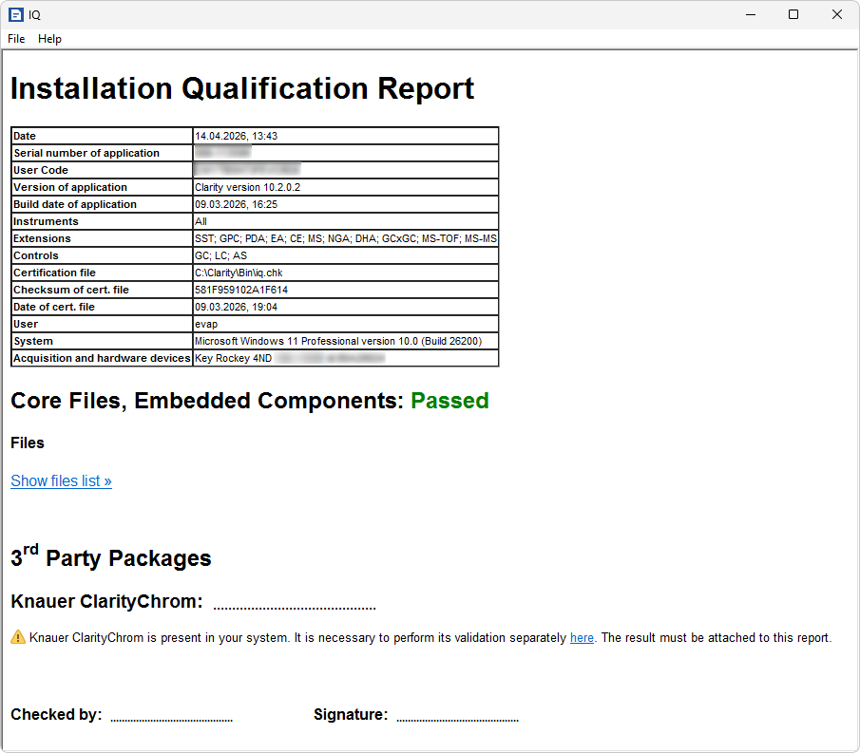
Installation qualification - IQ
Checks correct installation of Clarity
REGULATED ENVIRONMENT / IQ

Slide 5
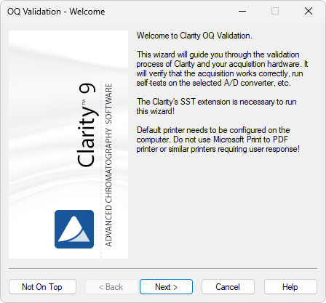
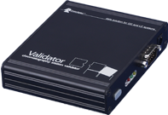
OPERATIONAL qualification - OQ
Needed for Clarity validation – requires SST extension
Checks acquisition and data processing
REGULATED ENVIRONMENT / OQ

Slide 6
performance qualification - PQ
SST extension can be used
IQ and OQ must be successfully completed before performing PQ
Must be prepared by the workplace personnel based on:
  Used instruments
  SOPs
  Applicable regulations
No certificate for PQ is issued by DataApex, , but support is available if required
REGULATED ENVIRONMENT / PQ

Slide 7
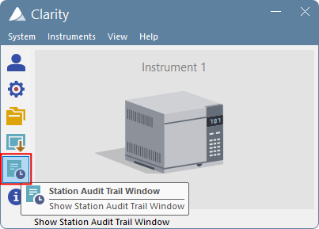
Audit Trail
Tool to support attributable and legible data
Tracking user activities
Tracking all actions and data modification
  Audit trail is not modifiable
  Audit trail can be exported in various formats
Complete AT for the entire station
Specific AT for each file
REGULATED ENVIRONMENT / AUDIT TRAIL

Slide 8
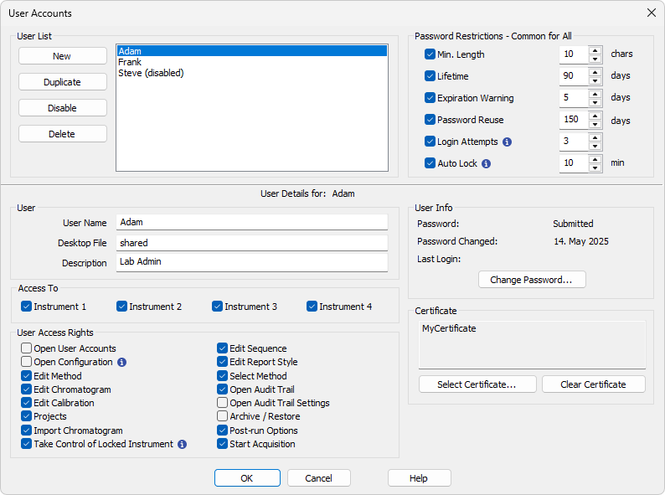
USER ACCOUNTS
Tool to support attributable and legible data
Limiting actions that can be done by specific user
Set different roles
REGULATED ENVIRONMENT / USER ACCOUNTS

Slide 9
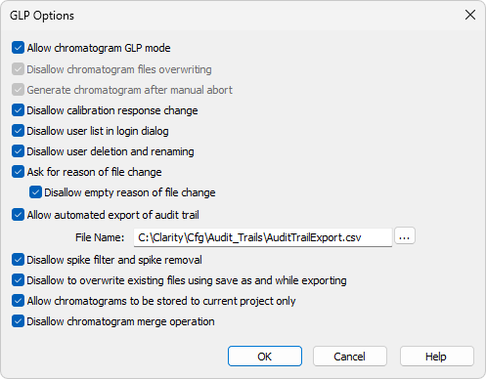
GLP OPTIONS
Tool to support contemporaneous, original and accurate data
Set of options to ensure compliance
  All MUST* be enabled in regulated environment
REGULATED ENVIRONMENT / GLP OPTIONS

Slide 10
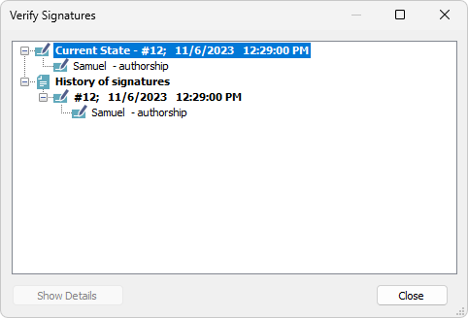
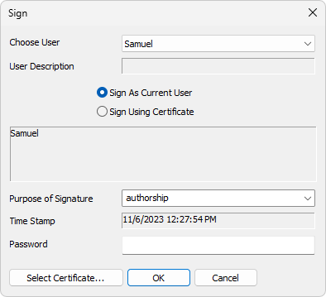
ELECTRONIC SIGNATURES
Tool to support attributable and legible data
Enables signing chromatograms electronically
  No need for manual signature of printouts
  Using Clarity user accounts
  Using various certificates
REGULATED ENVIRONMENT / ELECTRONIC SIGNATURES

Slide 11
Data protection
Data deletion and alteration must be prohibited
Proper Windows user accounts required
Step-by-step setup procedure in M132 manual
M132 – Regulated Environment - https://www.dataapex.com/downloads/26163/view
REGULATED ENVIRONMENT / DATA PROTECTION

Slide 12
documentation
Manual M132 – Clarity in Regulated Environment
Datasheet D021 – Declaration of Software Validation
Datasheet D019 - Clarity 21 CFR Part 11 tools
Above documentation is available for download at www.dataapex.com
REGULATED ENVIRONMENT / DOCUMENTATION

Slide 13
Thank you for your attention

