Slide 1
Clarity 8.8
WHAT‘S NEW
P059/80A 10/2022
Notes:
yyyy

Slide 2
What is new in Clarity 8.8?
WHAT‘S NEW → OVERVIEW
A new function Filter Not Used Compounds in Calibration
A new option to Export Data to CSV format
A new option to Offset data in Colibrick
Colibrick, U-PAD2 and Zebrick now use WinUSB driver
UNI-Ruby control modules now support User Units settings
A new current unit nanoamperes "nA"
Integration Algorithm updated to version 8.0 Rev.3

Slide 3
What is new in Clarity 8.8?
WHAT‘S NEW → OVERVIEW
A new dynamic Open chromatogram button indicating use of Overlay Mode
New columns “Start Value (Signal)" and "End Value (Signal)" for Peak to Valley Ratio calculation
A new improved method of rescaling for Peak Purity calculation in PDA Extension
New and updated control modules

Slide 4
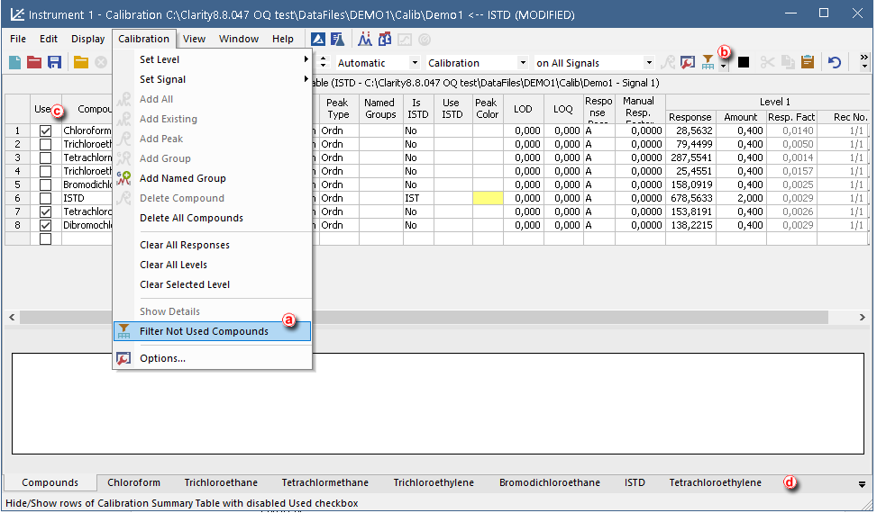
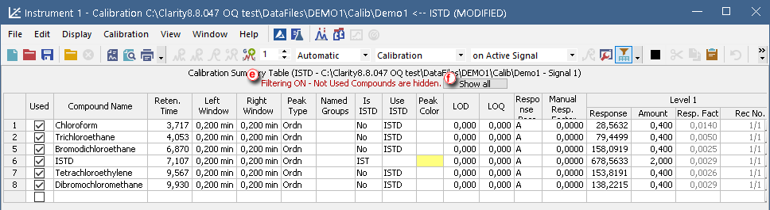

WHAT‘S NEW → FILTER NOT USED COMPOUNDS
A new option in Calibration menu
Allows to hide rows with disabled Used check-box on selected signal
Corresponding Compound tabs are hidden
Eases work with multisignal chromatograms
Eases work with calibrations with compounds relevant to a particular signal
Helps to make the Calibration Summary Table clear and easy to read
Use of the Filter is indicated in table header
Restore rows by Show all
Saved in *.dsk file and Print Report

Slide 5
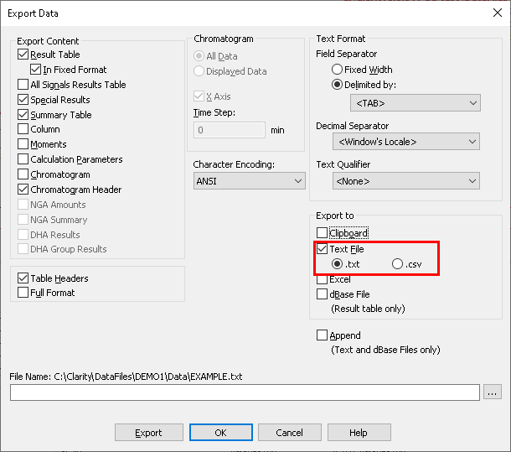
WHAT‘S NEW → EXPORT DATA TO CSV FORMAT
A new option in Export Data dialog
Text file in CSV format (= comma-separated values)
Notes:
Open Dialog
The Open Chromatogram dialog has new possibilities.
When selecting multiple chromatograms, Overlay is intuitively the default opening option.
It is also possible to choose whether you want to open the selected
chromatograms in the Overlay or browse them one by one by clicking on the arrow in the Open button. The selection of signals to display is also more convenient as there is a new three-state All signals checkbox.

Slide 6
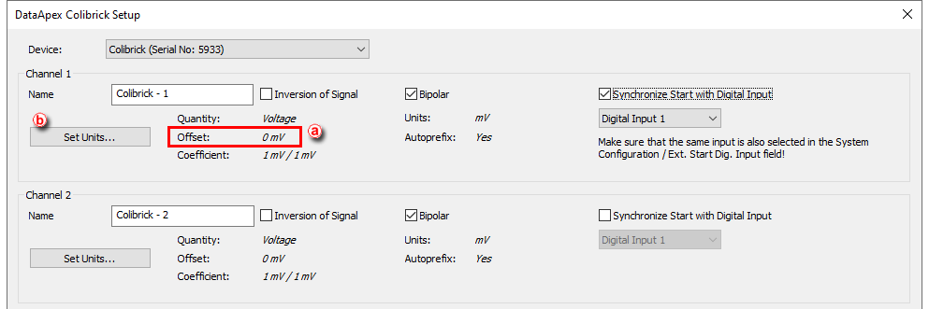
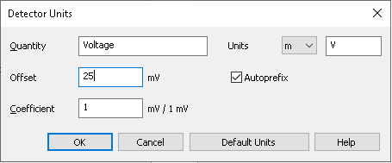
WHAT‘S NEW → OFFSET DATA IN COLIBRICK
A new option to Offset data in Colibrick
Allows to set zero signal different than 0 mV (default)
Corresponds to the value that should be deducted from the measured data to receive the real one
Accessible from Set Units… dialog
Notes:
MS extension
The MS Extension has been improved to address the situation when peaks are not separated. If each of the compounds has a specific m/z ion, they can be quantified even if they are not separated in the TIC.
Local Integration parameters are now specific for each quantification signal (instead of each compound), thus ensuring consistency of parameters for all peaks evaluated on the same m/z signal.

Slide 7
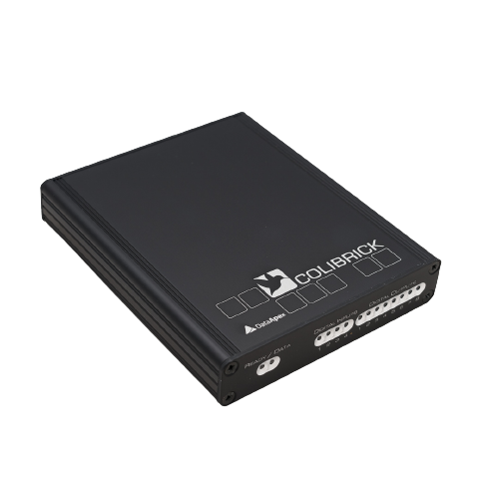
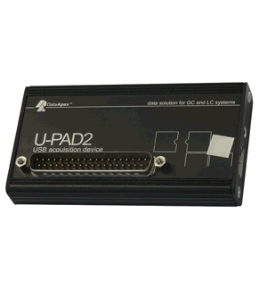
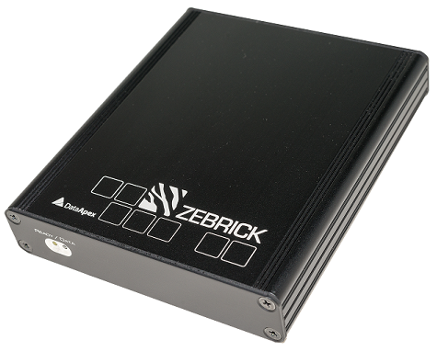
WHAT‘S NEW → WinUSB DRIVER
Colibrick, U-PAD2, Zebrick use WinUSB driver from Microsoft instead of the driver from Silicon Laboratories Inc.
Solves stability issues
Notes:
Now quantification signal is constructed for every m/z used for quantification. It means that compounds that have the same retention time, but which are quantified on different m/z, are calculated independently.
Peak selection in MS method and calibration now supports Best Match option.

Slide 8
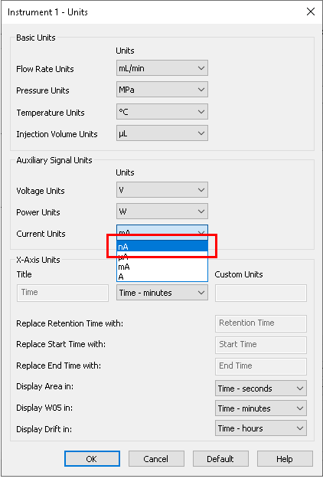
WHAT‘S NEW → UNITS
UNI-Ruby control modules now support User Units settings
A new current unit nanoamperes “ nA“
Notes:
Export Data
Export Data dialog has been slightly reorganized to include new exporting options and to better indicate which combinations of options are viable.
Clarity now exports to Excel in *.xslx format. For this export, it is now required to have Excel 2007 or later installed. Exporting to older versions of Excel has been discontinued.
All Signals Result Table now can be exported. It will always be sorted by Retention Time.

Slide 9
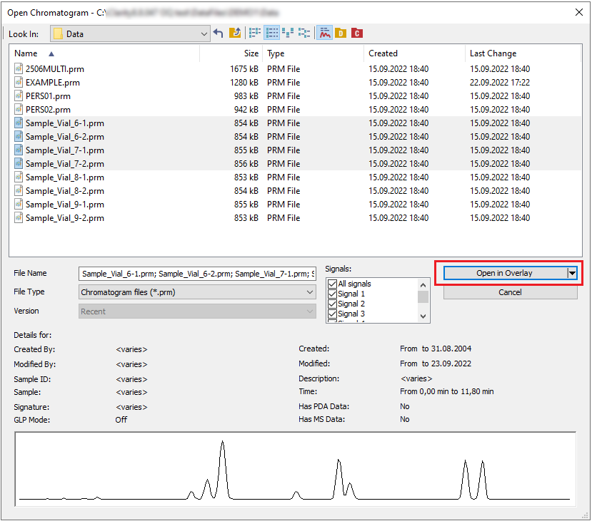
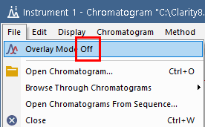
WHAT‘S NEW → DYNAMIC OPEN CHROMATOGRAM BUTTON
A new dynamic label on Open chromatogram button indicating Overlay Mode
Improved indication in File menu
Notes:
Footer
The Footer option has been added to Report Setup.
OQ reports styles has been amended to use the Footer.

Slide 10
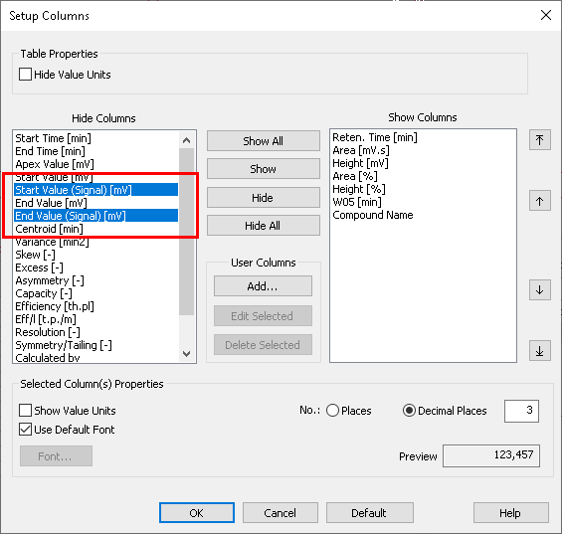
WHAT‘S NEW → START AND END VALUE (SIGNAL)
New columns "Start Value (Signal)" and "End Value (Signal)"
Hidden by default
Useful for Peak to Valley Ratio calculation
Notes:
Single Analysis Print Settings
In the Single Analysis window, all print settings are now easily accessible on the Post Run Settings tab, where you can check if you want to Print Results or Print Results To PDF with the selected Report Style.

Slide 11
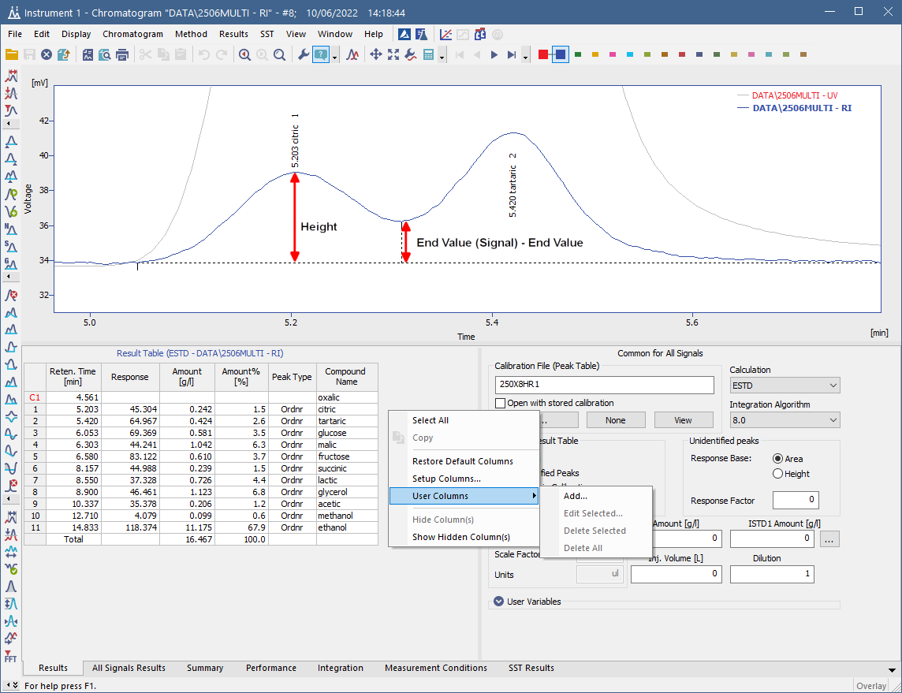
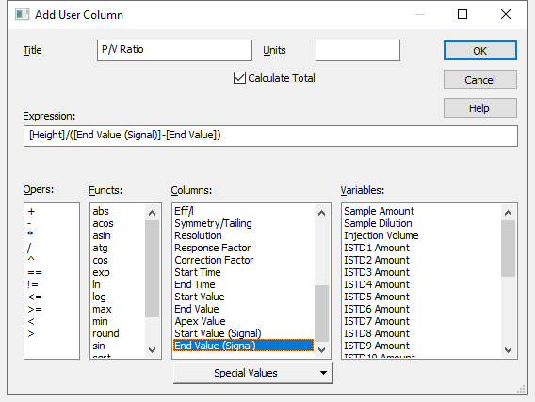
WHAT‘S NEW → PEAK TO VALLEY RATIO
Peak to Valley Ratio calculation:
Add new User Column
Define the Expression
Notes:
In the User Accounts is a new option to duplicate existing user settings when creating a new user

Slide 12

WHAT‘S NEW → OTHER IMPROVEMENTS
Integration Algorithm was updated to version 8.0 Rev.3
The Pearson correlation coefficient (noted as Correlation in Clarity), used for Peak Purity or Match Factor calculations, now uses an improved method of rescaling to the resulting 0-1000 interval.
And many other small improvements have been made and many bugs fixed
Notes:
Other improvements
SST extension now supports SST method versions.
Improved memory handling of method versions history during chromatogram creation.
In calibration, when adding peaks from a multi-signal chromatogram with the option On Active Signal, the default names of compounds or groups will be constructed as "Retention Time" + "Signal number".
And many other small improvements have been made and many bugs fixed.

Slide 13
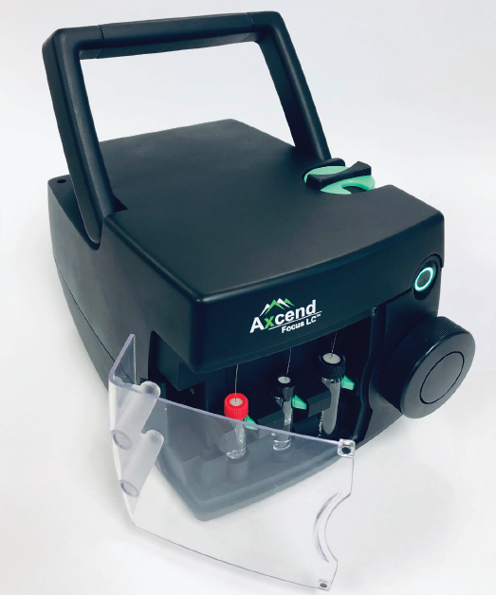
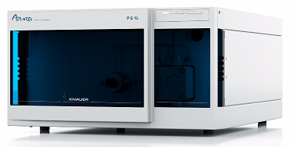
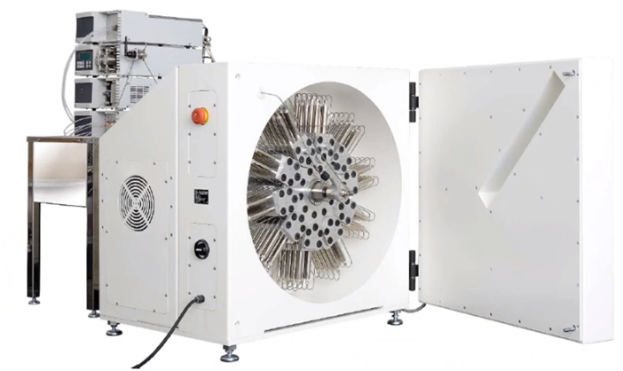
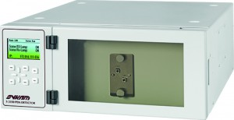
New control modules
WHAT‘S NEW → CONTROL MODULES
Analytik Jena PQ LC PDA Detector
Axcend Focus LC
Chromophor PDA Detector
CQS Climax S 3345 and S 3350 PDA Detectors
ECE-001
Knauer P8.1L pump
RotaChrom rCPC
Schambeck S 4345 and S 4350
Sykam S3345 and S3350
Watrex Streamline PDA
... and many control modules have been updated and improved, for more see https://www.dataapex.com/version_history
Notes:
Following control modules are new in Clarity 8.7.
Analytik Jena PQ LC HPLC Pump 1125, 1130, 1132
Gow Mac 836 GC
Sunchrom SpectraFlow 2050
Sunchrom SunTherm 2070
And many other control modules have been updated.
-- koniky a interlab MAESTRO asi nechceme inzerovat?

Slide 14
…THANK YOU FOR YOUR TIME

