Slide 1
Clarity 8.7
WHAT‘S NEW
P058/80A 03/2022
Notes:
Clarity 8.7, what is new.

Slide 2
What is new in Clarity 8.7?
WHAT‘S NEW → OVERVIEW
Compatibility with Windows 11
Improvements in Open Dialog
MS extension improvements
Export to new *.xlsx format
Footer option in the Report Setup
Duplicate existing user settings option in User Accounts
A lot of other small improvements and fixed bugs
New and updated control modules
Notes:
Compatibility with Windows 11
Changes in Open Dialog, e.g. three ways of opening chromatogram
Footer option is added to the Report Setup
Export to new *.xslx format
MS extension improvements
A lot of other small improvements and fixed bugs
New and updated control modules

Slide 3
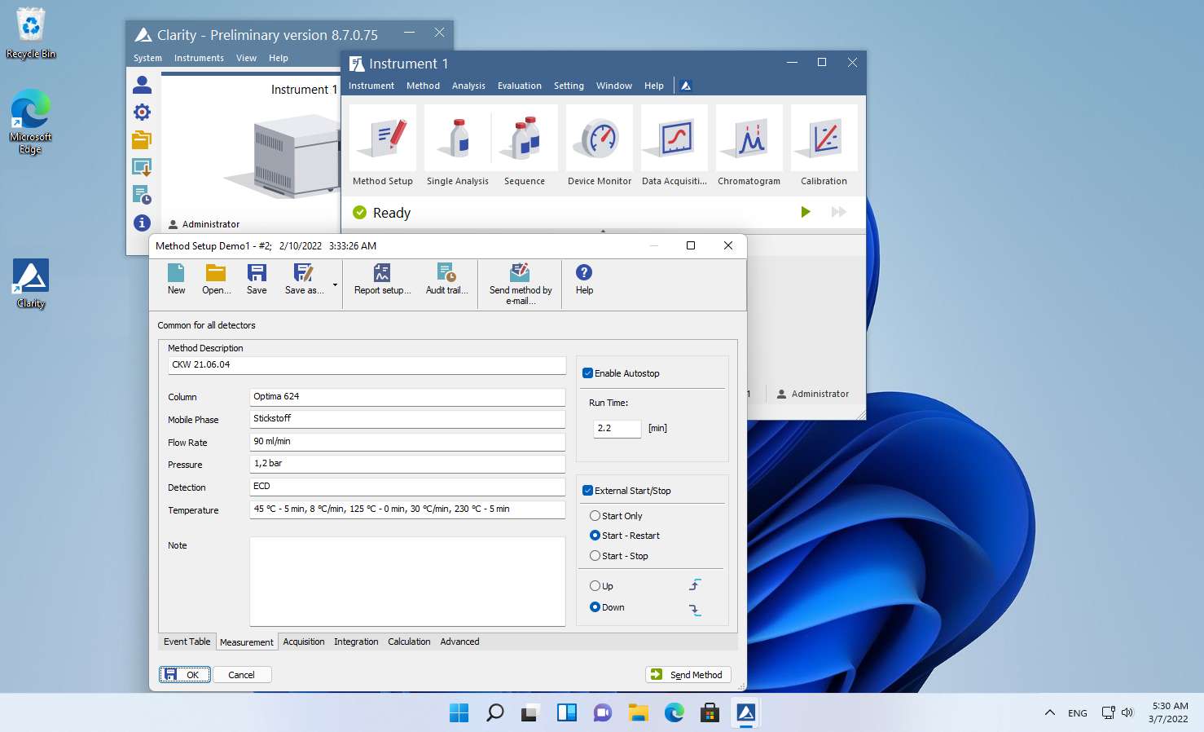

WHAT‘S NEW → WINDOWS 11
Clarity is now compatible with Windows 11.
Notes:
Windows 11
Clarity is now compatible with Windows 11. The Windows 11 operating system can only run on 64-bit CPUs, this can be incompatible with some control modules or hardware, for more information please refer to the Clarity compatibility table on www.dataapex.com or the datasheet D016 - Clarity Compatibility Table.

Slide 4
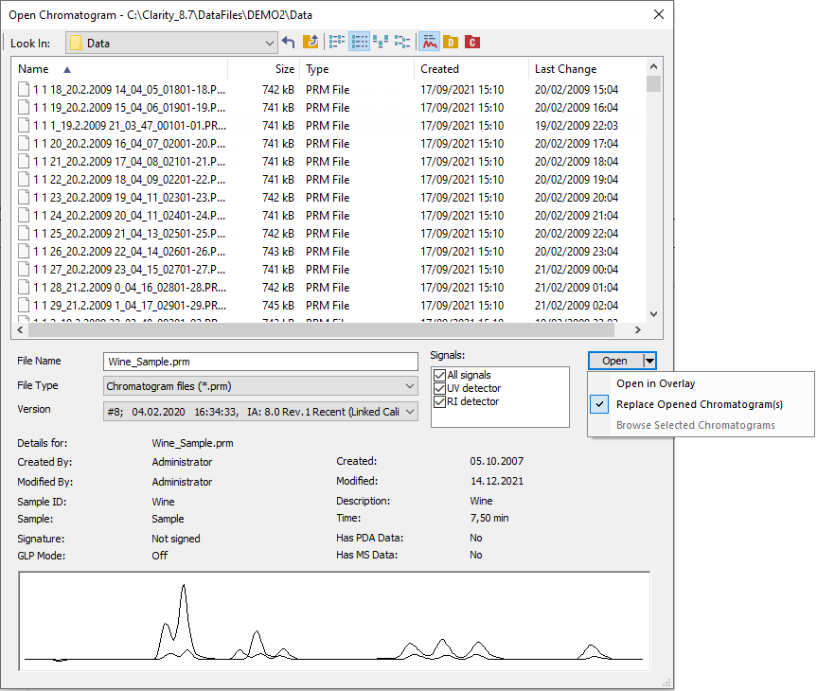
WHAT‘S NEW → OPEN DIALOG
Significantly improved for browsing through larger sets of files
When selecting multiple chromatograms, Open in Overlay is the default opening option.
Using the arrow it is possible to use alternative opening options.
Notes:
Open Dialog
The Open Chromatogram dialog has new possibilities.
When selecting multiple chromatograms, Overlay is intuitively the default opening option.
It is also possible to choose whether you want to open the selected
chromatograms in the Overlay or browse them one by one by clicking on the arrow in the Open button. The selection of signals to display is also more convenient as there is a new three-state All signals checkbox.

Slide 5
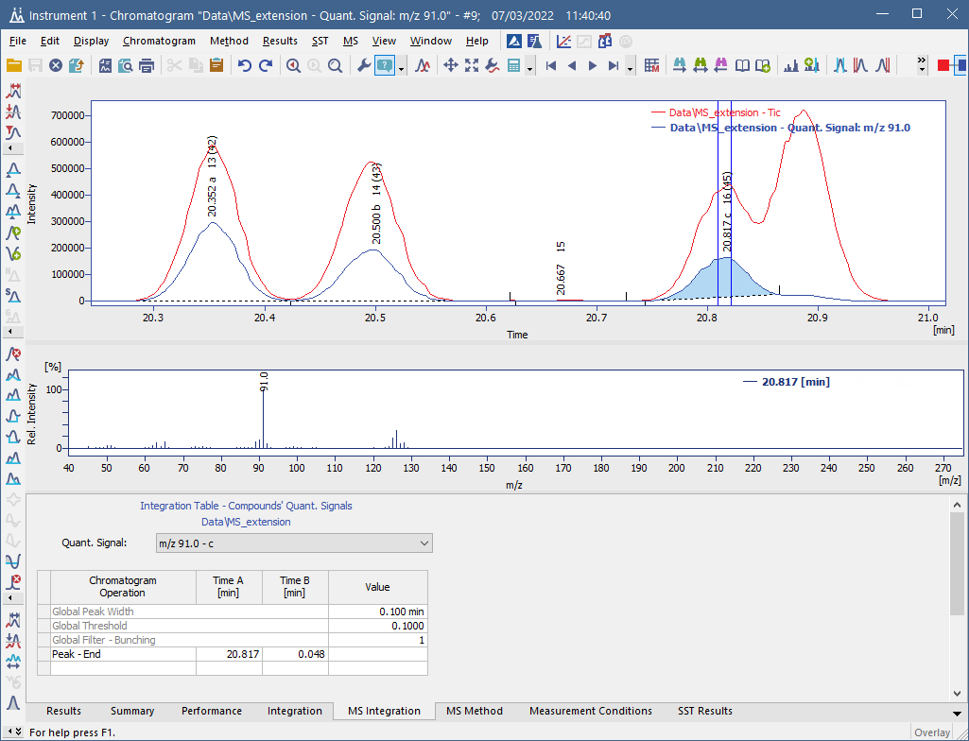
WHAT‘S NEW → MS EXTENSION
Quantification signal is constructed for every m/z used for quantification.
As one of the results Local Integration parameters are specific for each quantification signal (instead of each compound) to improve the consistency of the data.
Notes:
MS extension
The MS Extension has been improved to address the situation when peaks are not separated. If each of the compounds has a specific m/z ion, they can be quantified even if they are not separated in the TIC.
Local Integration parameters are now specific for each quantification signal (instead of each compound), thus ensuring consistency of parameters for all peaks evaluated on the same m/z signal.

Slide 6
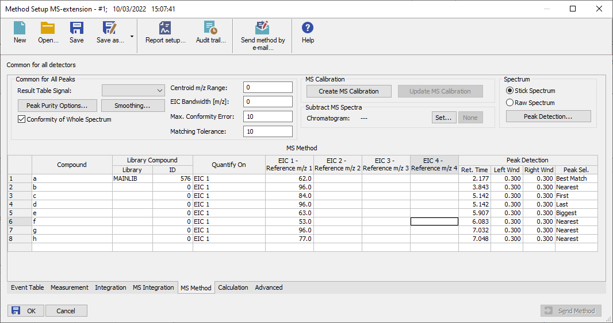
WHAT‘S NEW → MS EXTENSION
Compounds that have the same retention time but are quantified on different m/z are calculated independently.
Peak selection in MS method and calibration now supports Best Match option.
Notes:
Now quantification signal is constructed for every m/z used for quantification. It means that compounds that have the same retention time, but which are quantified on different m/z, are calculated independently.
Peak selection in MS method and calibration now supports Best Match option.

Slide 7
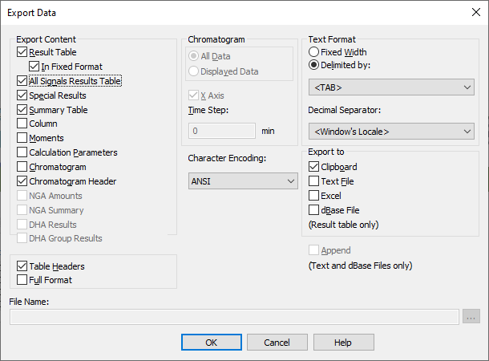
WHAT‘S NEW → EXPORT DATA
All Signals Result Table now can be exported.
Clarity now exports to Excel in *.xslx format.
Notes:
Export Data
Export Data dialog has been slightly reorganized to include new exporting options and to better indicate which combinations of options are viable.
Clarity now exports to Excel in *.xslx format. For this export, it is now required to have Excel 2007 or later installed. Exporting to older versions of Excel has been discontinued.
All Signals Result Table now can be exported. It will always be sorted by Retention Time.

Slide 8
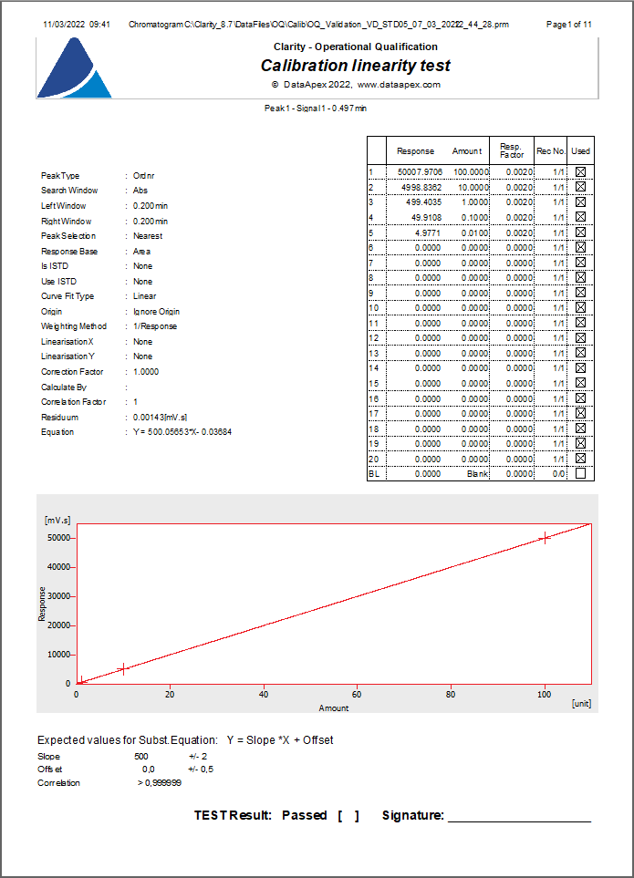
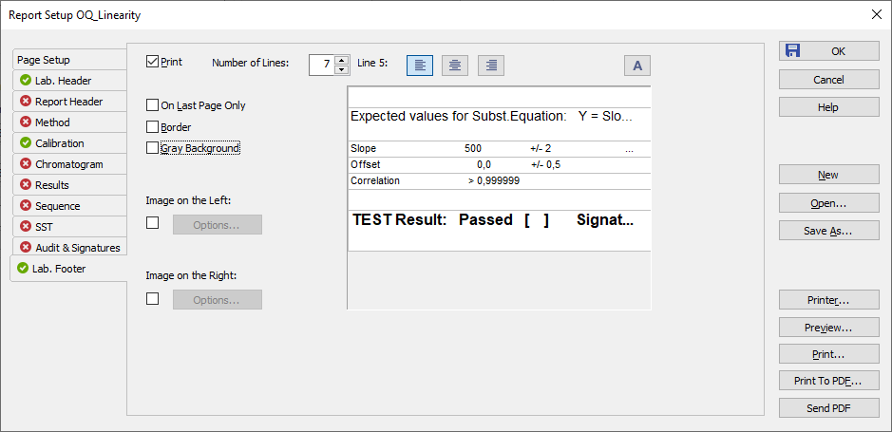
WHAT‘S NEW → PRINT → FOOTER
Footer option has been added to the Report Setup
Footer is now used as a place for test result confirmation and signature in our OQ reports
Notes:
Footer
The Footer option has been added to Report Setup.
OQ reports styles has been amended to use the Footer.

Slide 9
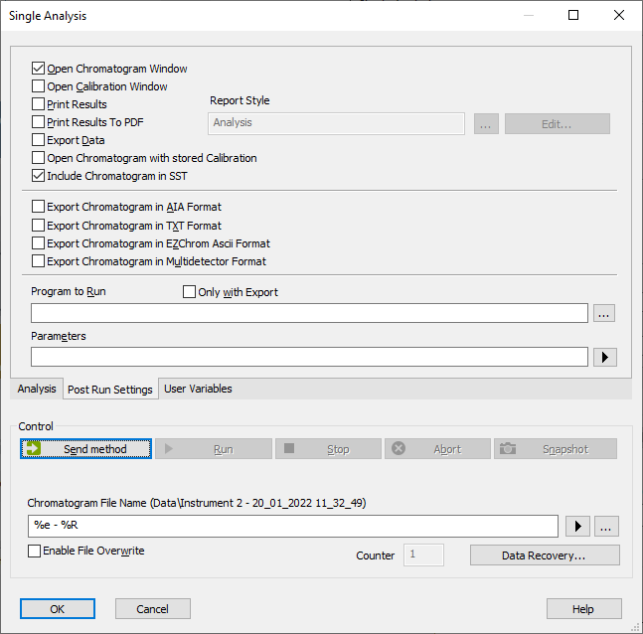
WHAT‘S NEW → PRINT → SINGLE ANALYSIS
Setting of the Report Style is moved from the Analysis tab to the Post Run Settings tab
Thanks to that all print settings in the Single Analysis window are now accessible in one place
Notes:
Single Analysis Print Settings
In the Single Analysis window, all print settings are now easily accessible on the Post Run Settings tab, where you can check if you want to Print Results or Print Results To PDF with the selected Report Style.

Slide 10
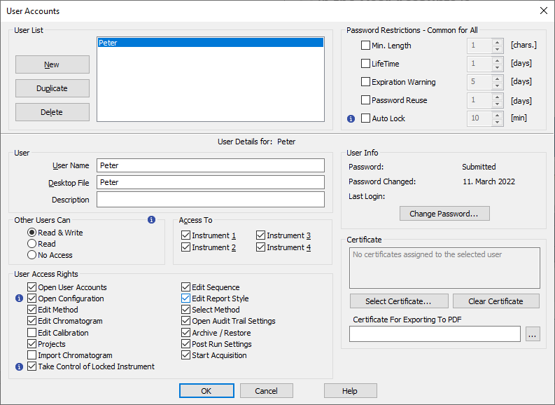
WHAT‘S NEW → USER ACCOUNTS
In the User Accounts is a new option to duplicate existing user settings.
Notes:
In the User Accounts is a new option to duplicate existing user settings when creating a new user

Slide 11

WHAT‘S NEW → OTHER IMPROVEMENTS AND FIXED BUGS
SST extension now supports SST method versions.
Improved memory handling of method versions history during chromatogram creation.
In calibration, when adding peaks from a multi-signal chromatogram with the option On Active Signal, the default names of compounds or groups are improved.
And many other small improvements have been made and many bugs fixed.
Notes:
Other improvements
SST extension now supports SST method versions.
Improved memory handling of method versions history during chromatogram creation.
In calibration, when adding peaks from a multi-signal chromatogram with the option On Active Signal, the default names of compounds or groups will be constructed as "Retention Time" + "Signal number".
And many other small improvements have been made and many bugs fixed.

Slide 12
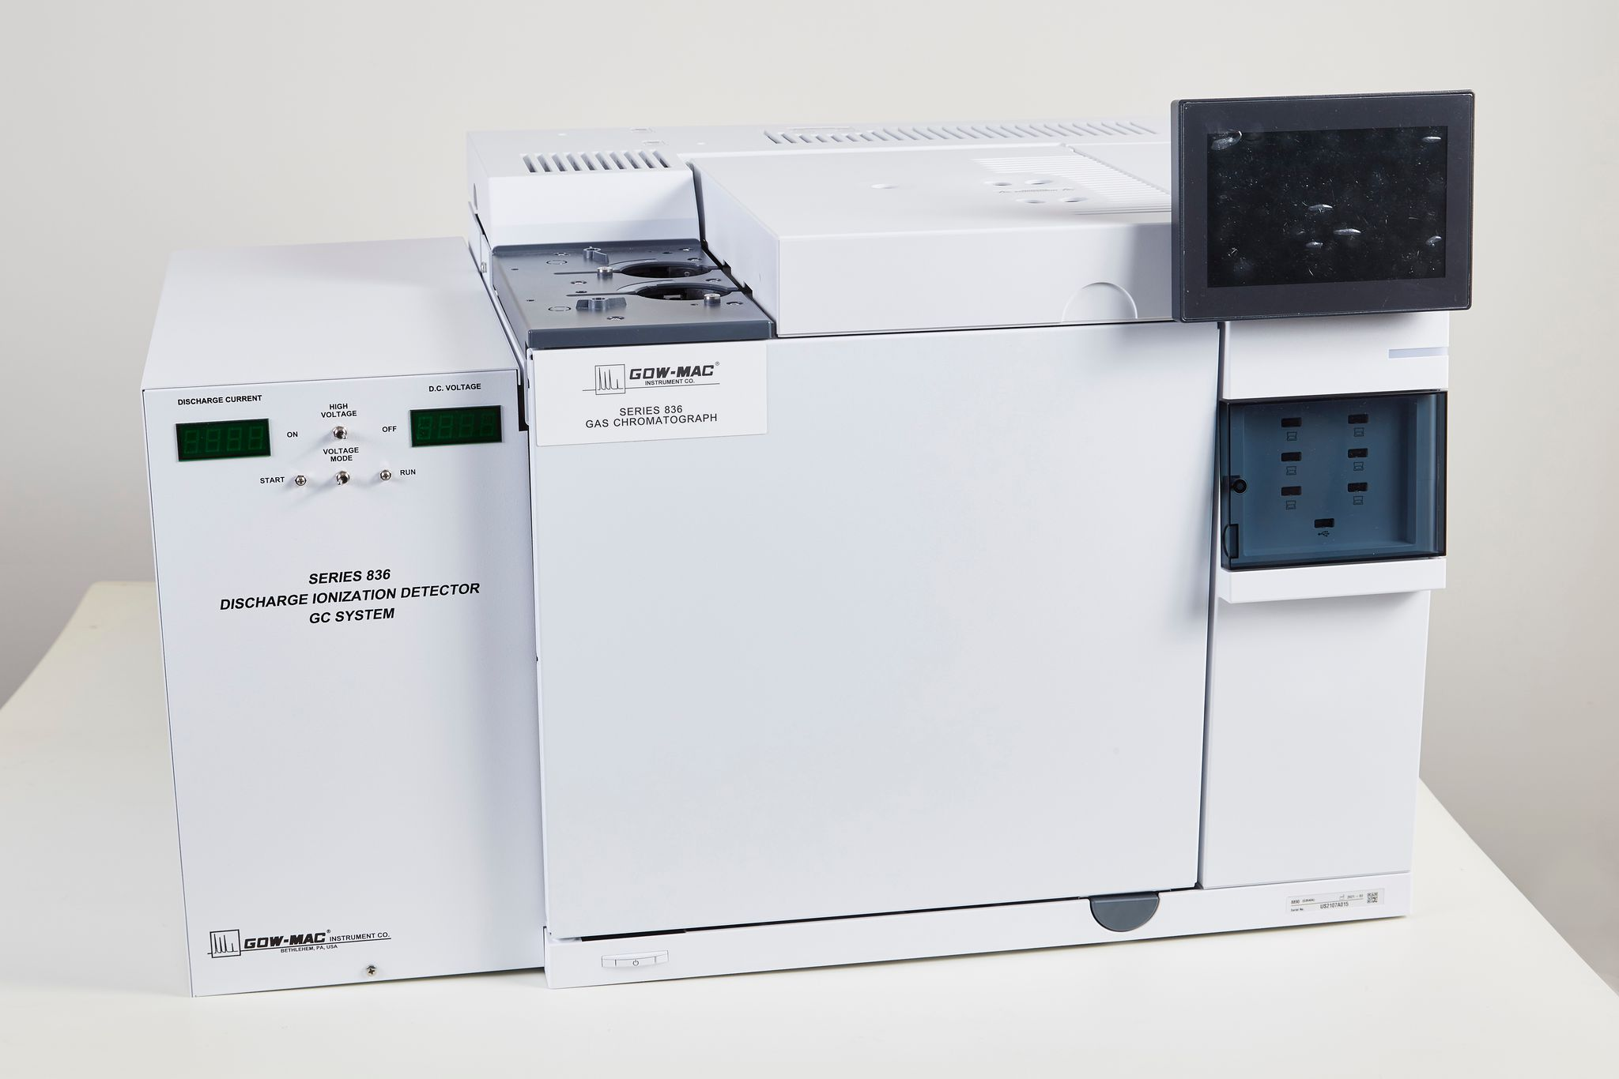
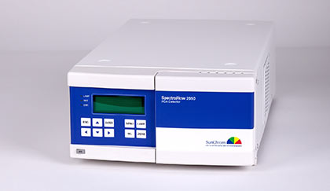
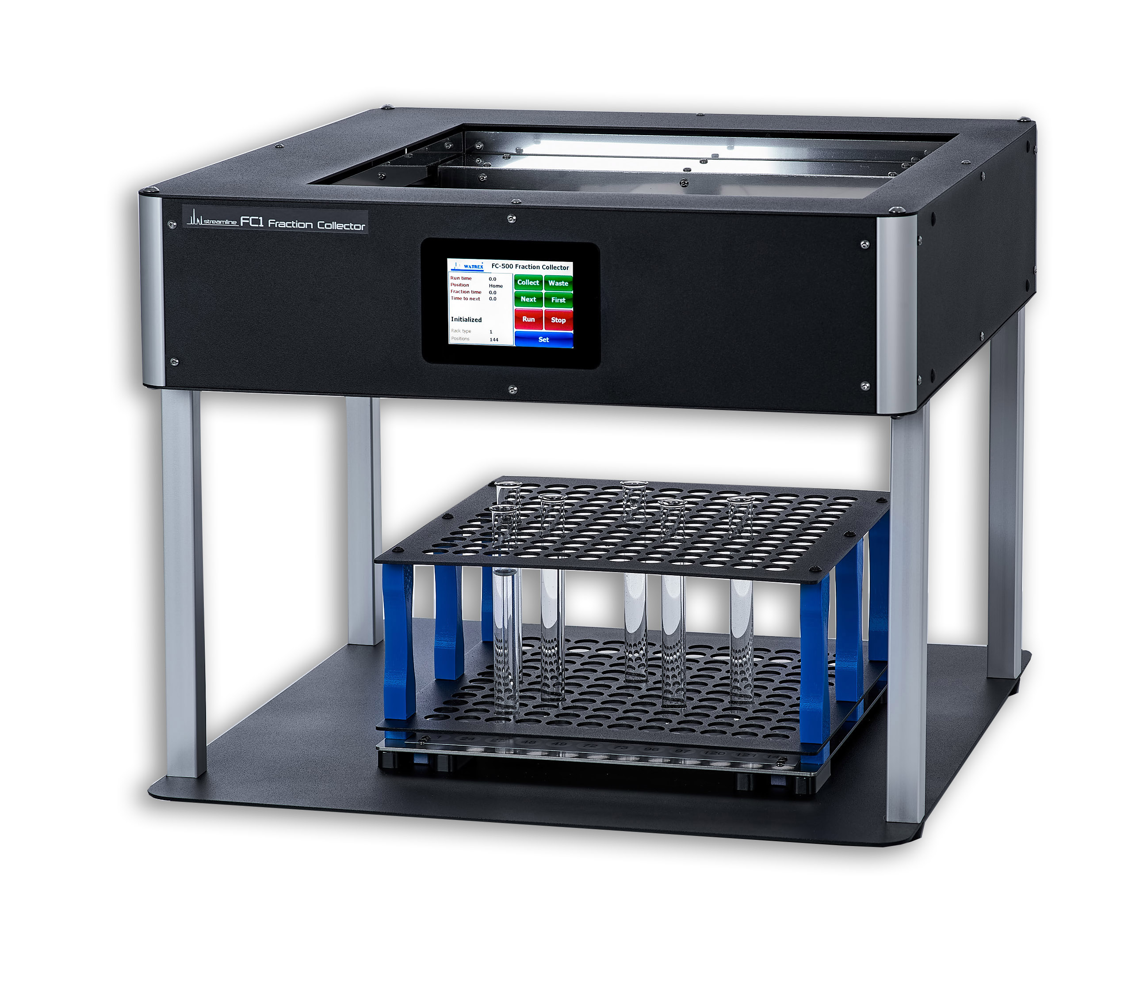
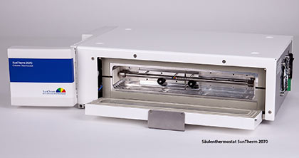
New control modules
WHAT‘S NEW → CONTROL MODULES
Analytik Jena PQ LC HPLC Pump 1125, 1130, 1132
Gow Mac 836 GC
Sunchrom SpectraFlow 2050
Sunchrom SunTherm 2070
Watrex StreamLine FC
... and many control modules have been updated and improved, for more see https://www.dataapex.com/version_history
Notes:
Following control modules are new in Clarity 8.7.
Analytik Jena PQ LC HPLC Pump 1125, 1130, 1132
Gow Mac 836 GC
Sunchrom SpectraFlow 2050
Sunchrom SunTherm 2070
And many other control modules have been updated.
-- koniky a interlab MAESTRO asi nechceme inzerovat?

Slide 13
…THANK YOU FOR YOUR TIME

