Slide 1
Clarity 8.6
WHAT‘S NEW
P057/80A 06/2021

Slide 2
What is new in Clarity 8.6?
WHAT‘S NEW → OVERVIEW
User Accounts – a new user right to take control over locked Instrument
Shutdown options – a new section to set routines being run after the sequence finishes
Report Setup – Sample Parameters option are more granular
Report Setup – a possibility to report vial and injection number
Miscellaneous – a new system for programmer logging

Slide 3
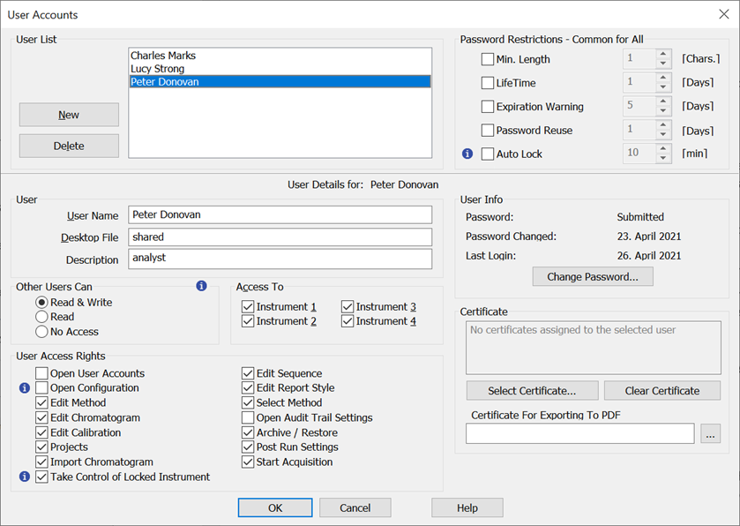

WHAT‘S NEW → TAKE CONTROL OVER LOCKED INSTRUMENT
A new right in User Accounts dialog:
Allows to unlock Clarity Instruments locked by different user
Changing shifts without interrupting running sequence
Unsaved changes are discarded
Changes on locked Instrument are logged under original user
Changes on unlocked Instrument are logged under new user
Shared desktop recommended

Slide 4
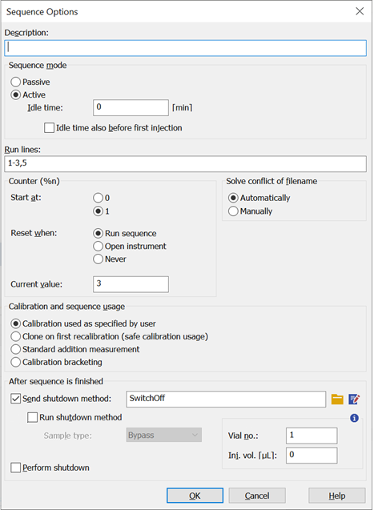
WHAT‘S NEW → SHUTDOWN METHOD
A new section to define actions after sequence finish:
  Send shutdown method
  Run shutdown method
  Send shutdown event to all control modules
Cannot be modified during run
Use Abort command to avoid shutdown routine

Slide 5
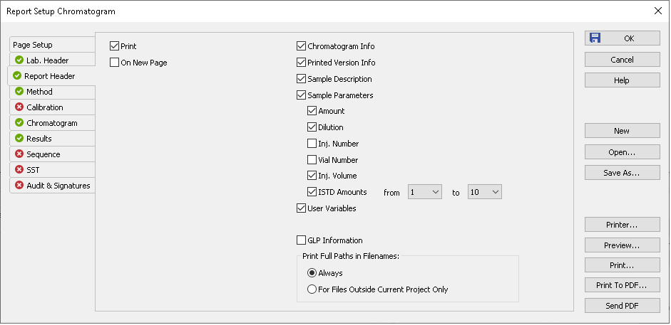
WHAT‘S NEW → REPORT SETUP – SAMPLE PARAMETERS
Sample Parameters section divided into sub options
Parameters can be separately added or removed
ISTD Amount values can be customized
Newly Injection and Vial Number can be reported

Slide 6
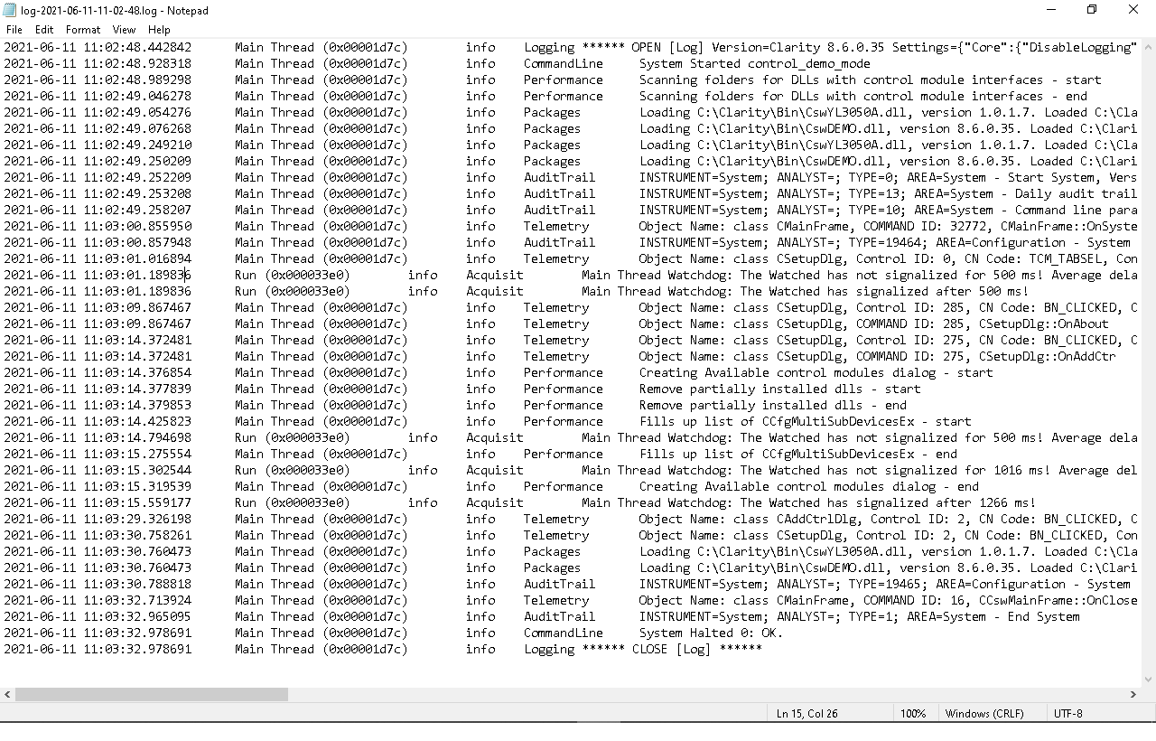
WHAT‘S NEW → MISCELLANEOUS – PROGRAMMER LOGGING
A new system of programmer logging
More complete, helps in diagnosing problems
Switched on by default

Slide 7
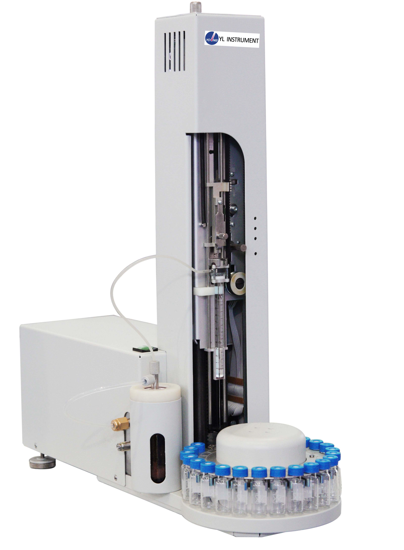
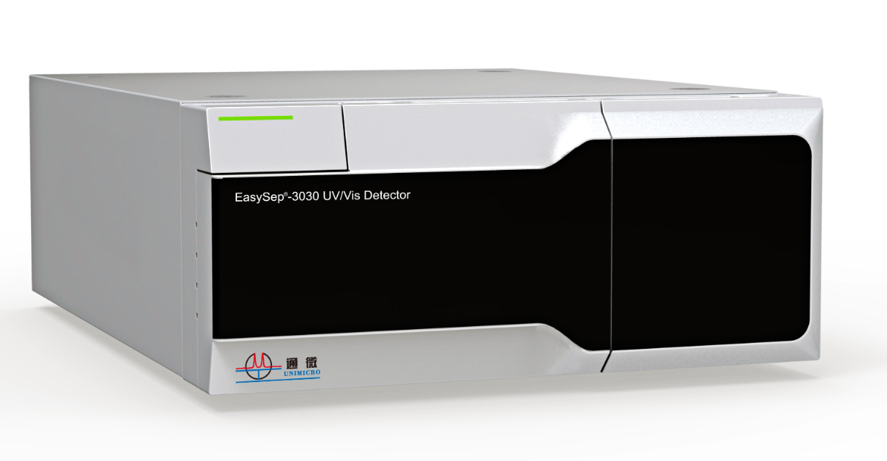
New control modules
WHAT‘S NEW → CONTROL MODULES
Unimicro EasySep-3030 Pump
Unimicro EasySep-3030 Thermostat
Unimicro EasySep-3030 UV Detector
Unimicro EasySep-3030 UV/VIS Detector
Young In Chromass YL3050A Autosampler
... and many control modules have been updated and improved

Slide 8
…THANK YOU FOR YOUR TIME

