Slide 1
Clarity 8.5
WHAT‘S NEW
P056/80A 02/2021
Notes:
Clarity 8.5, what is new.

Slide 2
What is new in Clarity 8.5?
WHAT‘S NEW → OVERVIEW
Tablet Mode
Mathematical Operations dialog can be opened and if any action is applied, the overlay mode is turned on automatically
Chromatogram opened outside of current project is opened only with stored calibration
Some options can be now added or amended before AIA file import
A lot of other small improvements and fixed bugs
New and updated control modules
Notes:
Tablet Mode.
Mathematical Operations dialog can be opened and if any action is applied, the overlay mode is turned on automatically.
Chromatogram opened outside of current project is opened only with stored calibration
Some options can be now added or amended before AIA file import
A lot of other small improvements and fixed bugs
New and updated control modules

Slide 3
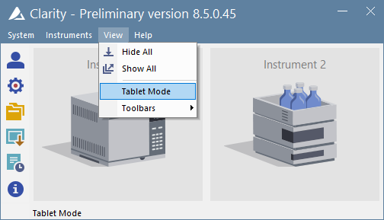

WHAT‘S NEW → TABLET MODE
Tablet Mode is a specific windows layout for tablet size monitors.
Simulates one window application.
Is switched ON/OFF from View menu.
Enables general scale up to 200%.
Notes:
Tablet Mode
Tablet Mode is a specific windows layout designed for devices with small tablet size monitor that enables their control.
It simulates one window application.
Layout can be switched on or off in the Main window menu View.
Tablet Mode allows to use higher general scales in Windows (up to 200 %) for better touchscreen experience and readability.

Slide 4
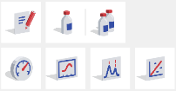
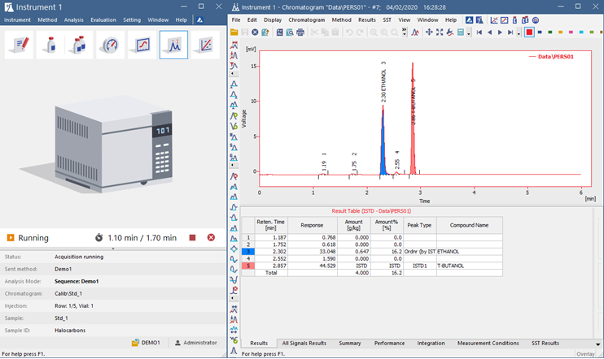
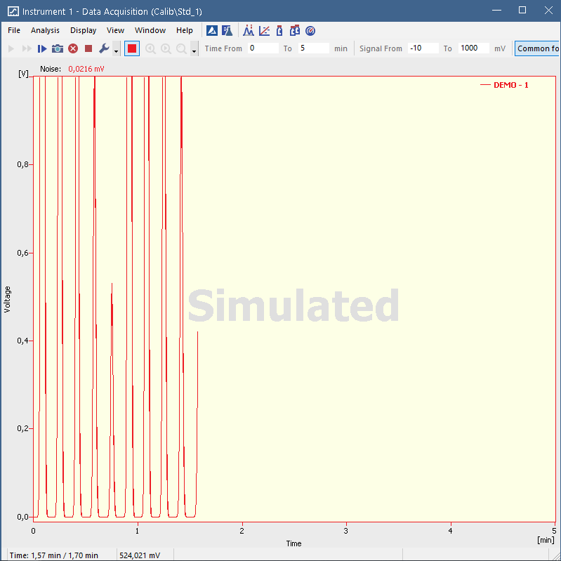
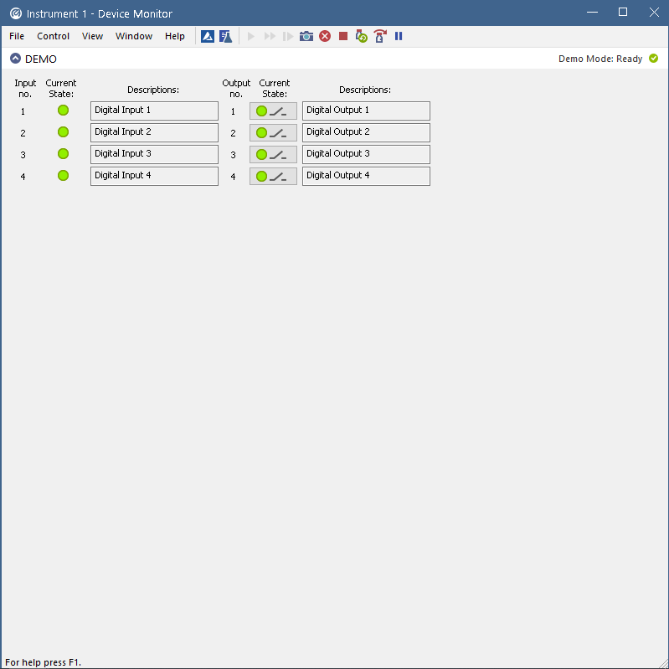
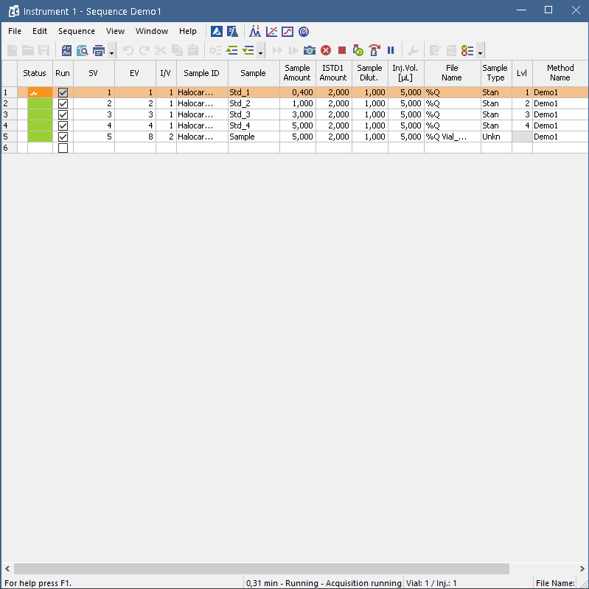

WHAT‘S NEW → TABLET MODE
Windows do not overlay.
Instrument window is on the left side, other windows on the right side of the monitor.
All windows remain fully resizable and customizable.
Active window is highlighted.
Process icon and Status bar may be in two lines at higher scale.
Notes:
Windows do not overlay.
Instrument window is narrower than in standard Clarity and is positioned to the upper left corner of the monitor, other windows are opened one over another and fill the remaining space on the monitor.
All windows remain fully resizable and customizable.
Active window is highlighted by blue frame.
At higher general scales (more than 100%), the process icon and status line may be devided into two lines.

Slide 5
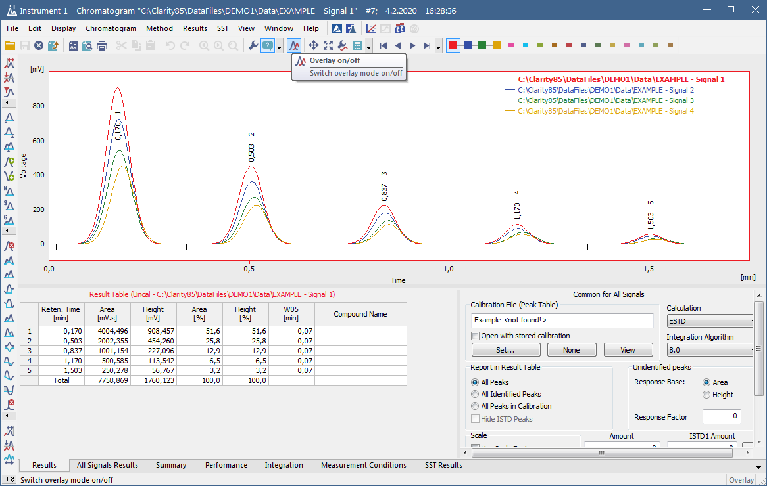
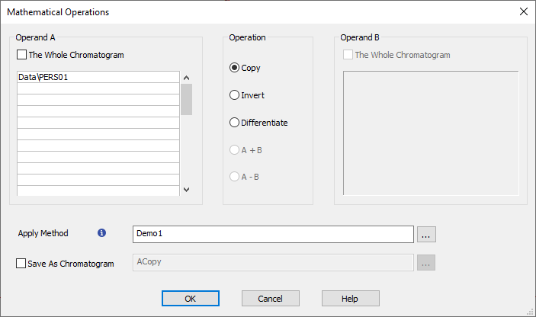
WHAT‘S NEW → CHROMATOGRAM
Mathematical operations do not require Overlay mode to be on before an action.
Overlay mode is turned on automatically.
Notes:
Mathematical operations
It is not necessary to activate the Overlay mode before performing Mathematical operations.
Dialog can be opened and if any action is applied, Overlay mode is turned on automatically.

Slide 6
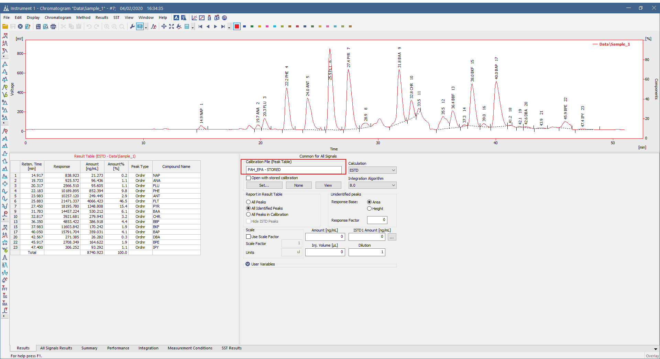
WHAT‘S NEW → CHROMATOGRAM
Chromatogram opened outside of current project is opened only with stored calibration.
Notes:
Stored Calibration
Since Clarity 8.5, chromatogram opened outside of current project is opened with none or stored calibration only. To prevent the risk of opening incorrect calibration.

Slide 7
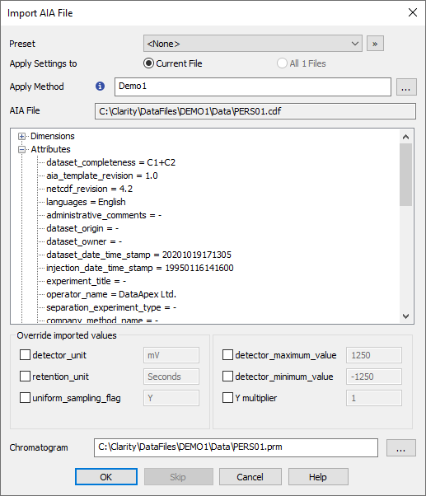
WHAT‘S NEW → IMPORT OF AIA FILE
Some more options can be added or amended before AIA file import:
    detector_unit
    retention_unit
    uniform_sampling_flag
    detector_maximum_value
    detector_minimum_value
    Y multiplier
Notes:
Import of AIA file
Selected additional parameters, such as the detector and retention unit or detector maximum and minimum values can be added or amended before AIA file import.

Slide 8
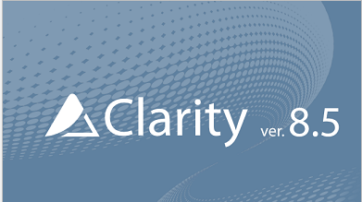
WHAT‘S NEW → OTHER IMPROVEMENTS AND FIXED BUGS
Agilent ICF libraries have been updated to version 3.0
Single Analysis window is now resizable
System Configuration window is now resizable
A new option for command line parameter Enable_asserts =2
Many other small improvements and fixed bugs
Notes:
Other improvements
Agilent ICF libraries have been updated to version 3.0.
Single Analysis window is now resizable.
System Configuration window is now resizable.
A new option for command line parameter Enable_asserts =2 that enables to create a memory dump, but does not offer to send it, has been added.
And many other small improvements have been made and many bugs fixed.

Slide 9
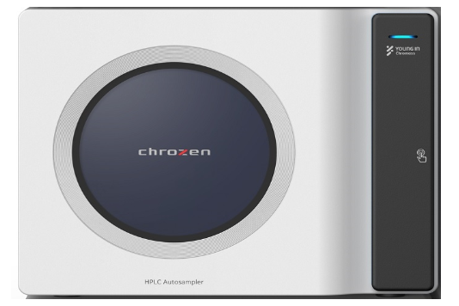
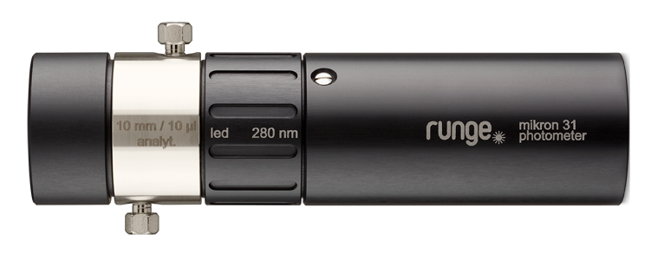
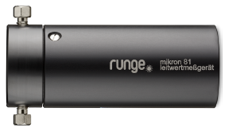
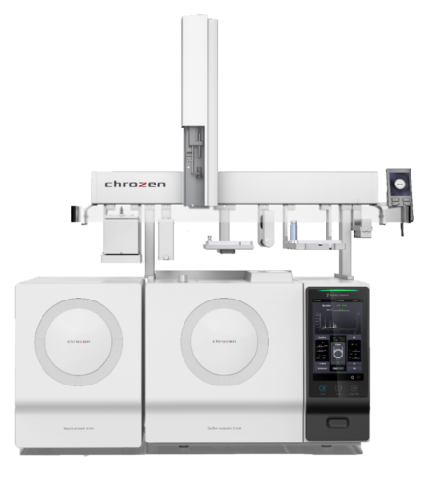
New control modules
WHAT‘S NEW → CONTROL MODULES
Runge Mikron 81
Runge Mikron 31
Separflow FC fraction collector
Young In Chromass YCChroZen AS
Young In Chromass YCChroZen Column
Young In Chromass YCChroZen Pump
Young In Chromass YCChroZen PDA
Young In Chromass YCChroZen UVD
... and many control modules have been updated and improved
Notes:
Following control modules are new in Clarity 8.5.
And many other control modules have been updated.

Slide 10
…THANK YOU FOR YOUR TIME

