Slide 1
validation

Slide 2
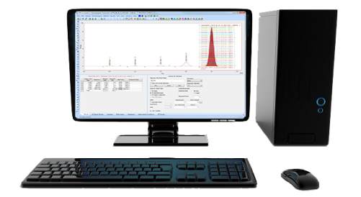
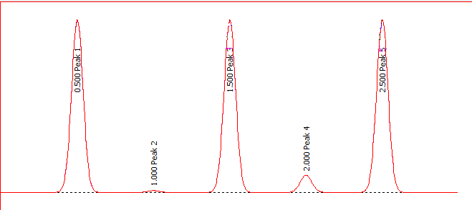
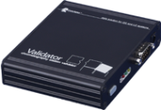
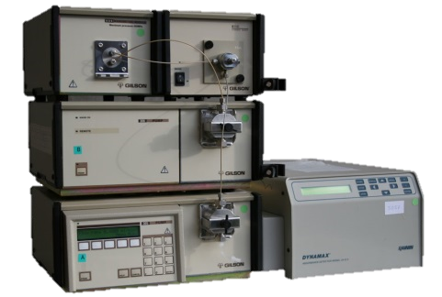
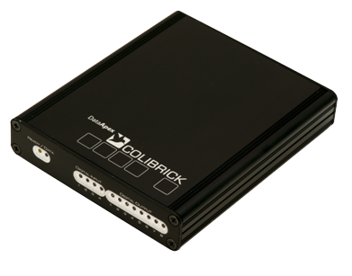
VALIDATION LEVELS
Operational
Qualification
Installation
Qualification
Performance
Qualification
Validator
A/D Converter
Checks version and integrity of Clarity files
IQ
Tests data acquisition and processing
OQ
Tests the overall analytical system performance
PQ
OQ types:
Hardware (HW) generated data – Validator
Software (SW) generated data – Clarity Virtual Detector
VALIDATION / VALIDATION LEVELS

Slide 3
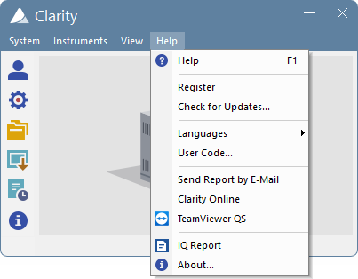
INSTALLATION QUALIFICATION (IQ)
Checks version and integrity of Clarity files
Run from main Clarity window – Help menu
VALIDATION / IQ

Slide 4
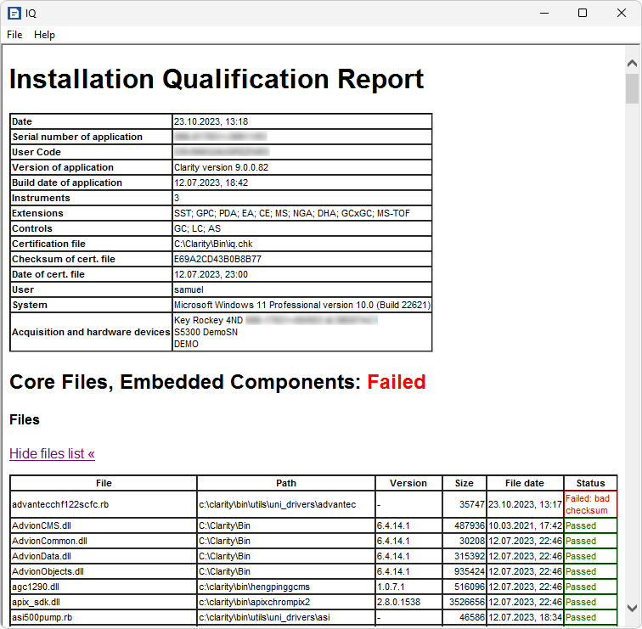
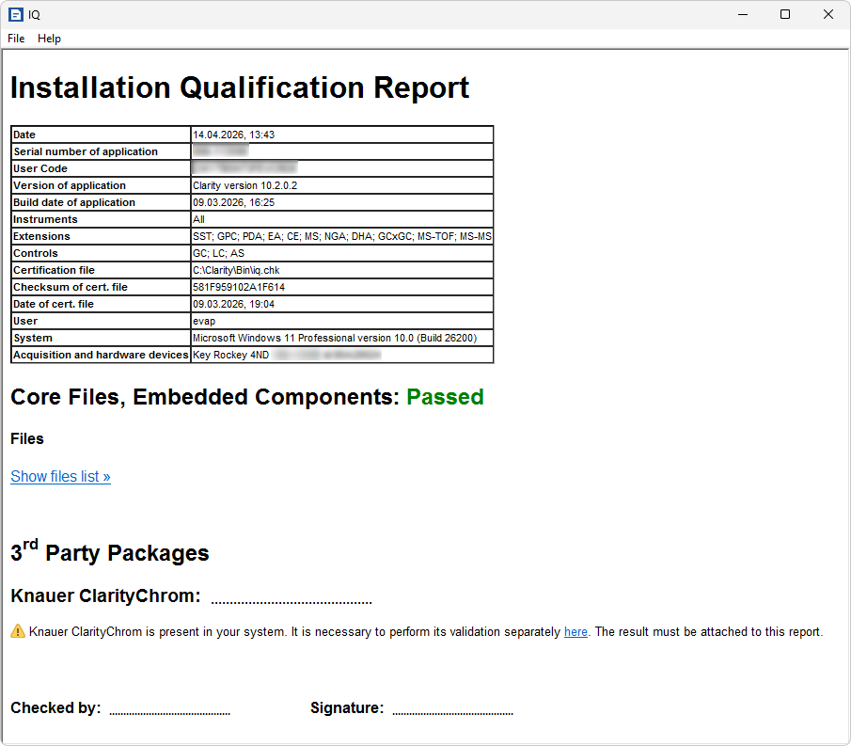
Iq report
General infromation
Overall IQ status
  Passed
  Passed with warnings
  Failed
Status of each file
VALIDATION / IQ REPORT

Slide 5
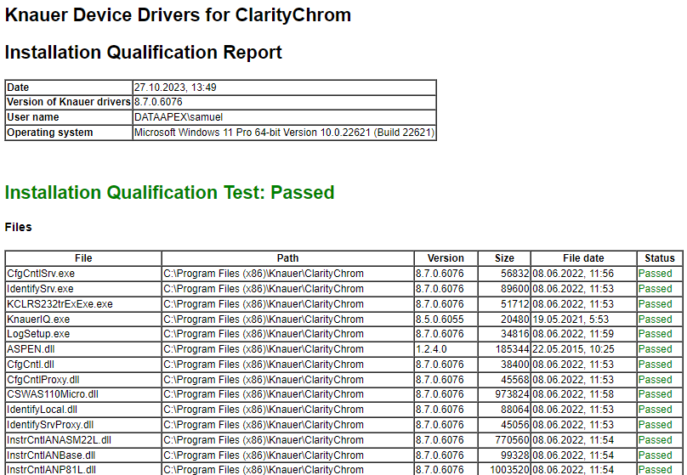
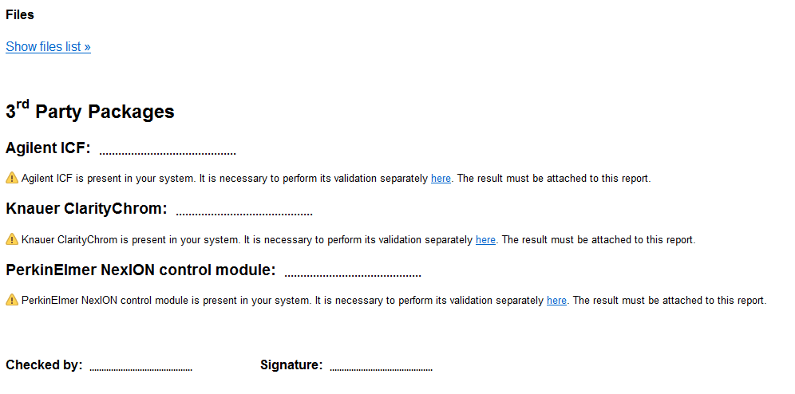
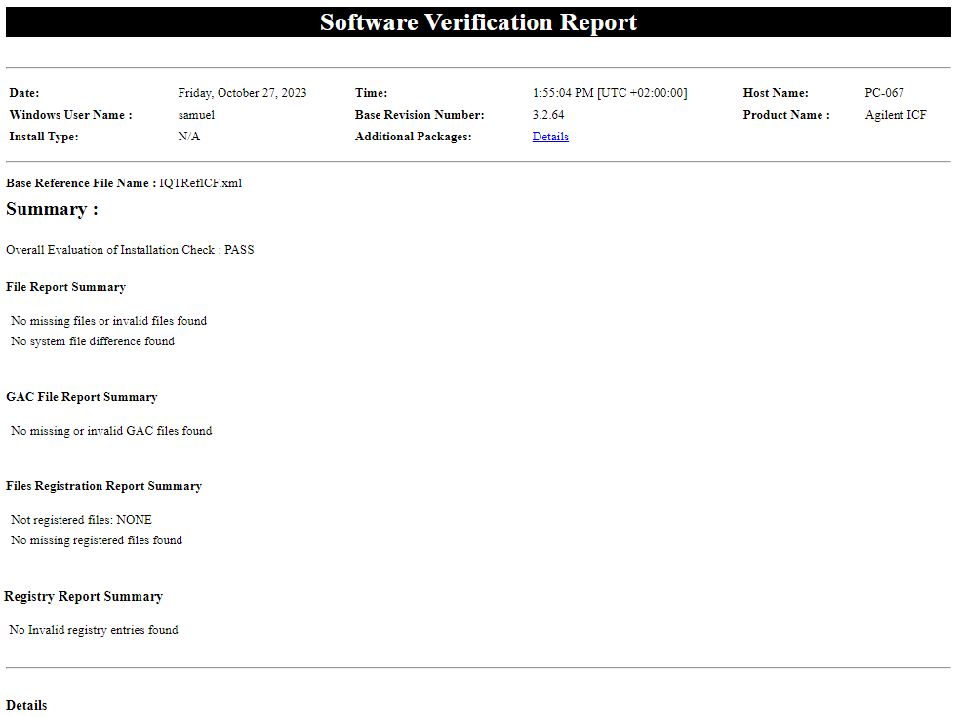
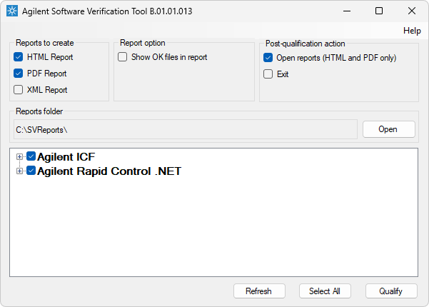
Iq reporT
3rd partY package
Run separately
Must be enclosed with Clarity IQ
VALIDATION / IQ REPORT

Slide 6
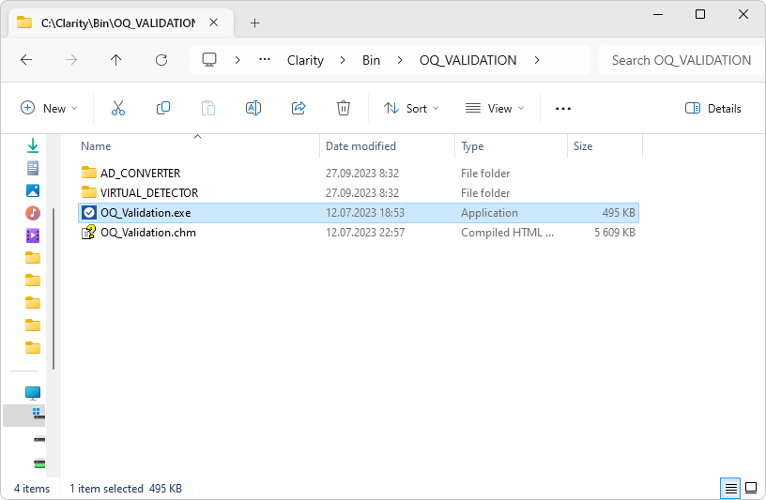
operational QUALIFICATION (oQ)
Tests data acquisition and processing
Tool supporting 21 CFR Part 11 Regulations
Requires System Suitability Test (SST) extension
Validation kit required only for stations with A/D converters
VALIDATION / OQ

Slide 7
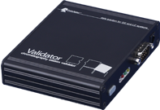
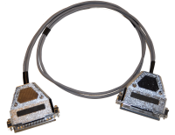

OQ
validation kit
Validator
AC/DC power adapter
Cable for A/D converter
Terminal board
Validator certificate
VALIDATION / OQ / VALIDATION KIT

Slide 8


OQ
Validator
Generating chromatograms
Validator
  Station with A/D converter
Virtual detector
  Station with only digital acquisition
A/D Converter
+
SST
Virtual Detector
+
SST
VALIDATION / OQ / GENERATING CHROMATOGRAMS

Slide 9
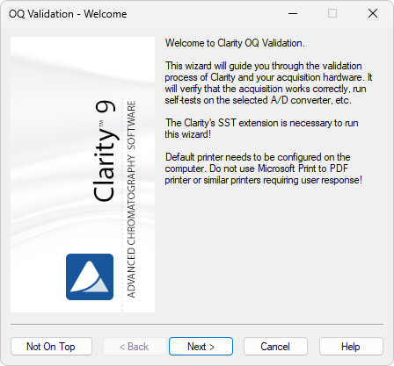
OQ
Wizard 1/5
Run from …\Clarity\Bin\OQ_VALIDATION\
Avoid printers requiring user response
VALIDATION / OQ / WIZARD

Slide 10
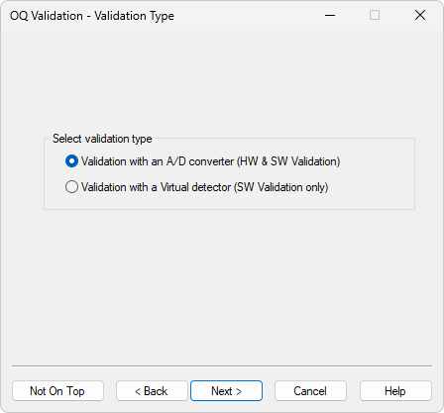
OQ
Wizard 2/5
Select validation type
  Do you use A/D converter?
VALIDATION / OQ / WIZARD

Slide 11
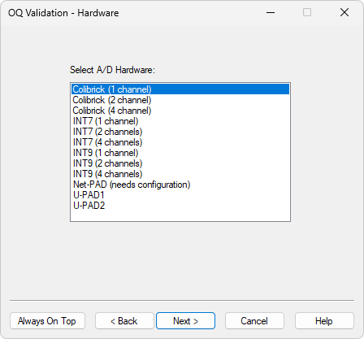
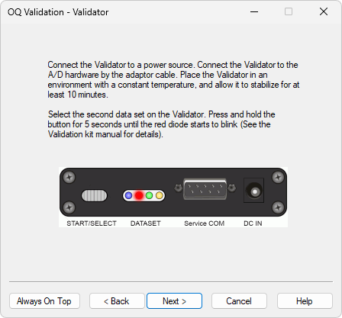
OQ
Wizard 3/5
Exclusive to A/D converter validation
  Select your HW
  Let the Validator stabilize
  Change Validator data set
VALIDATION / OQ / WIZARD

Slide 12
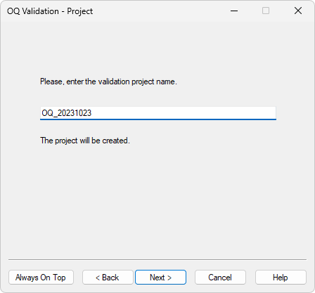
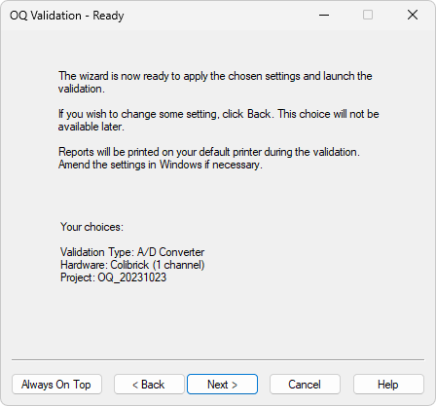
OQ
Wizard 4/5
Set project name
  All OQ data will be stored into it
Check the summary
VALIDATION / OQ / WIZARD

Slide 13
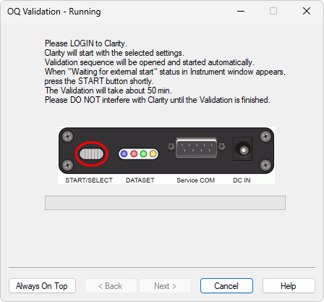
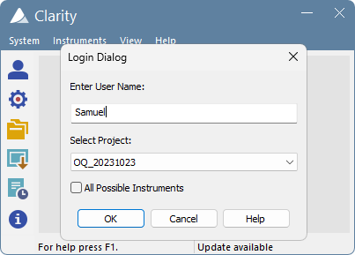
OQ
Wizard 5/5
Login to Clarity
For A/D converter validation
  Press the button on Validator
Virtual detector validation starts automatically
VALIDATION / OQ / WIZARD

Slide 14
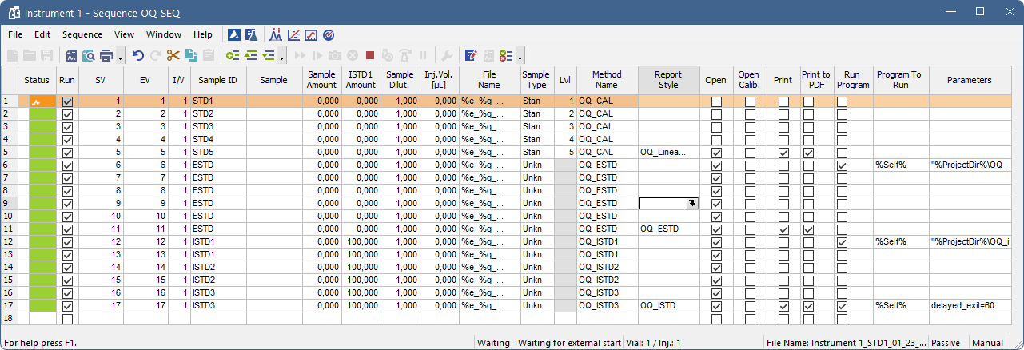
OQ
sequence
3 sets of analyses within 1 sequence
  Calibration curve linearity
  Repeatability and precision
  Acquisition range
Each set associated with different method and report style
Linearity
Repeatability
Range
VALIDATION / OQ / SEQUENCE

Slide 15
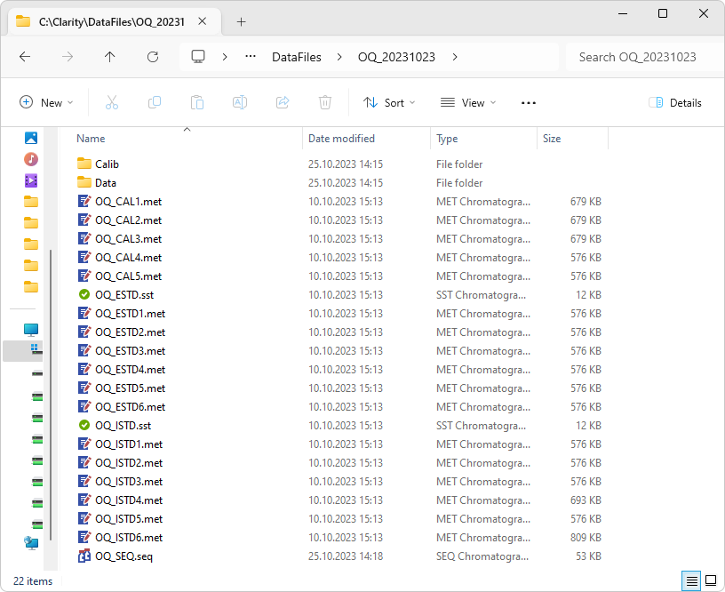
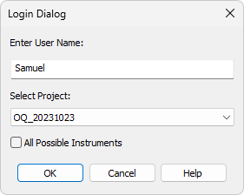
OQ
Results 1/3 – DATA
Project folder named according to OQ wizard
2 PDF in Data, 1 PDF in Calib
VALIDATION / OQ / RESULTS

Slide 16
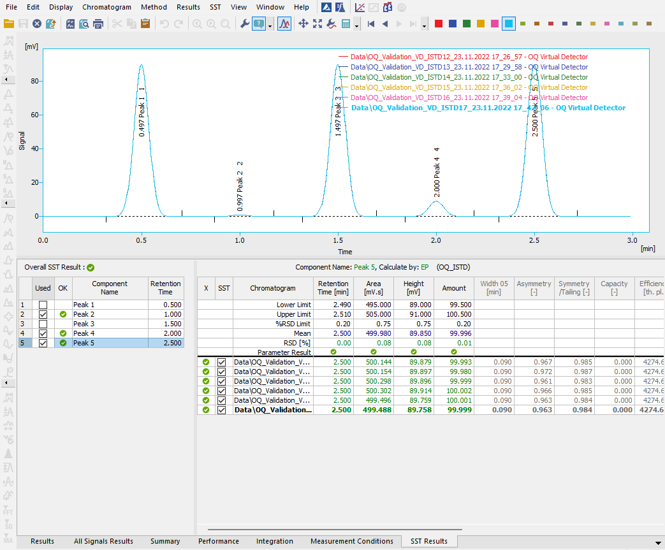
OQ
Results 2/3 - Evaluation
1st set must be checked manually
2nd and 3rd are checked by SST
VALIDATION / OQ / RESULTS

Slide 17
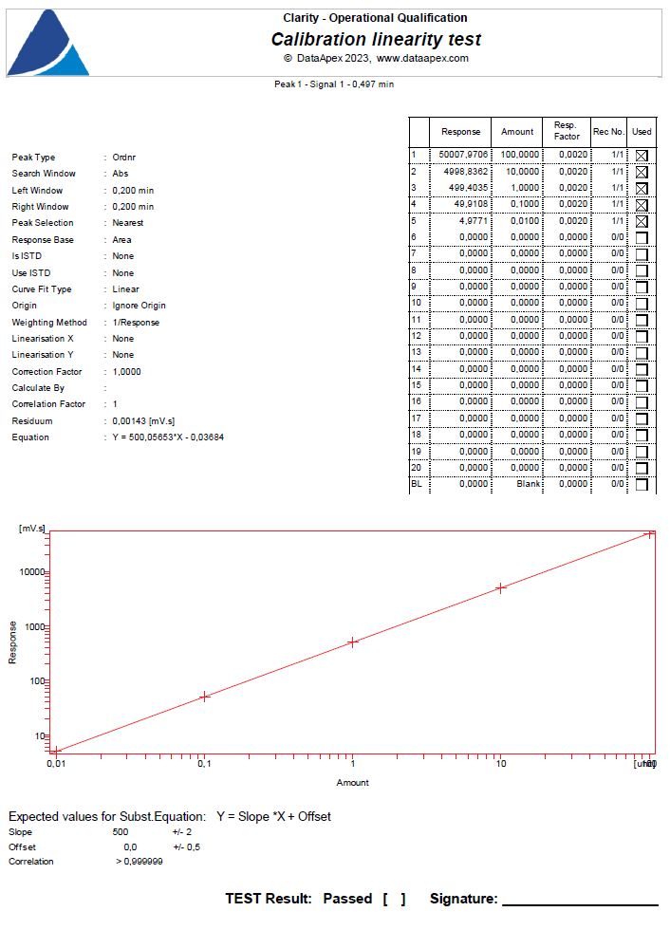
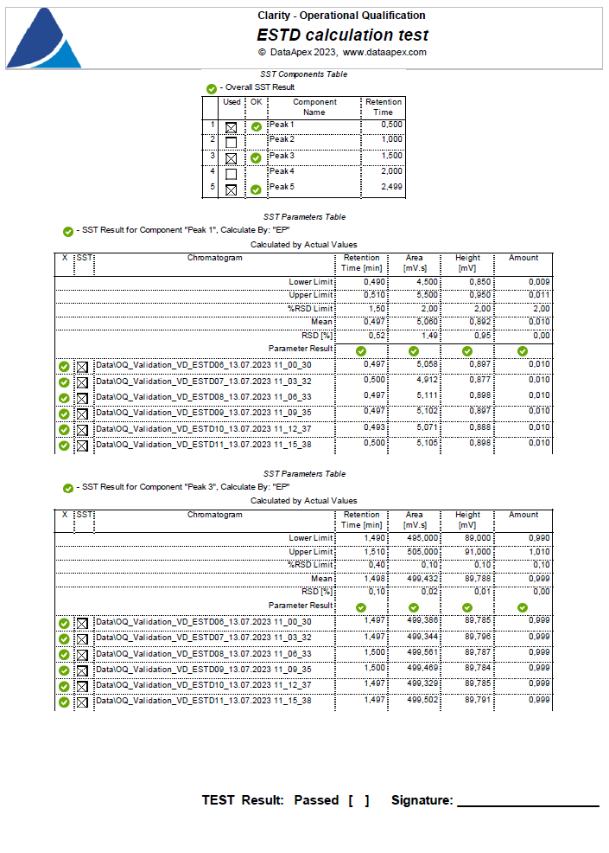
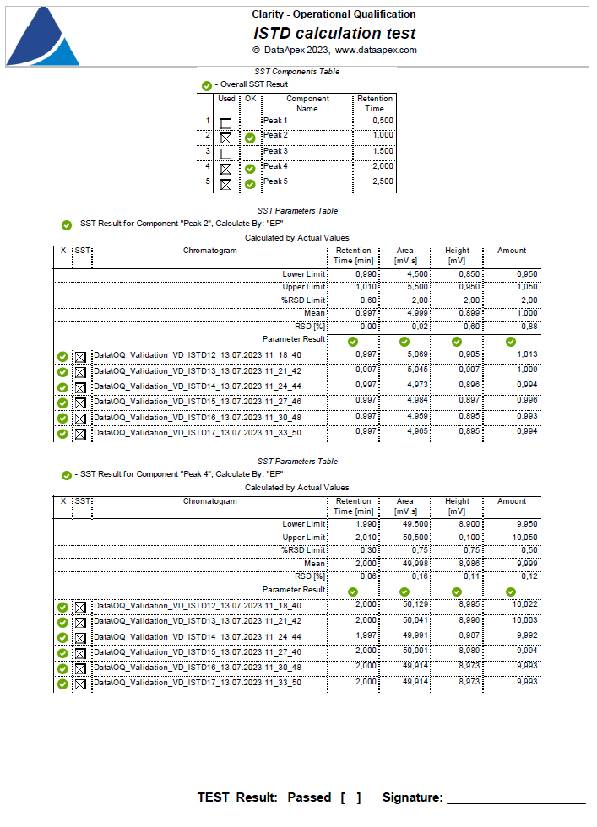
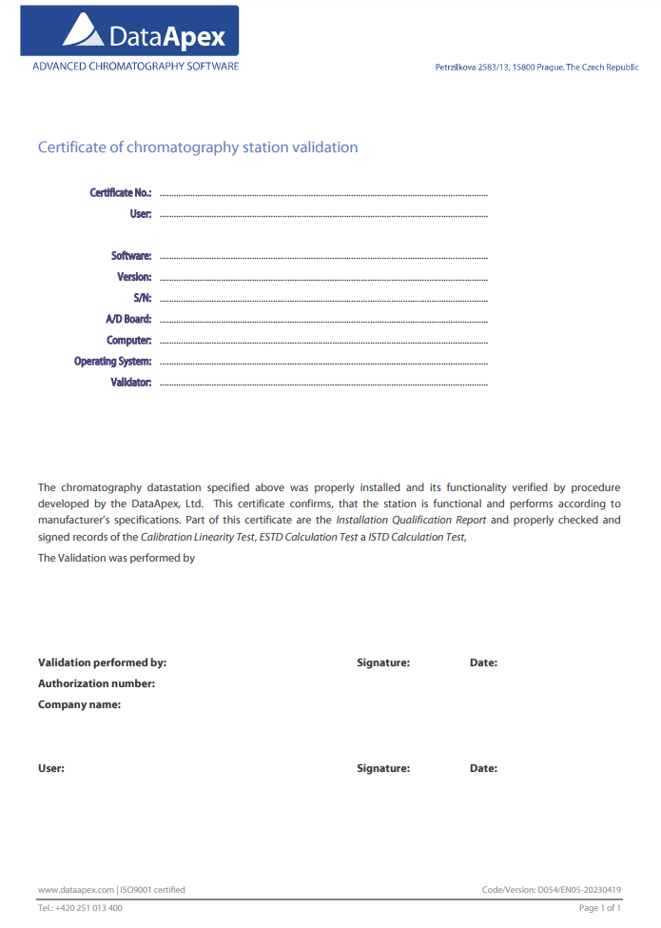
OQ
Results 3/3 – OQ report
3 PDF files from OQ project folder
Protocol
VALIDATION / OQ / RESULTS

Slide 18
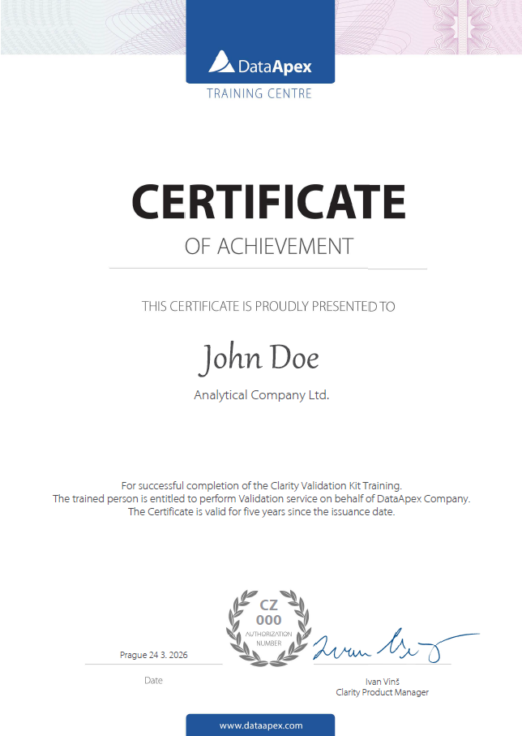
OQ
Who can perform?
Personnel trained in validation
Certified by DataApex
Certification valid for 5 years
VALIDATION / OQ / WHO CAN PERFORM

Slide 19
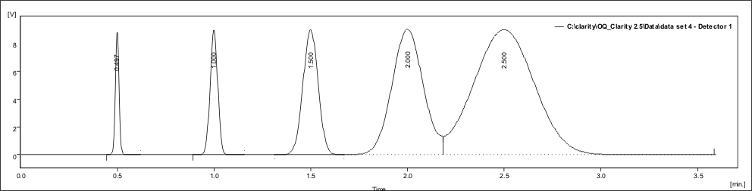
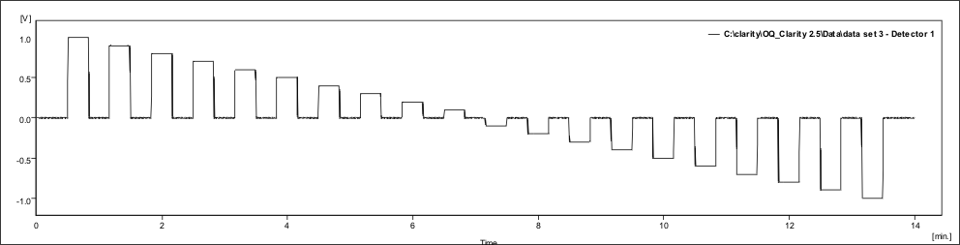
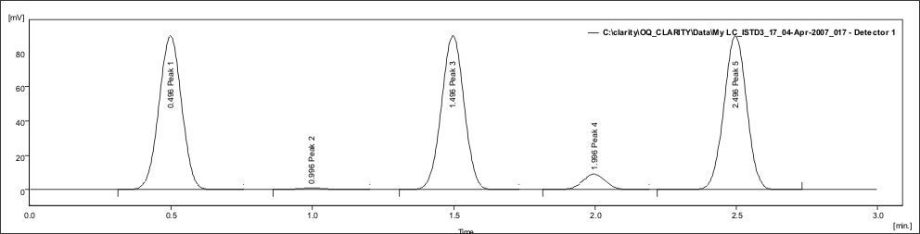
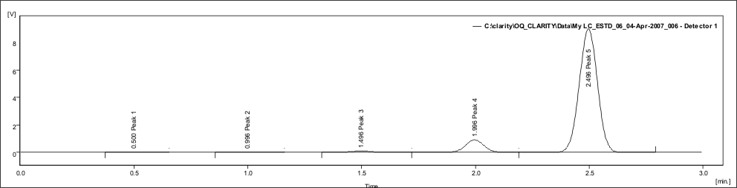
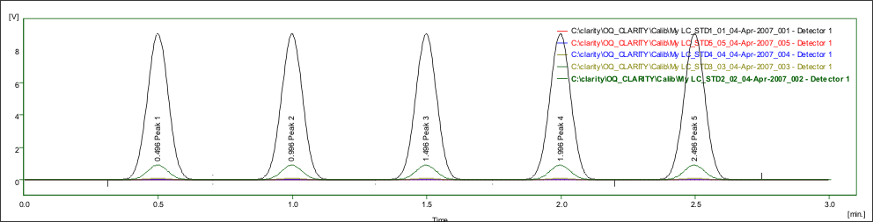
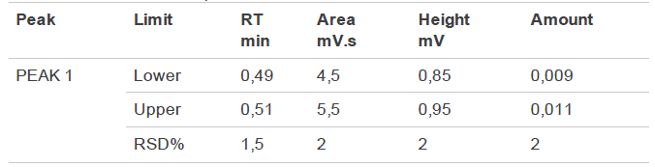
OQ
Additional info
Validation kit manual
  Tested parameters
  SST limits
  Validator chromatograms
VALIDATION / OQ / ADDITIONAL INFO

Slide 20
Performance qualification (pq)
Compliance with SOPs and workflow of given workplace
SST extension can be used
Must be prepared by the workplace personnel based on:
  Used instruments
  SOPs
  Applicable regulations
IQ and OQ must be successful before doing PQ
No certificate for PQ is issued by DataApex, , but support is available if required
VALIDATION / PQ

Slide 21
Thank you for your attention

