Slide 1
Clarity training
Advanced – part 3

Slide 2
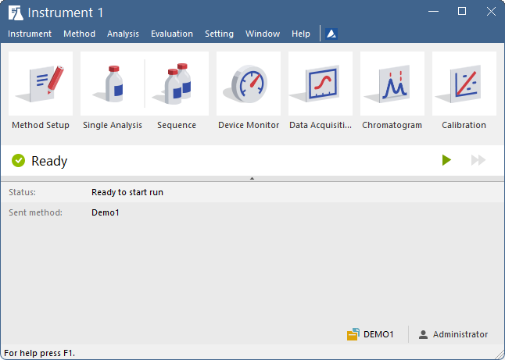
agenda
Batch processing
Report Setup
  Lab. header
  Tiled signals
  Order of sections
Export data
  Available options
Archive & Backup
Tips & Tricks
  Customization
  Post-run options
  Command Lock
  Shortcuts
ADVANCED TRAINING

Slide 3
agenda
Batch processing
Report Setup
  Lab. header
  Tiled signals
  Order of sections
Export data
  Available options
Archive & Backup
Tips & Tricks
  Customization
  Post-run options
  Command Lock
  Shortcuts
ADVANCED TRAINING

Slide 4
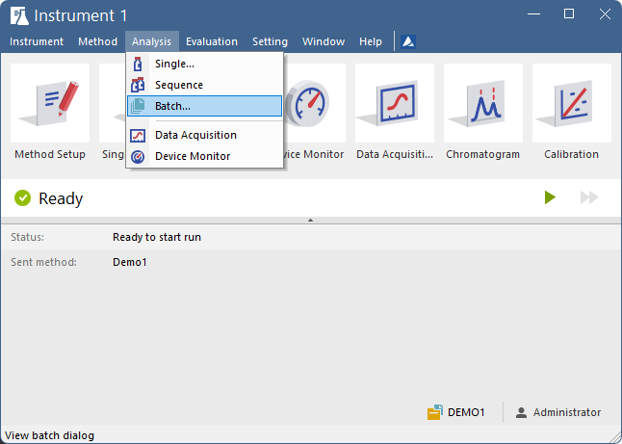
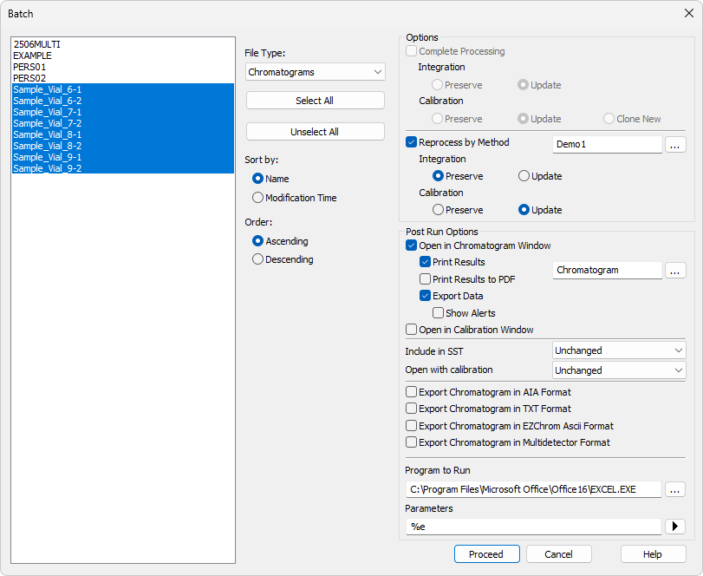
BATCH PROCESSING
BATCH
File Types available for Batch: Chromatograms, Calibration Standards, Sequence Files
Reprocessing chromatograms by selected method
Complete processing of whole sequences
Subsequent printing of results using a defined Report Style
Opening via a program of choice or further processing of the exported data
ADVANCED TRAINING / BATCH PROCESSING / BATCH

Slide 5
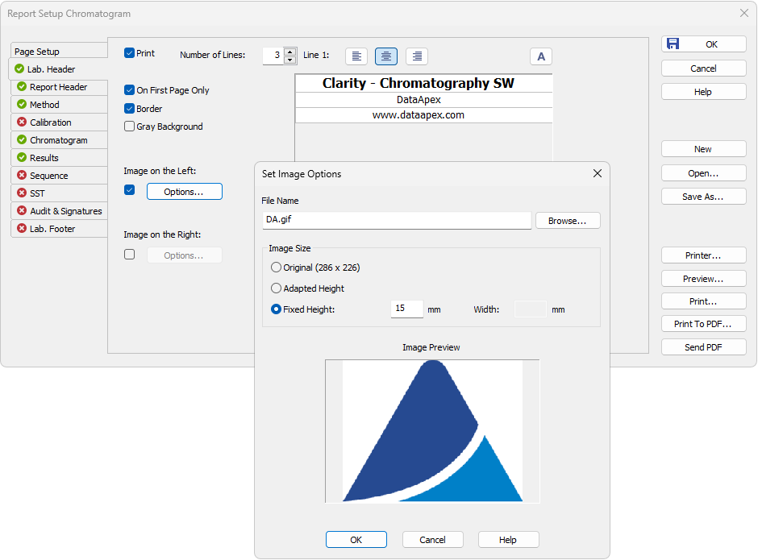
Report setup
Lab. header
Window header contains the name of the current report style (depending on the window it was opened from)
Tabs which are to be printed are marked by a tick
Custom image/logo can be set in the Lab. Header of the report
ADVANCED TRAINING / REPORT SETUP / LAB. HEADER

Slide 6
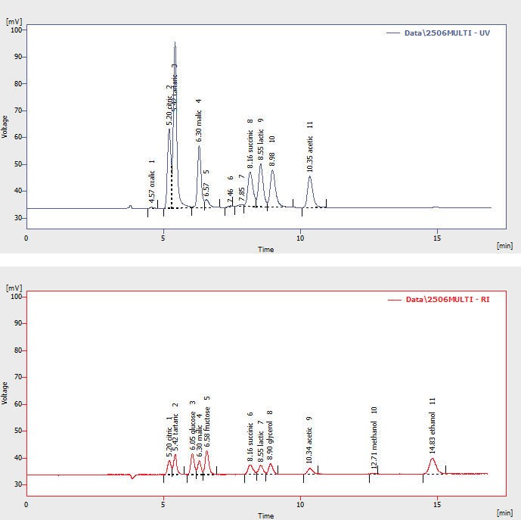
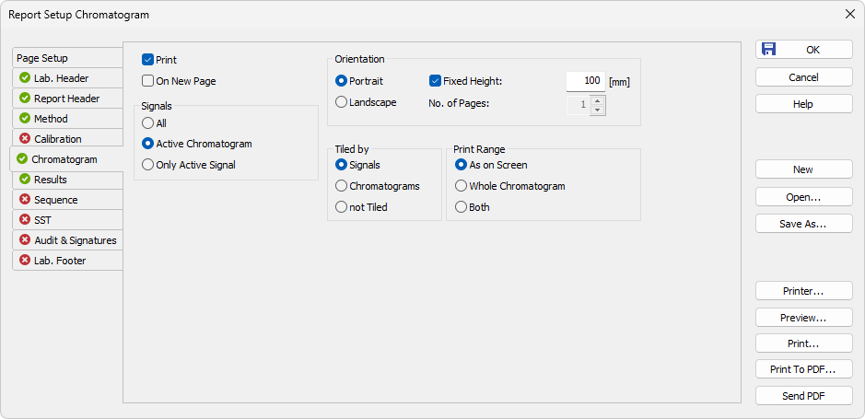
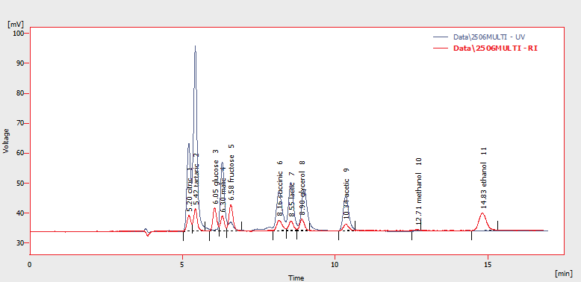
Report setup
Tiled signals
Chromatogram – Tiled by
ADVANCED TRAINING / REPORT SETUP / TILED SIGNALS

Slide 7
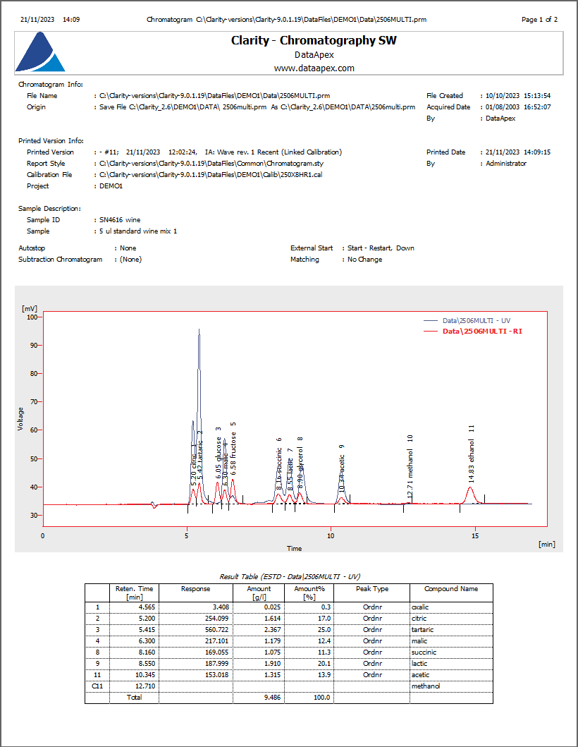
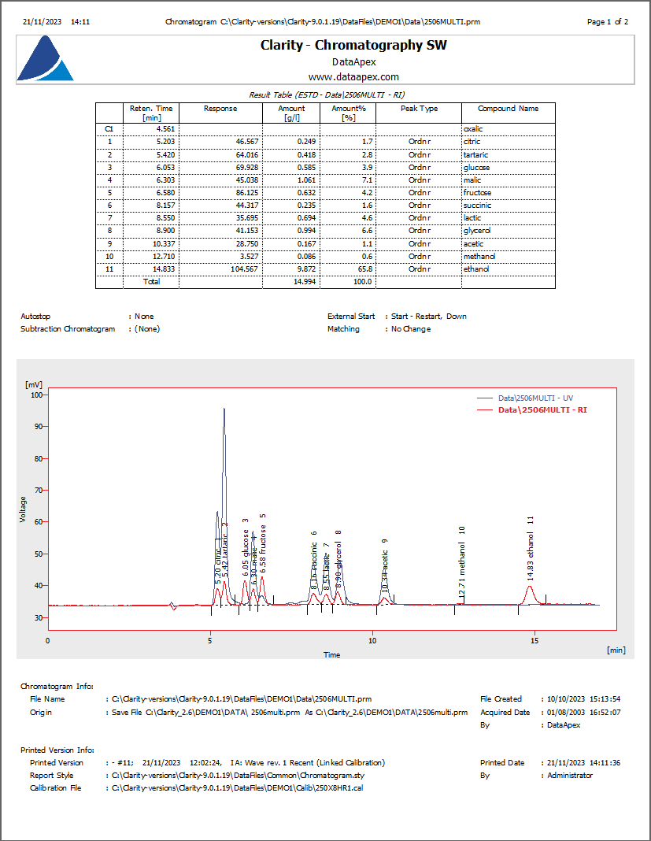
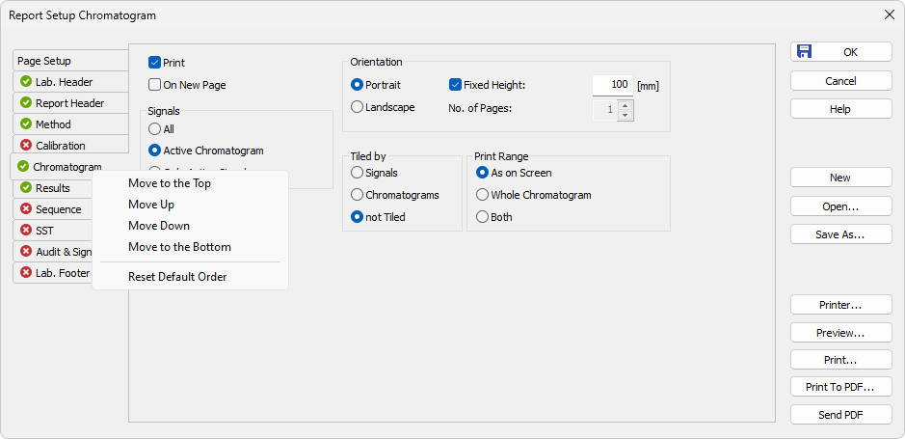
Report setup
Order of sections
Order of all tabs between Lab. Header and Audit & Signatures can be changed by left-clicking the tab and dragging it to the desired position or by right-clicking and selecting where to move the selected tab
ADVANCED TRAINING / REPORT SETUP / ORDER OF SECTIONS

Slide 8
agenda
Batch processing
Report Setup
  Lab. header
  Tiled signals
  Order of sections
Export data
  Available options
Archive & Backup
Tips & Tricks
  Customization
  Post-run options
  Command Lock
  Shortcuts
ADVANCED TRAINING

Slide 9
Export data
OPTIONS
Exporting data to other programs for further processing:
  Straightforwad way: Select, Copy & Paste (Ctrl+C, Ctrl+V)
  Automatic exports
Global settings applied in the Export Data dialog are common for:
  Manual export from the chromatogram window
  Automatic export via post run after each run end
  Automatic export via batch reprocessing or chromatograms/sequences
Export chromatograms is possible in various formats
ADVANCED TRAINING / EXPORT DATA / OPTIONS

Slide 10
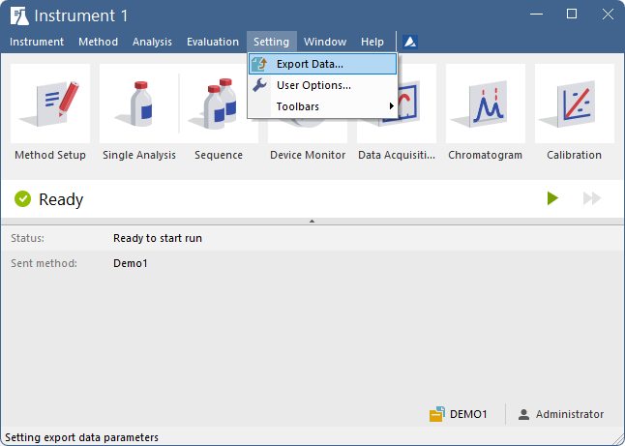
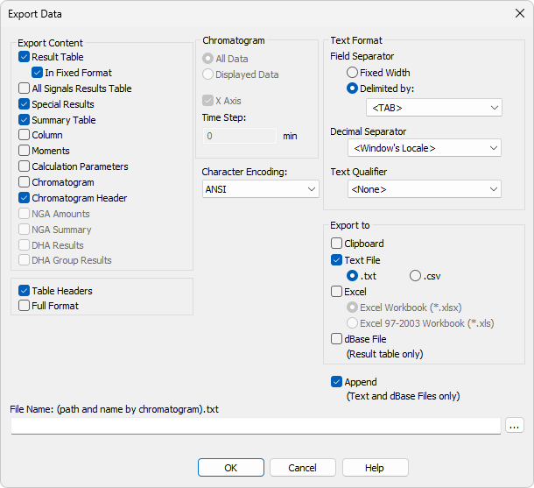
Export data
Instrument window
Chromatogram Header = export basic chromatogram info (File Name, Sample ID, Sample, Instrument, Amount, Dilution)
Table Headers = column headers of the Result Table
Full format = filename, date, and time for each row of the Result Table
Append = export into a single file
Blank field in the File Name field indicates the use of the current chromatogram name + .txt
ADVANCED TRAINING / EXPORT DATA / INSTRUMENT WINDOW

Slide 11
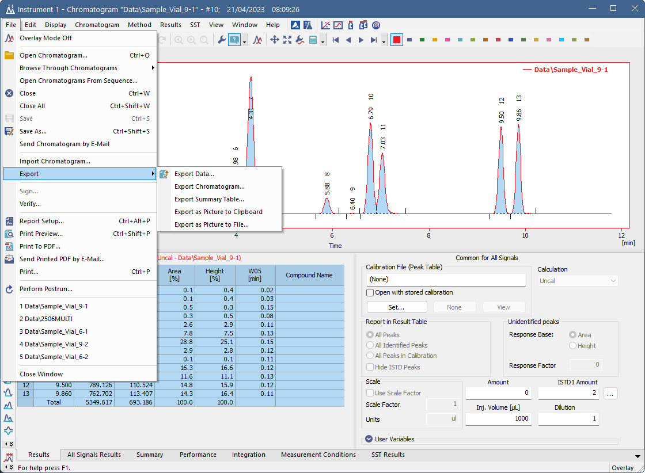
Export data
Chromatogram window
Additional export options are available; the Export Data dialog can be opened from Chromatogram as well
You can also select table content to Copy & Paste
ADVANCED TRAINING / EXPORT DATA / CHROMATOGRAM WINDOW

Slide 12
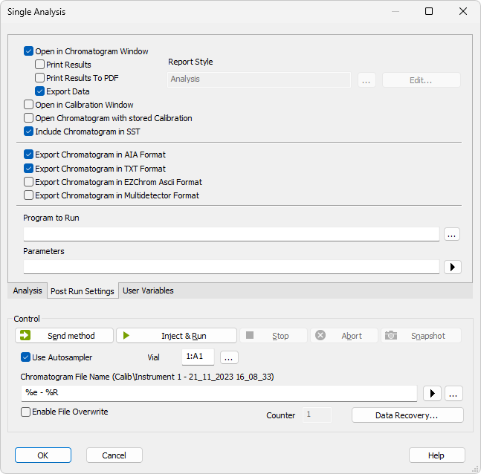
Export data
SINGLE ANALYSIS POST RUN SETTINGS
When the Export Data option is enabled, the export is performed automatically post-run, according to the settings in the Export Data dialog
Chromatogram can be exported in different formats
ADVANCED TRAINING / EXPORT DATA / SINGLE ANALYSIS POST RUN SETTINGS

Slide 13
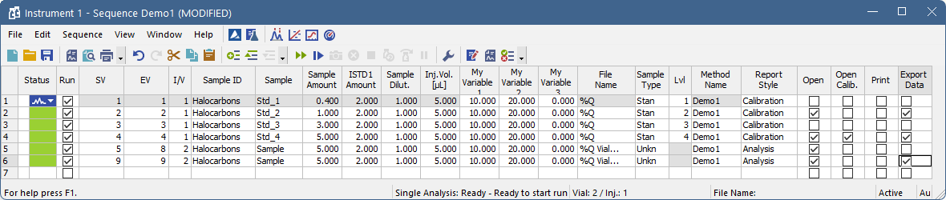
Export data
SEQUENCE
Export data automatically after the chromatogram in the row is measured
The Export Data column can be added via Setup Columns
The export is performed according to the settings in the Export Data dialog
Together with the Export Data option, the Open option must be checked as well
ADVANCED TRAINING / EXPORT DATA / SEQUENCE

Slide 14
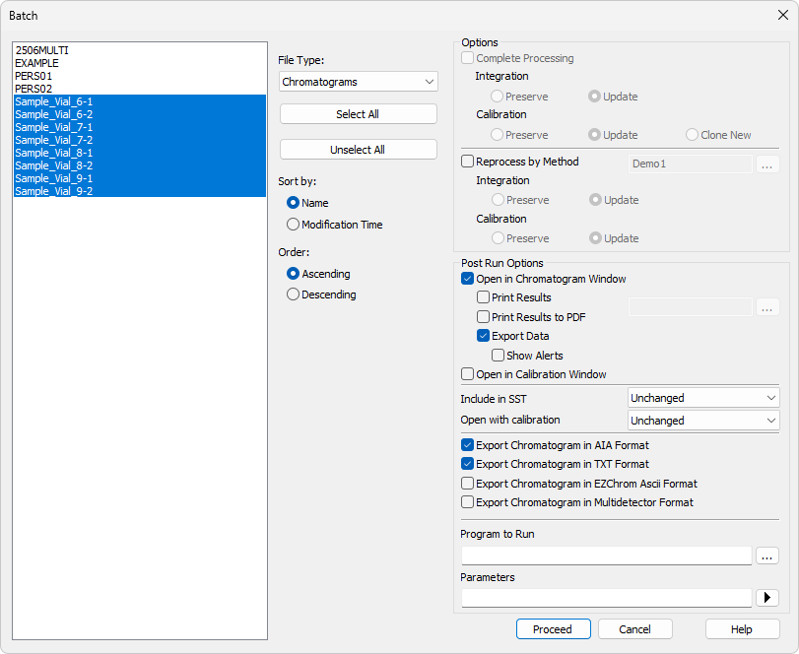
Export data
Batch
Export data for multiple chromatograms using the Batch dialog
The export is performed according to the settings in the Export Data dialog
Chromatograms can be exported in various formats
ADVANCED TRAINING / EXPORT DATA / BATCH

Slide 15
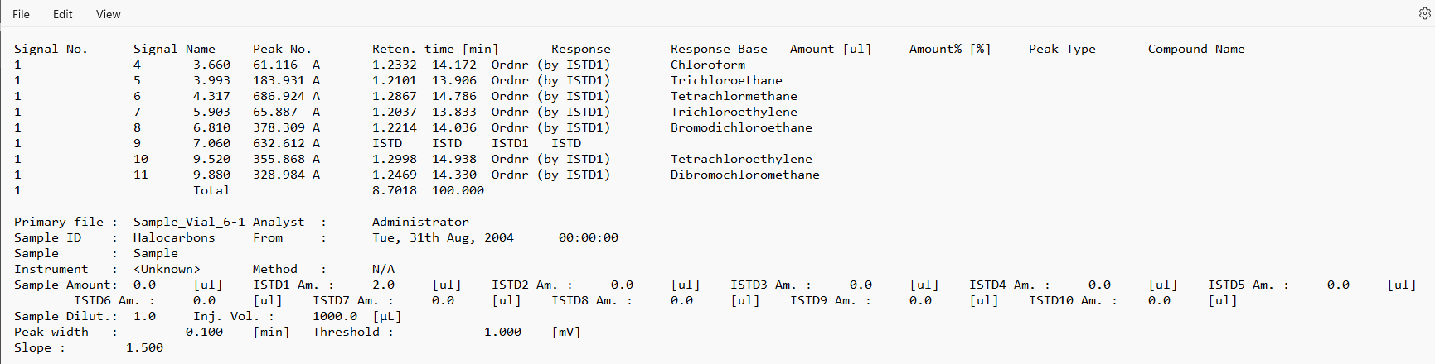
Export data
TEXT FILE FORMAT
ADVANCED TRAINING / EXPORT DATA / TEXT FILE FORMAT

Slide 16
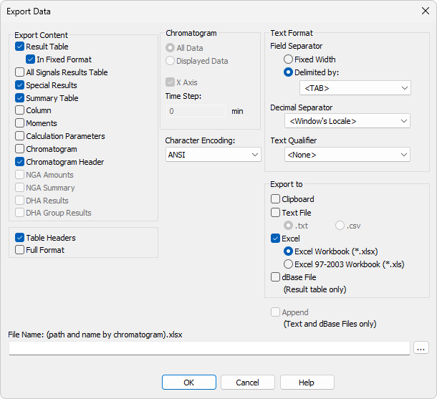
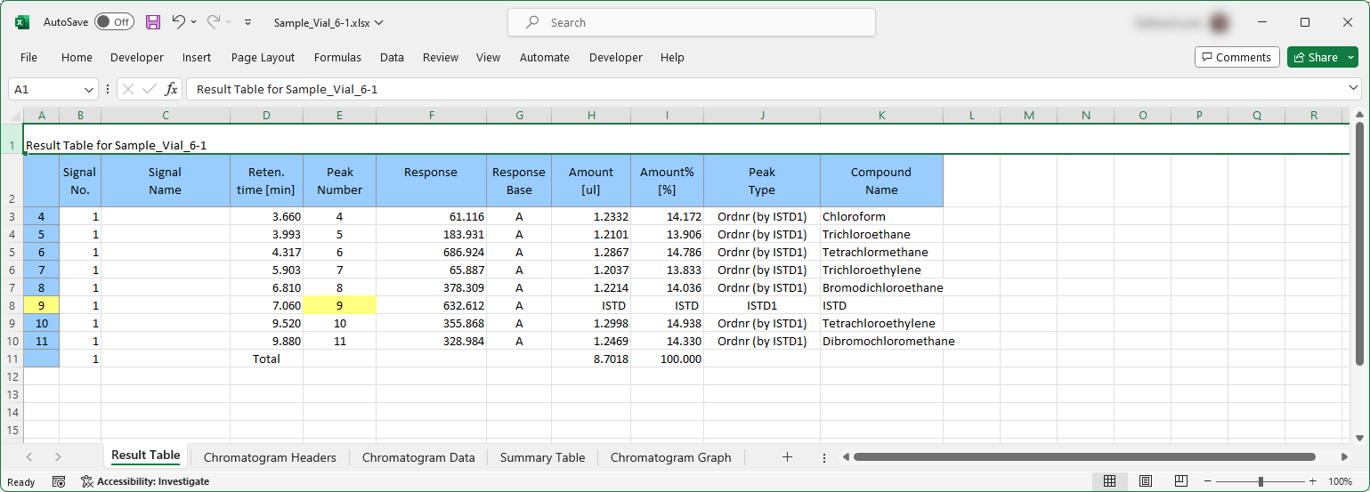
Export data
EXCEL (*.XLSX) FORMAT
ADVANCED TRAINING / EXPORT DATA / EXCEL (*.XLSX) FORMAT

Slide 17
agenda
Batch processing
Report Setup
  Lab. header
  Tiled signals
  Order of sections
Export data
  Available options
Archive & Backup
Tips & Tricks
  Customization
  Post-run options
  Command Lock
  Shortcuts
ADVANCED TRAINING

Slide 18
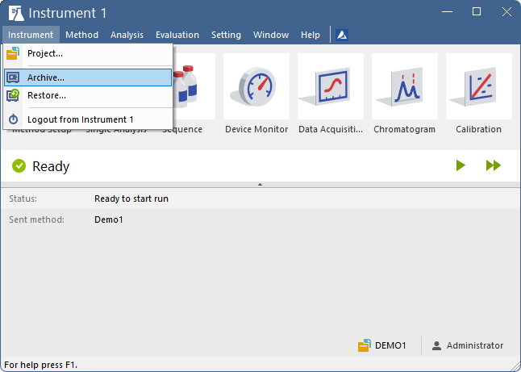
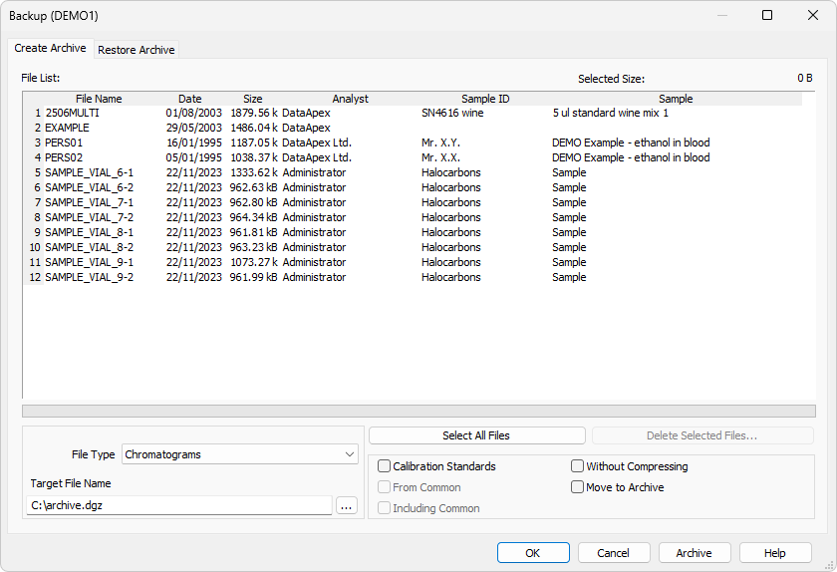
ARCHIVE & RESTORE
OVERVIEW
Data can be compressed to *.dgz archive files with reduced size
Writing into an existing *.dgz archive replaces all the preset data (appending is not possible)
Plan ahead: the project structure should allow you to archive whole projects when necessary
Access Create/Restore functions via Instrument
  Choose which file type to archive
Without compressing:
  When checked, no archive is created; the selected files are copied/moved
  When not checked, an archive containing selected files is created, located according to Target File Name
ADVANCED TRAINING / ARCHIVE & RESTORE / OVERVIEW

Slide 19
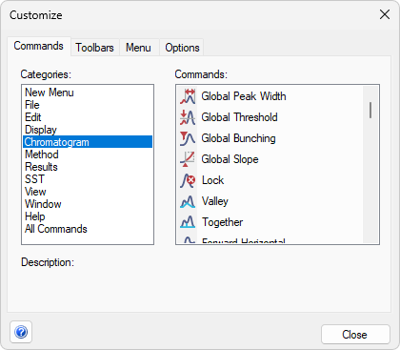
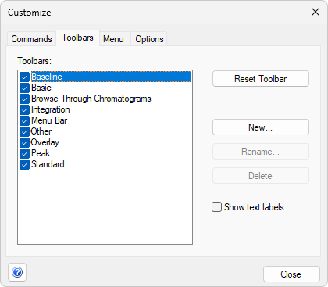
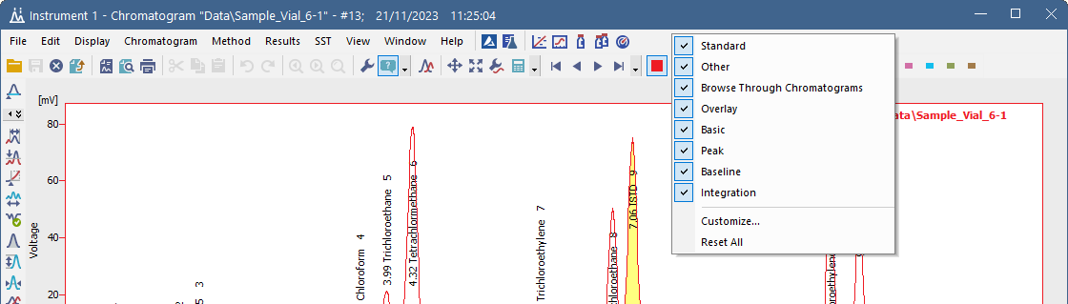
TIPS & TRICKS
customization
You can customize Clarity to your preferred use in several ways
Open the Customize dialog by right-clicking the toolbar and selecting Customize…
  To add command icons to the toolbar, drag them from the menu in the Commands tab
  To change the Toolbar options, use the Toolbars tab or (un)select the corresponding items in the context menu
ADVANCED TRAINING / TIPS & TRICKS / CUSTOMIZATION

Slide 20
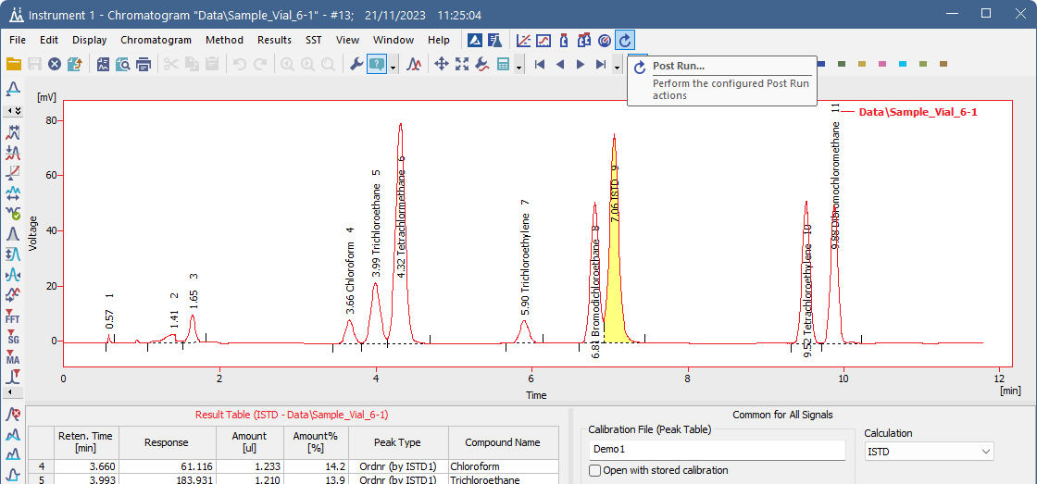
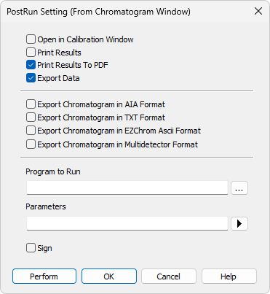
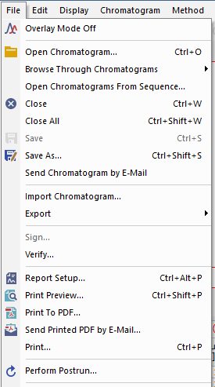
TIPS & TRICKS
PERFORM POST RUN ACTIONS
PostRun Setting dialog is accessible from the menu File; the icon for Post Run can be added via Customize
ADVANCED TRAINING / TIPS & TRICKS / PERFORM POST RUN ACTIONS

Slide 21
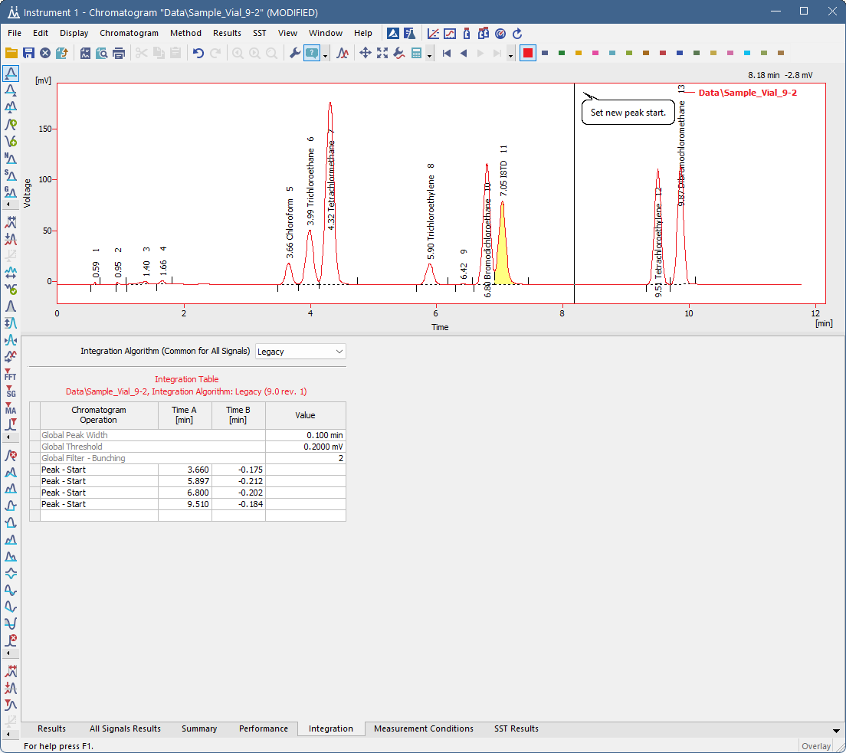
TIPS & TRICKS
COMMAND LOCK
Pressing Ctrl when invoking a command will lock the command for repeated use
  This is useful when changing start/end for multiple peaks etc.
Terminate the command by Esc
ADVANCED TRAINING / TIPS & TRICKS / COMMAND LOCK

Slide 22
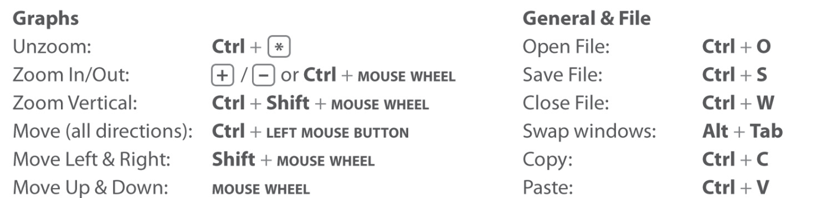
TIPS & TRICKS
Shortcuts
Most useful Clarity shortcuts
ADVANCED TRAINING / TIPS & TRICKS / SHORTCUTS

Slide 23
Thank you for your attention
Next training coming soon

