Slide 1
Clarity training
Advanced – part 2

Slide 2
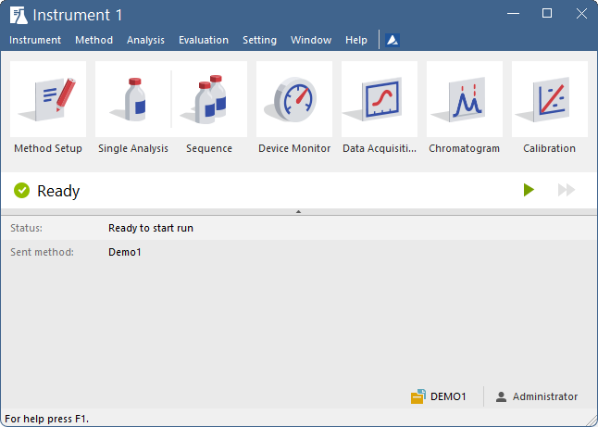
agenda
Chromatogram window
  Column setup, User columns, Noise & Drift
  Mathematical operations, Labels
  Result table, User variables
  Summary table, Performance table
  Force peak name, Peak coloring, Graph properties
Calibration
  LOD, LOQ
  Calibration Options, Manual Calibration
  Details of Calibration Point
  Bracketing and Standard Addition
Calculations
  ISTD, Normalized %
Groups
ADVANCED TRAINING

Slide 3
agenda
Chromatogram window
  Column setup, User columns, Noise & Drift
  Mathematical operations, Labels
  Result table, User variables
  Summary table, Performance table
  Force peak name, Peak coloring, Graph properties
Calibration
  LOD, LOQ
  Calibration Options, Manual Calibration
  Details of Calibration Point
  Bracketing and Standard Addition
Calculations
  ISTD, Normalized %
Groups
ADVANCED TRAINING

Slide 4
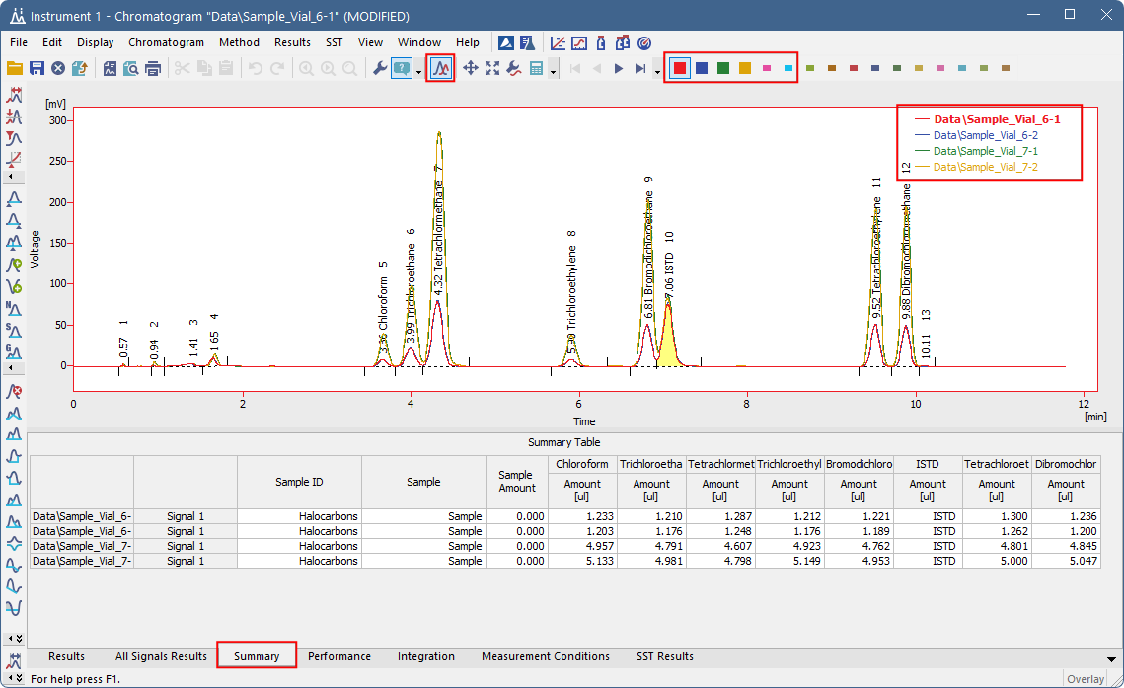
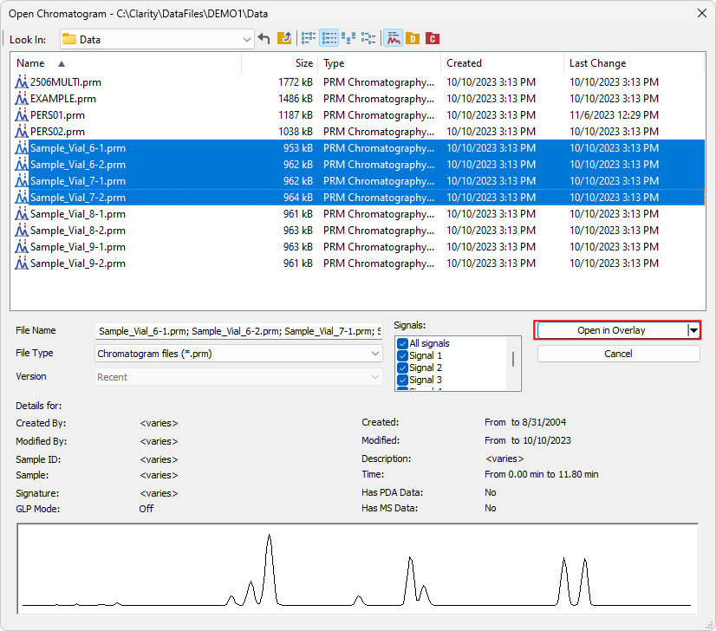
CHROMATOGRAM WINDOW
OVERLAY
Comparing multiple chromatograms
  Max. number is set in User Options
Summary table shows results of the displayed chromatograms/signals
Hide/show signals via Ctrl+Click on signal color
ADVANCED TRAINING / CHROMATOGRAM WINDOW / OVERLAY

Slide 5
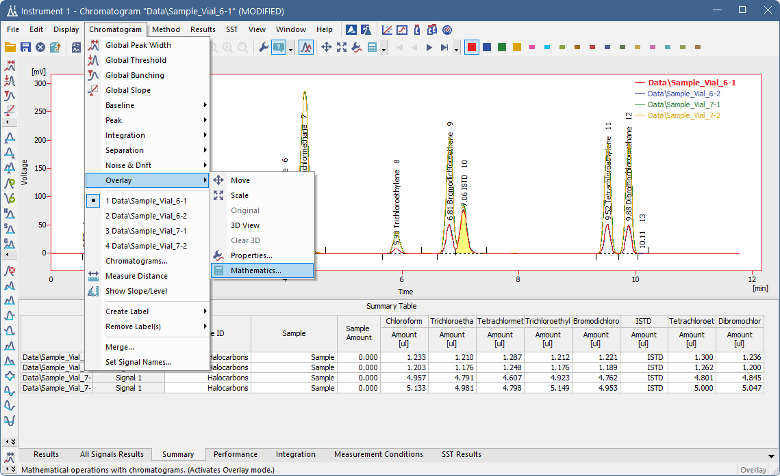
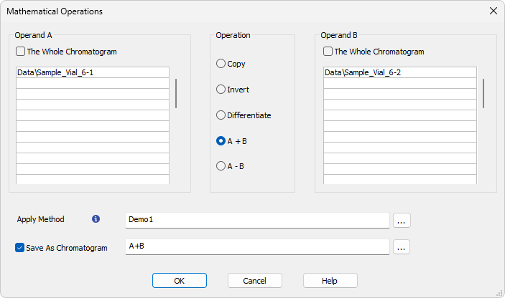
CHROMATOGRAM WINDOW
Mathematical operations
Mathematical operations between signals/chromatograms
ADVANCED TRAINING / CHROMATOGRAM WINDOW / MATHEMATICS

Slide 6
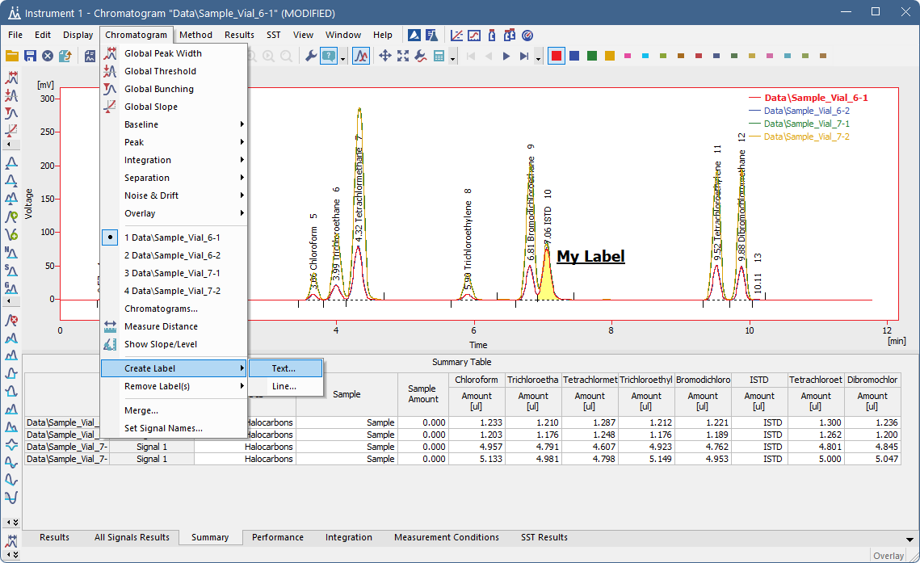
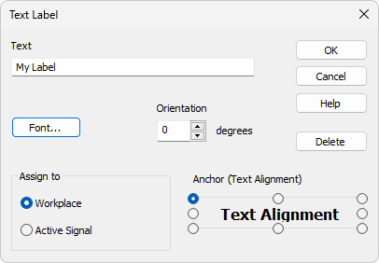
CHROMATOGRAM WINDOW
labels
Add text labels or lines
ADVANCED TRAINING / CHROMATOGRAM WINDOW / LABELS

Slide 7
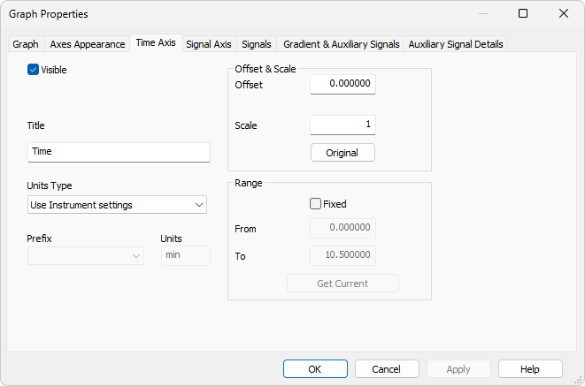
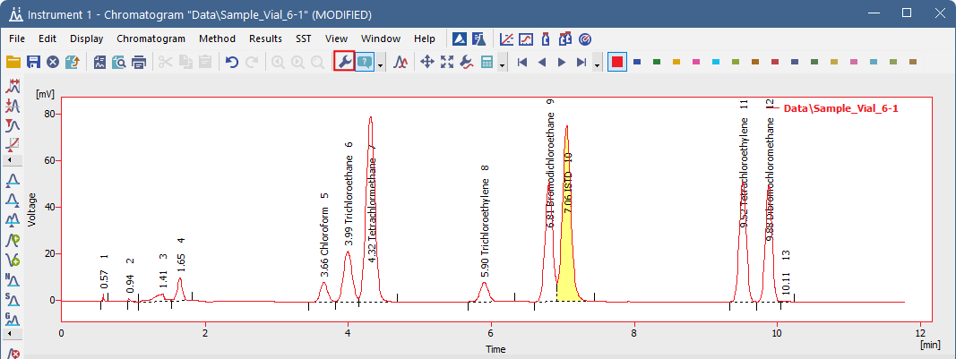
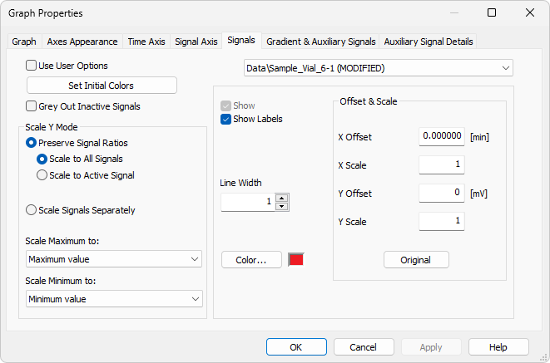
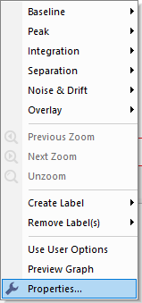
Chromatogram window
GRAPH PROPERTIES
Axis settings
Signal scaling –general settings, settings for individual signals
ADVANCED TRAINING / CHROMATOGRAM WINDOW / GRAPH PROPERTIES

Slide 8
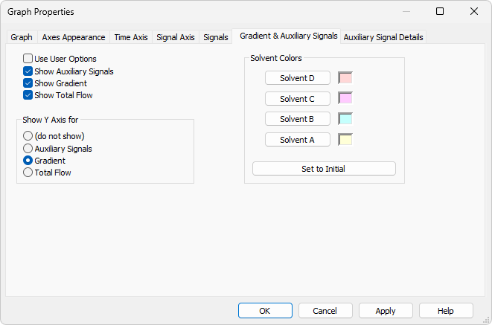
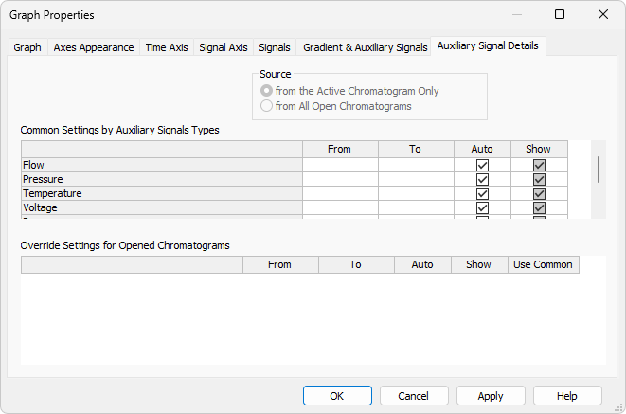
Chromatogram window
GRAPH PROPERTIES
Gradient display option
Auxiliary signals options
ADVANCED TRAINING / CHROMATOGRAM WINDOW / GRAPH PROPERTIES

Slide 9
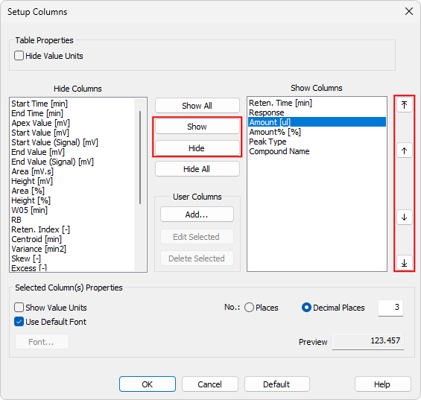
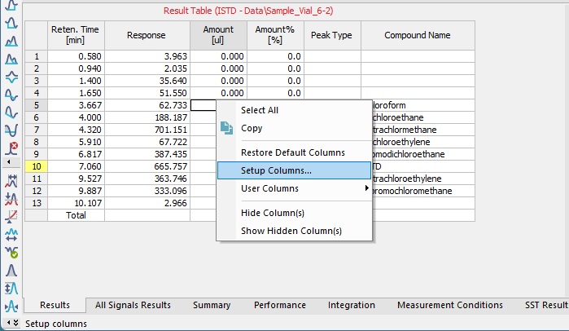
CHROMATOGRAM WINDOW
Setup columns
Operable from the context menu of any table
Hide/Show columns
Change the order of columns
ADVANCED TRAINING / CHROMATOGRAM WINDOW / SETUP COLUMNS

Slide 10
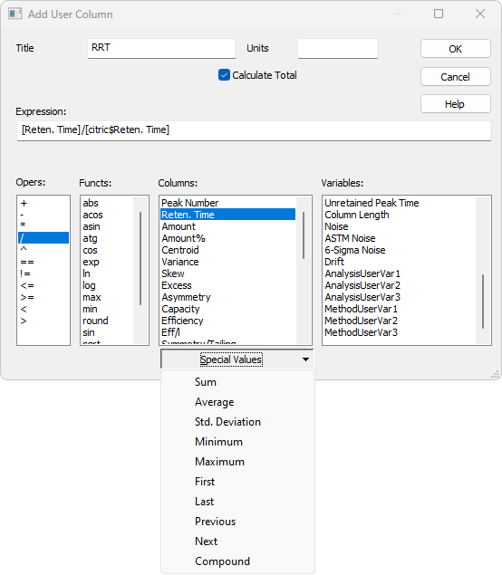
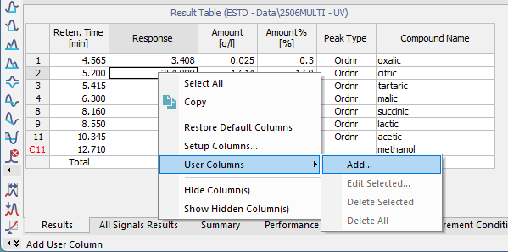
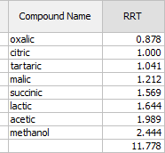
CHROMATOGRAM WINDOW
User columns – RRT (Relative retention time)
Access via context menu in Result/Summary table
Add custom calculations
Special values menu for more options
Specify user variables
1
1
ADVANCED TRAINING / CHROMATOGRAM WINDOW / USER COLUMNS

Slide 11
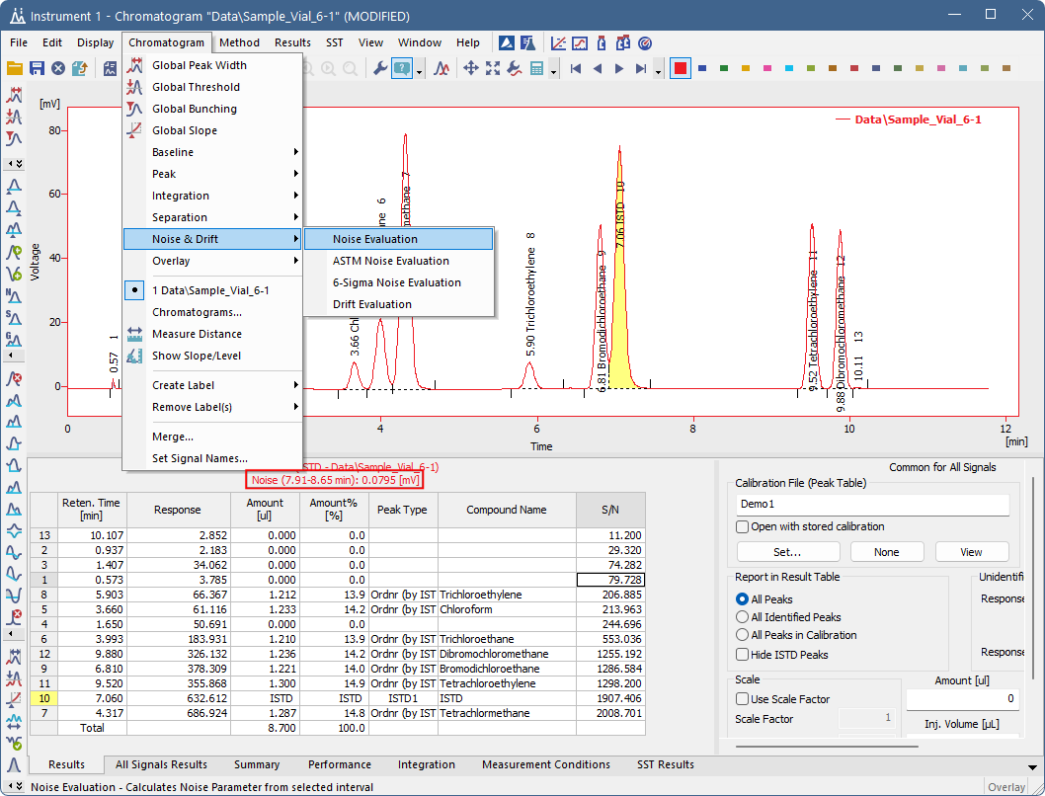
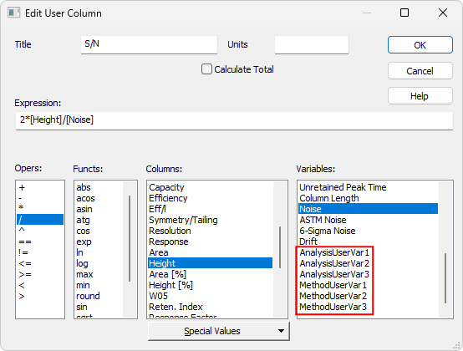
CHROMATOGRAM WINDOW
User columns – noise & drift
Set noise interval
Add Signal/Noise calculation
to a user column
User variables can be used
1
1
ADVANCED TRAINING / CHROMATOGRAM WINDOW / USER COLUMNS

Slide 12
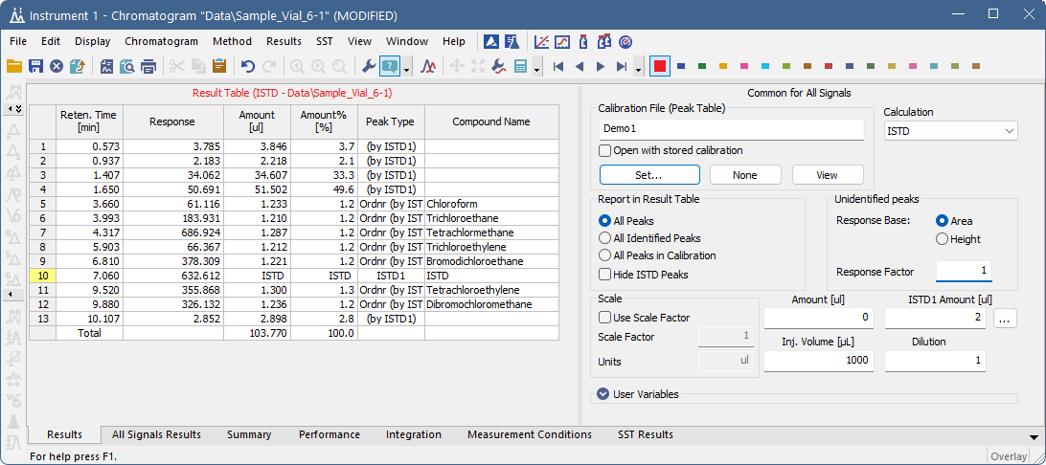
CHROMATOGRAM WINDOW
UNIDENTIFIED PEAKS – UNCALIBRATED RESPONSE
Manually assign response base and factor to unidentified peaks (peaks not present in calibration)
Calculation of amounts of unidentified (uncalibrated) compounds:
Amount = [Response Base] × [Response Factor]
Provides a “single-point quantification” of unidentified compounds (e.g., for universal response detectors like ELSD, FID, RI, etc.)
ADVANCED TRAINING / CHROMATOGRAM WINDOW / UNIDENTIFIED PEAKS – UNCALIBRATED RESPONSE

Slide 13
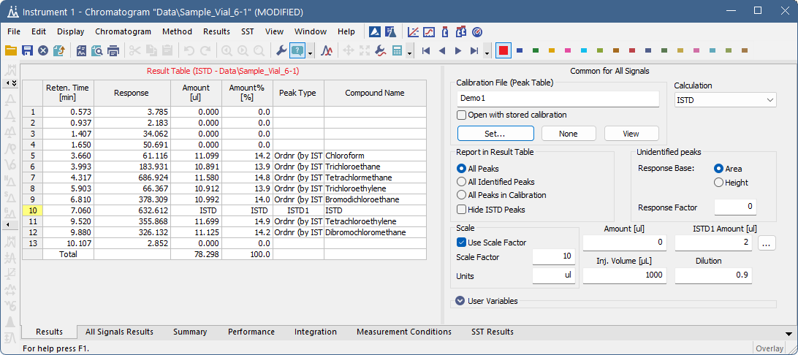
CHROMATOGRAM WINDOW
SCALE & DILUTION
Scale factor multiplies values in the Amount column and the Sample Amount (the entered units are used in the Amount when scaled, overriding the calibration settings)
  Method-specific (can be used only when calibration is set)
Dilution multiplies values in the Amount column
  Sample-specific (can also be entered via Sequence or Single Analysis)
ADVANCED TRAINING / CHROMATOGRAM WINDOW / SCALE & DILUTION

Slide 14
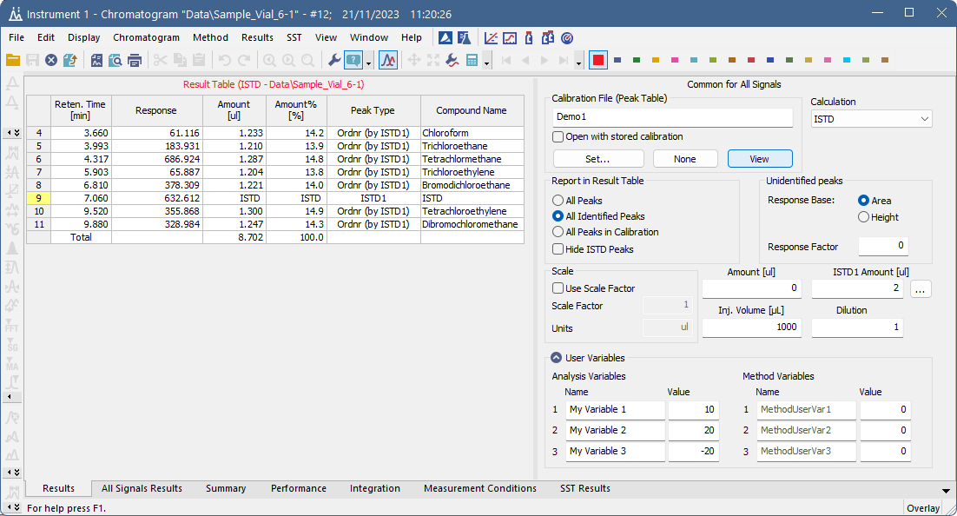
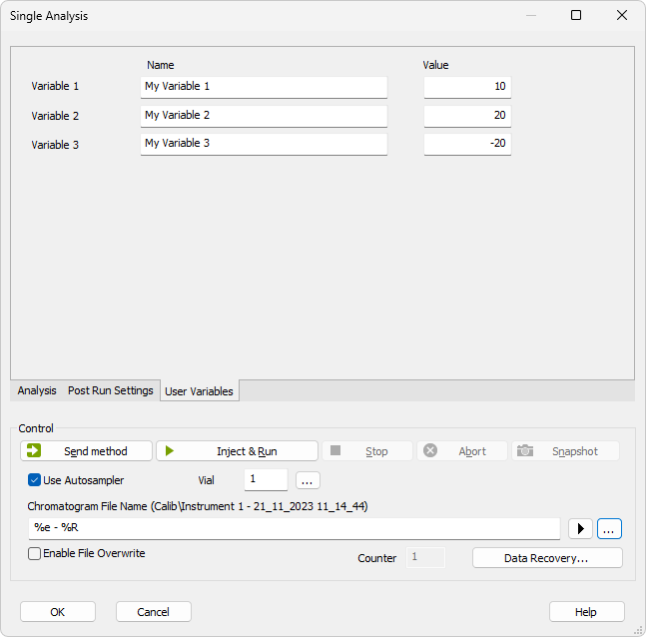
CHROMATOGRAM WINDOW
User variables – Analysis variables
Analysis Variables are propagated from Single Analysis or Sequence to the measured chromatogram
  These can be used for custom calculations in the Result Table
ADVANCED TRAINING / CHROMATOGRAM WINDOW / USER VARIABLES – ANALYSIS VARIABLES

Slide 15
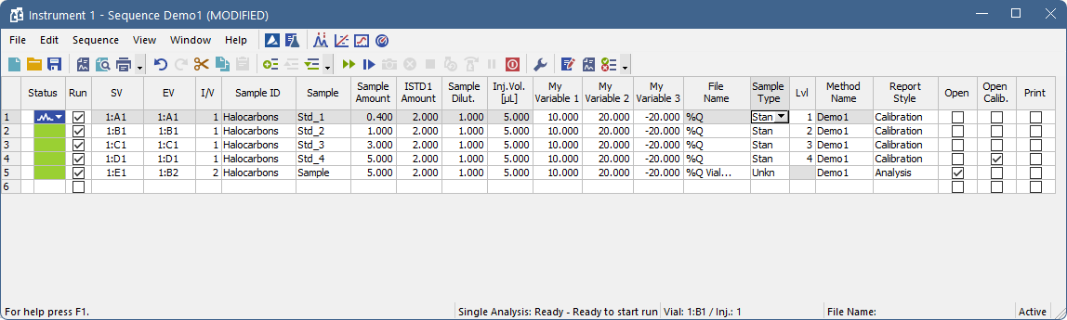
CHROMATOGRAM WINDOW
User variables – Analysis variables
Analysis Variables are propagated from Single Analysis or Sequence to the measured chromatogram
  These can be used for custom calculations in the Result Table
ADVANCED TRAINING / CHROMATOGRAM WINDOW / USER VARIABLES – ANALYSIS VARIABLES

Slide 16
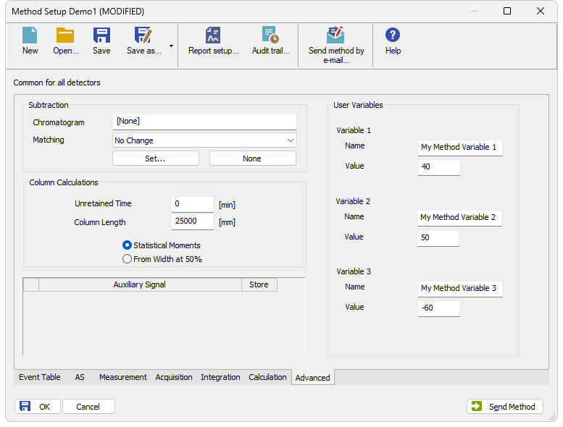
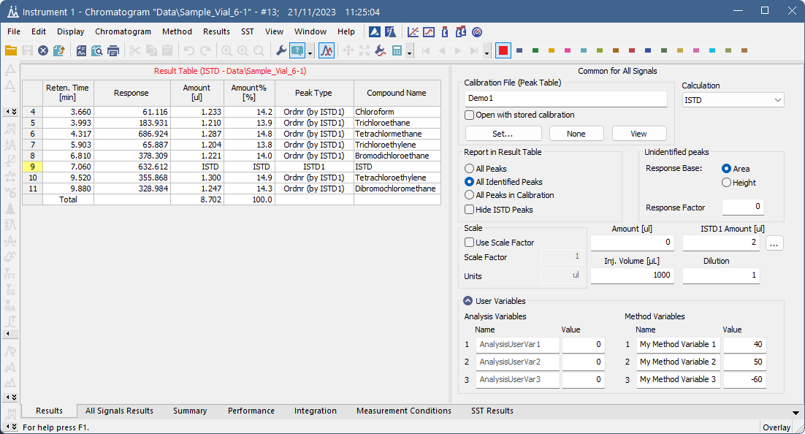
CHROMATOGRAM WINDOW
User variables – Method variables
Method Variables are propagated from Method Setup – Advanced tab to the measured chromatogram
  These can be used for custom calculations in the Result Table
ADVANCED TRAINING / CHROMATOGRAM WINDOW / USER VARIABLES – METHOD VARIABLES

Slide 17
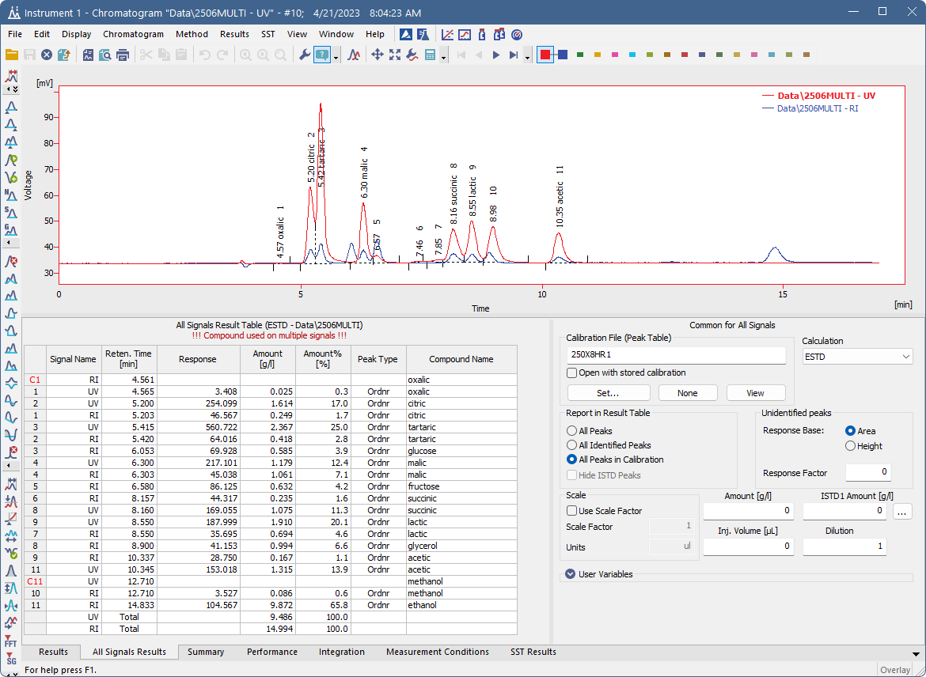
Chromatogram window
ALL SIGNALS RESULTS TABLE
Results for all signals of selected
chromatogram in one table
ADVANCED TRAINING / CHROMATOGRAM WINDOW / ALL SIGNALS RESULT TABLE

Slide 18
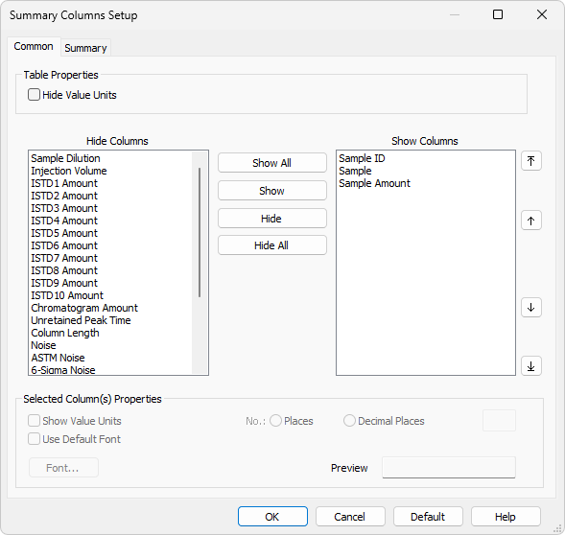
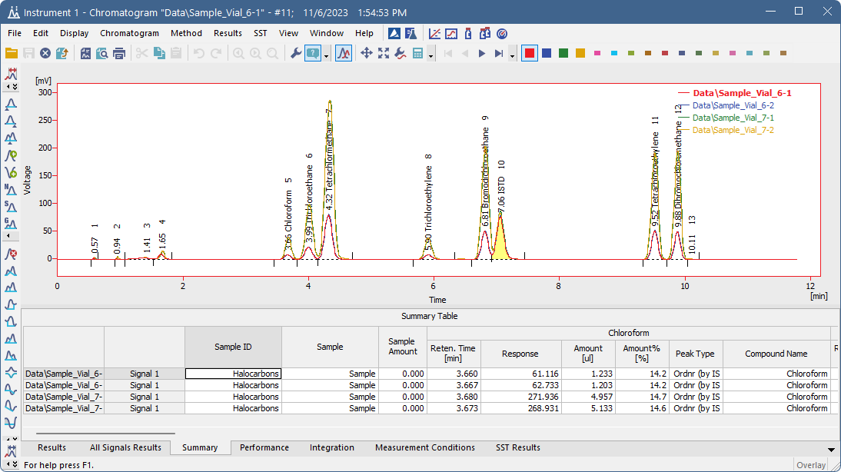
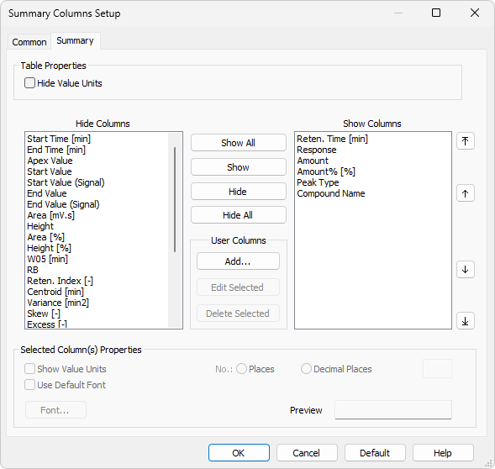
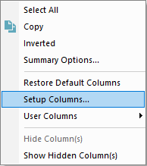
Chromatogram window
Summary table
Summary of all opened chromatograms and signals based on calibration settings
Setup columns:
  Common for all compounds
  Compound-specific (Summary)
ADVANCED TRAINING / CHROMATOGRAM WINDOW / SUMMARY TABLE

Slide 19
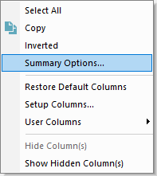
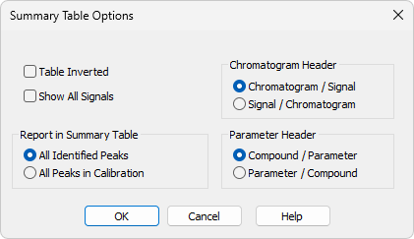
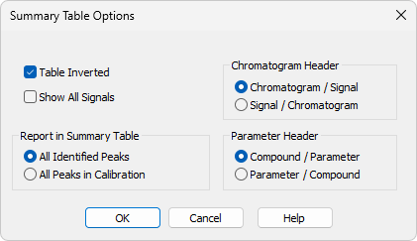
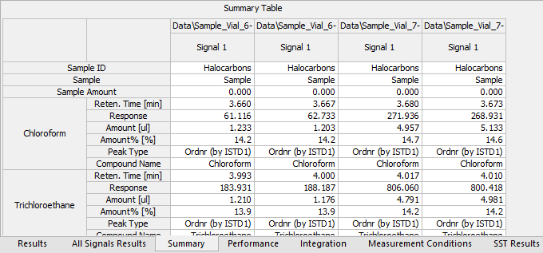
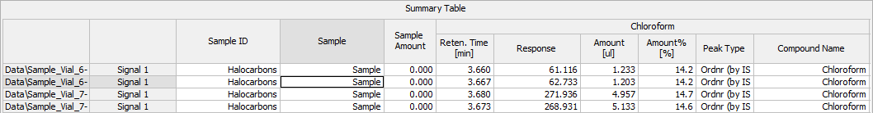
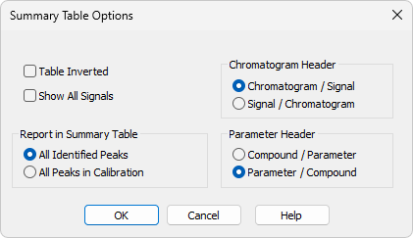
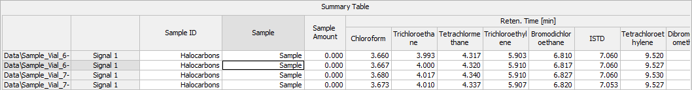
Chromatogram window
Summary table options
Accessible through the context menu
Table inversion, header organization…
ADVANCED TRAINING / CHROMATOGRAM WINDOW / SUMMARY TABLE

Slide 20
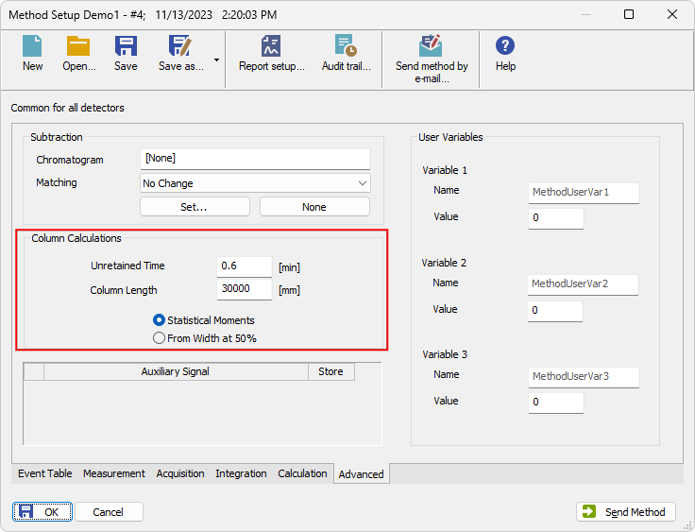
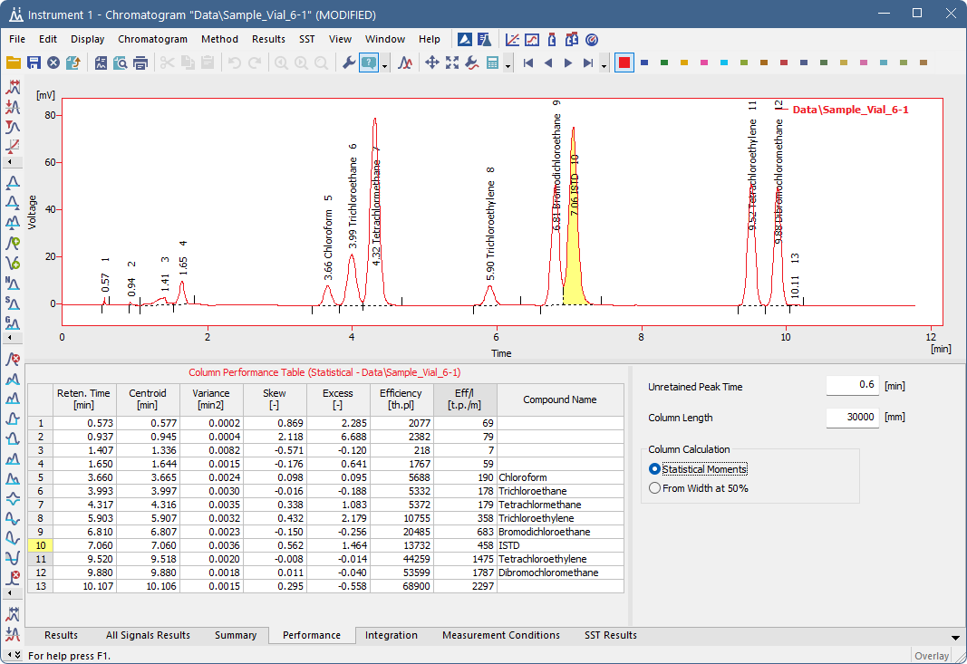
Chromatogram window
performance table
Set calculation type
Values for capacity ratio and efficiency from the used method
ADVANCED TRAINING / CHROMATOGRAM WINDOW / PERFORMANCE TABLE

Slide 21
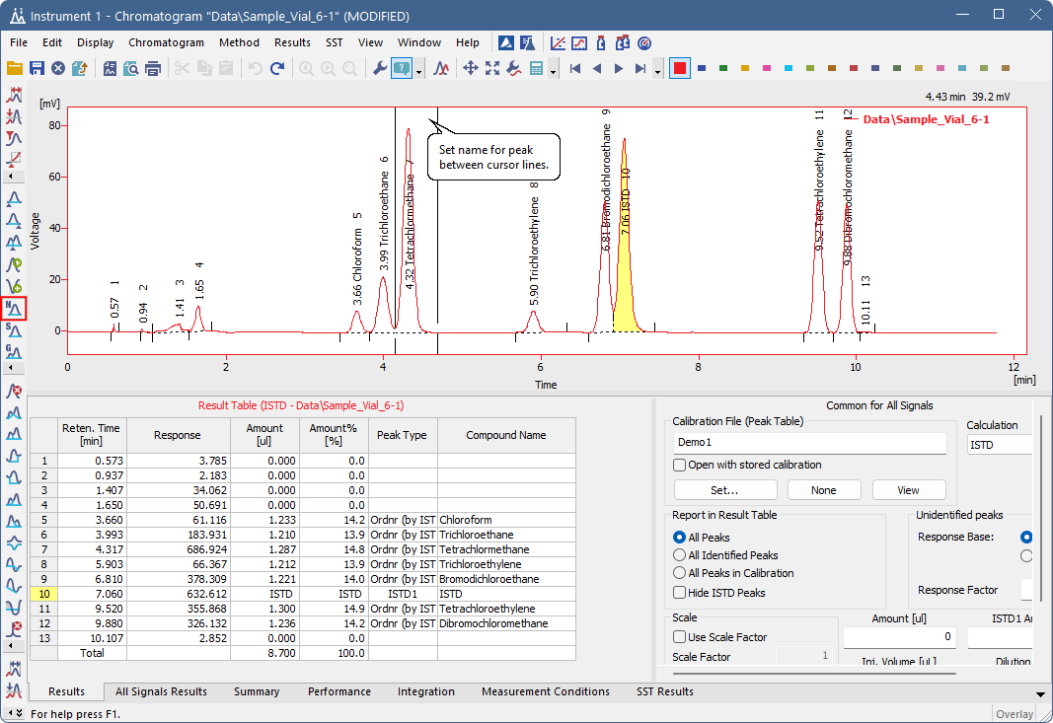
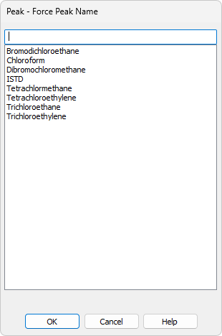
Chromatogram window
Force peak name
Set compound from calibration
Set custom name
ADVANCED TRAINING / CHROMATOGRAM WINDOW / FORCE PEAK NAME

Slide 22
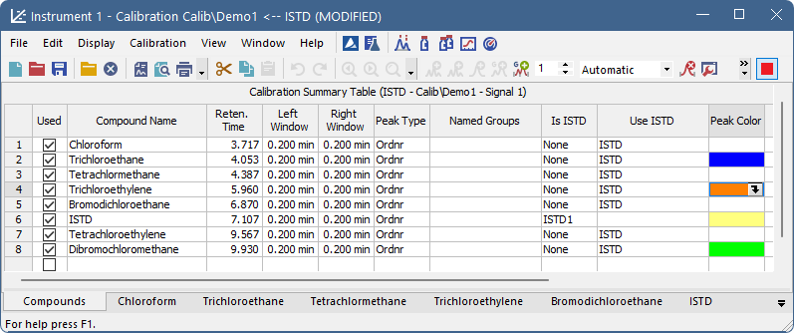
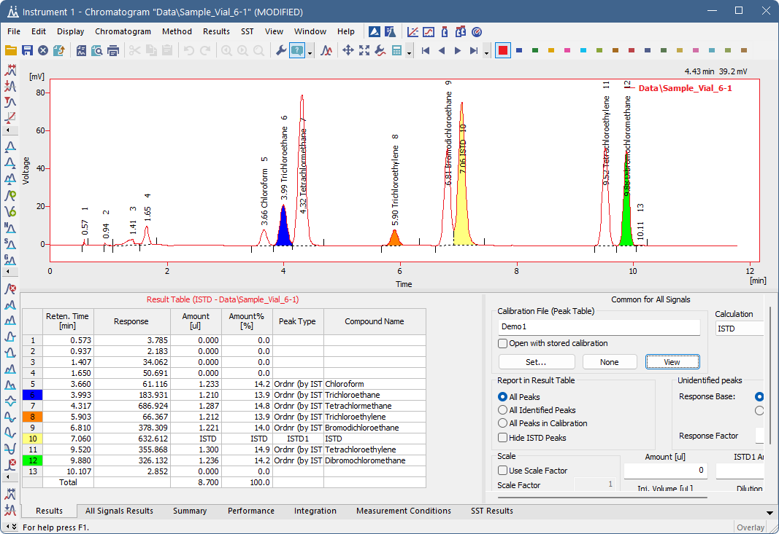
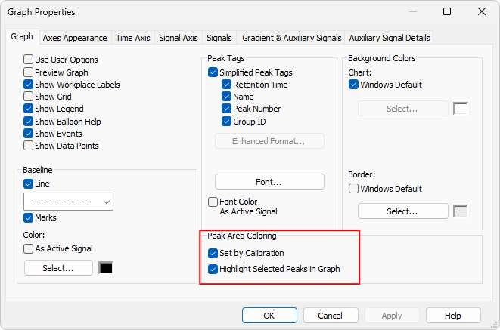
Chromatogram window
Peak colors
Set via Calibration,
Set peak area coloring via Graph Properties
ADVANCED TRAINING / CHROMATOGRAM WINDOW / PEAK COLORS

Slide 23
agenda
Chromatogram window
  Column setup, User columns, Noise & Drift
  Mathematical operations, Labels
  Result table, User variables
  Summary table, Performance table
  Force peak name, Peak coloring, Graph properties
Calibration
  LOD, LOQ
  Calibration Options, Manual Calibration
  Details of Calibration Point
  Bracketing and Standard Addition
Calculations
  ISTD, Normalized %
Groups
ADVANCED TRAINING

Slide 24
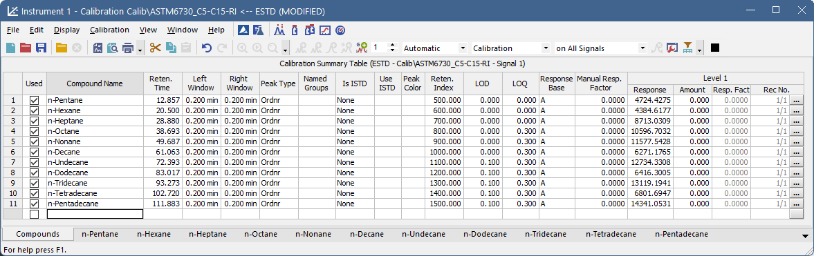
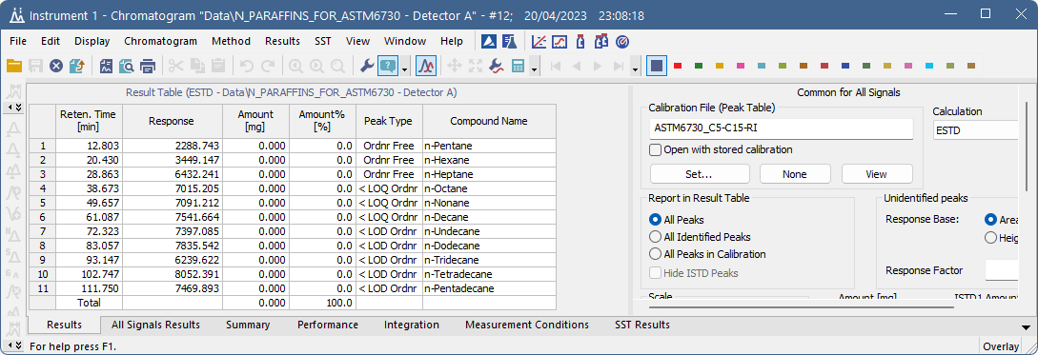
CALIBRATION
LOD, LOQ
Limit of Detection (LOD) and Limit of Quantification (LOQ) – amounts lower than LOD/LOQ specified in calibration are marked accordingly in chromatogram Peak Type
ADVANCED TRAINING / CALIBRATION / LOD, LOQ

Slide 25

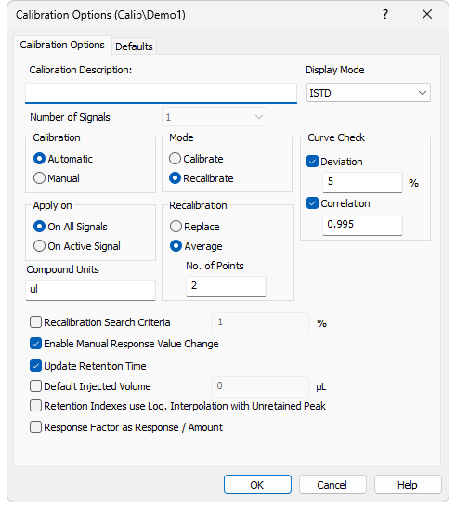
Calibration
Calibration options
Open via Calibration – Options or Calibration Options button
Display Mode – related to calculation types: ESTD, ISTD, NORM, STDADD
Calibration curve check – threshold used for the Failure message in Result Table – Peak Type
Automatic/Manual calibration
ADVANCED TRAINING / CALIBRATION / CALIBRATION OPTIONS

Slide 26
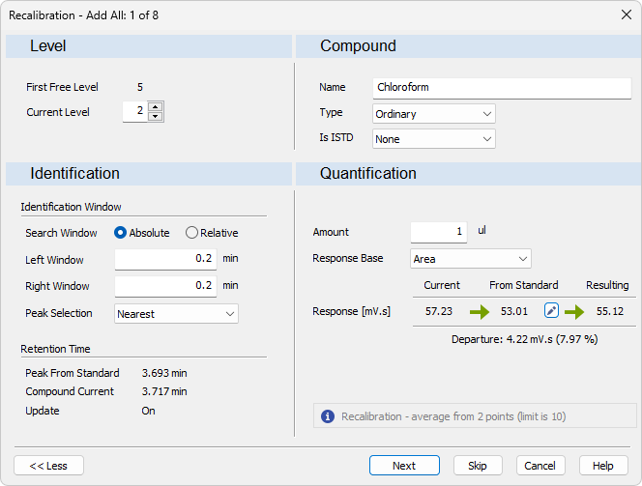

Calibration
Manual calibration
Accessible when adding points to calibration if Manual calibration is selected in Calibration Options
You can edit:
  Calibration level
  Identification criteria
  Compound information
  Response options (Area, Height, or Area %)
Manual response adjustment
ADVANCED TRAINING / CALIBRATION / MANUAL CALIBRATION

Slide 27


Calibration
details OF Calibration point
When recalibrating a level using more points, you can view calibration point details for selected level (accessible also via Calibration – Show Details)
Checkbox state – include/omit from calibration
ADVANCED TRAINING / CALIBRATION / DETAILS OF CALIBRATION POINT

Slide 28


Calibration
BRACKETING AND STANDARD ADDITION
Calibration in Method is used according to the Sequence Options – Calibration and sequence usage option
Name of calibration clone used if the method selected in Calibration and sequence usage supports cloning
ADVANCED TRAINING / CALIBRATION / BRACKETING AND STANDARD ADDITION

Slide 29


Calculations
ISTD
Up to ten ISTD compounds can be present in the calibration/sample
2 types of ISTD calculations available:
  Any amount of ISTD (both calibration and sample chromatogram contain the used ISTD amount)
  Same amount of ISTD in samples and standards (ISTD amount = 0 in both locations)
ADVANCED TRAINING / CALCULATIONS / ISTD

Slide 30

Calculations
Normalized %
Amount % column contains the normalized percentage if all integrated peaks are calibrated
If the Sample Amount is 0, compounds in the Amount % column add up to a total of 100%
Otherwise, the value serves as the total sum of Amount %, and values in the Amount % column are normalized to the Amount set
NORM is the same as ESTD, except it additionally checks that both all identified peaks are calibrated, and all peaks from calibration are identified in the sample chromatogram
ADVANCED TRAINING / CALIBRATION / NORMALIZED %

Slide 31


GROUPS
CREATING A GROUP
Set group ID and add peaks to the group
Add group in Calibration – set name and amount as for an ordinary peak
ADVANCED TRAINING / GROUPS / CREATING A GROUP

Slide 32
Short break

