Slide 1
P029/70A
2.5.2016
Clarity 7.0
WhaT‘s new

Slide 2
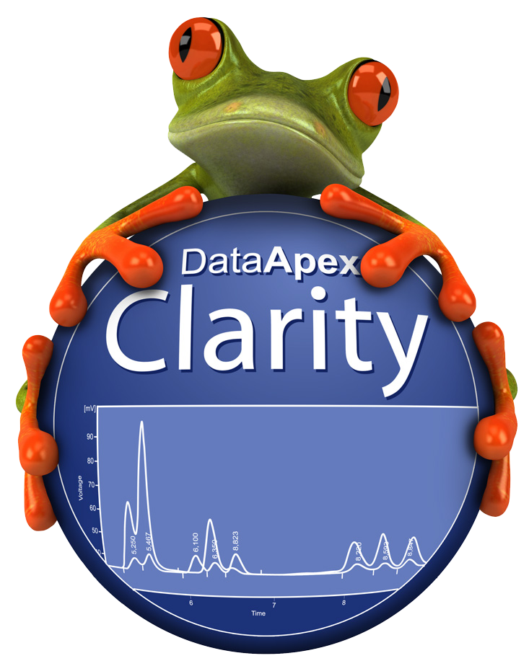
New Features in Clarity 7.0
Simplified installation structure
Custom units
User defined variables
Single Analysis supports
  injection by AS
Improved batch
New control modules

Slide 3

Installation
structure
Custom
units
User defined
variables
AS in single analysis
Improved
batch
New control modules
With Clarity 7.0 we deliver to you a totally reorganized installation structure.
How will you benefit?
Datafiles conveniently stored in one location
Easier backup
Well-arranged installation structure

Slide 4
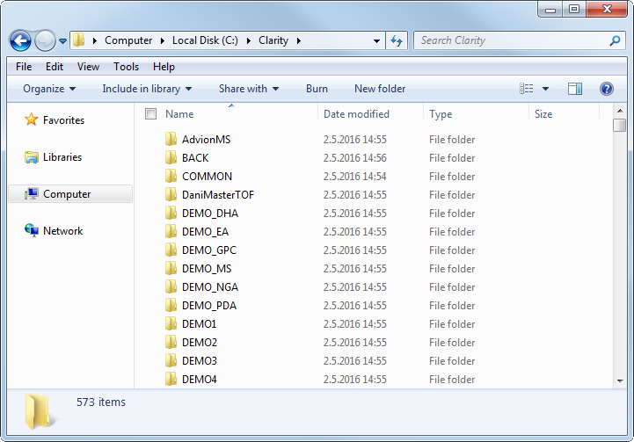
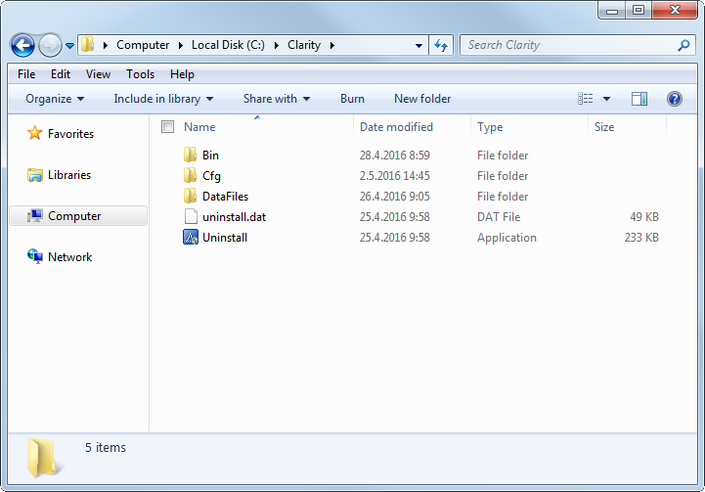
Installation
structure
Custom
units
User defined
variables
AS in single analysis
Improved
batch
New control modules
Clarity up to 6.2:
Binary files, configurations and data files all mixed up in one directory
Clarity 7.0:
All files sorted in relevant sub-directories

Slide 5
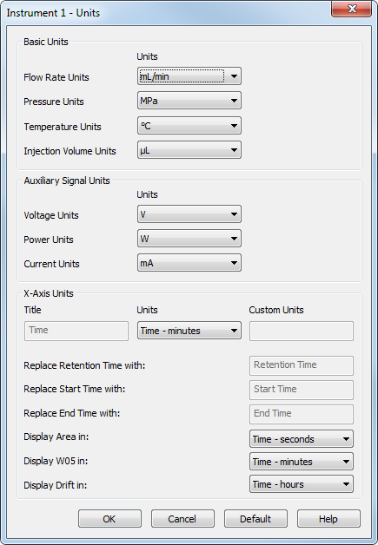
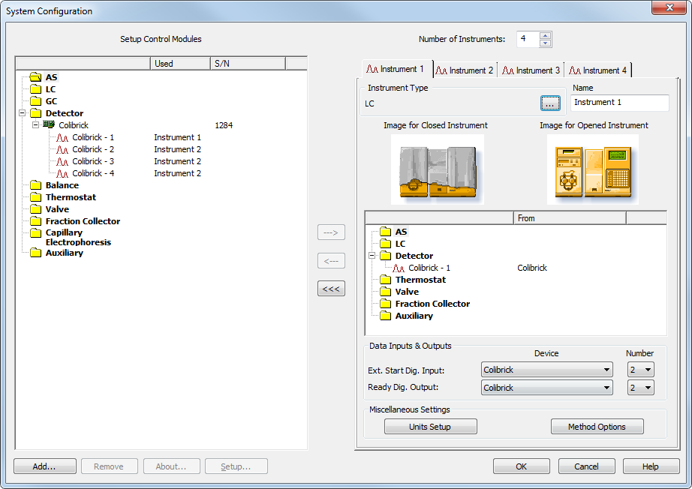

Installation
structure
Custom
units
User defined
variables
AS in single analysis
Improved
batch
New control modules
Units setup:
Set globally per instrument
Available setup from main Clarity window or from System Configuration

Slide 6
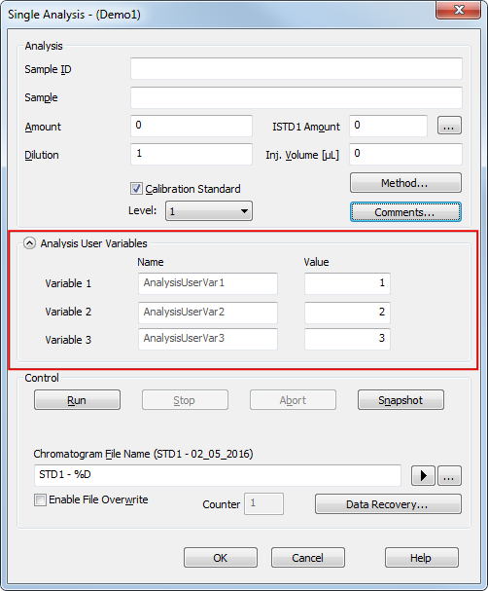
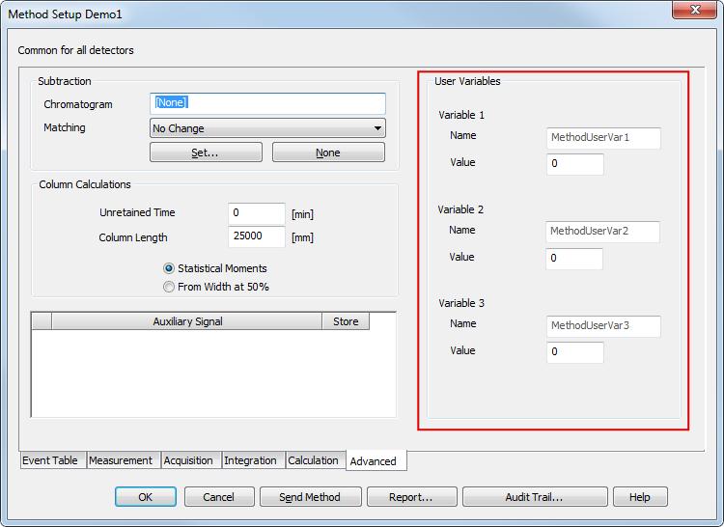
Installation
structure
Custom
units
User defined
variables
AS in single analysis
Improved
batch
New control modules
Newly implemented user defined variables can be used for further custom calculations
Advanced tab of method setup – variables are copied to the measured chromatogram
Available for Single Analysis and Sequence

Slide 7
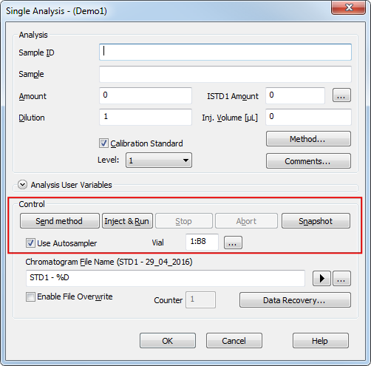
Installation
structure
Custom
units
User defined
variables
AS in single analysis
Improved
batch
New control modules
Single Analysis now supports injection via directly controlled autosampler

Slide 8
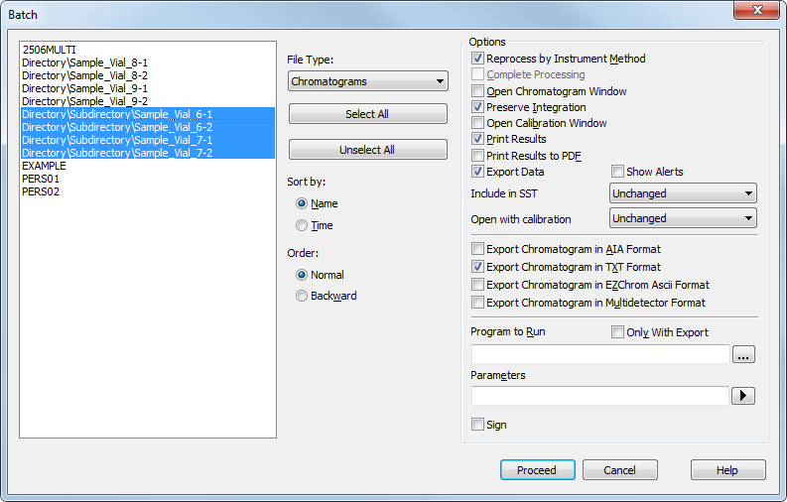
Installation
structure
Custom
units
User defined
variables
AS in single analysis
Improved
batch
New control modules
Batch dialog now supports reprocessing of files in subdirectories

Slide 9
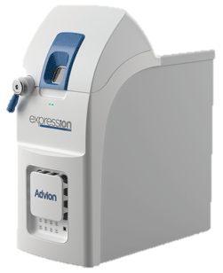
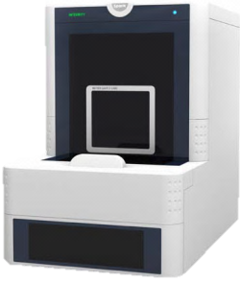
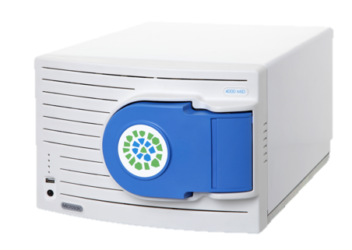
Installation
structure
Custom
units
User defined
variables
AS in single analysis
Improved
batch
New control modules
Microsaic 4000 MiD
Spark Integrity autosampler
Various control modules are updated
  Advion Expression CMS

Slide 10
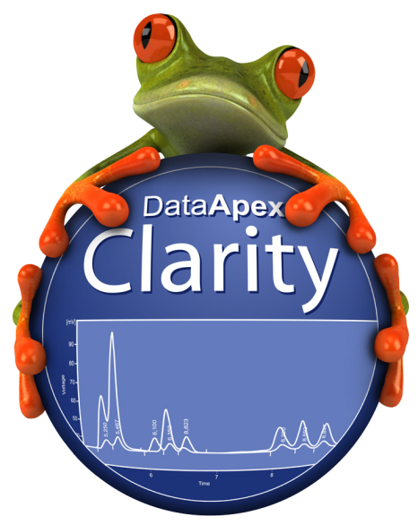
Thanks for your attention
More information about Clarity and DataApex at:
www.dataapex.com
For technical support contact us at:
support@dataapex.com

