Slide 1
NGA – NATURAL GAS ANALYSIS
CLARITY EXTENSION

Slide 2
NGA Extension
Overview
Natural or LPG Gas Analysis
Calculates the Calorific values according to
  Natural Gas ISO 6976-16 (and 95)
  Natural Gas ASTM D 3588-98 and GPA 2172-09
  LPG ASTM D 2598-02 / 2421-02
  LPG ISO 8973-97 / EN589-04
Multiple detectors supported
Individual or Summary results
Export of results
https://www.dataapex.com/product/extensions-NGA
NGA Extension / Overview

Slide 3
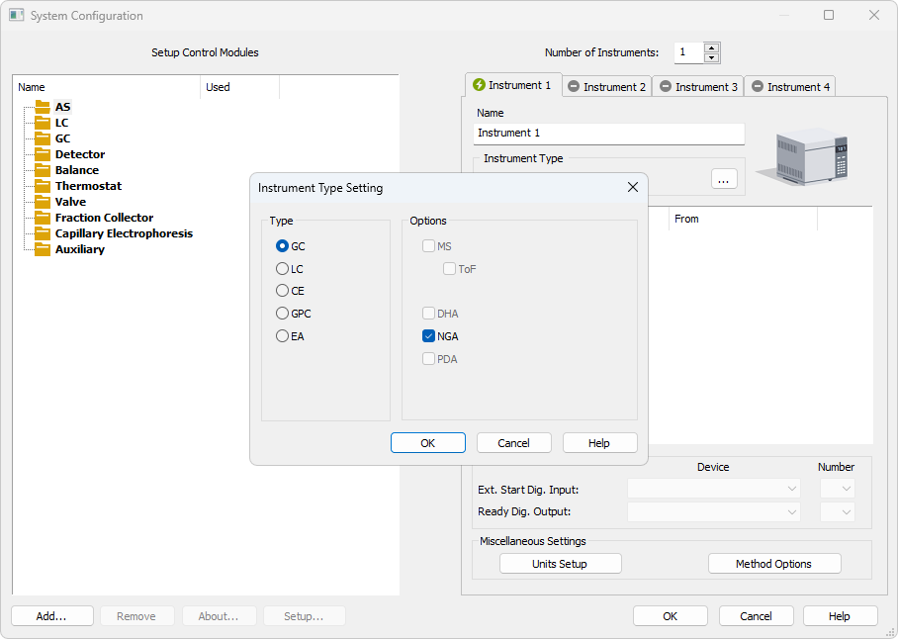
System Configuration
NGA Instrument is configured in the System Configuration window
NGA can be enabled on a station where p/n A32 is purchased
NGA Extension / System Configuration

Slide 4
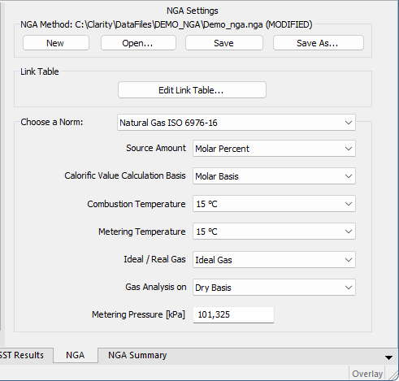
Settings on the NGA tab
NGA Result tab in the chromatogram window
Select the NGA method
Edit Link Table...
Choose a Norm and set preferences
NGA Extension / Settings on the NGA tab

Slide 5
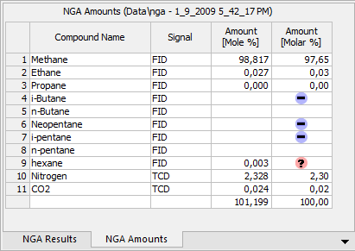
NGA amounts
Display the amounts and Amount% calculated over all signals
Shows warnings for individual compounds:
  Compound name not found in NGA table
  Compound not used in selected norm
  The same compound used on several signals
NGA Extension / NGA Amounts

Slide 6
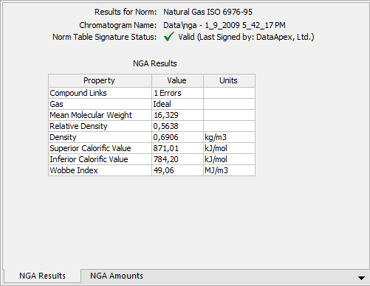
NGA Results
Shows the calculated results
Shows the method and norm info
NGA Extension / NGA Results

Slide 7
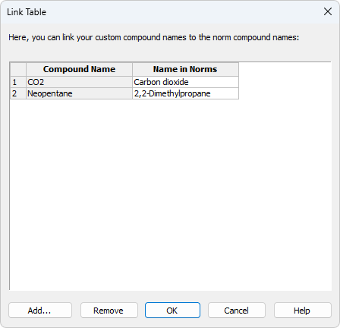
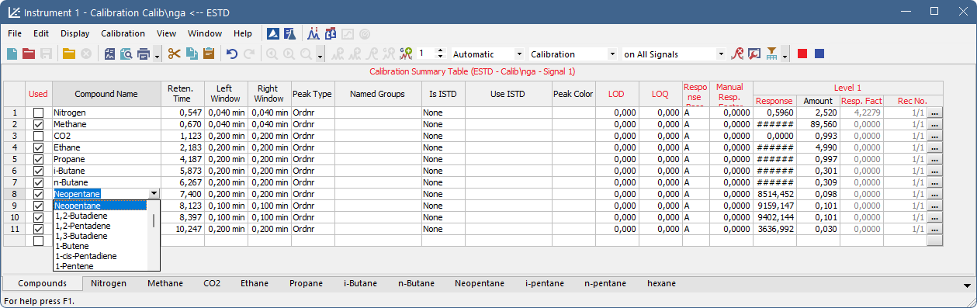
Nga Calibration
Compound names from the NGA Norm table are offered in calibration
In the Link Table you can link different names to the compounds listed in the norm
In multisignal chromatograms each compound could be used on one signal only
NGA Extension / NGA Calibration

Slide 8
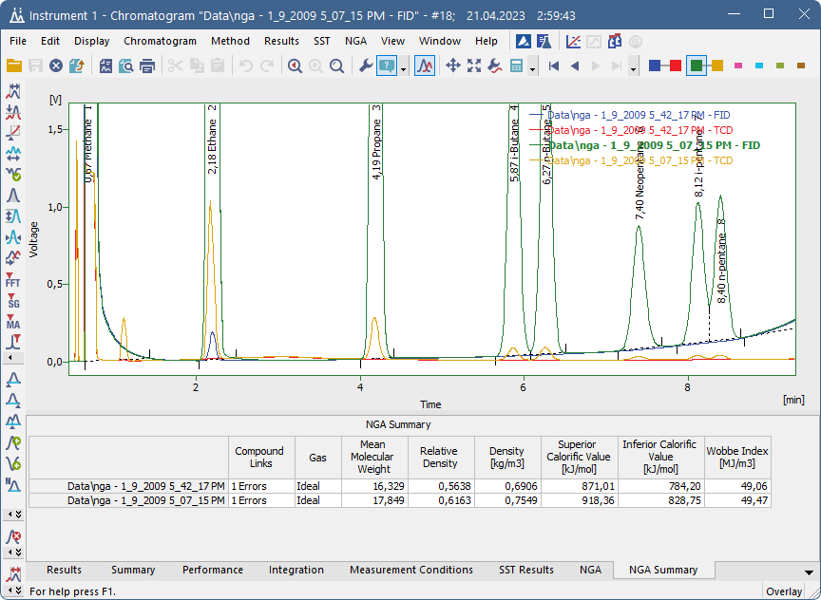
NGA Summary
NGA results are shown for all chromatograms in overlay
NGA Extension / NGA Summary

Slide 9
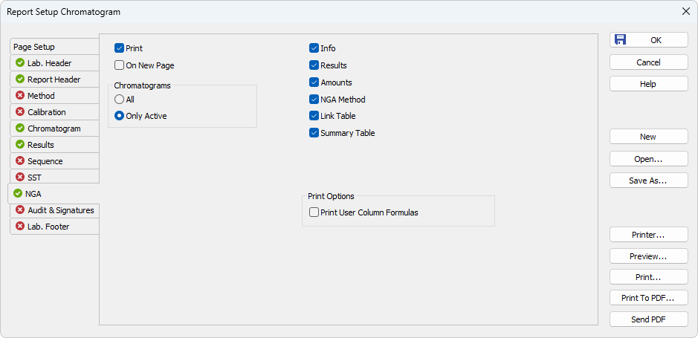
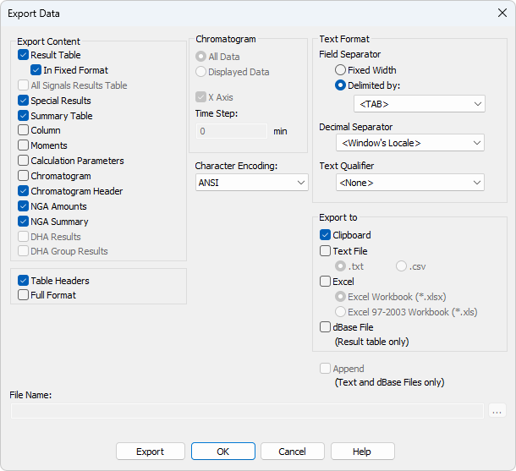
NGA Reports & Exports
Options for NGA in the Report Setup and in the Export Data windows
NGA Extension / NGA Reports & Exports

Slide 10
Thank you for your attention

