Slide 1
Launch Manager
Variable Configuration

Slide 2
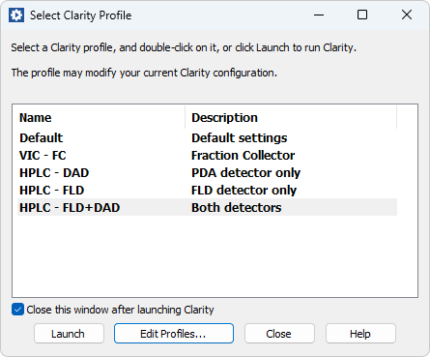
Launch Manager
Overview
Enables to use Clarity with different hardware configurations
Can be located by Windows Search
Can be started by LaunchManager.exe Clarity \Bin\ subfolder
Settings are stored in a dedicated file
(...\Cfg\Profiles.ini)
Launch Manager

Slide 3
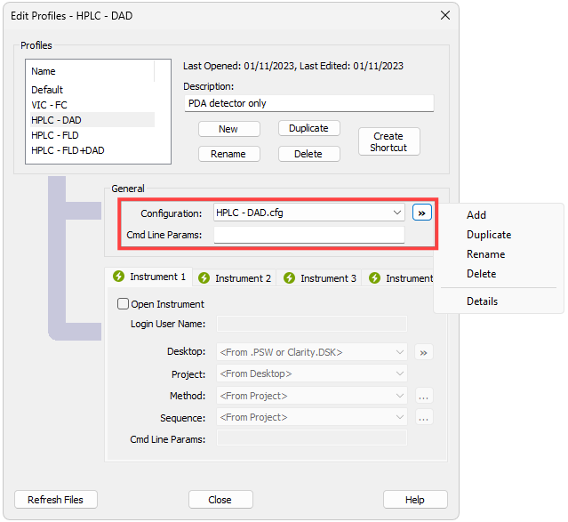
General Settings
Enables to maintain multiple configuration files (*.cfg)
  Configuration can be modified from the Clarity System Configuration dialog only
  Using a specific configuration file (*.cfg) requires entire Clarity station restart
Useful for:
  Agilent/Hitachi HPLC system with multiple detectors using only one or both
  Advanced autosamplers (HTA, CTC) – switching between LC, GC, liquid‚ headspace modes
Command line parameters to be applied with Clarity launch can be set
Launch Manager

Slide 4
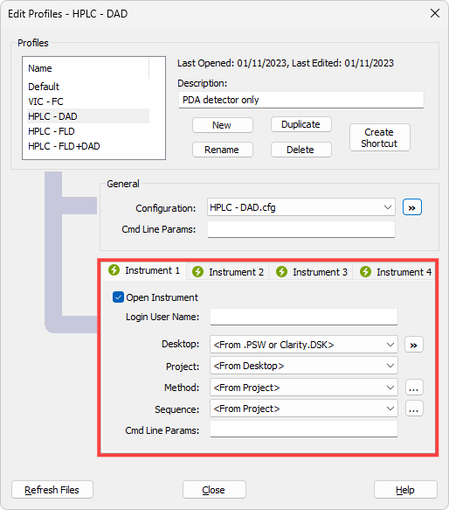
Instrument-Specific Settings
Enables to open Clarity Instrument with predefined variable presets – desktop, project, method, sequence, and command line parameters
Clarity can be already running when opening Instrument with different settings (desktop, project, method, sequence)
Using specific configuration file (*.cfg) requires entire Clarity station restart
Launch Manager

Slide 5
Thank you for your attention

