Slide 1
troubleshooting

Slide 2
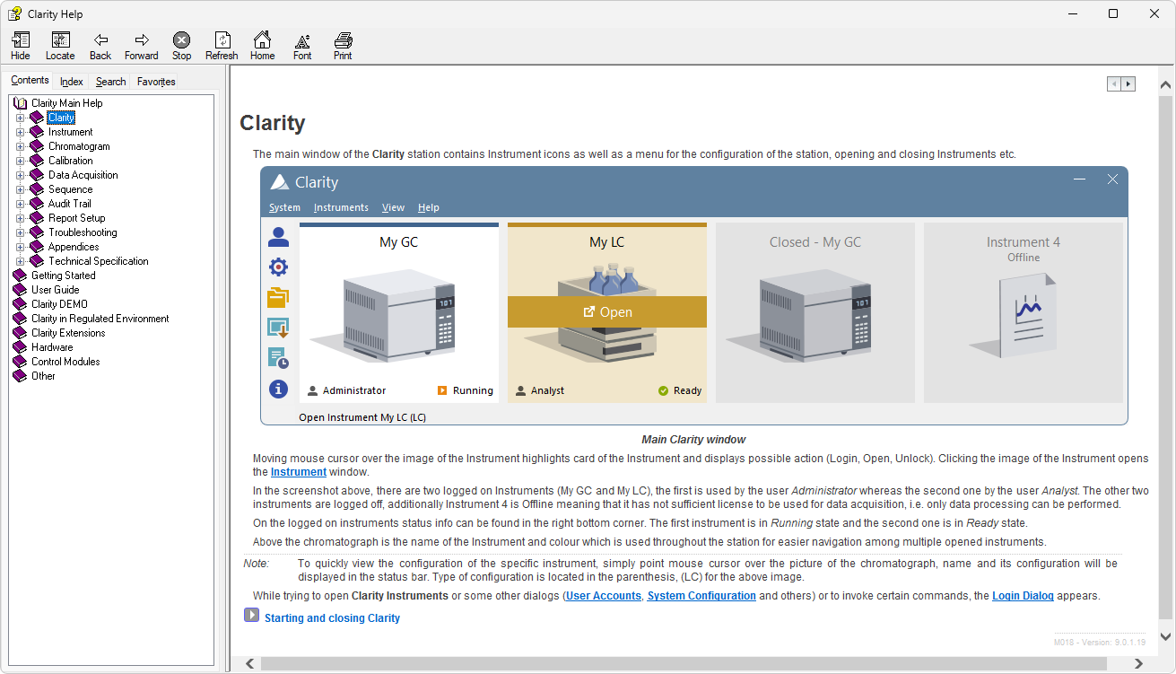
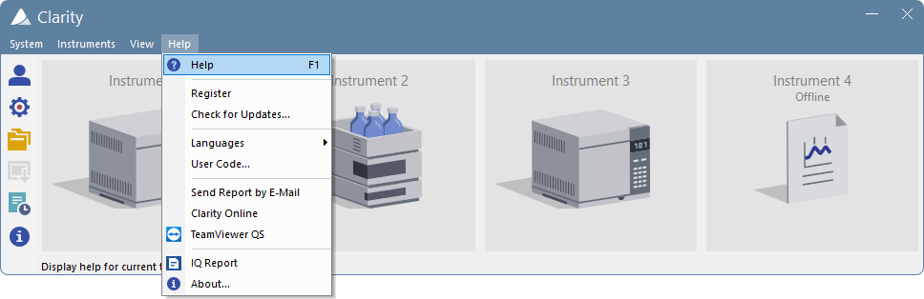
Context help
F1 = help with related topic
TROUBLESHOOTING / CONTEXT HELP

Slide 3
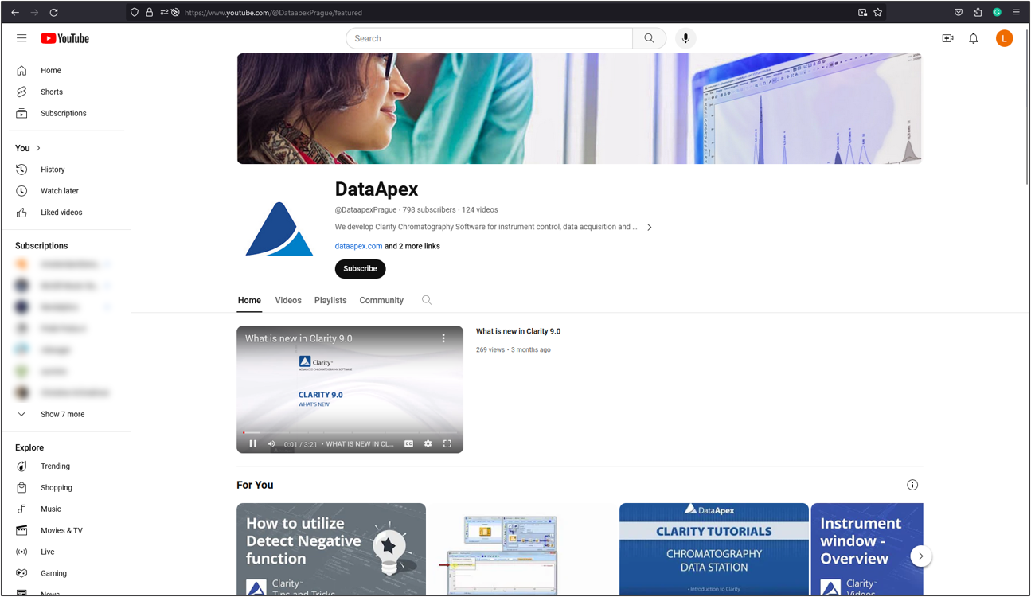
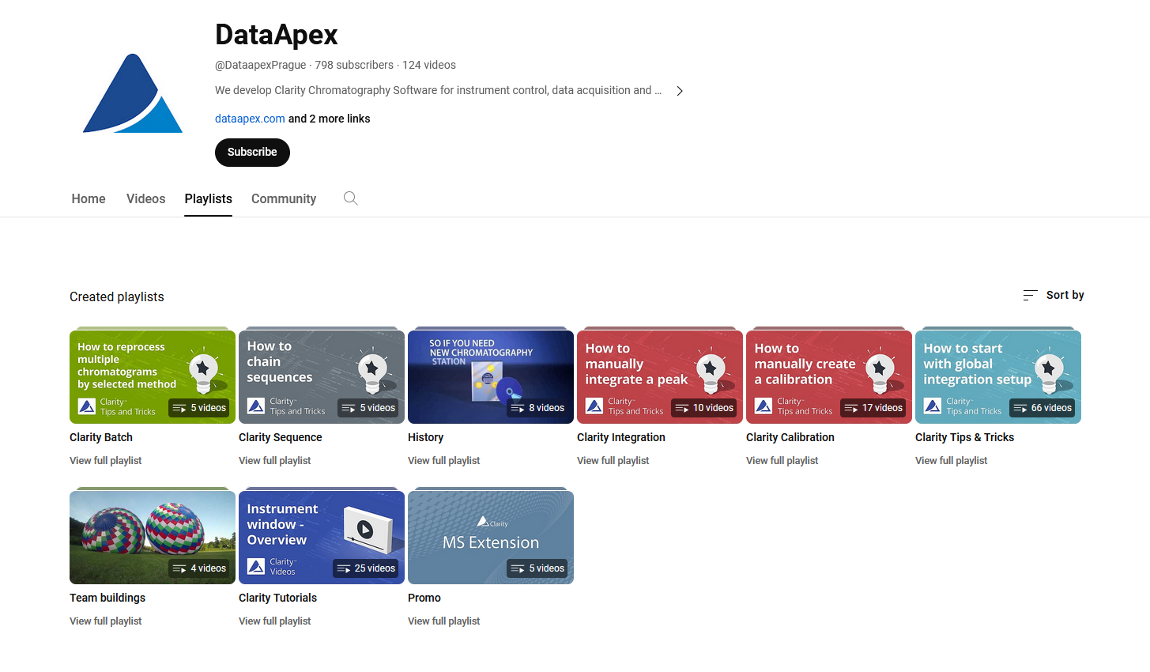
Youtube
Many helpful detailed video tutorials
Direct demonstration of how to efficiently perform complex tasks
TROUBLESHOOTING / YOUTUBE

Slide 4
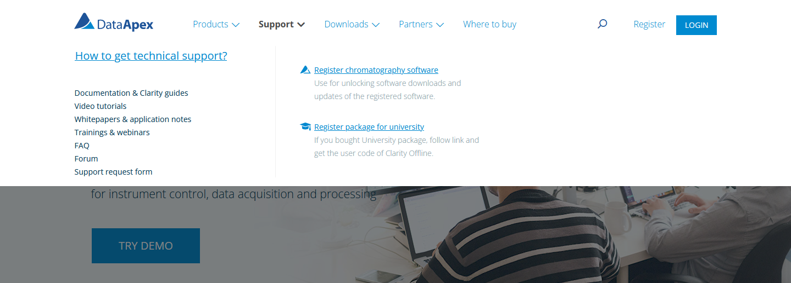
Information on our website
FAQ
Manuals
Video Tutorials
Online documentation
TROUBLESHOOTING / INFORMATION ON WEB

Slide 5

Support request
Only the last two major versions are supported for free (station registration required)
Form on the website https://www.dataapex.com/document/support
Directly to support@dataapex.com
  Station serial number
  Files according to D013 Clarity Support Note datasheet
  Detailed description: What is the goal? What were the last performed steps?
D013 - https://www.dataapex.com/downloads/26026/view
TROUBLESHOOTING / SUPPORT REQUEST

Slide 6
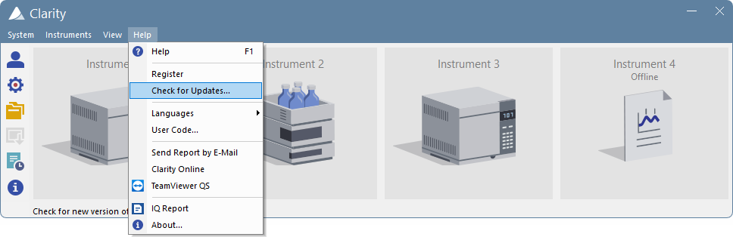
Support request
updates
Check for the updates
Send report by e-mail (Outlook)
TROUBLESHOOTING / SUPPORT REQUEST

Slide 7
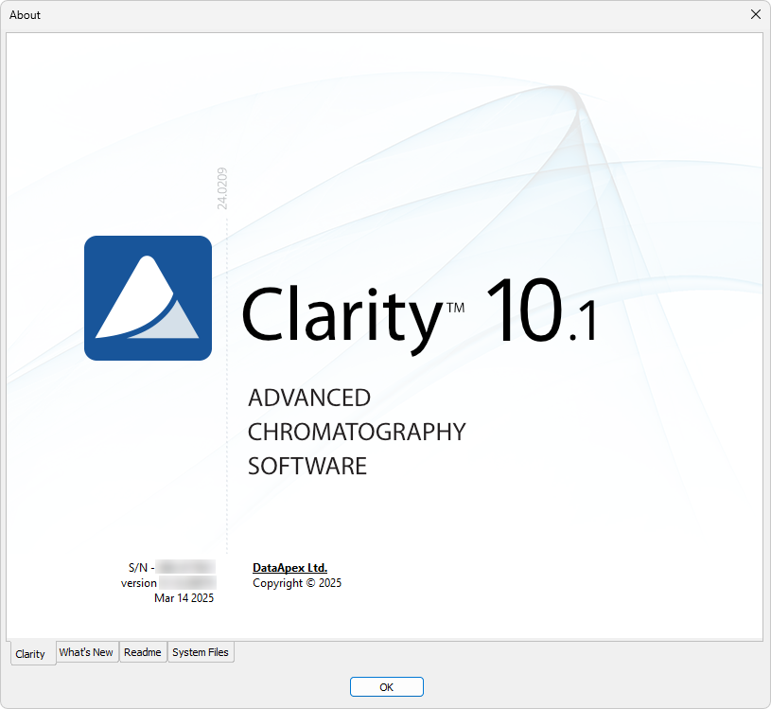
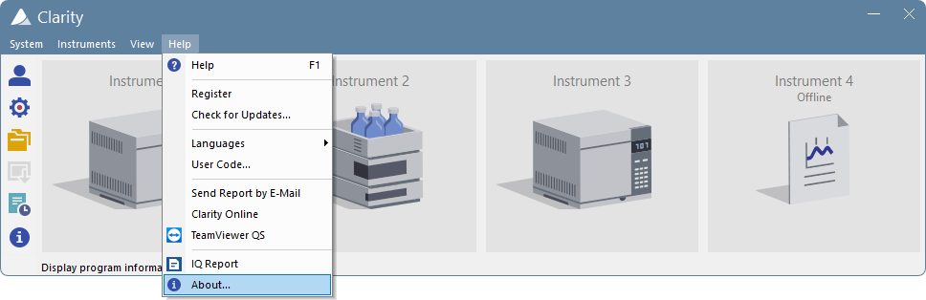
Support request
about
Information about station
  Serial number (s/n)
  Version
  Installed files
TROUBLESHOOTING / SUPPORT REQUEST

Slide 8
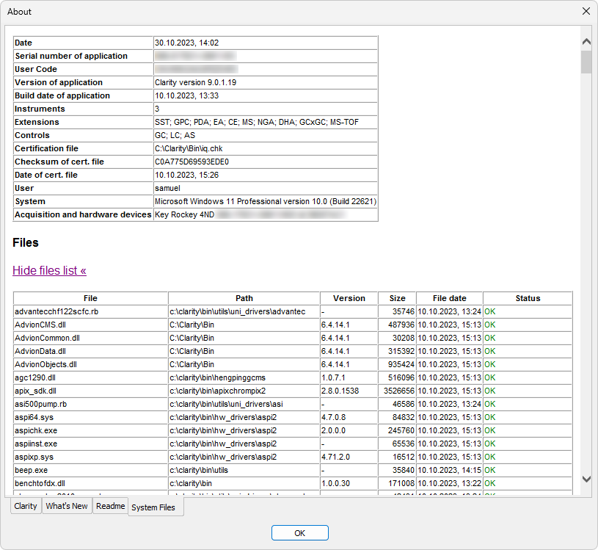
Support request
About – system files
≈ Systeminfo.txt
TROUBLESHOOTING / SUPPORT REQUEST

Slide 9
Support request
Diagnostic files
Folder | File | Meaning
Cfg | Systeminfo.txt | Installed Clarity version and components
Cfg | Clarity.cfg | Configuration and system settings
Cfg | Clarity.dsk | User preferences and settings
Cfg | Clarity.psw | User accounts
Cfg\Debug_Logs | BadTrace.txt + *.dmp files | Diagnostic files – only present after some problems
Cfg\Debug_Logs\PgmLog | *.log files | What was performed on/by station (more detailed than audit trail)
Cfg\Audit_Trails | yyyy_mm_dd.audit | Created daily – what was performed on/by station
D013 - https://www.dataapex.com/downloads/26026/view
TROUBLESHOOTING / SUPPORT REQUEST

Slide 10
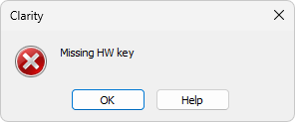
Problems related to hw key
Missing hw key
HW key missing – Check if it is properly inserted in USB port
USB port faulty – Check with another USB device
HW key faulty – Check the diode (blinking/lit/dim?)
HW key driver not installed properly – Check Device manager (only older RkUSB keys)
TROUBLESHOOTING / PROBLEMS WITH HW KEY / MISSING HW KEY

Slide 11
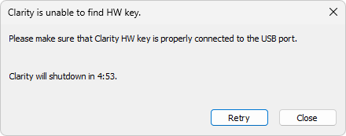
Problems related to hw key
Clarity is unable to find Hw key
HW key unplugged while Clarity is running
USB port entering sleep mode
TROUBLESHOOTING / PROBLEMS WITH HW KEY / UNABLE TO FIND HW KEY

Slide 12
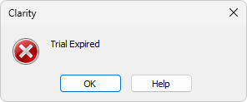
Problems related to user code
Trial expired
Trial code period has expired – Ask for prolongation or enter user code
User code was not entered during installation and HW key does not have trial enabled
TROUBLESHOOTING / PROBLEMS WITH USER CODE / TRIAL EXPIRED

Slide 13
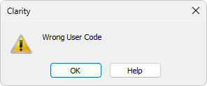
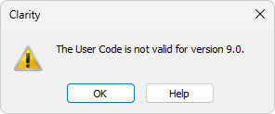
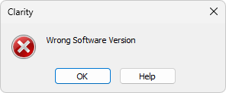
Problems related to user code
Wrong user code/Version
User code was mistyped
User code belongs to another station (HW key)
User code belongs to the station (HW key) but isn’t valid for installed version (8.x, 9.x, …)
User code isn’t valid for installed SW version (Clarity vs Clarity Lite etc.)
TROUBLESHOOTING / PROBLEMS WITH USER CODE / WRONG USER CODE/VERSION

Slide 14
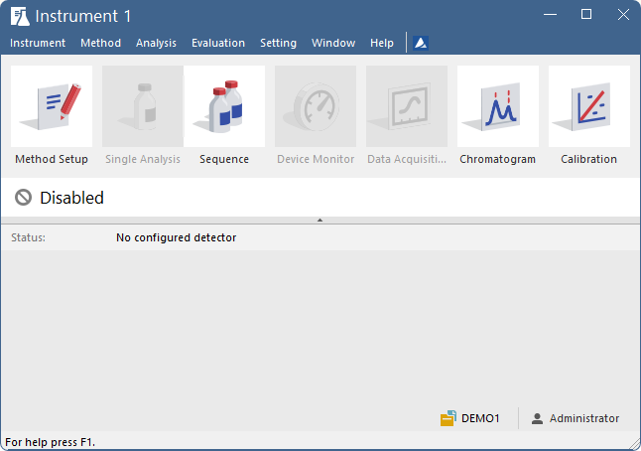
Problems related to Clarity
Disabled instrument
No detector was configured on the instrument
TROUBLESHOOTING / PROBLEMS WITH CLARITY / DISABLED INSTRUMENT

Slide 15
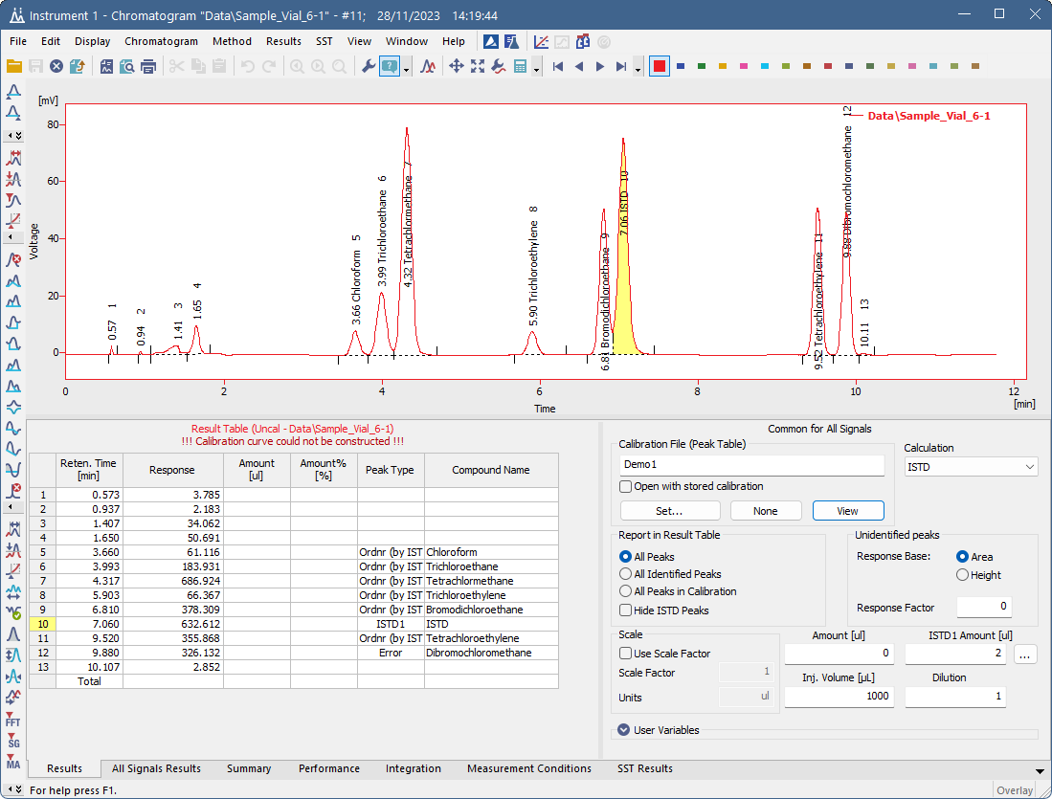
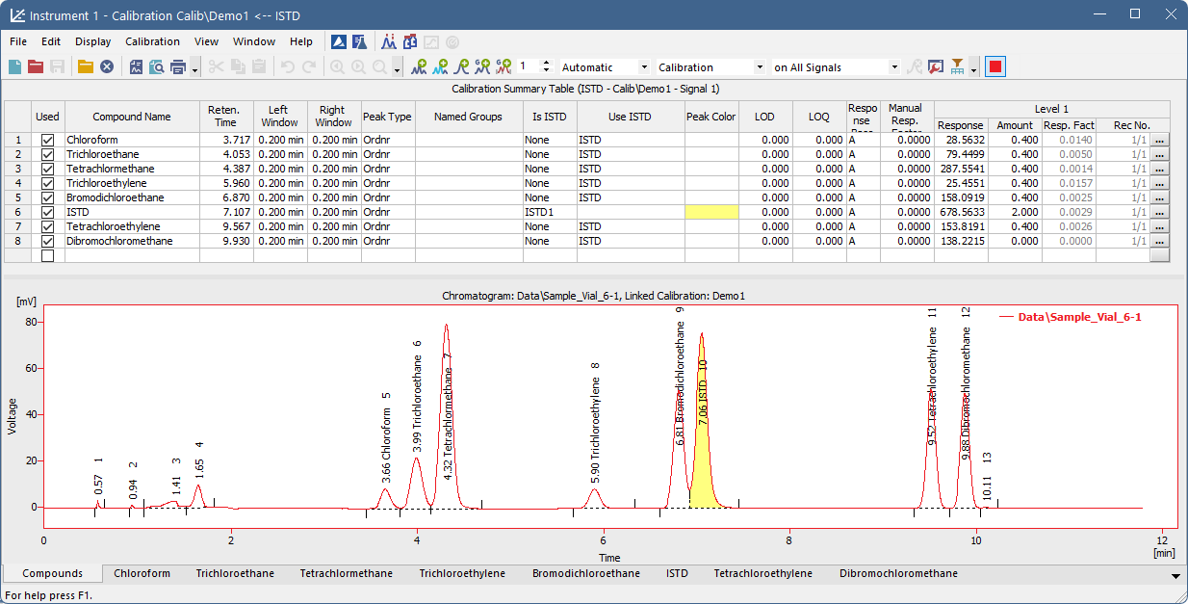
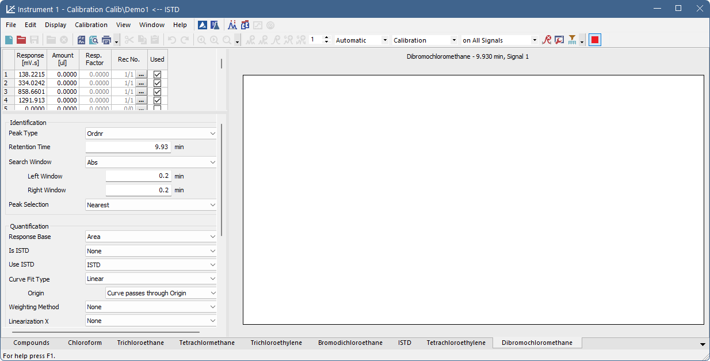
Problems related to Clarity
Calibration curve could not be constructed
At least one of the compounds does not have any amount filled in the calibration file
TROUBLESHOOTING / PROBLEMS WITH CLARITY / CALIBRATION CURVE COULD NOT BE CONSTRUCTED

Slide 16
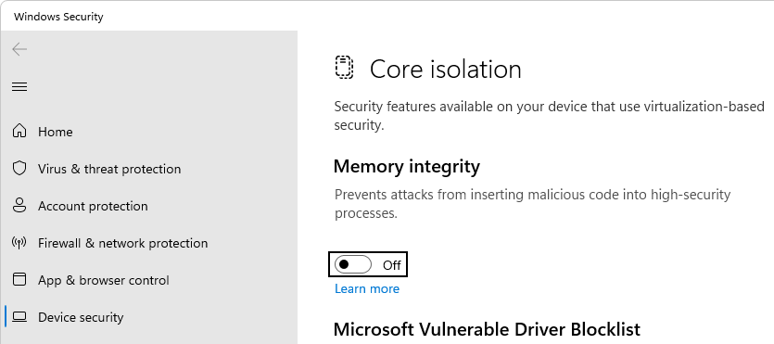
Computer settings
User access rights
  Must have Read/write access to all Clarity folders
  Install Clarity from intended user account using “Run as administrator”
Power-saving
  Disable sleep mode
Windows updates
  Prevent automatic updates – may cause restart during overnight runs
Windows user switching
  Avoid while Clarity is running
Memory integrity
  Turned on on new Windows 10/11
  Blocks some USB drivers (Old RkUSB key, Primaide, U-PAD2…)
  Won’t turn on if the driver is already present (update is safe)
TROUBLESHOOTING / COMPUTER SETTINGS

Slide 17
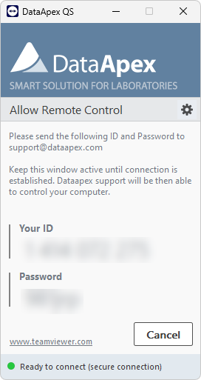
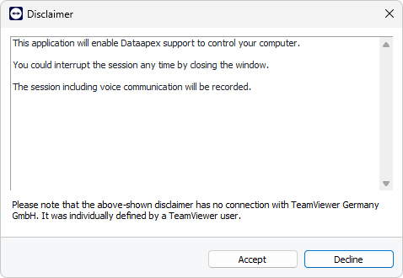
Remote support
teamviewer
Arrange session with the time zones in mind - Prague time is UTC+1 (UTC+2 in summer)
Do NOT close the QS utility during the support
Download TeamViewer Quick Support utility (27 MB) from: https://get.teamviewer.com/dataapexqs
TROUBLESHOOTING / REMOTE SUPPORT

Slide 18
Thank you for your attention

