Slide 1
Clarity TRAINING
Installation & configuration

Slide 2
content
Licensing & Software Protection
Installation
Registration
Station setup & configuration
INSTALLATION & CONFIGURATION / CONTENT

Slide 3

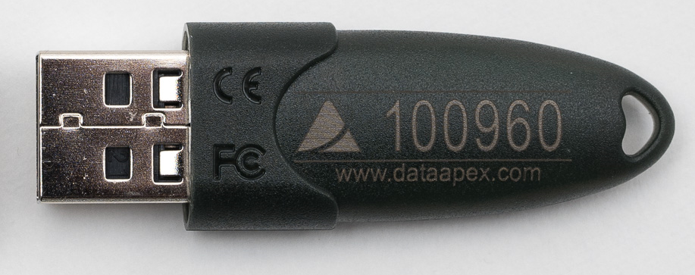
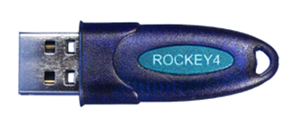
Software protection
One HW key required for each station (PC)
One Clarity station running per PC
Non-driver USB HW key is standard (other types are obsolete)
INSTALLATION & CONFIGURATION / SOFTWARE PROTECTION

Slide 4
Software protection
User code (16 position alphanumeric code) combined with the appropriate HW key (S/N yyyyyy) is required to operate Clarity (S/N xx-yyyyyy)
TRIAL option is available (HW key required) for potential customers' in‑house testing
Clarity rejects to start without a HW key plugged in
Clarity DEMO does not require a HW key
Important: Loss of the HW key is equal to a loss of the license!
INSTALLATION & CONFIGURATION / SOFTWARE PROTECTION

Slide 5
Installation – checklist
Installation medium (USB flash or installer)
All required cables for devices ready
Local IT Administrator support (depending on company IT policies)
Obey rule: „Install drivers first!“ before connecting hardware (mainly for USB connection)
  Connect devices to PC after installation of Clarity is successfully finished.
Get familiar how to configure all devices in Clarity
  Check with respective manuals (if available) - chapter „3.x Clarity Configuration“
  Get familiar how to wire complex system for correct synchronization (mainly when using A/D converter)
INSTALLATION & CONFIGURATION / INSTALLATION CHECKLIST

Slide 6
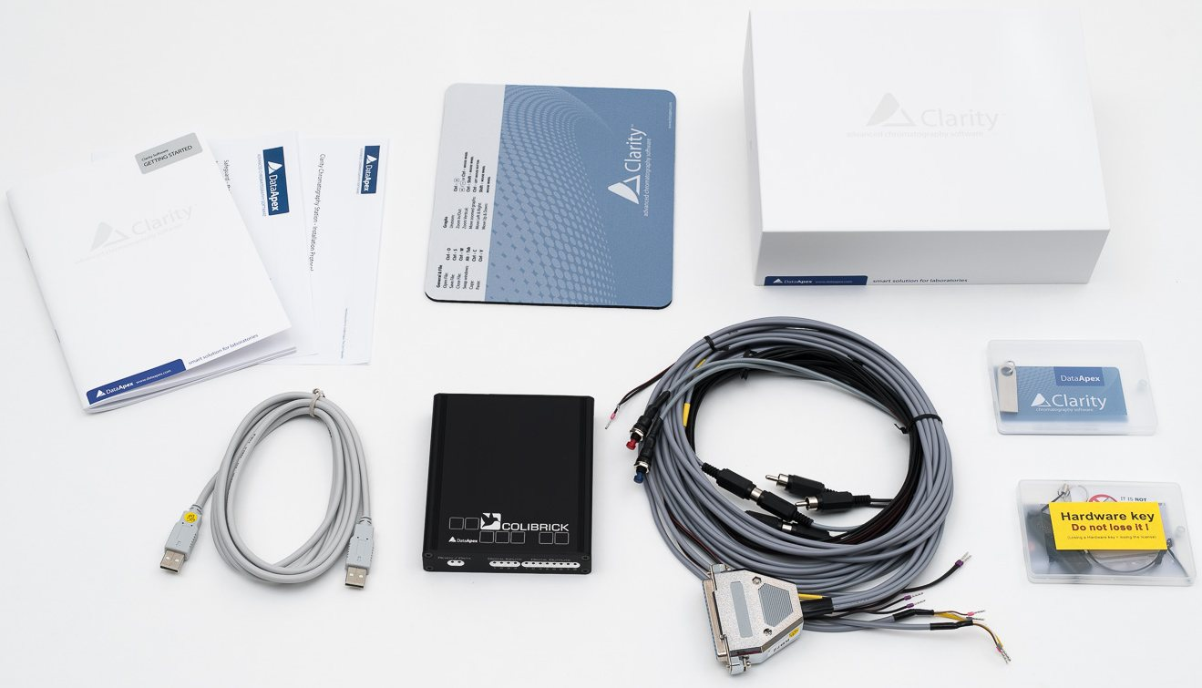
Installation – checklist
1. Hardware USB key
2. Installation USB with Clarity
3. Cables & wires (optional, order dependent)
4. A/D converter or another HW from DataApex portfolio
5. Documentation
5
2
4
3
3
1
INSTALLATION & CONFIGURATION / INSTALLATION CHECKLIST

Slide 7
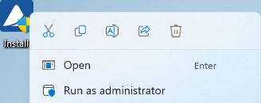
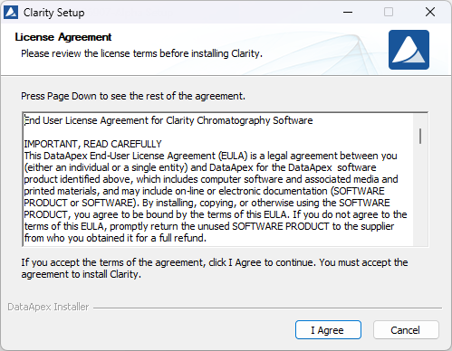
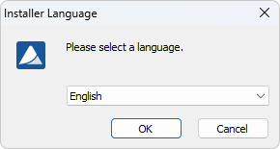
Installation
Clarity installer install.exe from USB or DataApex website (not applicable to OEM versions)
Use “Run as administrator“
Select language for installation
Confirm license agreement
Follow the guidance of the installer
Important: Do NOT connect any HW before installation (except for HW key)
INSTALLATION

Slide 8
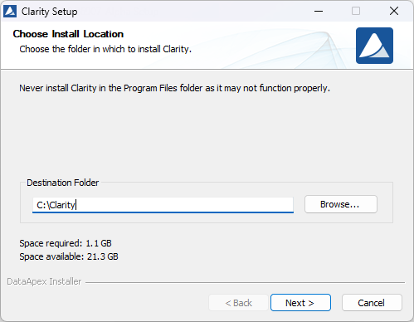
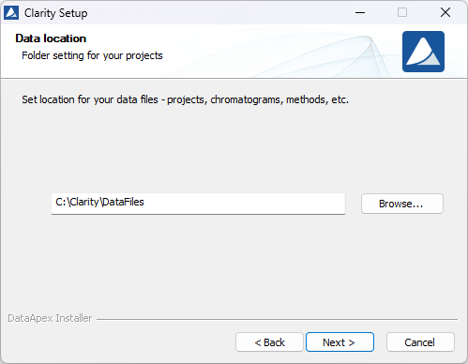
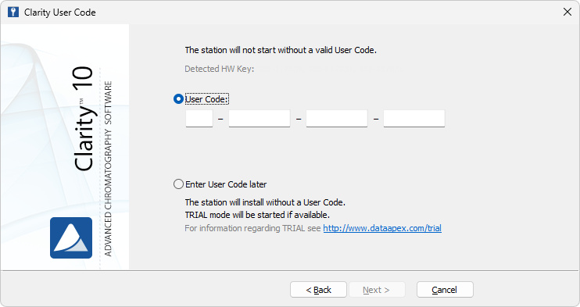
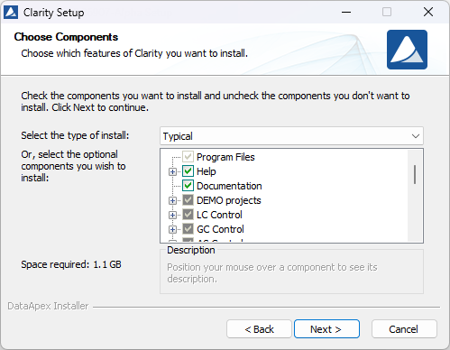
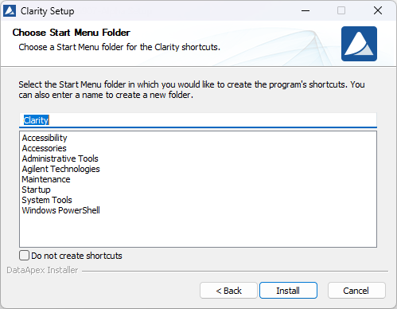
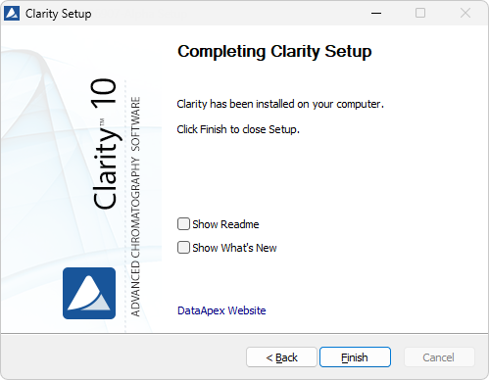
New installation
INSTALLATION / NEW INSTALLATION

Slide 9
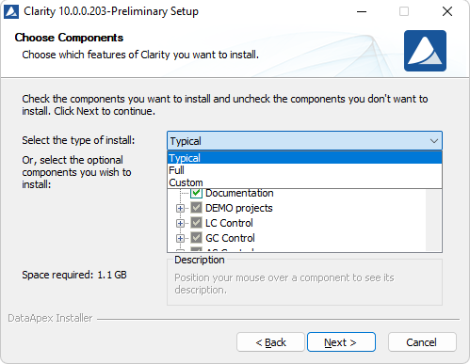
Types of installation
Typical installation is recommended
Some devices require additional parts – to be selected in the installation wizard e.g:
  Agilent HW (GC 8890…, Headspace AS, HPLC 1260/1290) → Instrument Control Framework (ICF)
INSTALLATION / TYPES OF INSTALLATION

Slide 10
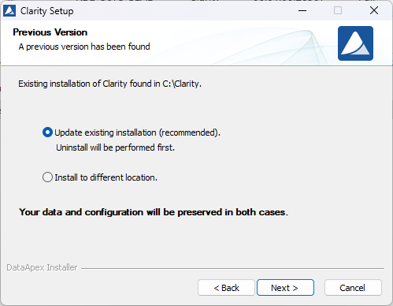
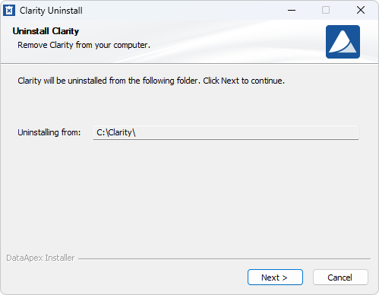
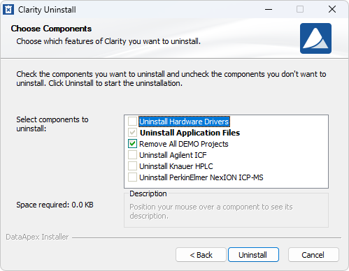
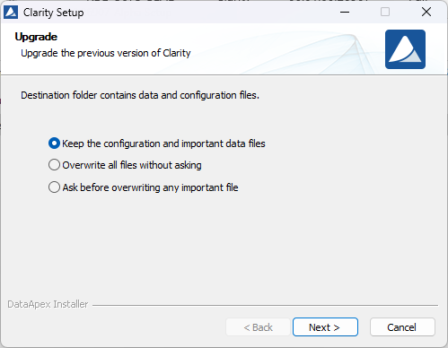
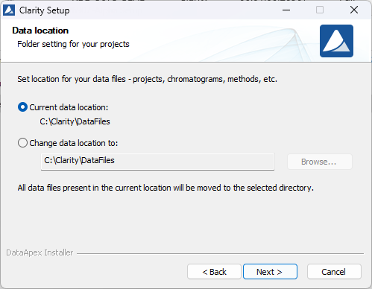
Update/Upgrade
Choose Components and the rest as new installation
INSTALLATION / UPDATE-UPGRADE

Slide 11
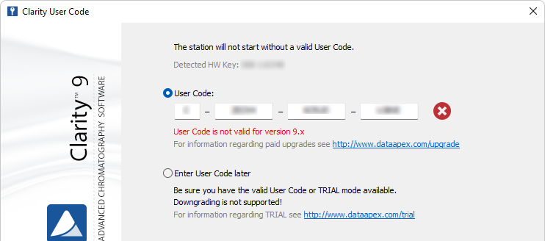
MAJOR VERSION UPDATES SINCE VERSION 9.0
Updates to major versions (change on the first digit place) are paid
  Validity of the entered user code is checked before installation
INSTALLATION / MAJOR VERSION UPDATES SINCE VERSION 9.0

Slide 12
A/D convertor connection
Connect hardware only after finishing the software installation
Electric connections – the shield on signal cable must be connected (The shield on the analog input DET cable serves as common ground)
The digital input and outputs could be used for the start and ready synchronization
INSTALLATION / A/D CONVERTOR

Slide 13
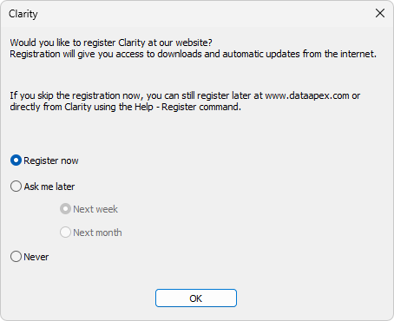
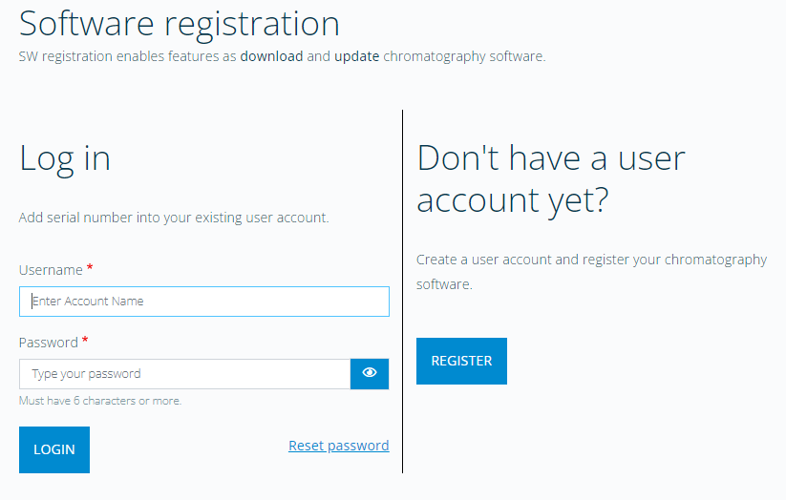
First start - registration
Appears after the very first start
Required for updates/upgrades and support
Can be done later on the DataApex website (also possible from different PC)
CONFIGURATION / REGISTRATION

Slide 14
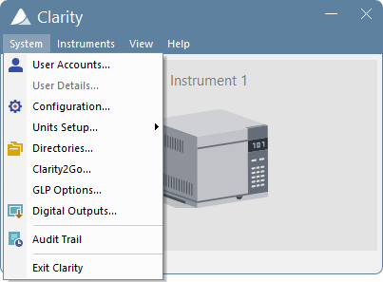
General settings
Valid for the entire station
  User Accounts
  Configuration (& Units Setup)
  Directories
  GLP Options
  Digital Outputs
CONFIGURATION / GENERAL SETTINGS

Slide 15
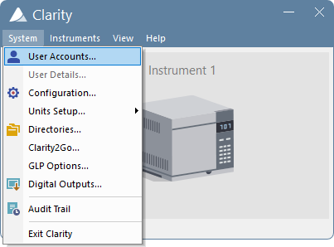

USER ACCOUNTS
CONFIGURATION / GENERAL SETTING / USER ACCOUNTS

Slide 16
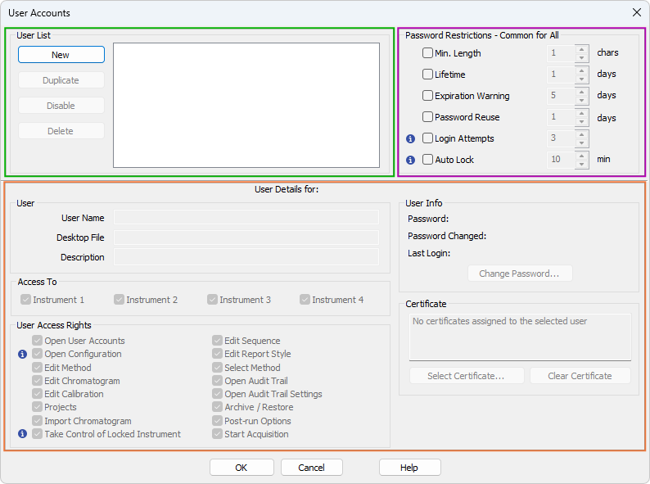
USER ACCOUNTS
Administration of user accounts
General settings of password rules
Setting of individual user privilages
CONFIGURATION / GENERAL SETTING / USER ACCOUNTS

Slide 17
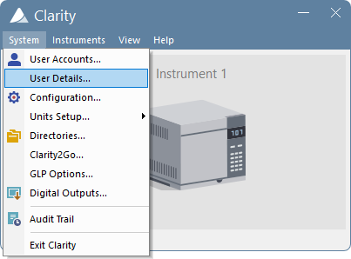
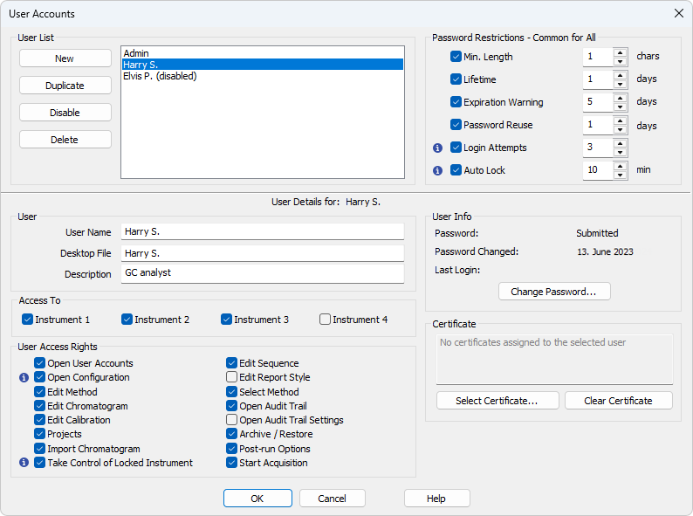
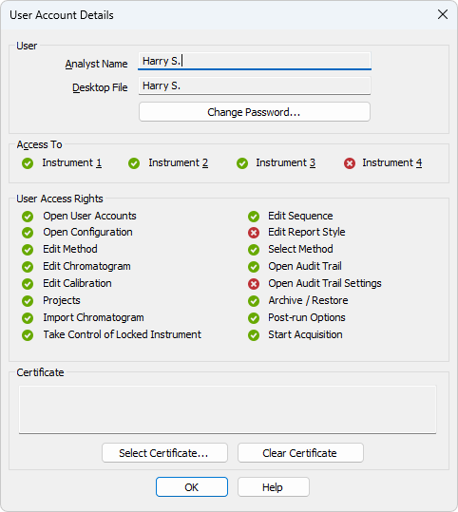
USER ACCOUNTS
CONFIGURATION / GENERAL SETTING / USER ACCOUNTS & USER DETAILS

Slide 18
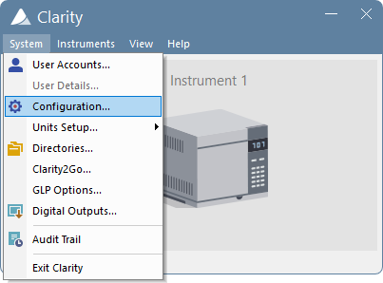
System COnfiguration
CONFIGURATION / GENERAL SETTING / SYSTEM CONFIGURATION

Slide 19
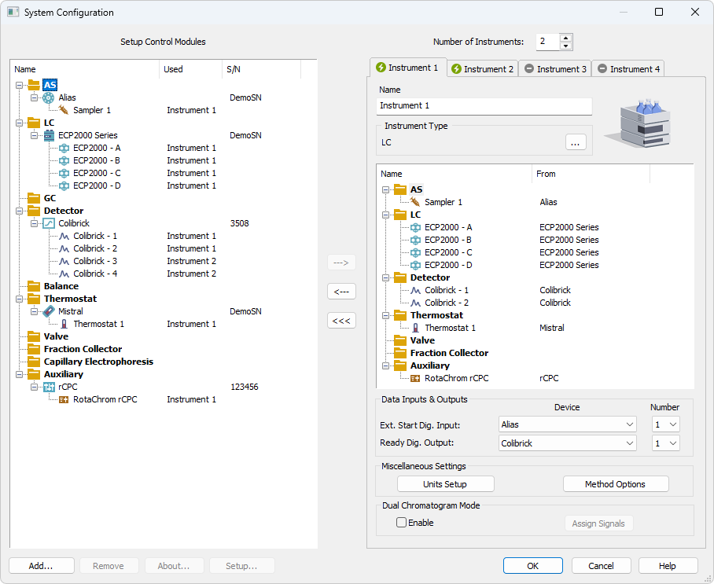
System COnfiguration
Link between HW and Clarity
Left side:
  List of set control modules
  Overview of assignments to Instruments
Right side:
  Instrument Type
  Control modules “on“ Instrument
  Synchronization of HW with Clarity
CONFIGURATION / GENERAL SETTING / SYSTEM CONFIGURATION

Slide 20
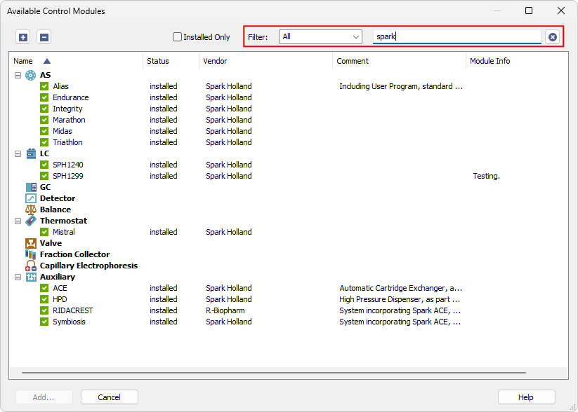
System COnfiguration
Available control modules
List of all available control modules
Search tool with filters
CONFIGURATION / GENERAL SETTING / SYSTEM CONFIGURATION

Slide 21
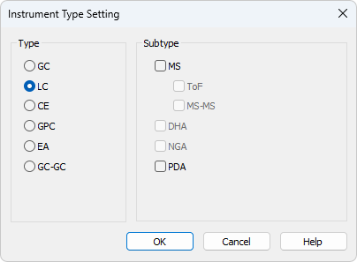
System COnfiguration
Instrument Type
Type enabled based on the User Code used
LC and GC by default
Switching ON the Extension
CONFIGURATION / GENERAL SETTING / SYSTEM CONFIGURATION

Slide 22
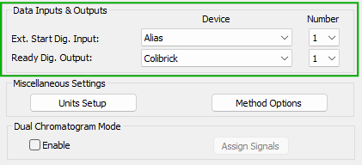
System COnfiguration
Data inputs & outputs
Synchronization of HW on Instrument with Clarity
Start Input – defines device that triggers analysis start
Ready Output – defines device that sets ready for next analysis (significant for Sequence)
CONFIGURATION / GENERAL SETTING / SYSTEM CONFIGURATION

Slide 23
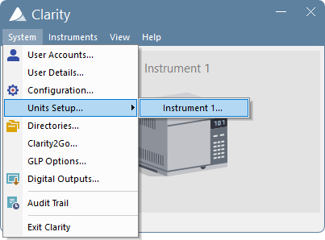
UNITs setup
CONFIGURATION / GENERAL SETTING / UNITS SETUP

Slide 24
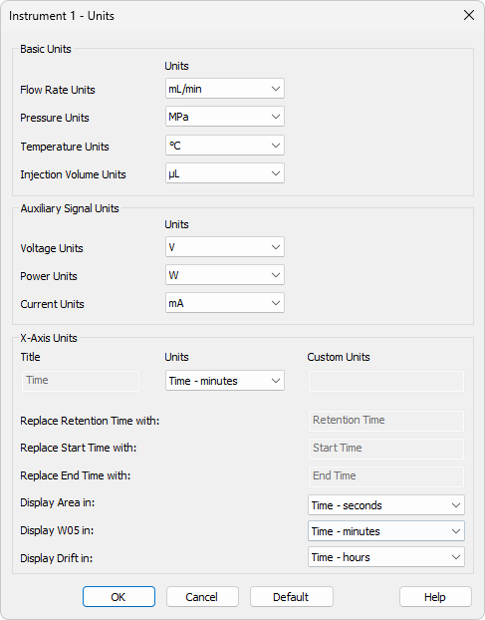
Units setup
Setting of used units
  Basic – Flow, Pressure....
  Auxiliary Signals – Voltage, Current...
  X-Axis (time) – minutes, seconds...
Set for each instrument separately
These setting are stored in the configuration *.cfg file
CONFIGURATION / GENERAL SETTING / UNITS SETUP

Slide 25
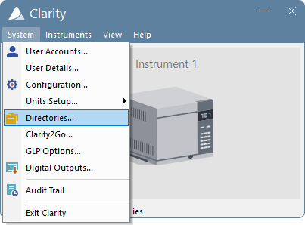
Directories
CONFIGURATION / GENERAL SETTING / DIRECTORIES

Slide 26
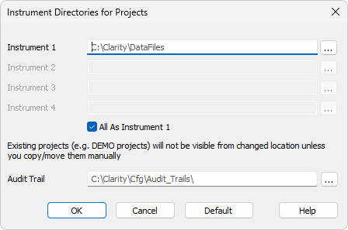
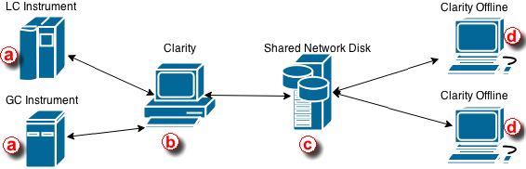
directories
Data and Audit Trail location
Directory = Where Clarity searches for Projects
Tool for networked use of Clarity with Clarity Offline
CONFIGURATION / GENERAL SETTING / DIRECTORIES

Slide 27
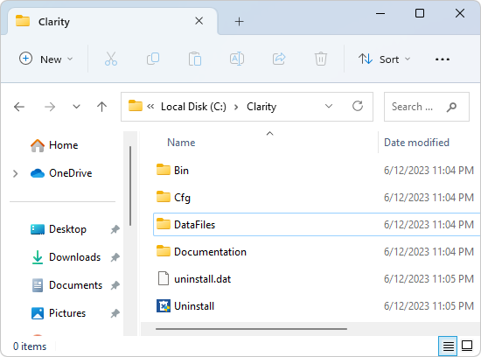
Installation folder
Bin – the software itself, IQ, OQ
Cfg – configuration of the software
DataFiles – the chromatographic data
Documentation – Manuals, Datasheets
Uninstalll.exe – for software unistallation
CONFIGURATION / GENERAL SETTING / INSTALLATION FOLDER

Slide 28
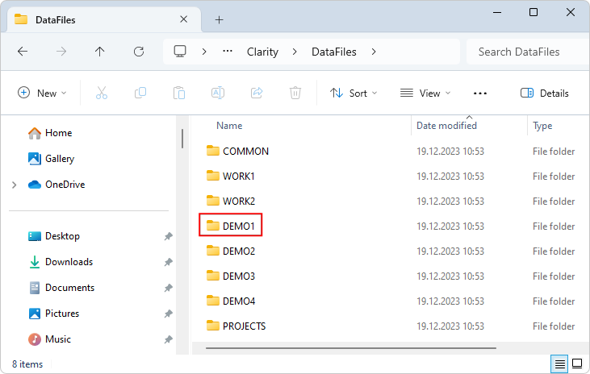
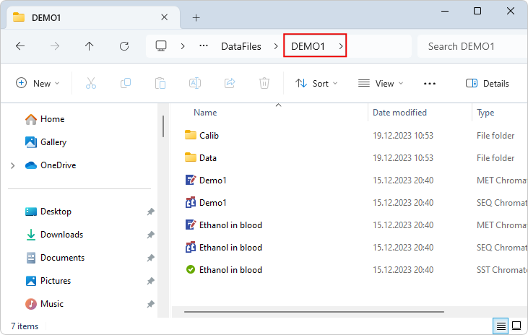
Installation folder
Datafiles
“Project_name“ folder – methods (*.met), seqeunces (*.seq)
  Calib subfolder – calibrations (*.cal), chromatograms of standards (*.prm)
  Data subfolder – sample chromatograms (*.prm)
Common – shared files = report styles, templates, etc.
Projects – individual project (*.prj) files
CONFIGURATION / GENERAL SETTING / INSTALLATION FOLDER

Slide 29
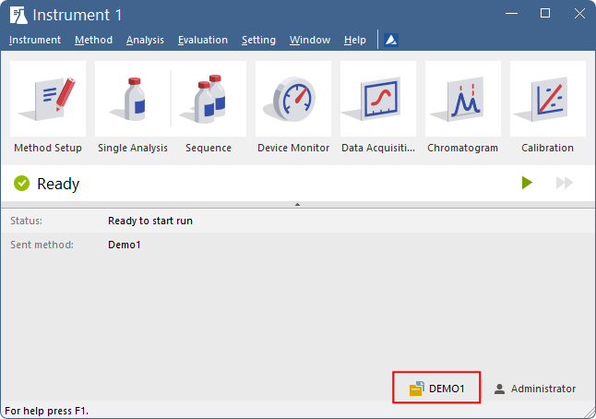
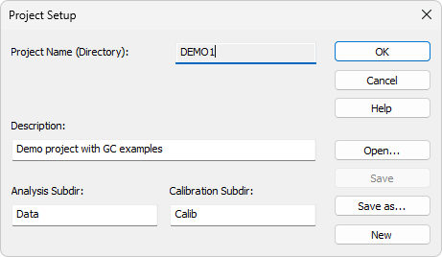
Project setup
Accessible from Instrument window
Administration of projects (opening, creation of new ones, renaming...)
Data and Calib folders of given project can be merged together in this dialog.
CONFIGURATION / GENERAL SETTING / PROJECT SETUP

Slide 30
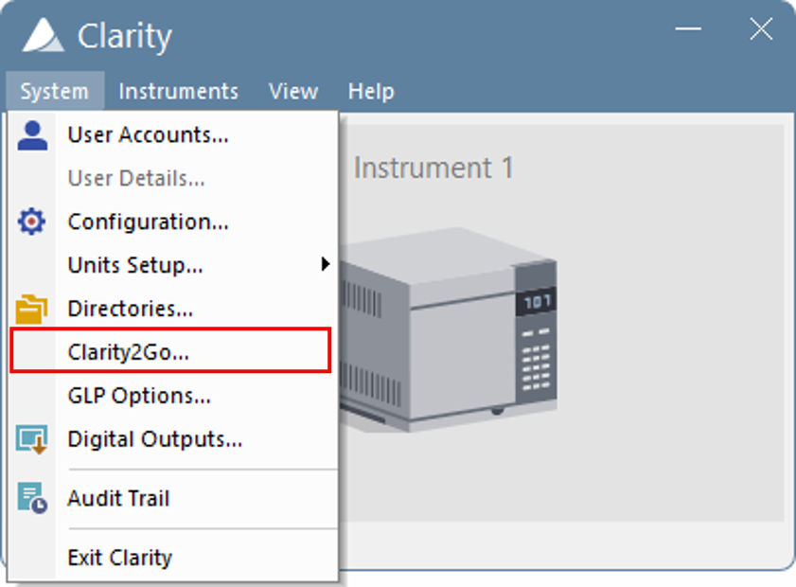
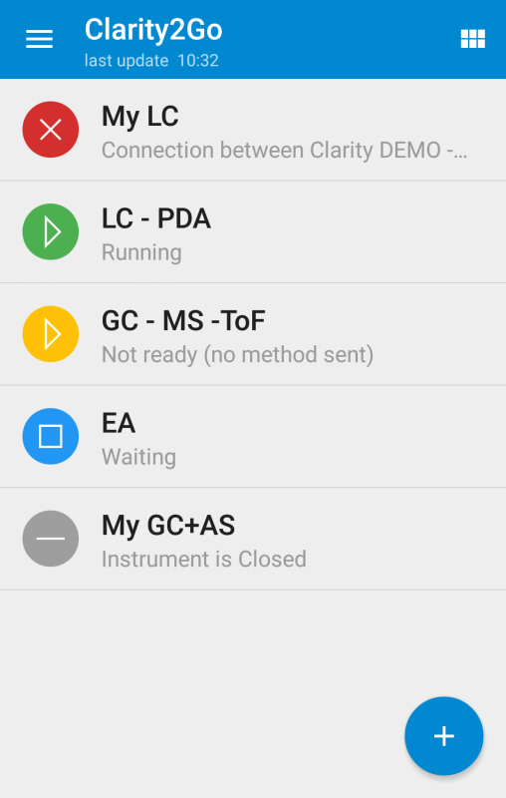
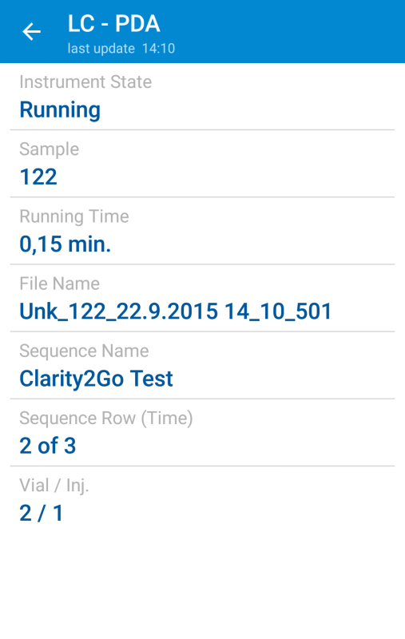
Clarity2Go
Analysis monitoring from your smartphone or tablet
Available for Android and iOS
CONFIGURATION / GENERAL SETTING / CLARITY2GO

Slide 31
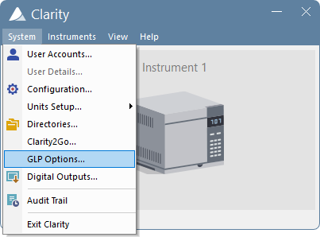
GLP Options
CONFIGURATION / GENERAL SETTING / GLP OPTIONS

Slide 32
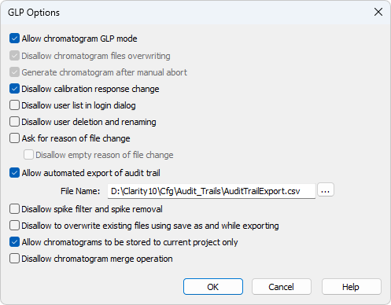
GLP Options
Necessary for work in a regulated environment
Turned off by default
CONFIGURATION / GENERAL SETTING / GLP OPTIONS

Slide 33
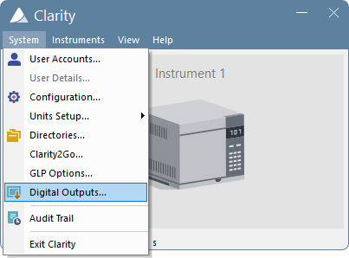
Digital outputs
CONFIGURATION / GENERAL SETTING / DIGITAL OUTPUTS

Slide 34
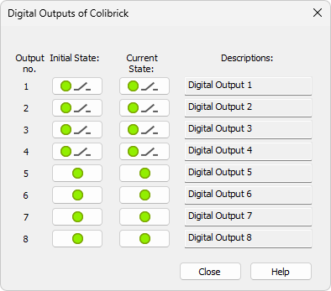
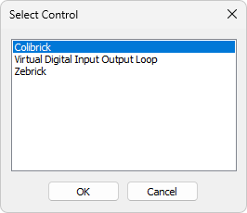
Digital outputs
Used to control the digital outputs of the installed A/D boards and other devices
CONFIGURATION / GENERAL SETTING / DIGITAL OUTPUTS

Slide 35



First start of instrument
Instrument window = center of analysis in Clarity
  Access to other windows + status information
Setup Configuration and other options as needed
Click Login
Select user name and project
CONFIGURATION / GENERAL SETTING / INSTRUMENT

Slide 36
Thank you for your attention

