Slide 1
CONTROL MODULES
Distributor training

Slide 2
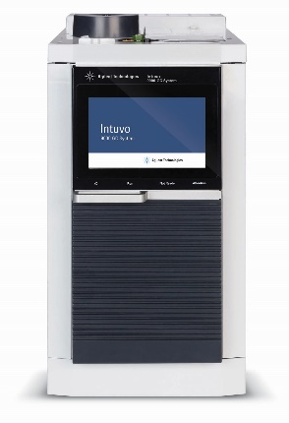
GC control modules
Agilent
Apix
Ellutia
Shimadzu
Young In Chromass
Etc.

Slide 3
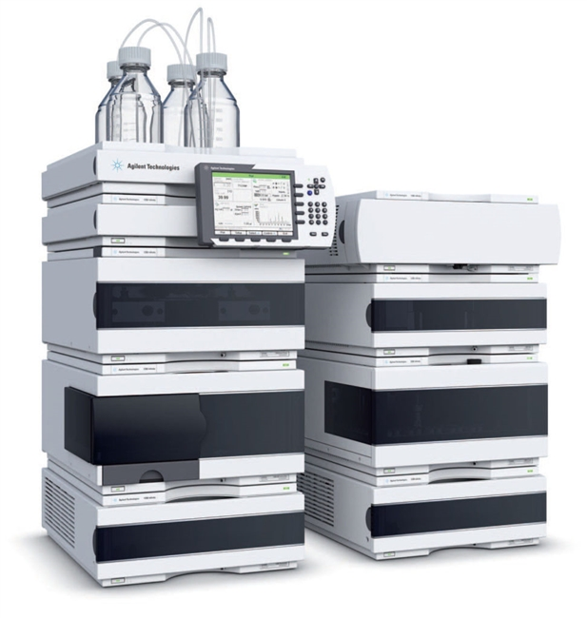
HPLC control modules
Agilent
Ecom
Knauer
Shimadzu
Sykam
Young In Chromass
Teledyne SSI
Etc.

Slide 4
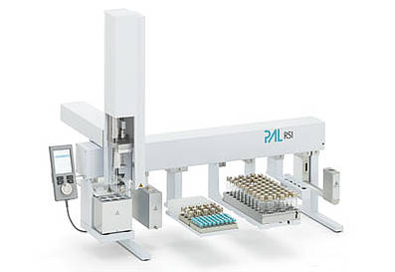
AS control modules
Agilent
CTC
Spark Holland
HTA
Cetac
Etc.

Slide 5
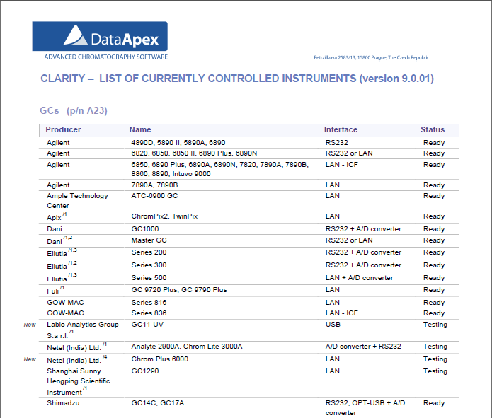
currently controlled instruments
Available at DataApex website or in the D004 datasheet

Slide 6
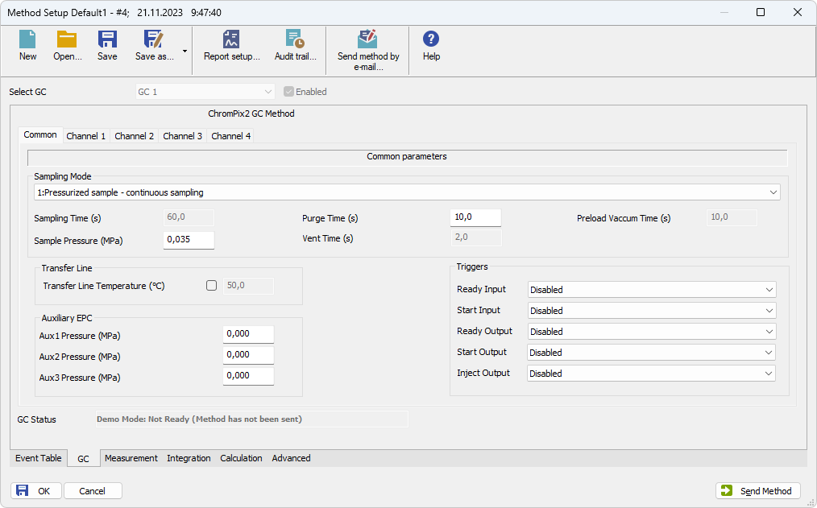
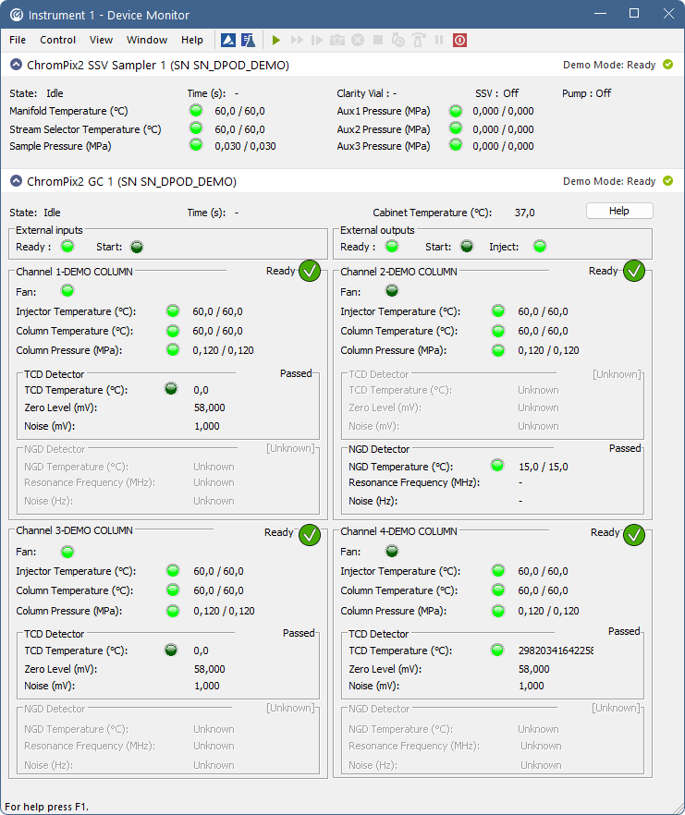
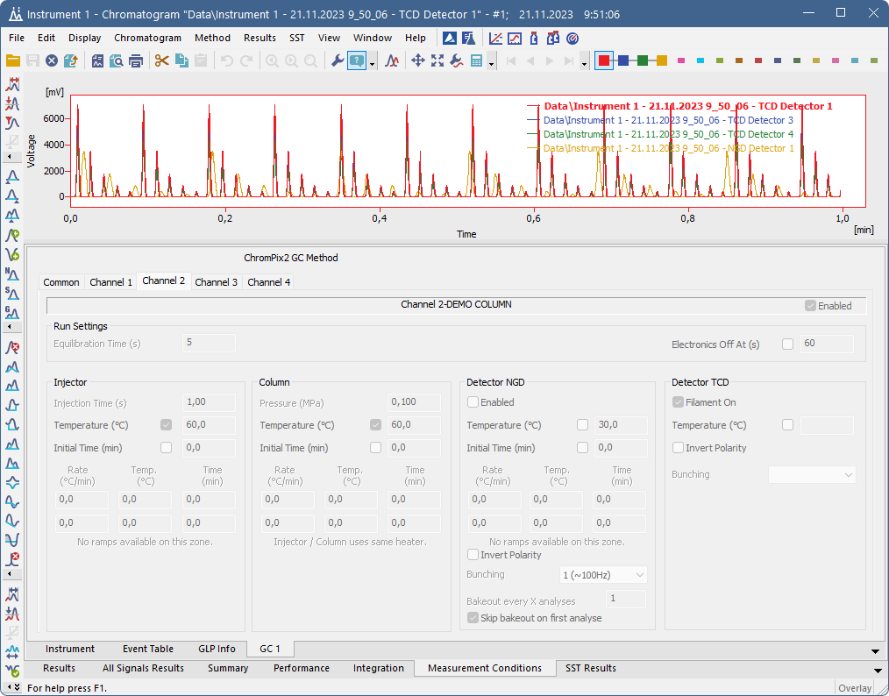
EFFECTS OF ADDED CONTROL MODULE
Tab in the Method Setup
Pane in the Device Monitor
Tab in the Chromatogram

Slide 7
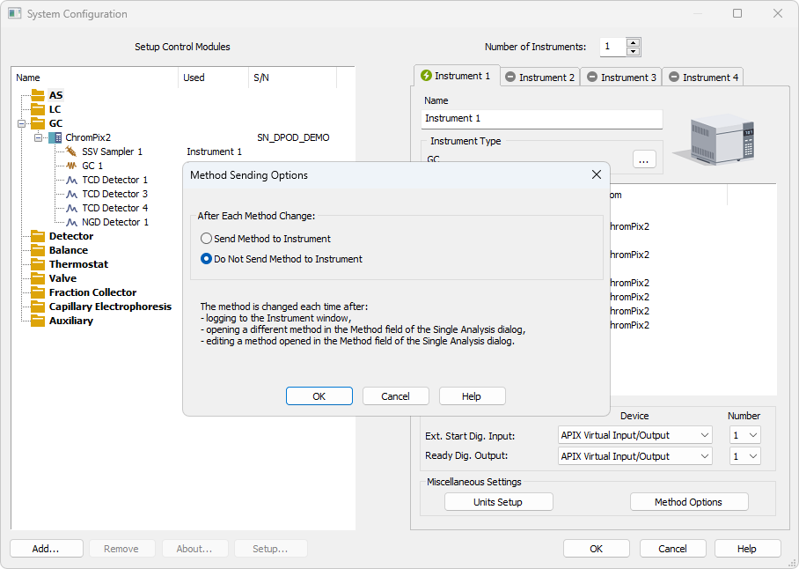
METHOD SENDING OPTIONS
Option to Send or Do not send method to instruments after method change

Slide 8
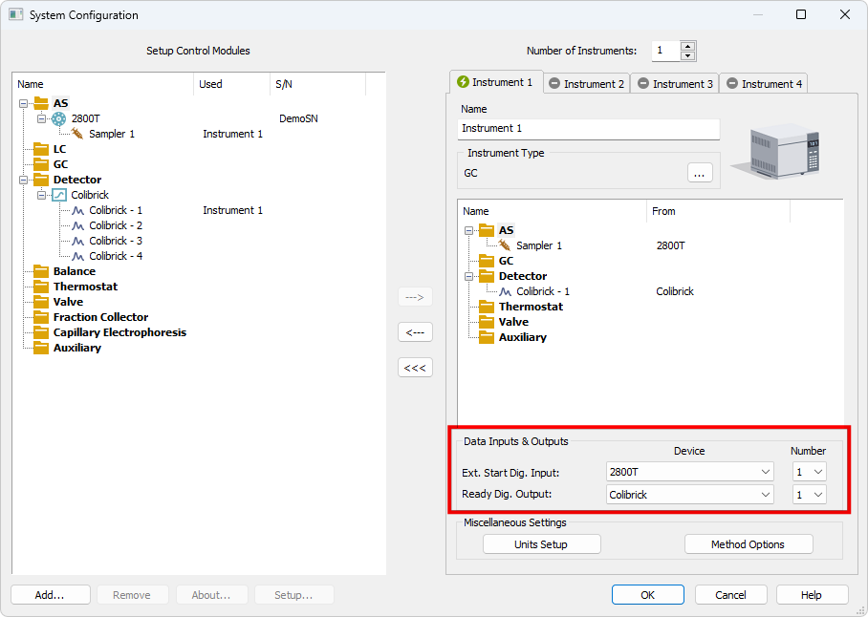
DIGITAL INPUTS AND OUTPUTS
Ext. Start Dig. Input – used to start the run
Ready Dig. Output – controlled by Active sequence

Slide 9
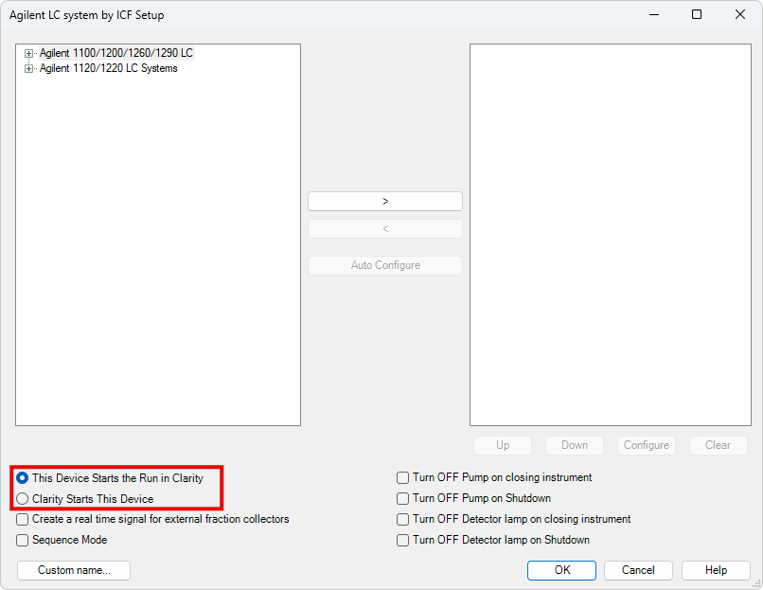
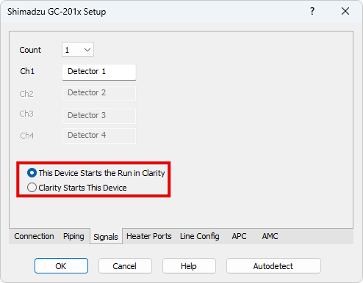
ENABLE START FROM CLARITY
Some control modules do not offer the Digital Start Input
When the run will be started by Clarity or another module, the Clarity Start This Device needs to be checked

Slide 10
AUTOSAMPLER SYNCHRONIZATION
Typical AS configurations are
  AS - ACTIVE sequence + AS Control + digital acquisition
  AS - ACTIVE sequence + AS Control + A/D converter
  AS + GC set - ACTIVE sequence
  AS + LC set - ACTIVE sequence
  AS - PASSIVE sequence (GC or LC)

Slide 11
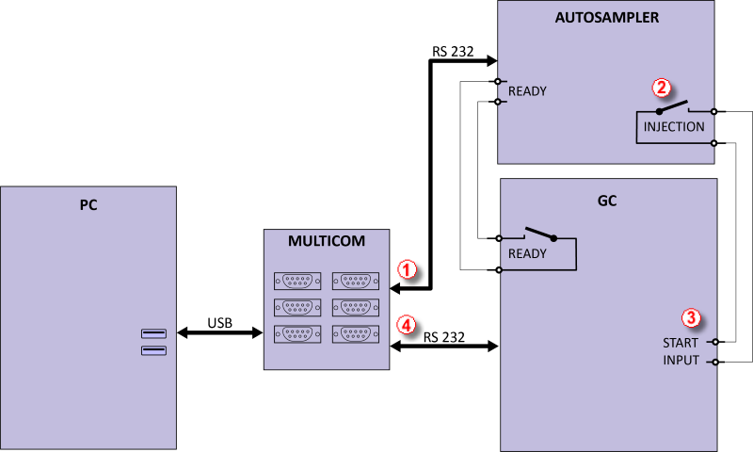
AUTOSAMPLER SYNCHRONIZATION
AS - ACTIVE sequence + AS Control + digital acquisition
DHA Extension / System Configuration

Slide 12
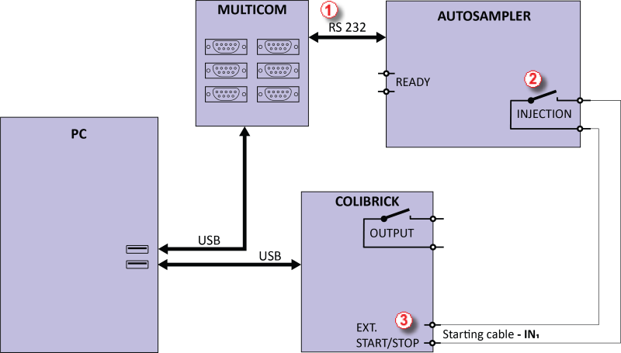
AUTOSAMPLER SYNCHRONIZATION
AS - ACTIVE sequence + AS Control + A/D converter

Slide 13
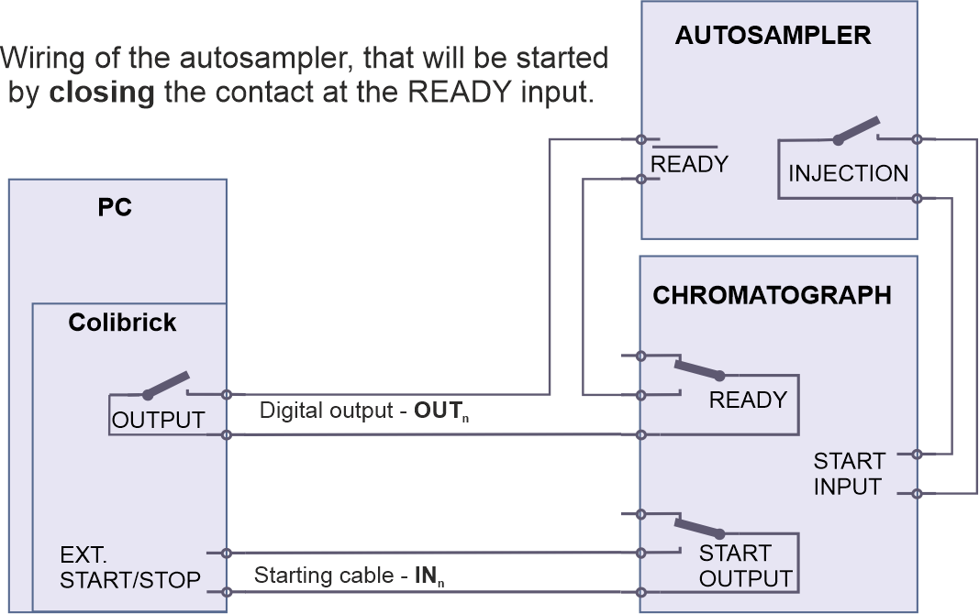
AUTOSAMPLER SYNCHRONIZATION
AS + GC set - ACTIVE sequence

Slide 14
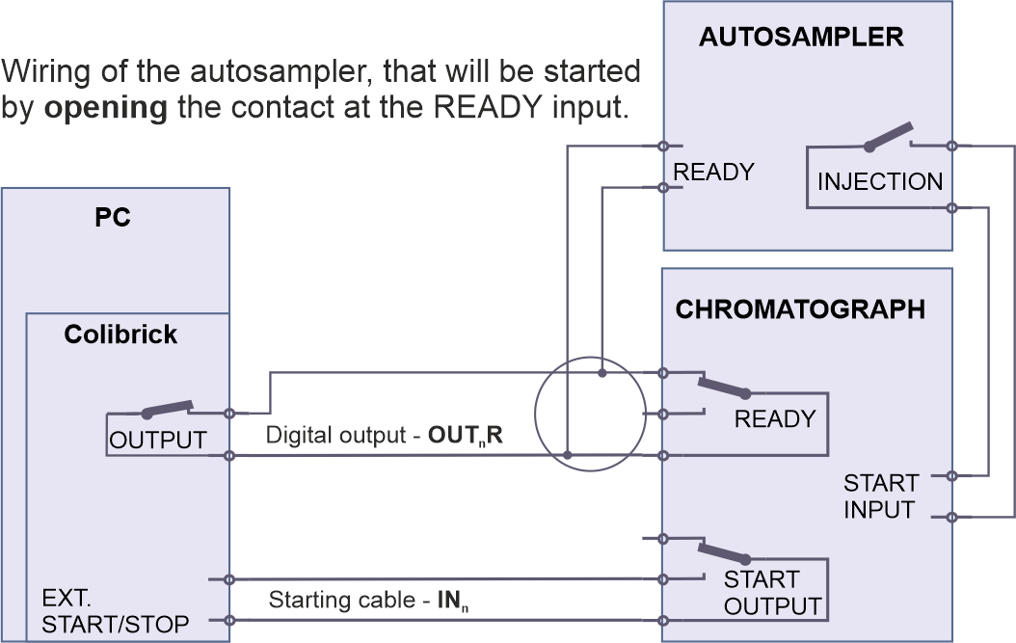
AUTOSAMPLER SYNCHRONIZATION
AS + GC set - ACTIVE sequence

Slide 15
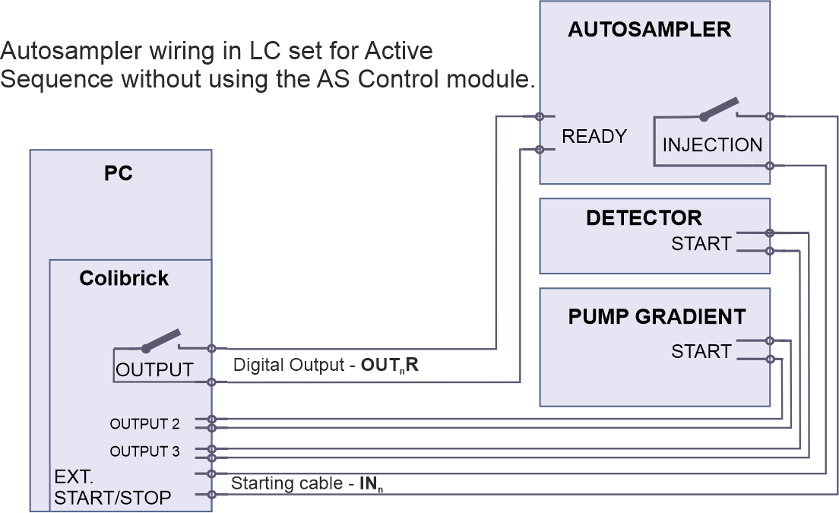
AUTOSAMPLER SYNCHRONIZATION
AS + LC set - ACTIVE sequence

Slide 16
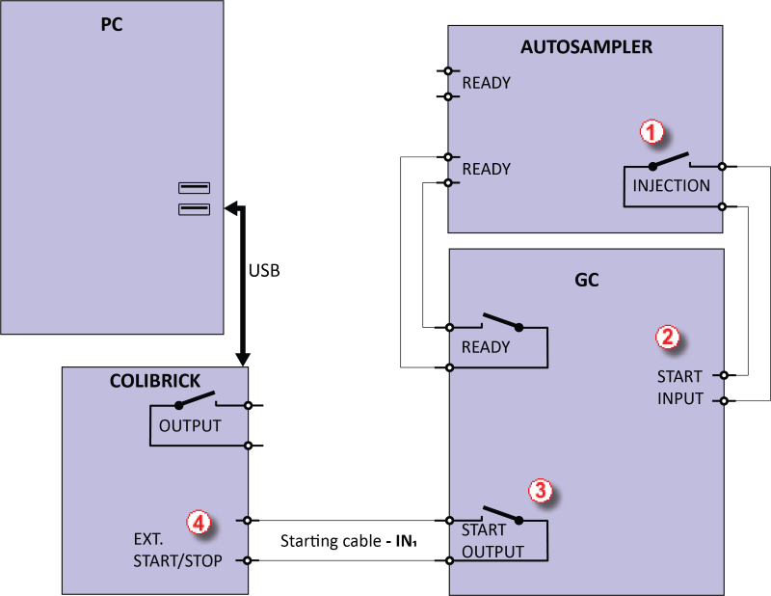
AUTOSAMPLER SYNCHRONIZATION
AS - PASSIVE sequence (GC or LC)

Slide 17
Active Sequence – start by Clarity
Elemental Analyzers
  No Start Out contact on the analyzer
Sampling by Gas valves
  the actual sampling is programmed in the event table as part of the run
Solution:
  A/D card – connect Start In to Ready out
  Virtual digital I/O module (simulates connection like a DEMO detector)

Slide 18
Overlapped mode in AS
Sequence in Clarity sends to autosampler one injection at a time
Overlap mode is available for selected AS
  Prep ahead mode (CTC PAL-xt series)
  Sequence mode (Spark, CTC PAL3)
  Overlapped mode (Sykam)
  Use Optimised Sequence (HTA200H)
Important for derivatization and headspace
Method Setup – besides Autostop time, the correct analysis time must be set in the Autosampler method

Slide 19
Thank you for your attention

