Slide 1
Clarity training
Basic operations

Slide 2
content
Developing a method
Acquiring data
  Single Analysis
  Sequence
Creating calibration
Quantifying results
Reporting results
BASIC OPERATIONS / CONTENT
Notes:
During this training session, we will be looking at the different basic tasks that Clarity can perform.
These are: Developing a Method, acquiring data, Creating a calibration file and Reporting of Data.
This session will be addressed from the point of view of a first-time user of the Clarity Chromatography Station.

Slide 3
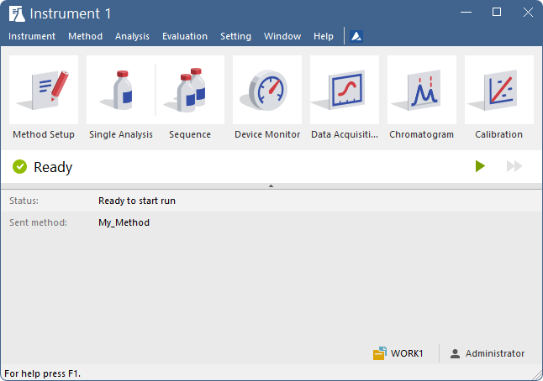
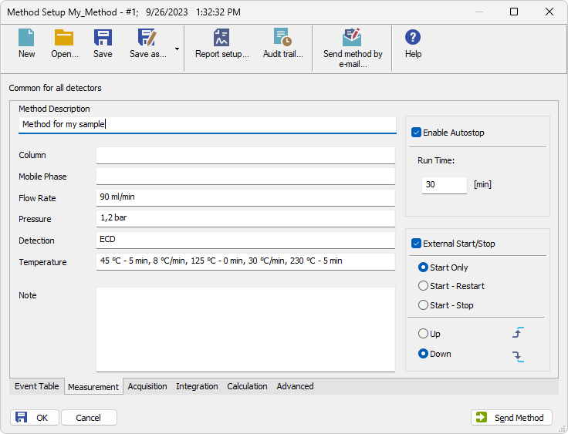
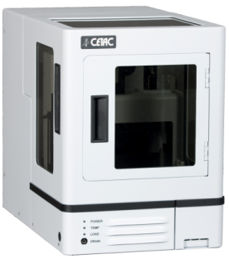
Method in clarity
Instrumental and processing parameters within one document
Can be sent to HW directly from Method Setup
Stored as *.met file in current project folder
BASIC OPERATIONS / METHOD

Slide 4
Method development
Proposed workflow
Set acquisition parameters
Enter sample information (optional)
Acquire the first chromatogram
Optimize integration parameters
Store the method for further analyses
BASIC OPERATIONS / METHOD DEVELOPMENT

Slide 5
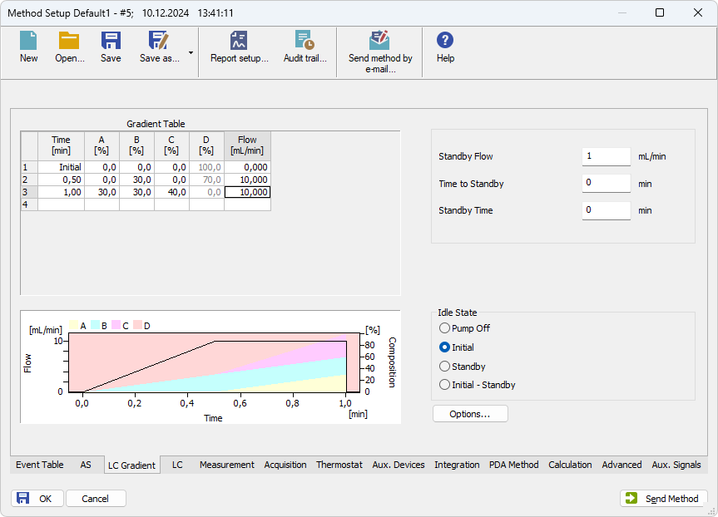
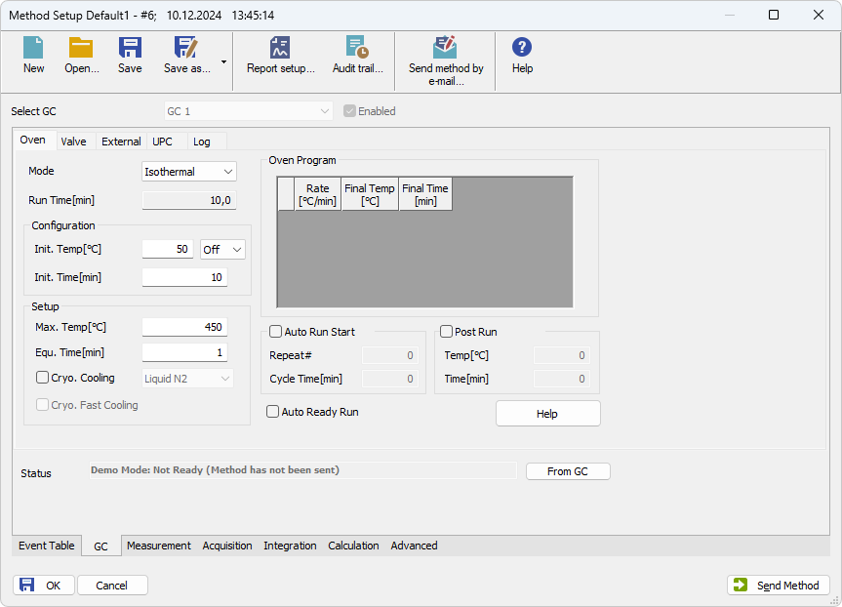
Method development
Method setup
Accessed from Instrument window
Available tabs are dependent on used configuration
BASIC OPERATIONS / METHOD DEVELOPMENT / METHOD SETUP

Slide 6
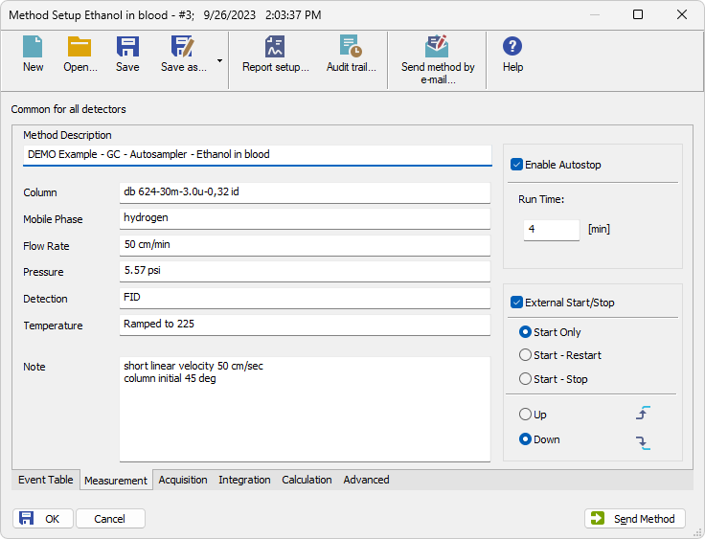
Method setup
Measurement tab
Description
  Informative
Autostop & Run time
External Start/Stop
BASIC OPERATIONS / METHOD DEVELOPMENT / METHOD SETUP / MEASUREMENT TAB

Slide 7
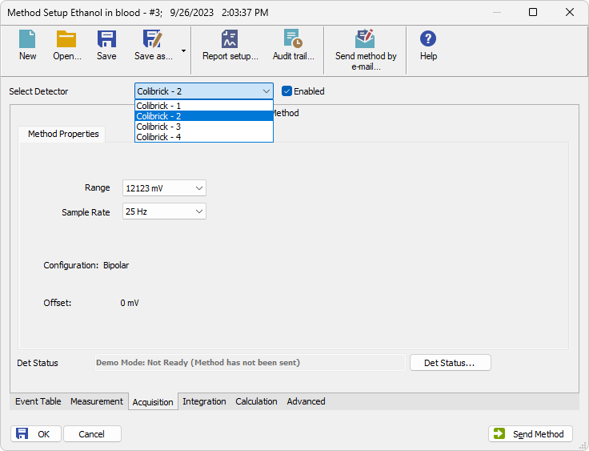
Method setup
acquisition tab
Device-specific
Cannot be modified during acquisition
“Enabled” checkbox
BASIC OPERATIONS / METHOD DEVELOPMENT / METHOD SETUP / ACQUISITION TAB

Slide 8
Method setup
Signal range
Signal out of range = loss of information
BASIC OPERATIONS / METHOD DEVELOPMENT / METHOD SETUP / ACQUISITION TAB / SIGNAL RANGE

Slide 9
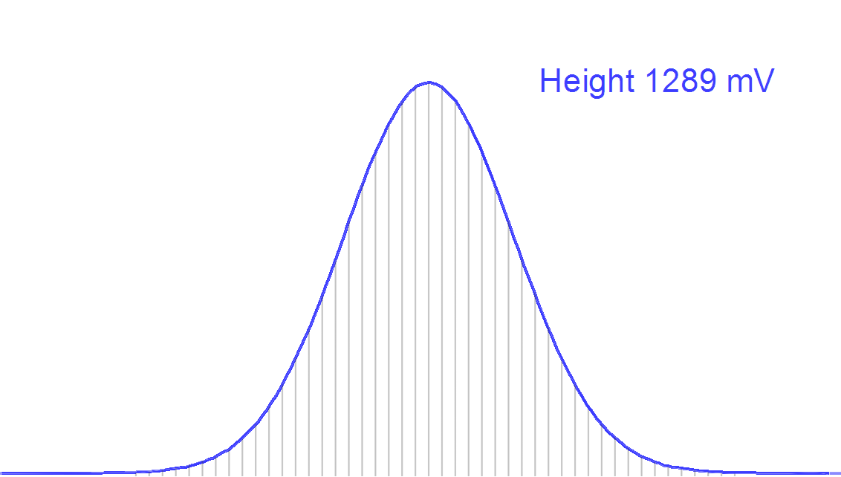
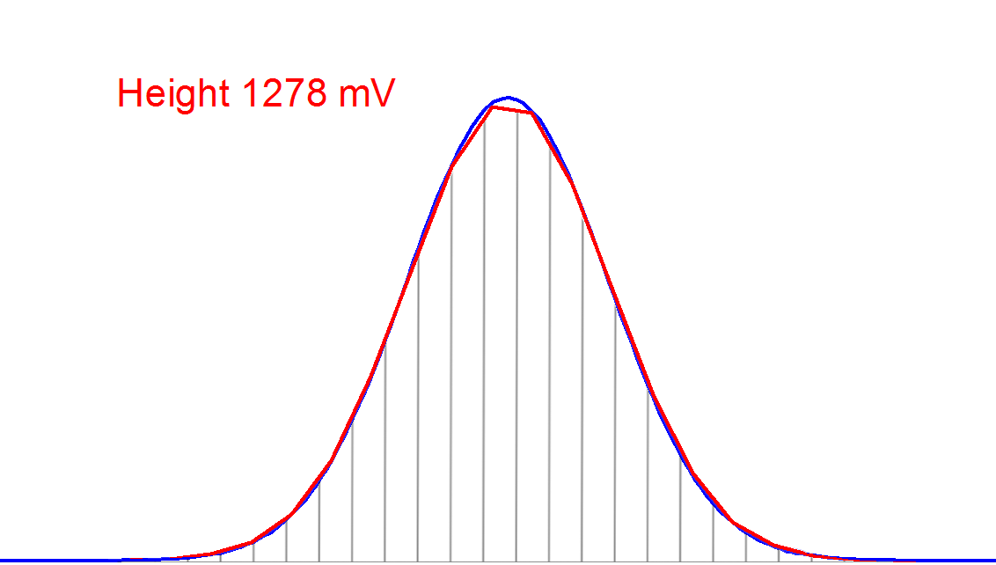
Method setup
SAMPLE RATE
Too low = not enough datapoints per peak = incorrect results
“Correct” rate is dependent on HW and analytical application
  GC detectors – usually 25-50 Hz
  LC and Spectral detectors – according to application and HW parameters
Low Sample Rate
BASIC OPERATIONS / METHOD DEVELOPMENT / METHOD SETUP / ACQUISITION TAB / SAMPLE RATE

Slide 10
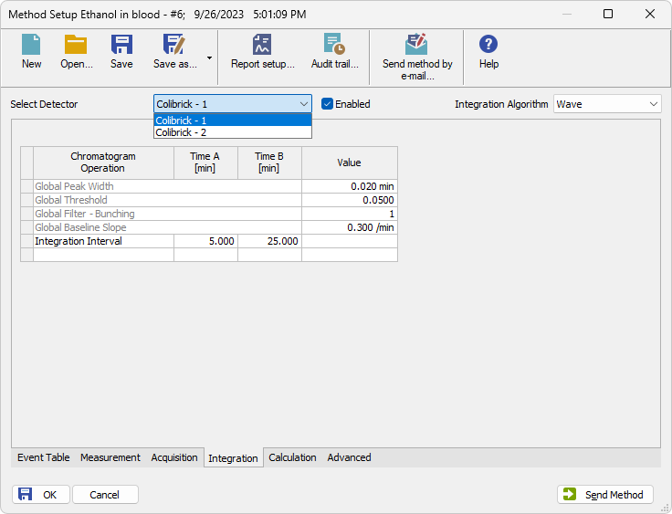
Method setup
integration tab
Parameters are applied to measured chromatograms
Selection of integration algorithm
Integration table is separate for each signal
BASIC OPERATIONS / METHOD DEVELOPMENT / METHOD SETUP / INTEGRATION TAB

Slide 11
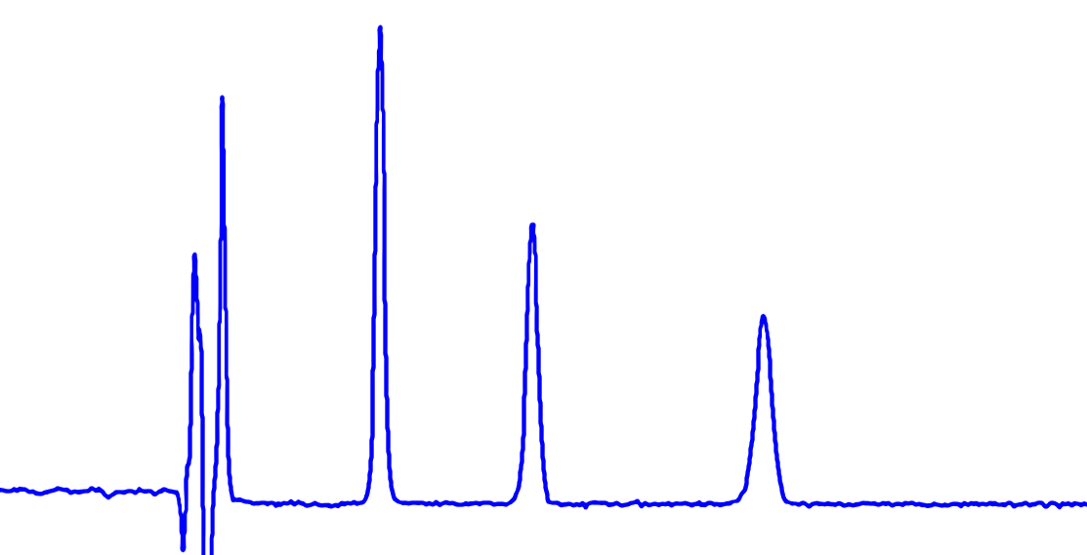
Method setup
integration parameters
Global parameters
  Peak width, Threshold, Bunching, Slope
Integration Interval
Other interval and peak functions
Threshold
Peak width
BASIC OPERATIONS / METHOD DEVELOPMENT / METHOD SETUP / INTEGRATION TAB / INTEGRATION PARAMETERS

Slide 12
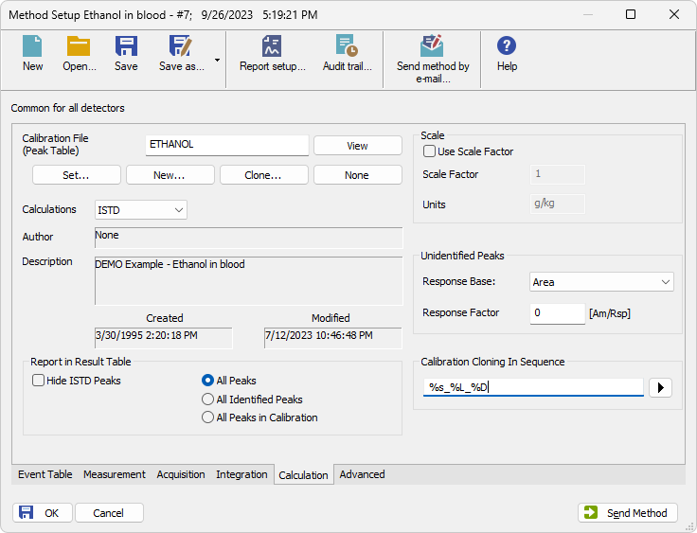
Method setup
Calculation tab
Calibration that is linked to measured chromatograms
Calculation type
Calibration cloning
BASIC OPERATIONS / METHOD DEVELOPMENT / METHOD SETUP / CALCULATION TAB

Slide 13
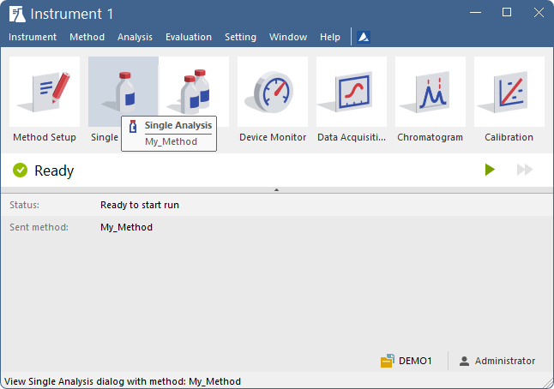
Method development
SINGLE ANALYSIS – FIRST RUN
BASIC OPERATIONS / METHOD DEVELOPMENT / SINGLE ANALYSIS

Slide 14
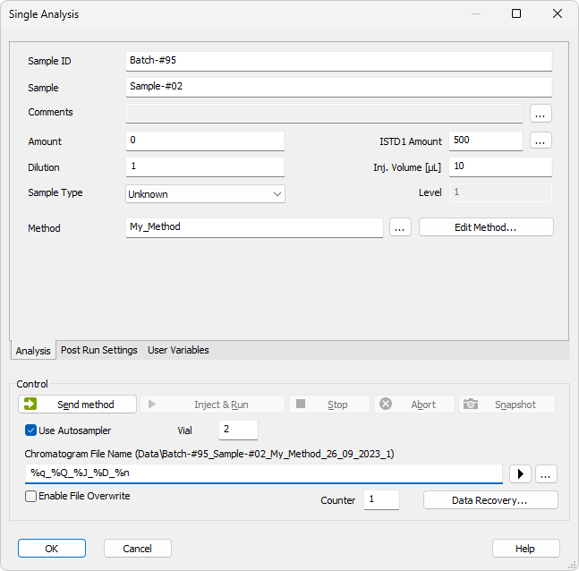
Single analysis
Analysis tab
Enter sample information
Enter file name
  Use variables by clicking
BASIC OPERATIONS / METHOD DEVELOPMENT / SINGLE ANALYSIS / ANALYSIS

Slide 15
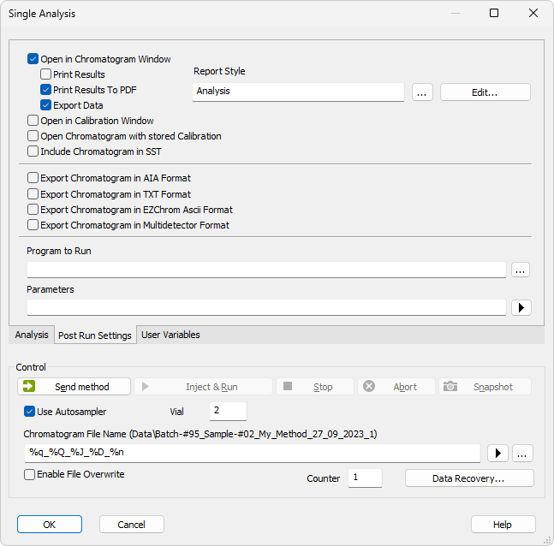
Single analysis
Post run settings tab
Automatic operations after the end of analysis
BASIC OPERATIONS / METHOD DEVELOPMENT / SINGLE ANALYSIS / POST RUN

Slide 16
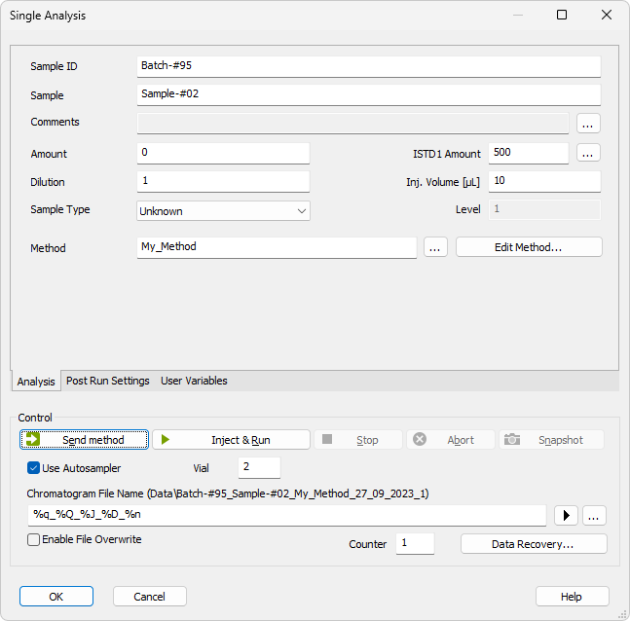
Single analysis
Sending method
BASIC OPERATIONS / METHOD DEVELOPMENT / SINGLE ANALYSIS / SENDING METHOD

Slide 17
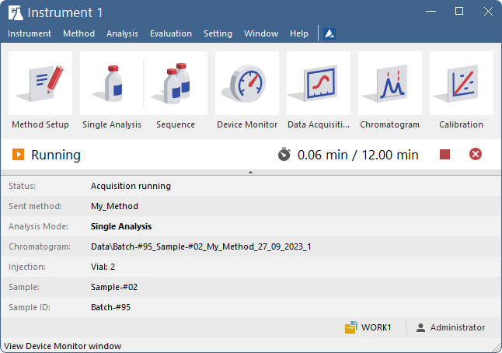
Method development
Data acquisition
BASIC OPERATIONS / METHOD DEVELOPMENT / DATA ACQUISITION

Slide 18
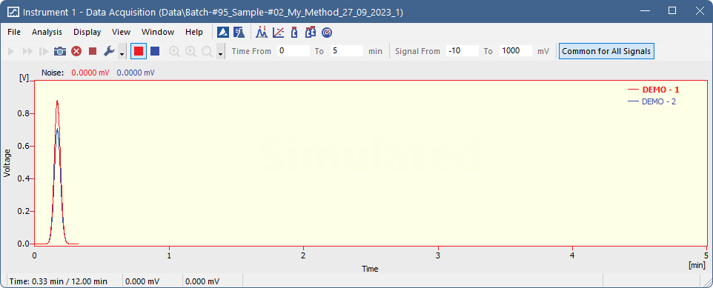
Data acquisition
Monitoring analysis
Functions
  Snapshot – Temporary chromatogram
  Abort – End analysis, no chromatogram saved
  Stop – End analysis, save chromatogram
Parameters – Only influence view, not data itself
BASIC OPERATIONS / METHOD DEVELOPMENT / DATA ACQUISITION

Slide 19
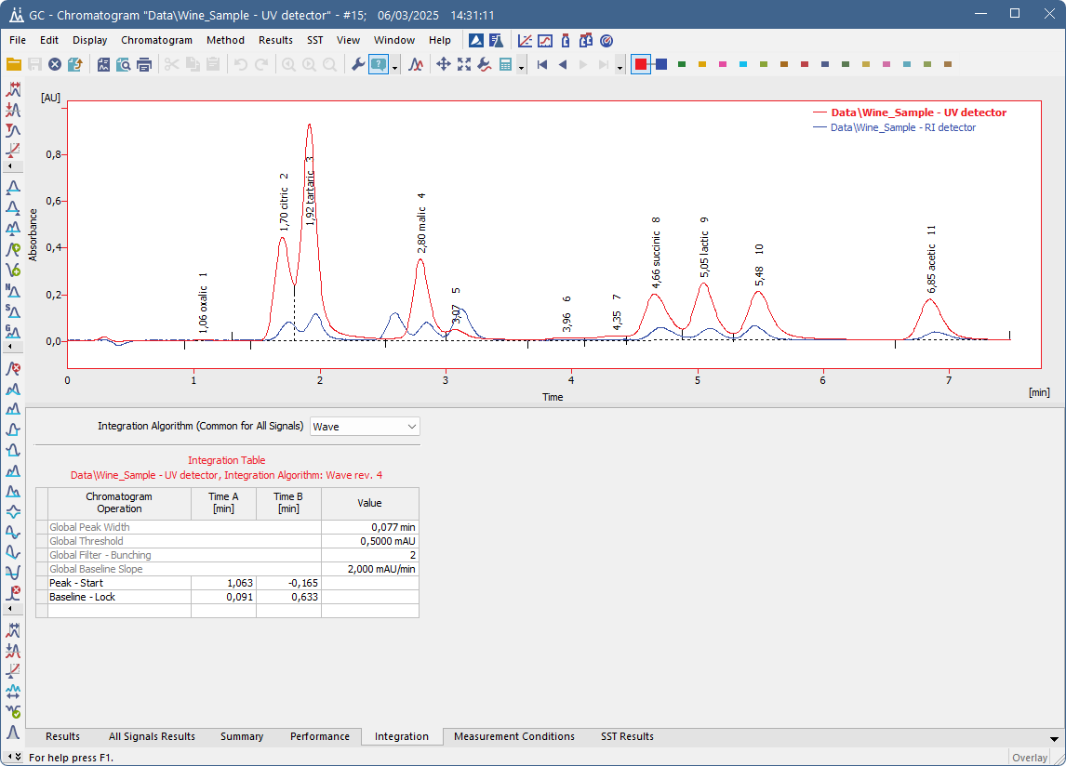
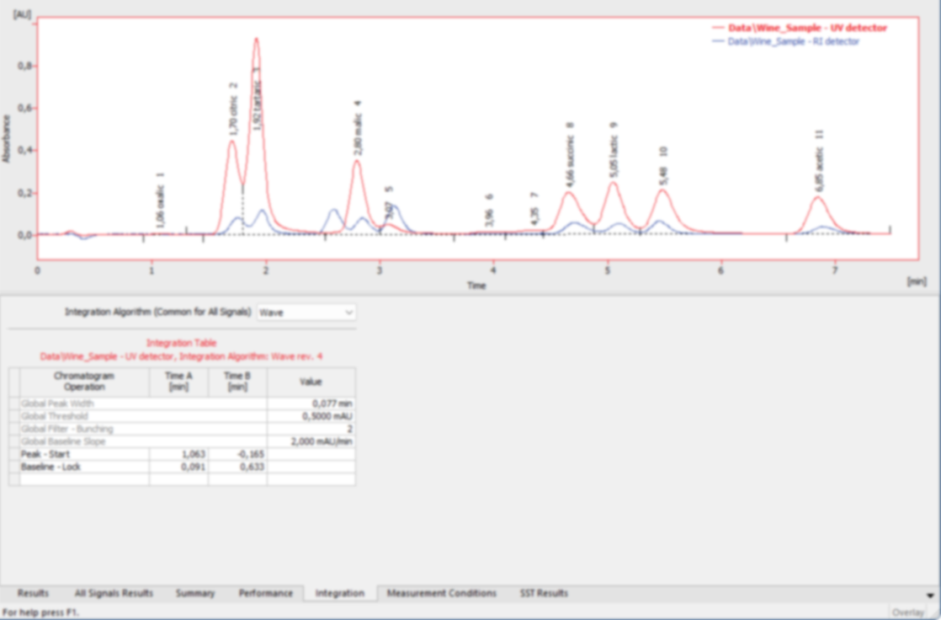
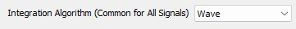

Method development
FIRST CHROMATOGRAM
Optimize integration
  Global parameters
  Integration interval
  Other functions
Change integration algorithm
Global parameters
Modify peaks
Modify baseline
Integration parameters
BASIC OPERATIONS / METHOD DEVELOPMENT / CHROMATOGRAM

Slide 20
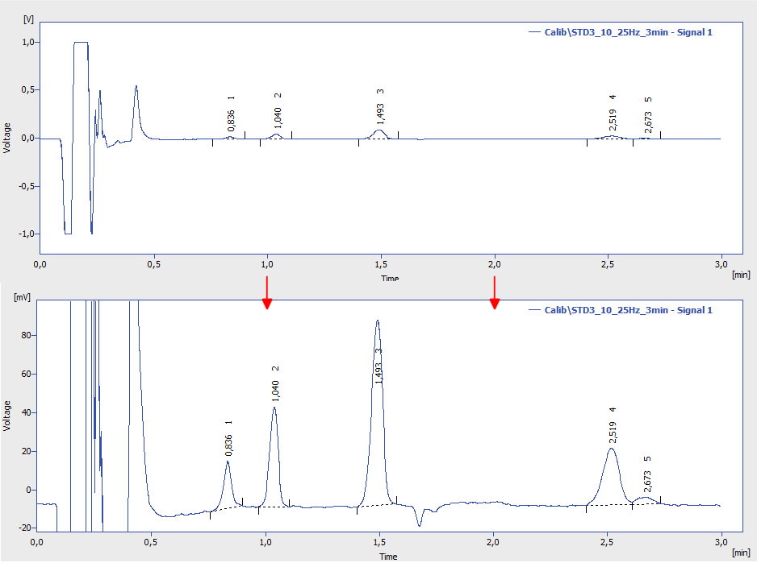
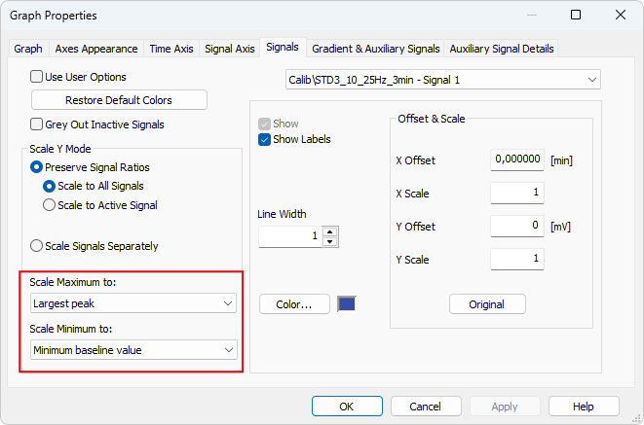
Method development
FIRST CHROMATOGRAM
Signal Scailing – Focus on relevant peaks before integration tuning
BASIC OPERATIONS / METHOD DEVELOPMENT / CHROMATOGRAM

Slide 21
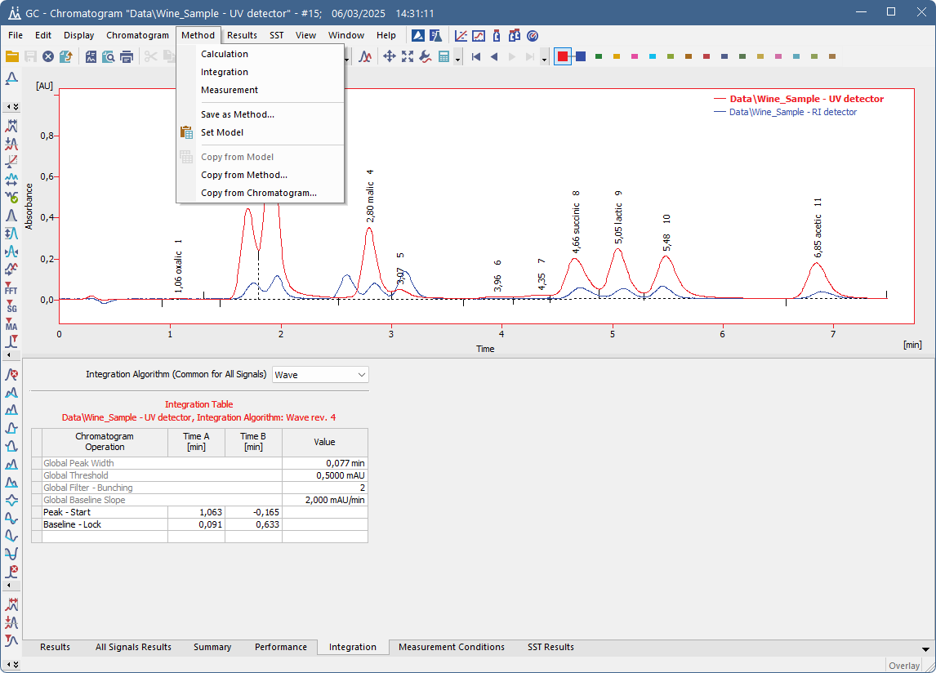
Chromatogram
Saving optimized method
Save as method – saves settings from a chromatogram to new method
  Instrumental part
  Integration
  Linked calibration
  Etc.
BASIC OPERATIONS / METHOD DEVELOPMENT / CHROMATOGRAM

Slide 22
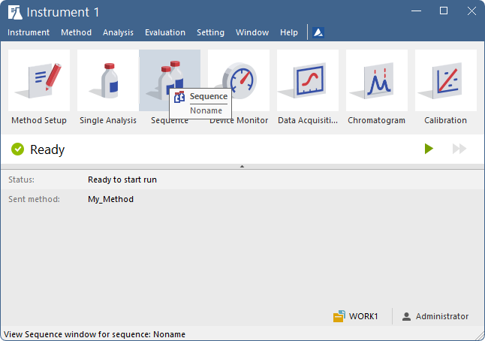
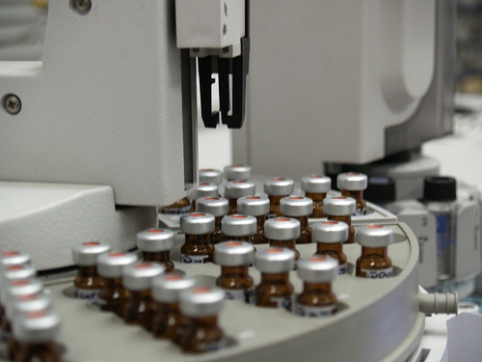
sequence
Analyze many samples using autosampler
  Can be used with manual injection
Utilize optimized method from previous steps
BASIC OPERATIONS / SEQUENCE

Slide 23
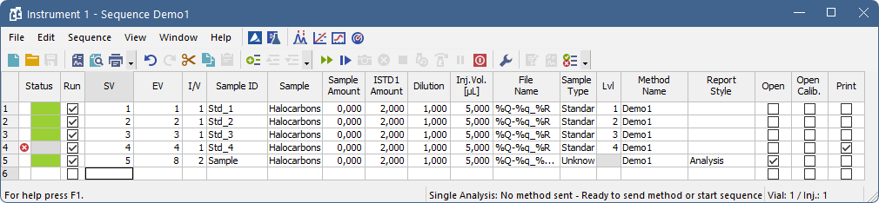
sequEnce
Sequence table 1/3
Status
Vial information
Sample information
Values for additional calculations
Injection volume – important for autosampler
BASIC OPERATIONS / SEQUENCE / SEQUENCE TABLE

Slide 24
sequEnce
Sequence table 2/3
File name – usable variables
Sample type (+ Levels for standards)
Acquisition and printing methods
Automated post run actions
BASIC OPERATIONS / SEQUENCE / SEQUENCE TABLE

Slide 25
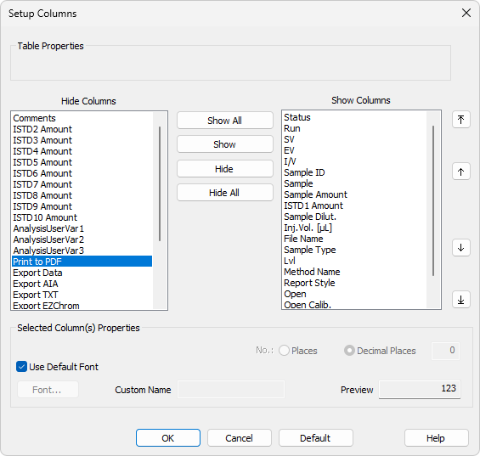
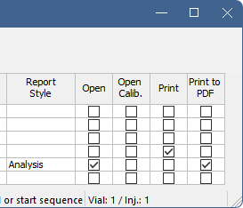
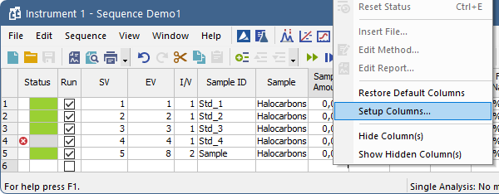
sequEnce
Sequence table 3/3
Hidden columns – setup columns dialog
  Accessible from local menu
  Applicable to most tables in Clarity
BASIC OPERATIONS / SEQUENCE / SEQUENCE TABLE

Slide 26
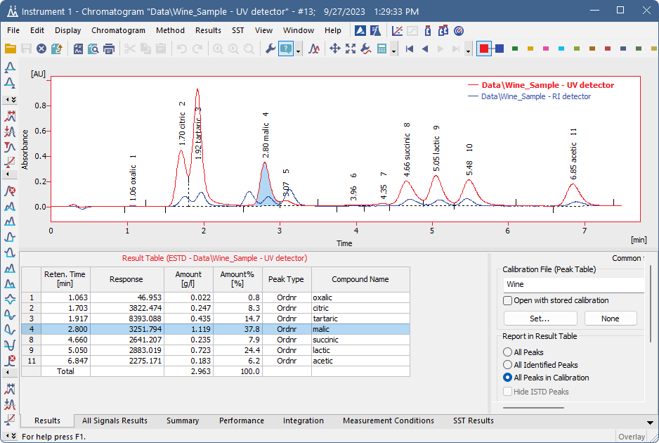
Calibration
Stored as *.cal files
Identification of compounds based on retention time
BASIC OPERATIONS / CALIBRATION

Slide 27
Calibration
Manual creation
Acquire and integrate standard samples
Set calibration options
Add (concentration) levels
Save calibration
Link it to chromatograms
Open Standard
Add Peaks
Enter Compounds‘ Names
(1st time only)
Enter Amounts
BASIC OPERATIONS / CALIBRATION / MANUAL CREATION

Slide 28
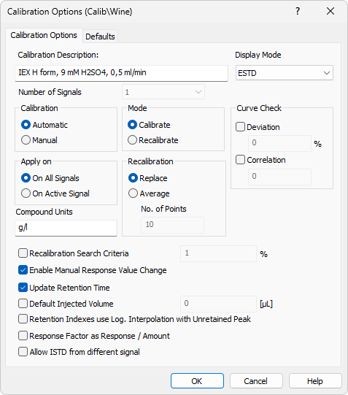
Calibration
Calibration options
Display mode – ESTD, ISTD etc.
Calibration
  Automatic – recommended
  Manual – addition of each peak requires manual confirmation
Mode
  Calibrate – peaks added to first empty level
  Recalibrate – peaks applied to selected level
Recalibration
  Replace – only uses last measured response
  Average – uses averaged response from “x” measurements
Compound units
  Displayed in result table
BASIC OPERATIONS / CALIBRATION / CALIBRATION OPTIONS

Slide 29
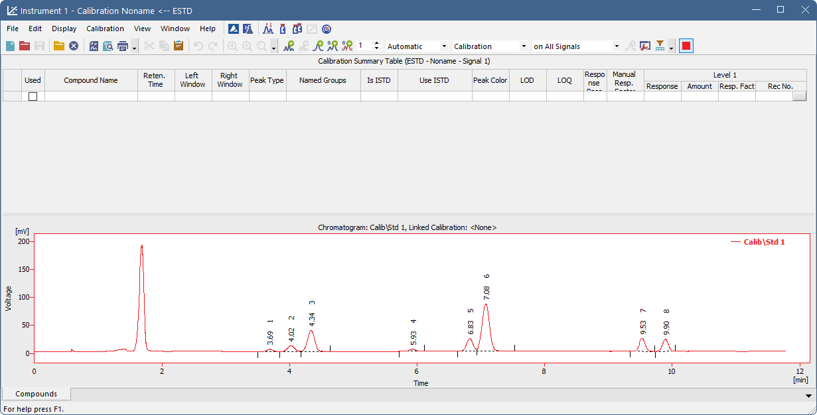
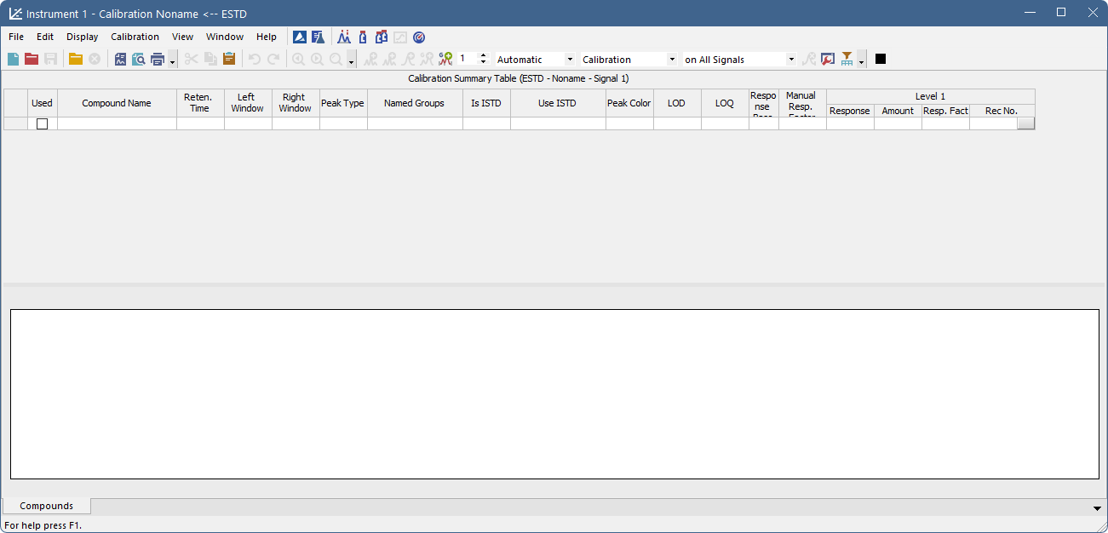
calibration
Filling level 1/4 - opening standard
BASIC OPERATIONS / CALIBRATION / FILLING LEVEL

Slide 30
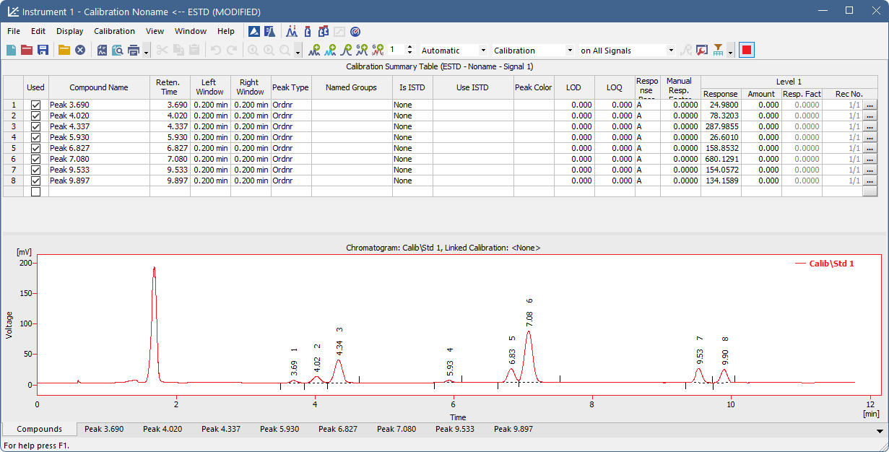
calibration
Filling level 2/4 - Adding peaks
BASIC OPERATIONS / CALIBRATION / FILLING LEVEL

Slide 31
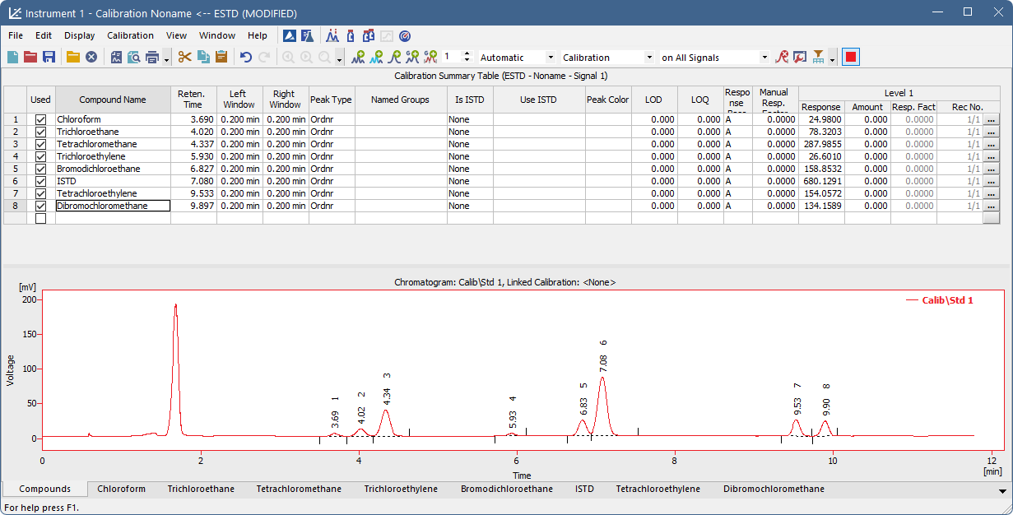
calibration
Filling level 3/4 – naming compounds (1st level only)
BASIC OPERATIONS / CALIBRATION / FILLING LEVEL

Slide 32
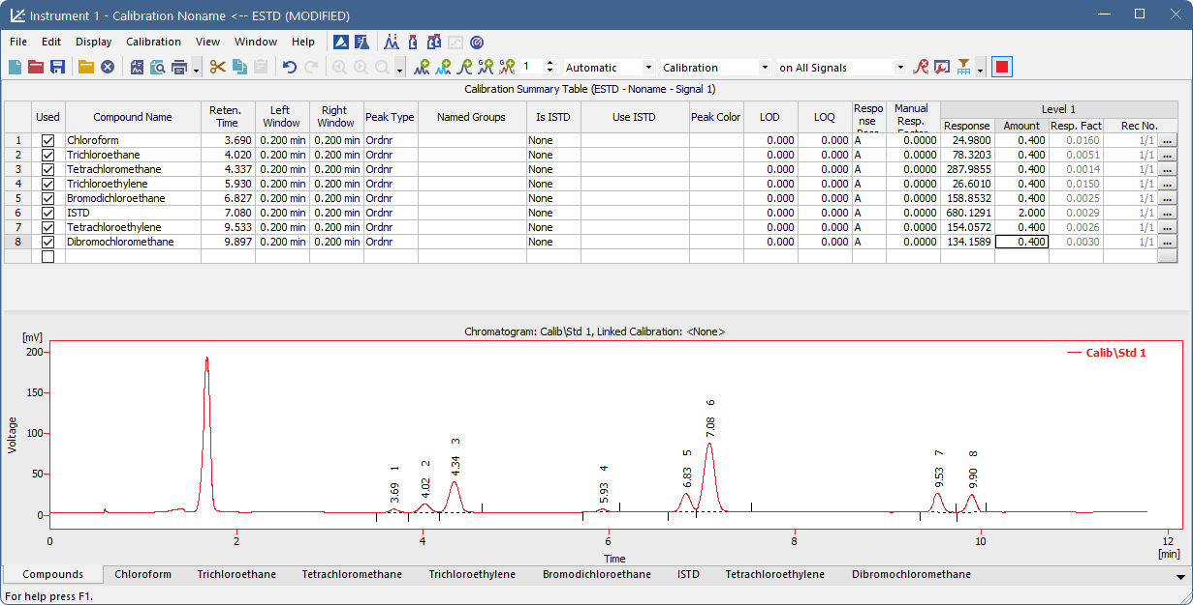
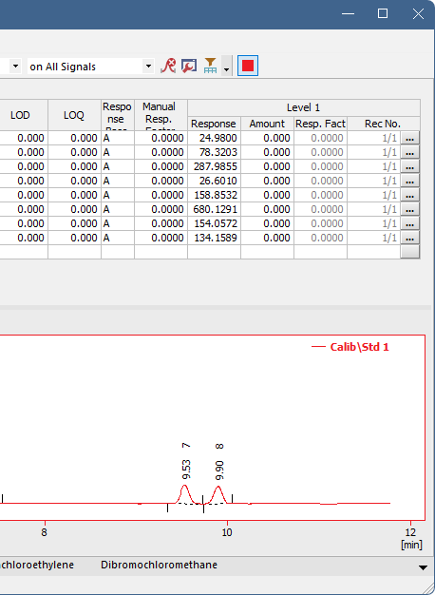
calibration
Filling level 4/4 – filling amounts
BASIC OPERATIONS / CALIBRATION / FILLING LEVEL

Slide 33
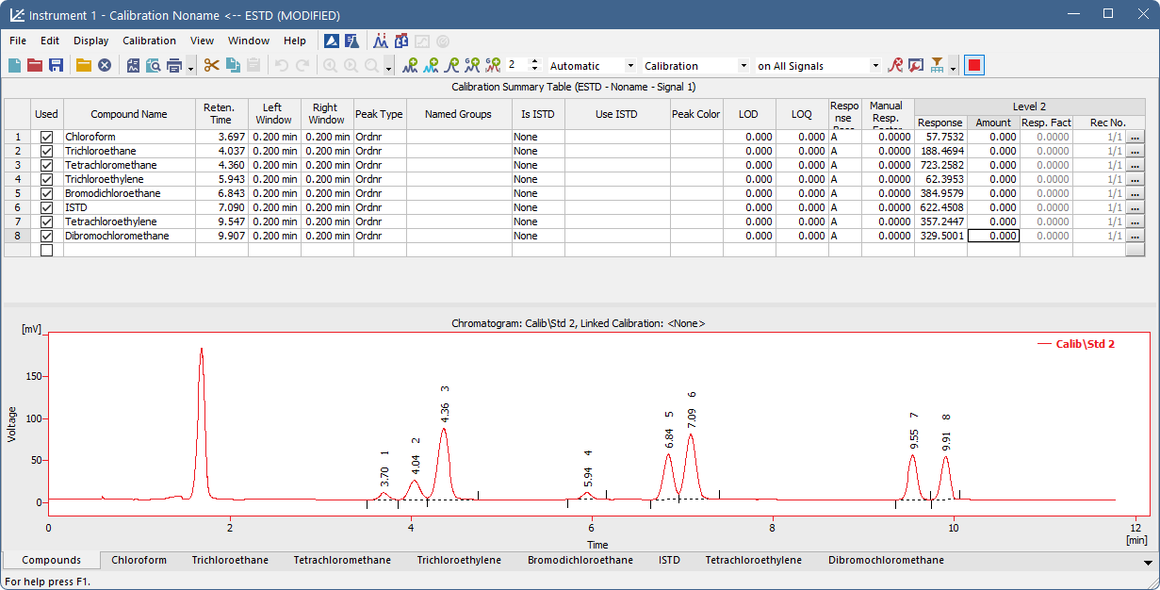
calibration
Next level
Repeat the previous steps for each level
Use “Calibration” settings
  New peaks added to empty level
BASIC OPERATIONS / CALIBRATION / NEXT LEVEL

Slide 34
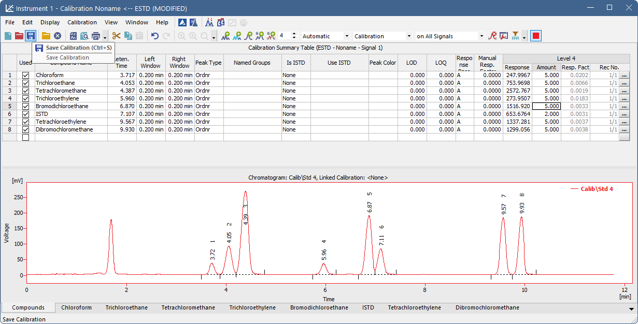
calibration
saving
BASIC OPERATIONS / CALIBRATION / SAVING

Slide 35
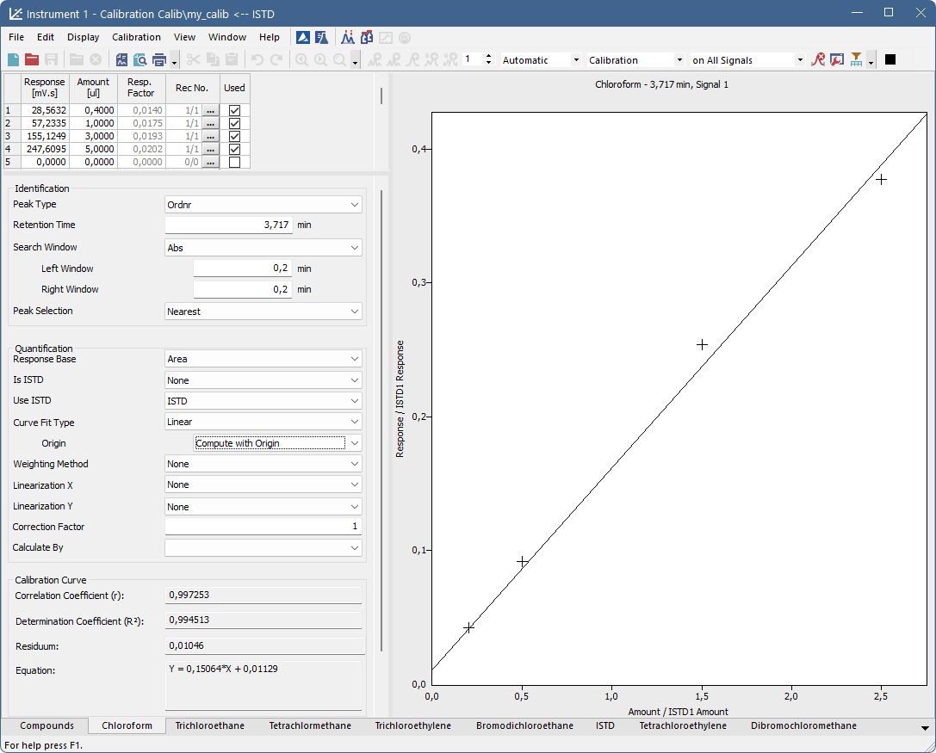
calibration
Individual compound tabs
Details for the given compound
Overview of all levels
How identified
How quantified
Calibration curve graph
BASIC OPERATIONS / CALIBRATION / COMPOUND TAB

Slide 36
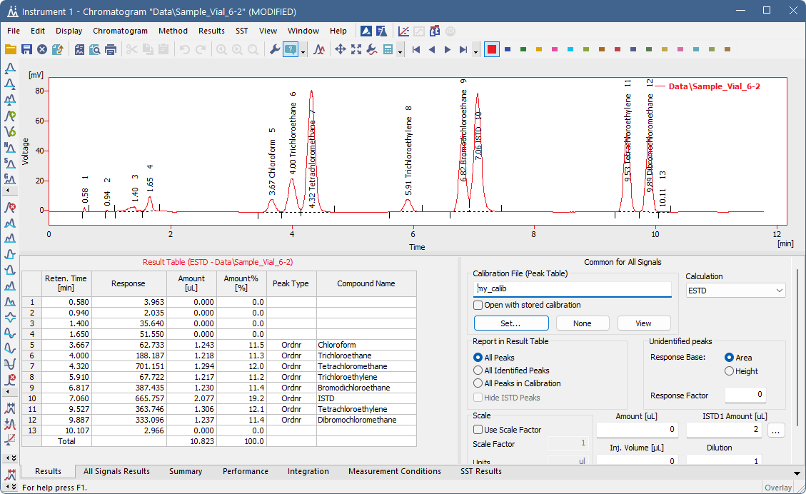
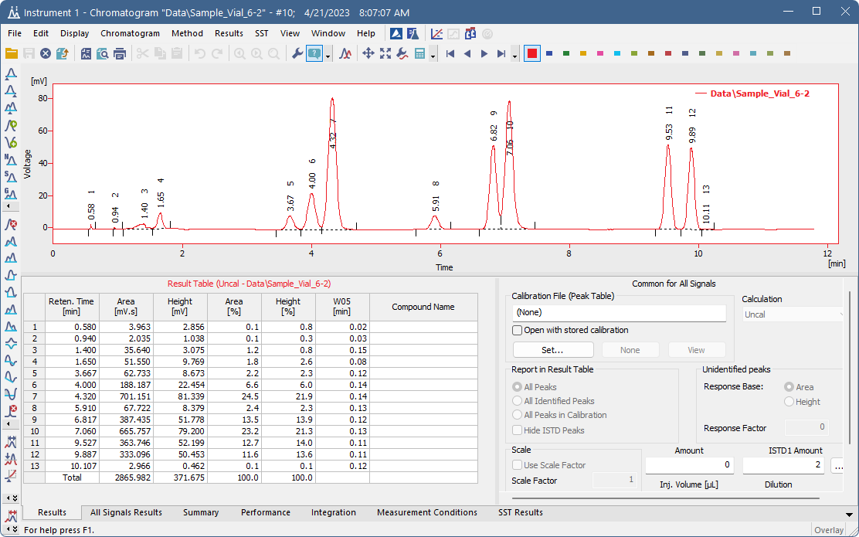

calibration
Linking to chromatogram
Calibration from method is automatically linked to all measured chromatograms
BASIC OPERATIONS / CALIBRATION / LINK TO CHROMATOGRAM

Slide 37
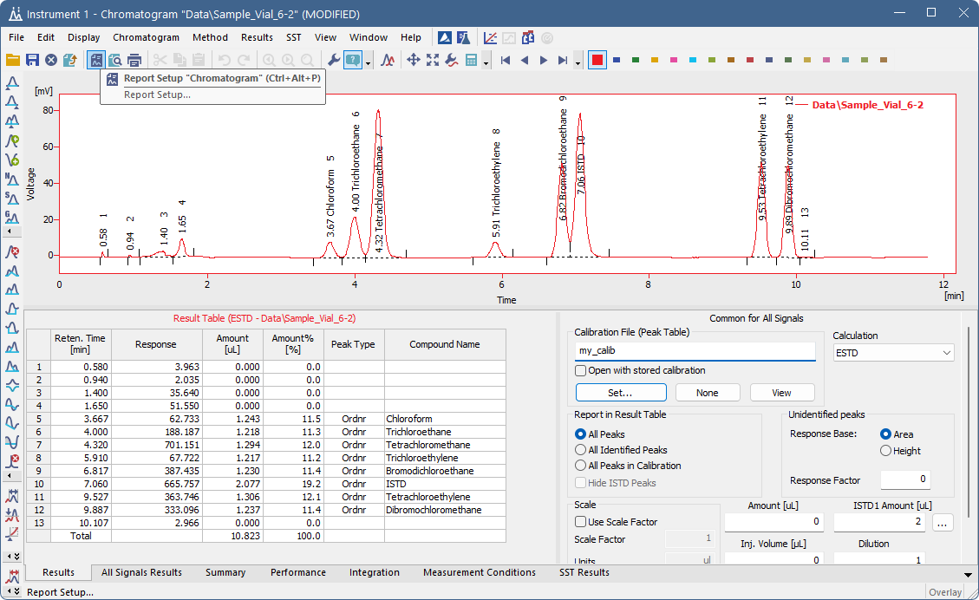
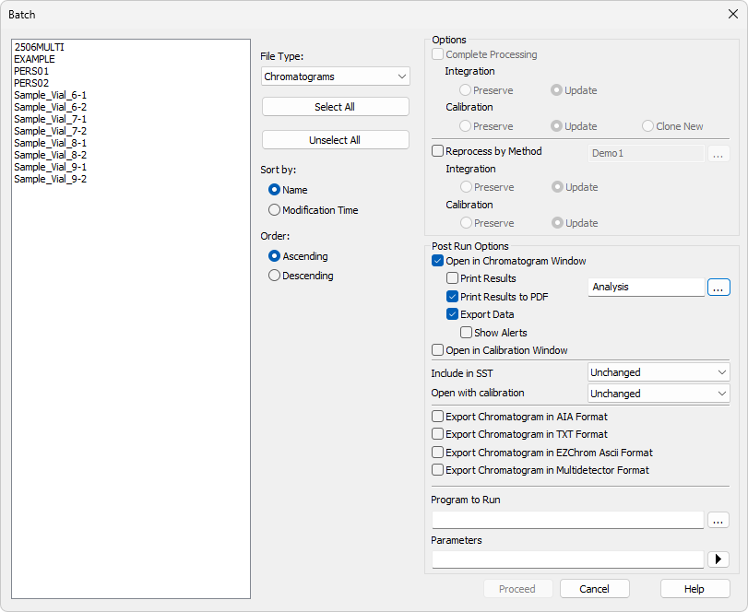
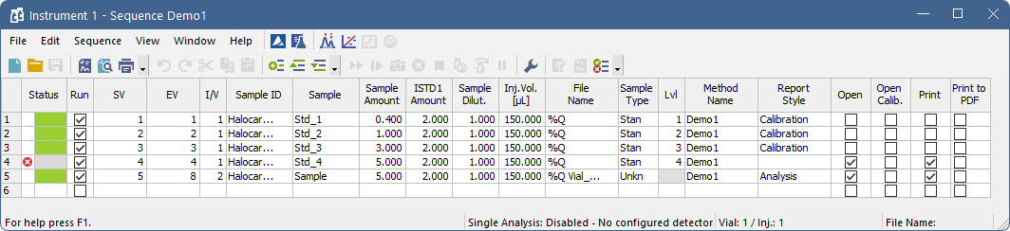
reports
WHERE TO ENABLE/EXECUTE
Manually from given window
Automatically after analysis end
Batch dialog
BASIC OPERATIONS / REPORTS

Slide 38
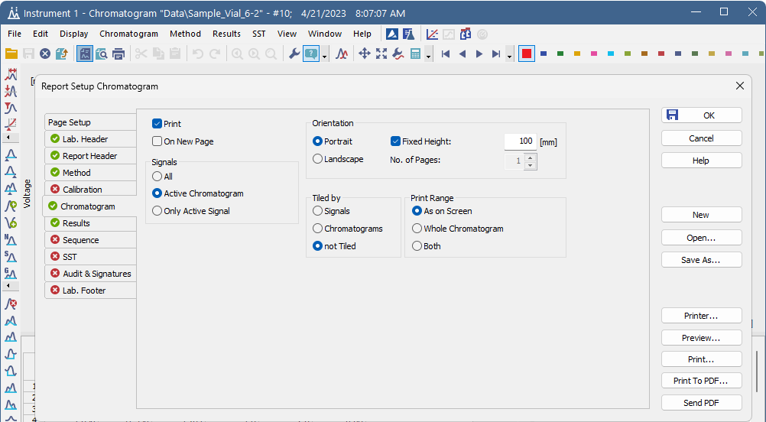
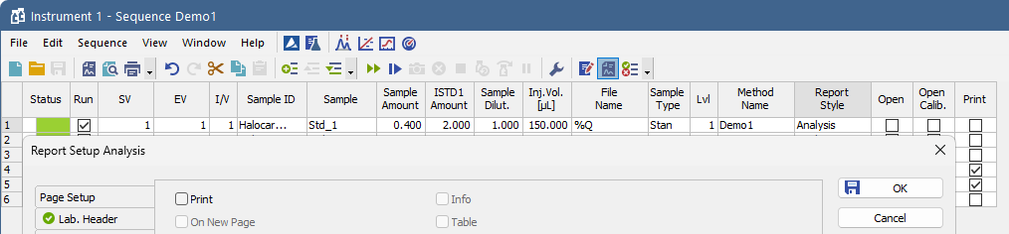
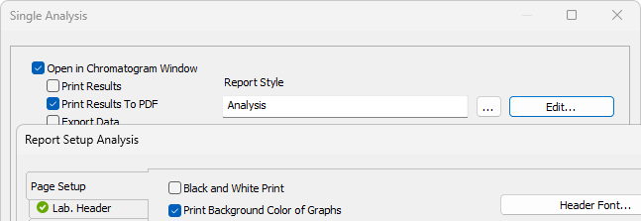
reports
Report setup
“Printing method” set separately for each window
*.sty files in COMMON folder
BASIC OPERATIONS / REPORTS

Slide 39
Thank you for your attention

