Slide 1
Clarity training
Advanced – part 1

Slide 2
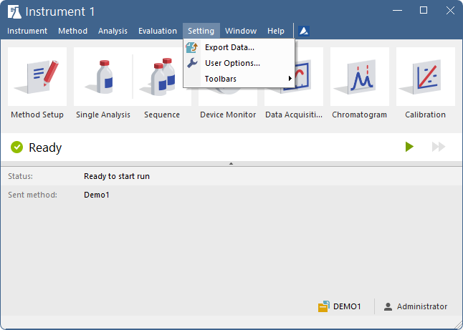
agenda
Instrument window
  User Options
Single Analysis
  Injected volume
  Autosampler use
Sequence table
  Sequence Mode
  Options
  Import, Fill series
ADVANCED TRAINING

Slide 3
agenda
Instrument window
  User Options
Single Analysis
  Injected volume
  Autosampler use
Sequence table
  Sequence Mode
  Options
  Import, Fill series
ADVANCED TRAINING

Slide 4
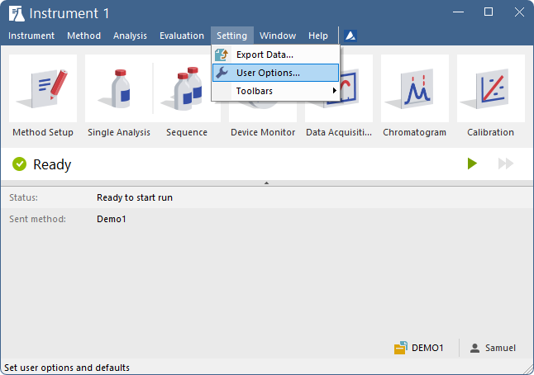
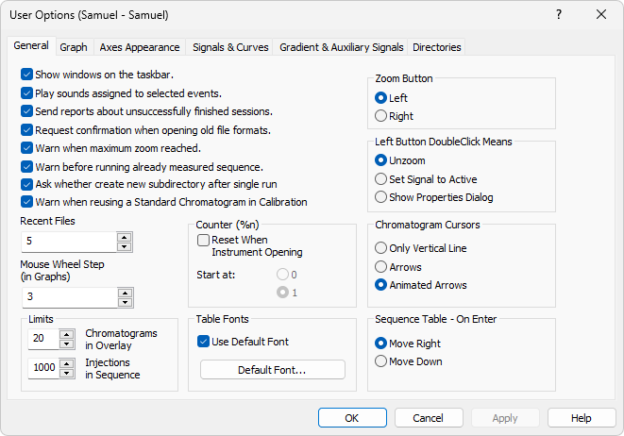
INSTRUMENT WINDOW
USER OPTIONS
Stored in desktop *.dsk files = can be set individually for each user
Shared desktop file to share settings
ADVANCED TRAINING / INSTRUMENT WINDOW / USER OPTIONS

Slide 5
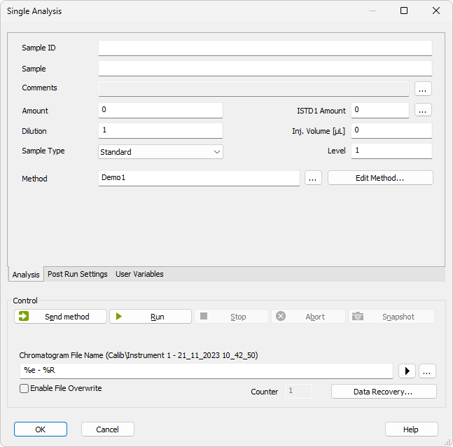
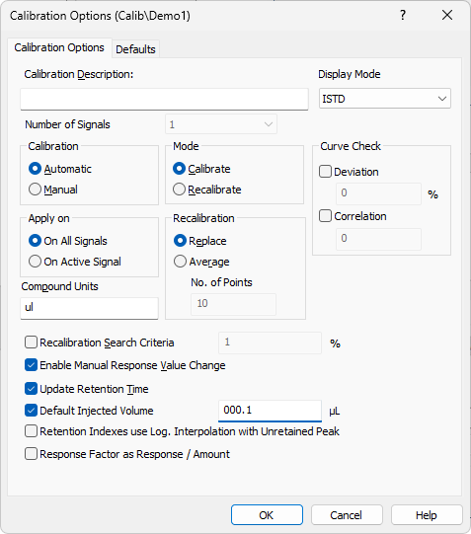
Single analysis
INJECTED volume
Linear detector response is considered
First, set Default Injected Volume in Calibration Options
In Single Analysis, set the Injection volume for the sample and standard
The responses are corrected by the ratio of Inj. Volume and Default Injected Volume in recalibration or calibration calculations
ADVANCED TRAINING / SINGLE ANALYSIS / INJECTED VOLUME

Slide 6
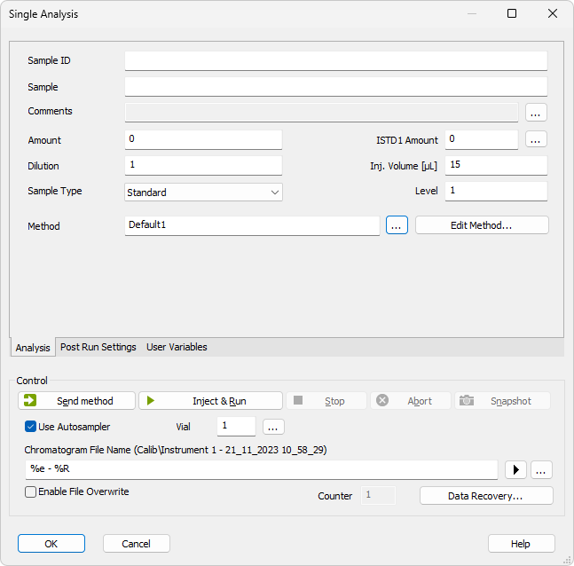
Single analysis
Autosampler use
Inject & Run performs one injection from the specified vial and starts the acquisition
Vial can be selected via a graphic interface if supported by the AS
The Use Autosampler checkbox is present only if AS is configured
ADVANCED TRAINING / SINGLE ANALYSIS / AUTOSAMPLER USE

Slide 7
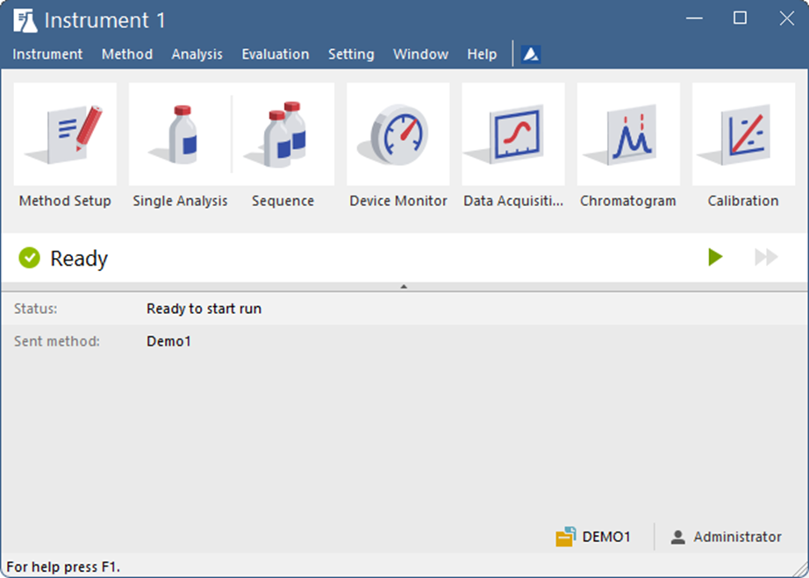
agenda
Instrument window
  User Options
Single Analysis
  Injected volume
  Autosampler use
Sequence
  Description
  Options and functions overview
  Import, Fill series, Select vial
ADVANCED TRAINING

Slide 8
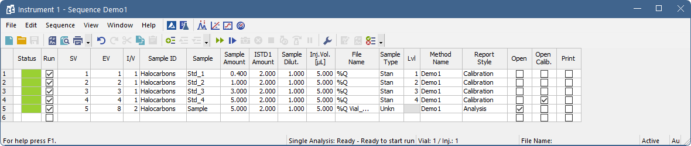
SEQUENCE TABLE OVERVIEW
ADD SAMPLES
Samples are added by filling the last empty row
  When any field is filled, the other fields are copied from the previous row
Copy & Paste one or more rows to add samples
Import of sample data from text files
Reprocessing of the last measured sample set
ADVANCED TRAINING / SEQUENCE TABLE OVERVIEW / ADD SAMPLES

Slide 9
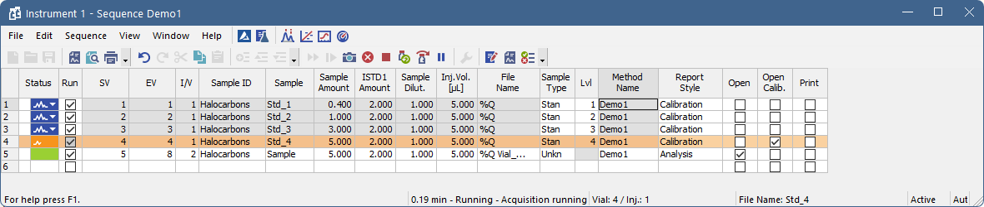
Sequence window
Description
SV, EV = start and end vial injection number
  A single row can define several vials/injections
Sample Type, Lvl = can be used for automatic recalibration via sequence
Window bottom shows the state of the sequence (runtime, vial, etc.)
ADVANCED TRAINING / SEQUENCE WINDOW / DESCRIPTION

Slide 10
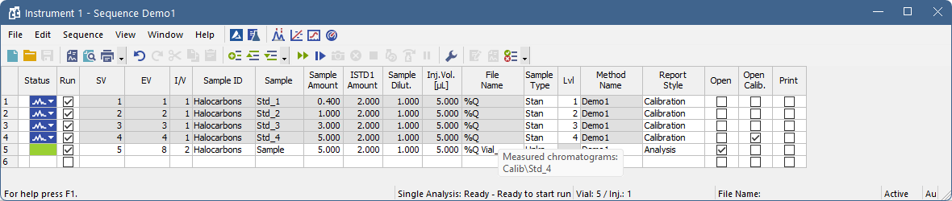
Sequence window
Description
Run sequence using Ctrl+Q or the icon
  Running sequence will lead to a reset of all rows (indicated by a message dialog)
Resume sequence Ctrl+Space or the icon
  Continue from the first unmeasured row with the Run option checked
Tooltips display additional details (e.g., actual file names of measured chromatograms, etc.)
ADVANCED TRAINING / SEQUENCE WINDOW / DESCRIPTION

Slide 11
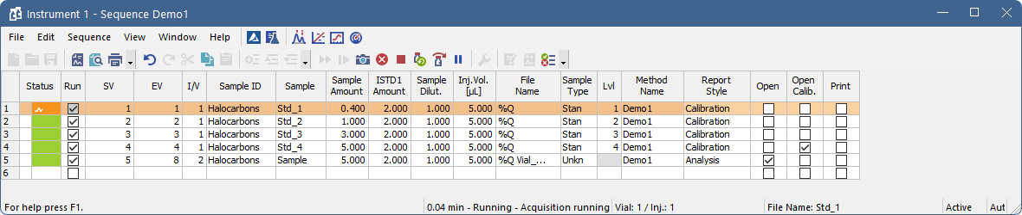
SEQUENCE WINDOW
Basic functions
Snapshot : create a temporary snapshot (will be replaced by the complete chromatogram when measured)
Abort sequence : terminate the sequence without saving the current chromatogram
Stop sequence : 1st click halts the sequence after the current measurement, 2nd click stops analysis immediately
Repeat injection : interrupt the actual measurement and repeat injection
Skip vial
Check sequence for errors
ADVANCED TRAINING / SEQUENCE WINDOW / BASIC FUNCTIONS

Slide 12
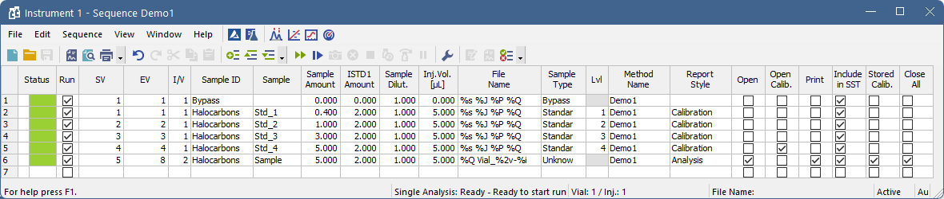
SEQUENCE WINDOW
Basic functions
Useful file name variables: %s = sequence, %J = Method, %P = project, %Q = Sample
Bypass sample type = run without injection (for startup and shutdown methods)
Include in SST – perform SST test when injection is finished
Stored Calib. – chromatogram will be opened with stored calibration
Close All – close all currently opened chromatograms in overlay
ADVANCED TRAINING / SEQUENCE WINDOW / BASIC FUNCTIONS

Slide 13
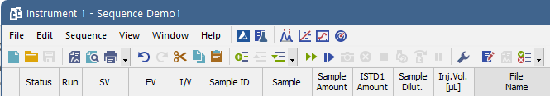
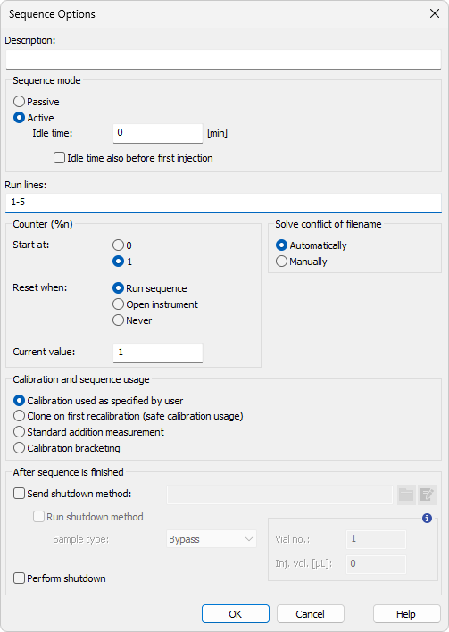
SEQUENCE WINDOW
SEQUENCE MODES AND OPTIONS
Passive sequence: Clarity only expects the START signal, the time of analysis is set by the autosampler (AS)
Active sequence: Clarity sends a READY signal to the AS and waits for the START signal
  AS control in active sequence: AS injects according to SV, EX, I/V, and Inj. Volume in the Sequence Table
Set the initial value for the %n variable
Choose the calibration mode applied for the whole sequence
ADVANCED TRAINING / SEQUENCE WINDOW / SEQUENCE MODES AND OPTIONS

Slide 14
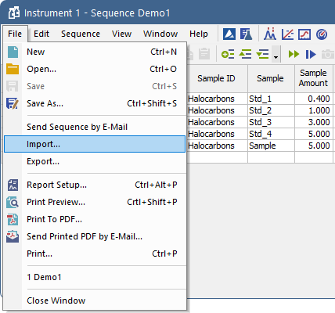
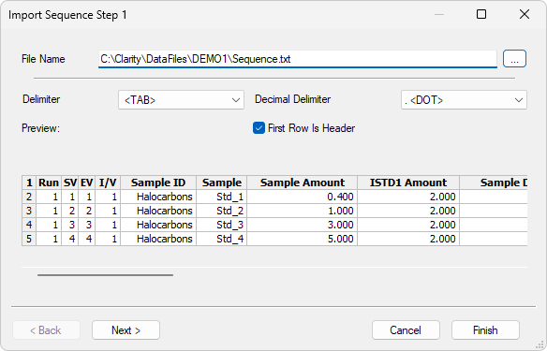
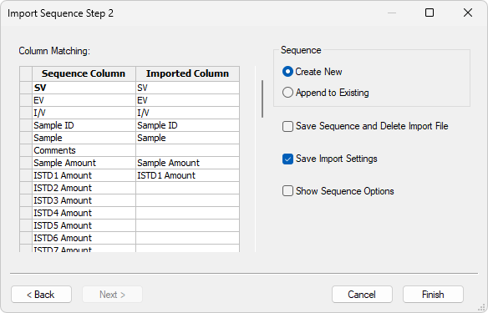
SEQUENCE WINDOW
IMPORT
Import Sequence Step 1 dialog: select files to import
Import Sequence Step 2 dialog: assign the respective fields to be imported
  the Start Vial (SV) and File Name (both in bold) are mandatory
ADVANCED TRAINING / SEQUENCE WINDOW / IMPORT

Slide 15
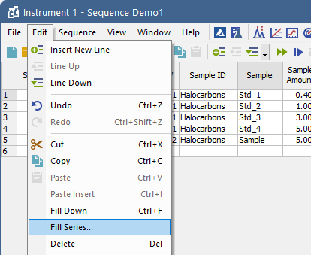
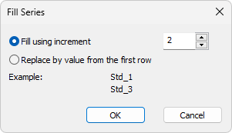
SEQUENCE WINDOW
FILL SERIES AND FILL DOWN
Available in Sequence and Calibration
Select a cell to be used for filling (numeric inputs, text inputs with numeric counters)
Fill down (Ctrl+F):
  Fill the cells below with the parameter in the selected cell
Fill series:
  Open the Fill Series dialog and specify the fill/replace parameters
ADVANCED TRAINING / SEQUENCE WINDOW / FILL SERIES AND FILL DOWN

Slide 16
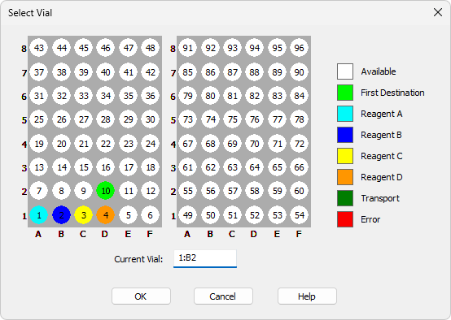
SEQUENCE WITH AUTOSAMPLERS
Select vial
The dialog with a graphic interface can be opened from Single Analysis/Sequence or viewed in Method Setup
Convenient for working with autosamplers (available only in some AS)
For controlled autosamplers, the vial number and injection volume are set in this dialog
Allows mid-run modifications for not yet processed samples
ADVANCED TRAINING / SEQUENCE WITH AUTOSAMPLERS / SELECT VIAL

Slide 17
Short break

