Slide 1
Uni Ruby
Development

Slide 2
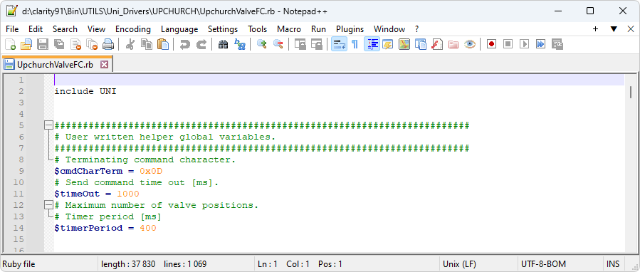
Uni Ruby
Text file with defined structure
Can be edited in text editor (Notepad++ recommended)
Easy to learn Ruby language https://www.ruby-lang.org/en/
  ruby gems not supported ☹
Simple instruments are made with UNI Ruby (pump, thermostat, detector)
C++ not needed (other than UNI Ruby script development the SDK needs to be used)
You need to know the protocol (commands issued on HW)
UNI Ruby Development

Slide 3
Script workflow
Lots of code
2 classes (Device and SubDevice)
You can‘t delete framework methods and classes (commented as „Method expected by framework“).
Common methods are Init, InitCommunication, InitConfiguration, CmdTimer, CmdSendMethod, ...
Common methods are in each script, but some devices have specific methods in addition
Global variables at the begining ($) – script scope
Device variables inside device class (@) – class scope
  Must be initialized in the CmdOpenInstrument function
UNI Ruby Development

Slide 4
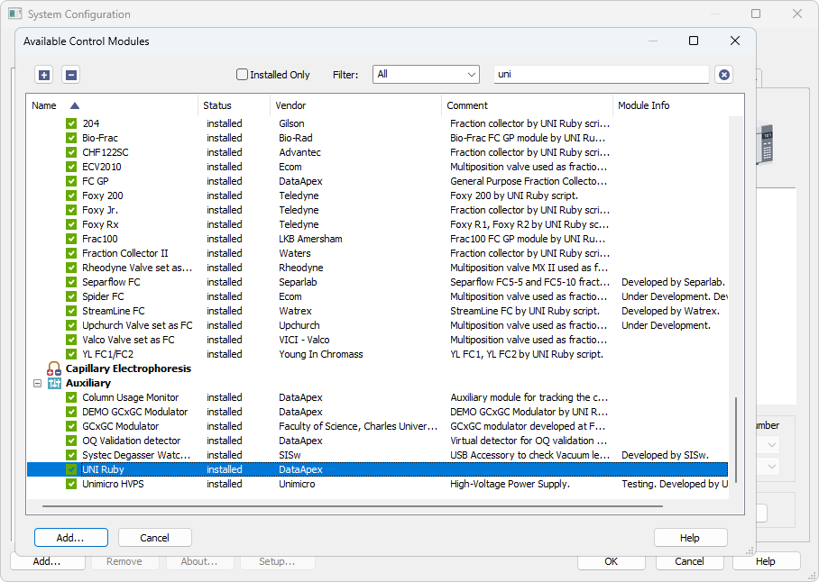
Open script in Clarity
UNI Ruby Development

Slide 5
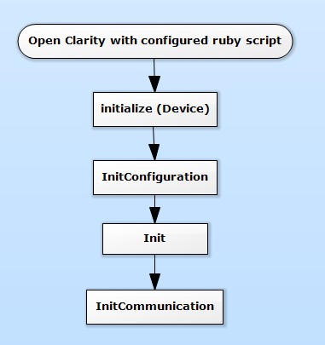
What‘s happening...
…when you open Clarity
When you modify a script file, you should restart Clarity to see changes.
UNI Ruby Development

Slide 6
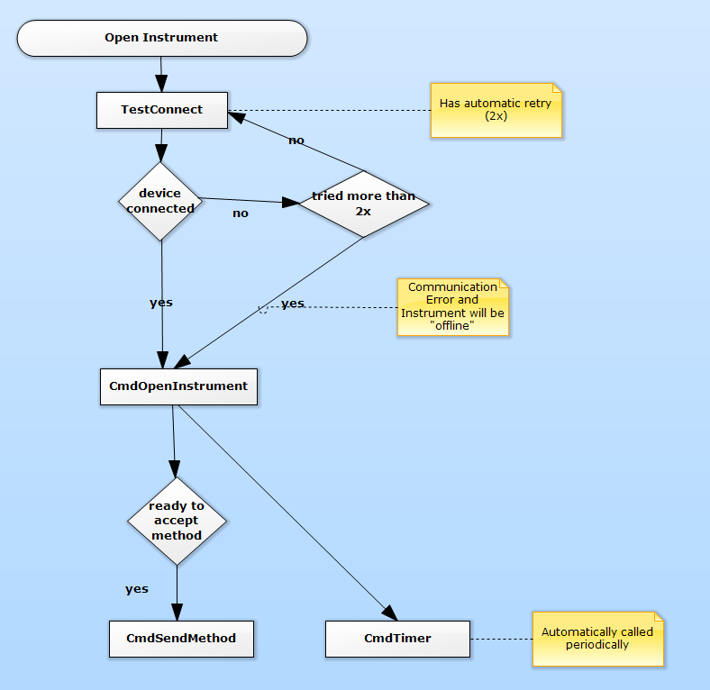
What‘s happening...
…when you open The Instrument
UNI Ruby Development

Slide 7
Clarity objects in script
Configuration()
  HW parameters, can‘t be changed after your open instrument (changes only from Clarity Configuration dialog)
  Autodetection, if CmdAutoDetect implemented
    Device name, Serial number
    Maximal flow, pressure
    Other options
Monitor()
  State of Device
  Buttons for Device control (stop pump, perform AutoZero, ...)
Method()
  Parameters that are set on the device when CmdSendMethod() is called
UNI Ruby Development

Slide 8
Clarity objects in script
Create UI Items
  TextBox <object>.AddString(...) or .AddInt(...) or .AddDouble
  CheckBox .AddCheckBox
  ComboBox .AddChoiceList and .AddChoiceListItem
  Button .AddButton
  Table .AddTable and .AddTableColumn
  (only allowed in Method)
Read values from UI Items with .GetString(...), GetInt(...), GetDouble(...), GetTableColumnValues(...)
  For ComboBox use GetString
  For CheckBox use GetInt
  For TextBox, it depends on definition
UNI Ruby Development

Slide 9
Objects type
Once you add object to a Configuration, Method or Monitor, a type of the object is stored within Clarity methods/configurations. You should not change the object type after releasing the script, that will break compatibility with already created configuration and method files in Clarity.
e.g.
First version of ruby script:
Method().AddString(„myObject“,…)
Later, when you change string to double:
Method().AddDouble(„myObject“,…)
Method().GetDouble(„myObject“) => ruby exception
When you need to change the type of existing object, it is better to create a brand new object with different ID and deprecate the old item (stop reading it, saving it, ...).
UNI Ruby Development

Slide 10
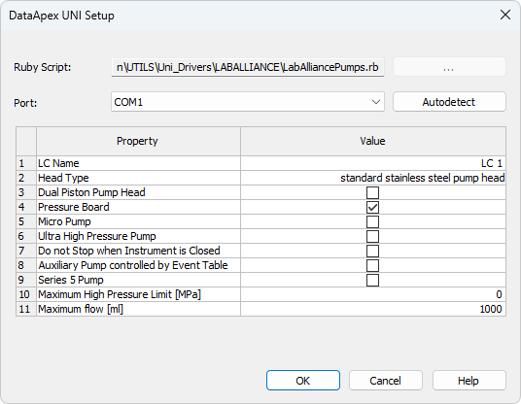
Configuration
InitCommunication
CmdAutoDetect
Hide with SetHideAutoDetect (true)
InitConfiguration
Values can be validated with user-defined function
UNI Ruby Development

Slide 11
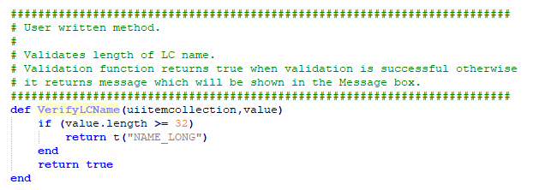
Validating items
You want to check some user input in Configuration table
  Configuration().AddString(..., ..., ..., 'VerifyDetectorName')
Validation function
  two parameters in declaration
    uiitemcollection, value
When the value is out of range, it returns message
Messagebox is shown automatically in Clarity from validation functions
UNI Ruby Development

Slide 12
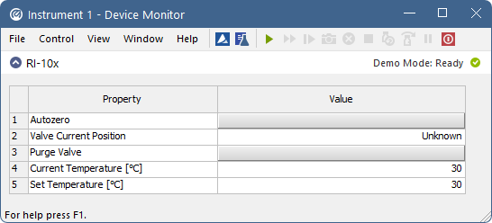

Device Monitor
Display status of device (temperature, flow, pressure)
Define in Init()
  Monitor().Add....
Data are typically read from device in CmdTimer()
Change values in Monitor with SetXyz methods
  Monitor().SetString(ID, value)
  Monitor().SetInt(ID, x)
Call Monitor().Synchronize() at the end of CmdTimer()
Similar to defining Configuration item
UNI Ruby Development

Slide 13
Device Monitor
Device state
Monitor().SetReady(bool)
Monitor().SetStateName(...)
Monitor().SetRunning(bool)
Items defined in Init
Monitor can be hidden
  SetHideMonitor(bool)
UNI Ruby Development

Slide 14
Device Monitor
Button with action
  Monitor().AddButton(‘ID‘, ‘label‘, ‘buttonText‘, ‘buttonAction‘)
Here, all parameters are passed as string, even the name of buttonAction.
buttonAction is your function in ruby script
UNI Ruby Development

Slide 15
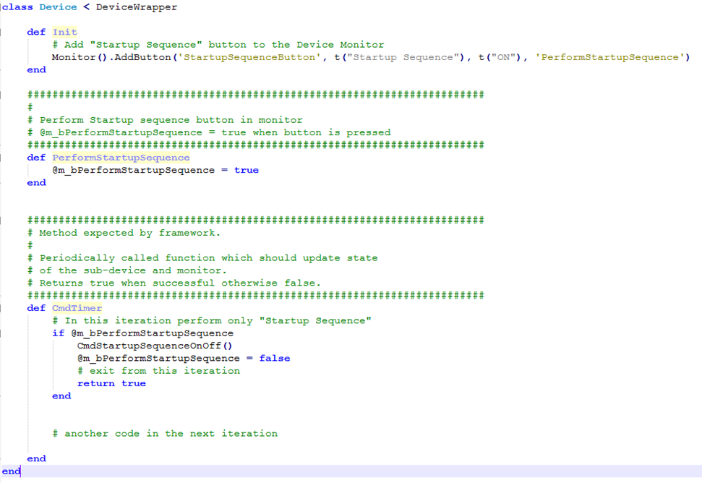
Device Monitor
  The buttonAction in the monitor is performed immediately and in parallel with the code in the CmdTimer, which can affect it executing code in the CmdTimer function.
  The solution is to perform only a single buttonAction in one iteration of the CmdTimer.
UNI Ruby Development

Slide 16
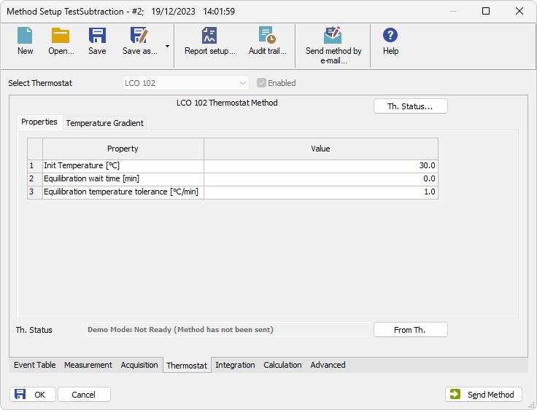
Method
Call Method().Add.... in Init() to define method table
  Similar to Configuration() and Monitor()
or Hide whole method with
  SetHidePropertyPage(true)
Framework functions:
CmdSendMethod()
  Send parameters to HW
  Method().Get....
CmdLoadMethod()
  Read HW settings from device
  hide button with SetHideLoadMethod(true)
CheckMethod(situation,method)
  Checking whether method is correct as a whole
  can get information from other places, e.g. vial number from sequence table, ...
UNI Ruby Development

Slide 17
The invoke order of Start functions
CmdStartSequence
CmdStartRun
CmdStartAcquisition
UNI Ruby Development

Slide 18
Communication with HW
Communication protocol
  Parameters of communication, set of commands used to control HW
Communication pipe
  Serial (rs232)
  TCP
  USB
UNI Ruby Development

Slide 19
Communication with HW
InitCommunication()
  Set number of pipe configurations for communication. In our case one - serial communication.
  Communication().SetPipeConfigCount(1)
  Set type for created pipe configuration.
    EPT_SERIAL Serial pipe.
    EPT_TCP TCP pipe.
    EPT_UDP UDP pipe.
    EPT_GSIOC GSIOC pipe.
    EPT_USBFTDI USB FTDI chipset pipe. SetUSBDeviceName().
    EPT_USBXP USB SiUSBXp chipset pipe. SetUSBDeviceName().
    Communication().GetPipeConfig(0).SetType(EPT_SERIAL)
    Communication().GetPipeConfig(0).SetBaudRate(19200)
    Communication().GetPipeConfig(0).SetParity(NOPARITY)
    Communication().GetPipeConfig(0).SetDataBits(DATABITS_8)
    Communication().GetPipeConfig(0).SetStopBits(ONESTOPBIT)
UNI Ruby Development

Slide 20
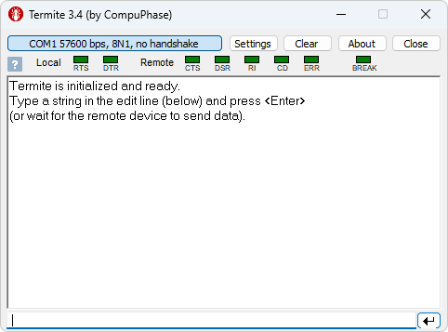
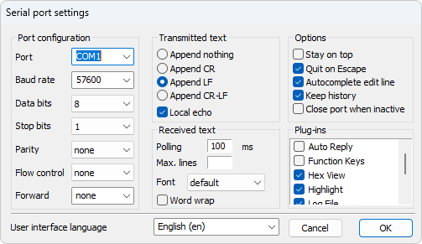
Communication with HW
Termite
  a simple RS232 terminal
  http://www.compuphase.com/software_termite.htm
  Test connection settings, answers from HW
UNI Ruby Development

Slide 21
Communication with HW
Create and Send Command
  cmd = CommandWrapper.new(self)
  cmd.AppendANSIString(" ")
  if (cmd.SendCommand($timeOut) == false)
  return false
  end
Read Answer
  answer = cmd.ParseANSIString()
  Parsed string when successful otherwise false!
  Parsed string is then removed from cmd
  other Append and Parse functions - see UNI Ruby documentation
  AppendANSIInt(x)
  AppendANSIDouble(...)
  AppendANSIChar
UNI Ruby Development

Slide 22
Communication with HW
Example – send command and parse answer
  cmd = CommandWrapper.new(self)
  cmd.AppendANSIString(„send me ok 100")
  if (cmd.SendCommand($timeOut) == false)
  return false
  end
  ok = cmd.ParseANSIString(„ok“)
  space = cmd.ParseANSIString(„ “)
  number100 = cmd.ParseANSIInt()
  thisIsFalse = cmd.ParseANSIString(„x“)
Expecting answer: „ok 100“
The last variable will be false, because cmd buffer contains nothing at the moment
UNI Ruby Development

Slide 23
Communication with HW
Example 2 – send command without expecting answer
  cmd = CommandWrapper.new(self)
  cmd.AppendANSIString("I1S0")
  cmd.AppendANSIChar($cmdCharTerm)
  if (cmd.SendCommand(0) == false)
  return „command not sent“
  else
  return „command sent“
  end
UNI Ruby Development

Slide 24
Communication with HW
How UNI ruby gets data from HW
UNI Ruby automatically checks for incoming data (sequence of bytes)
Data are then passed into FindFrame function for completion
FindFrame (dataArraySent, dataArrayReceived)
  dataArraySent – byte array containing your command
  dataArrayReceived – byte array containing incoming data
  Typical implementation - check leading & ending sequence of characters, calculate check sum of data and then mark beginning and end of the frame with framework functions:
    SetFrameStart(startIndex)
    SetFrameEnd(endIndex)
  If sentByteArray is nil – it means you have not send command to HW and it has sent unrequested data
  Return false, if data are incomplete (e.g. ending character is not found)
UNI Ruby Development

Slide 25
Communication with HW
Example:
FindFrame(dataArraySent, dataArrayReceived)
    nEndFrameIdx = dataArrayReceived.index($cmdCharTerm)
    if (nEndFrameIdx == nil)
    return false
    End
    # Set frame start and end indexes!
    SetFrameStart(0)
    SetFrameEnd(nEndFrameIdx)
    return true
Search character in byteArray with .index (or .rindex) function
  Example – find index of ‚a‘
    nEndFrameIdx = dataArrayReceived.index(‘A‘.ord) - correct
    nEndFrameIdx = dataArrayReceived.index(0x41) - correct (hex code)
    nEndFrameIdx = dataArrayReceived.index(‘A‘) - wrong
    you can‘t search char in byte array directly (convert array to string or parameter to code)
Frame is complete, if the data received from HW contains a terminating character.
Define $cmdCharTerm as global variable
UNI Ruby Development

Slide 26
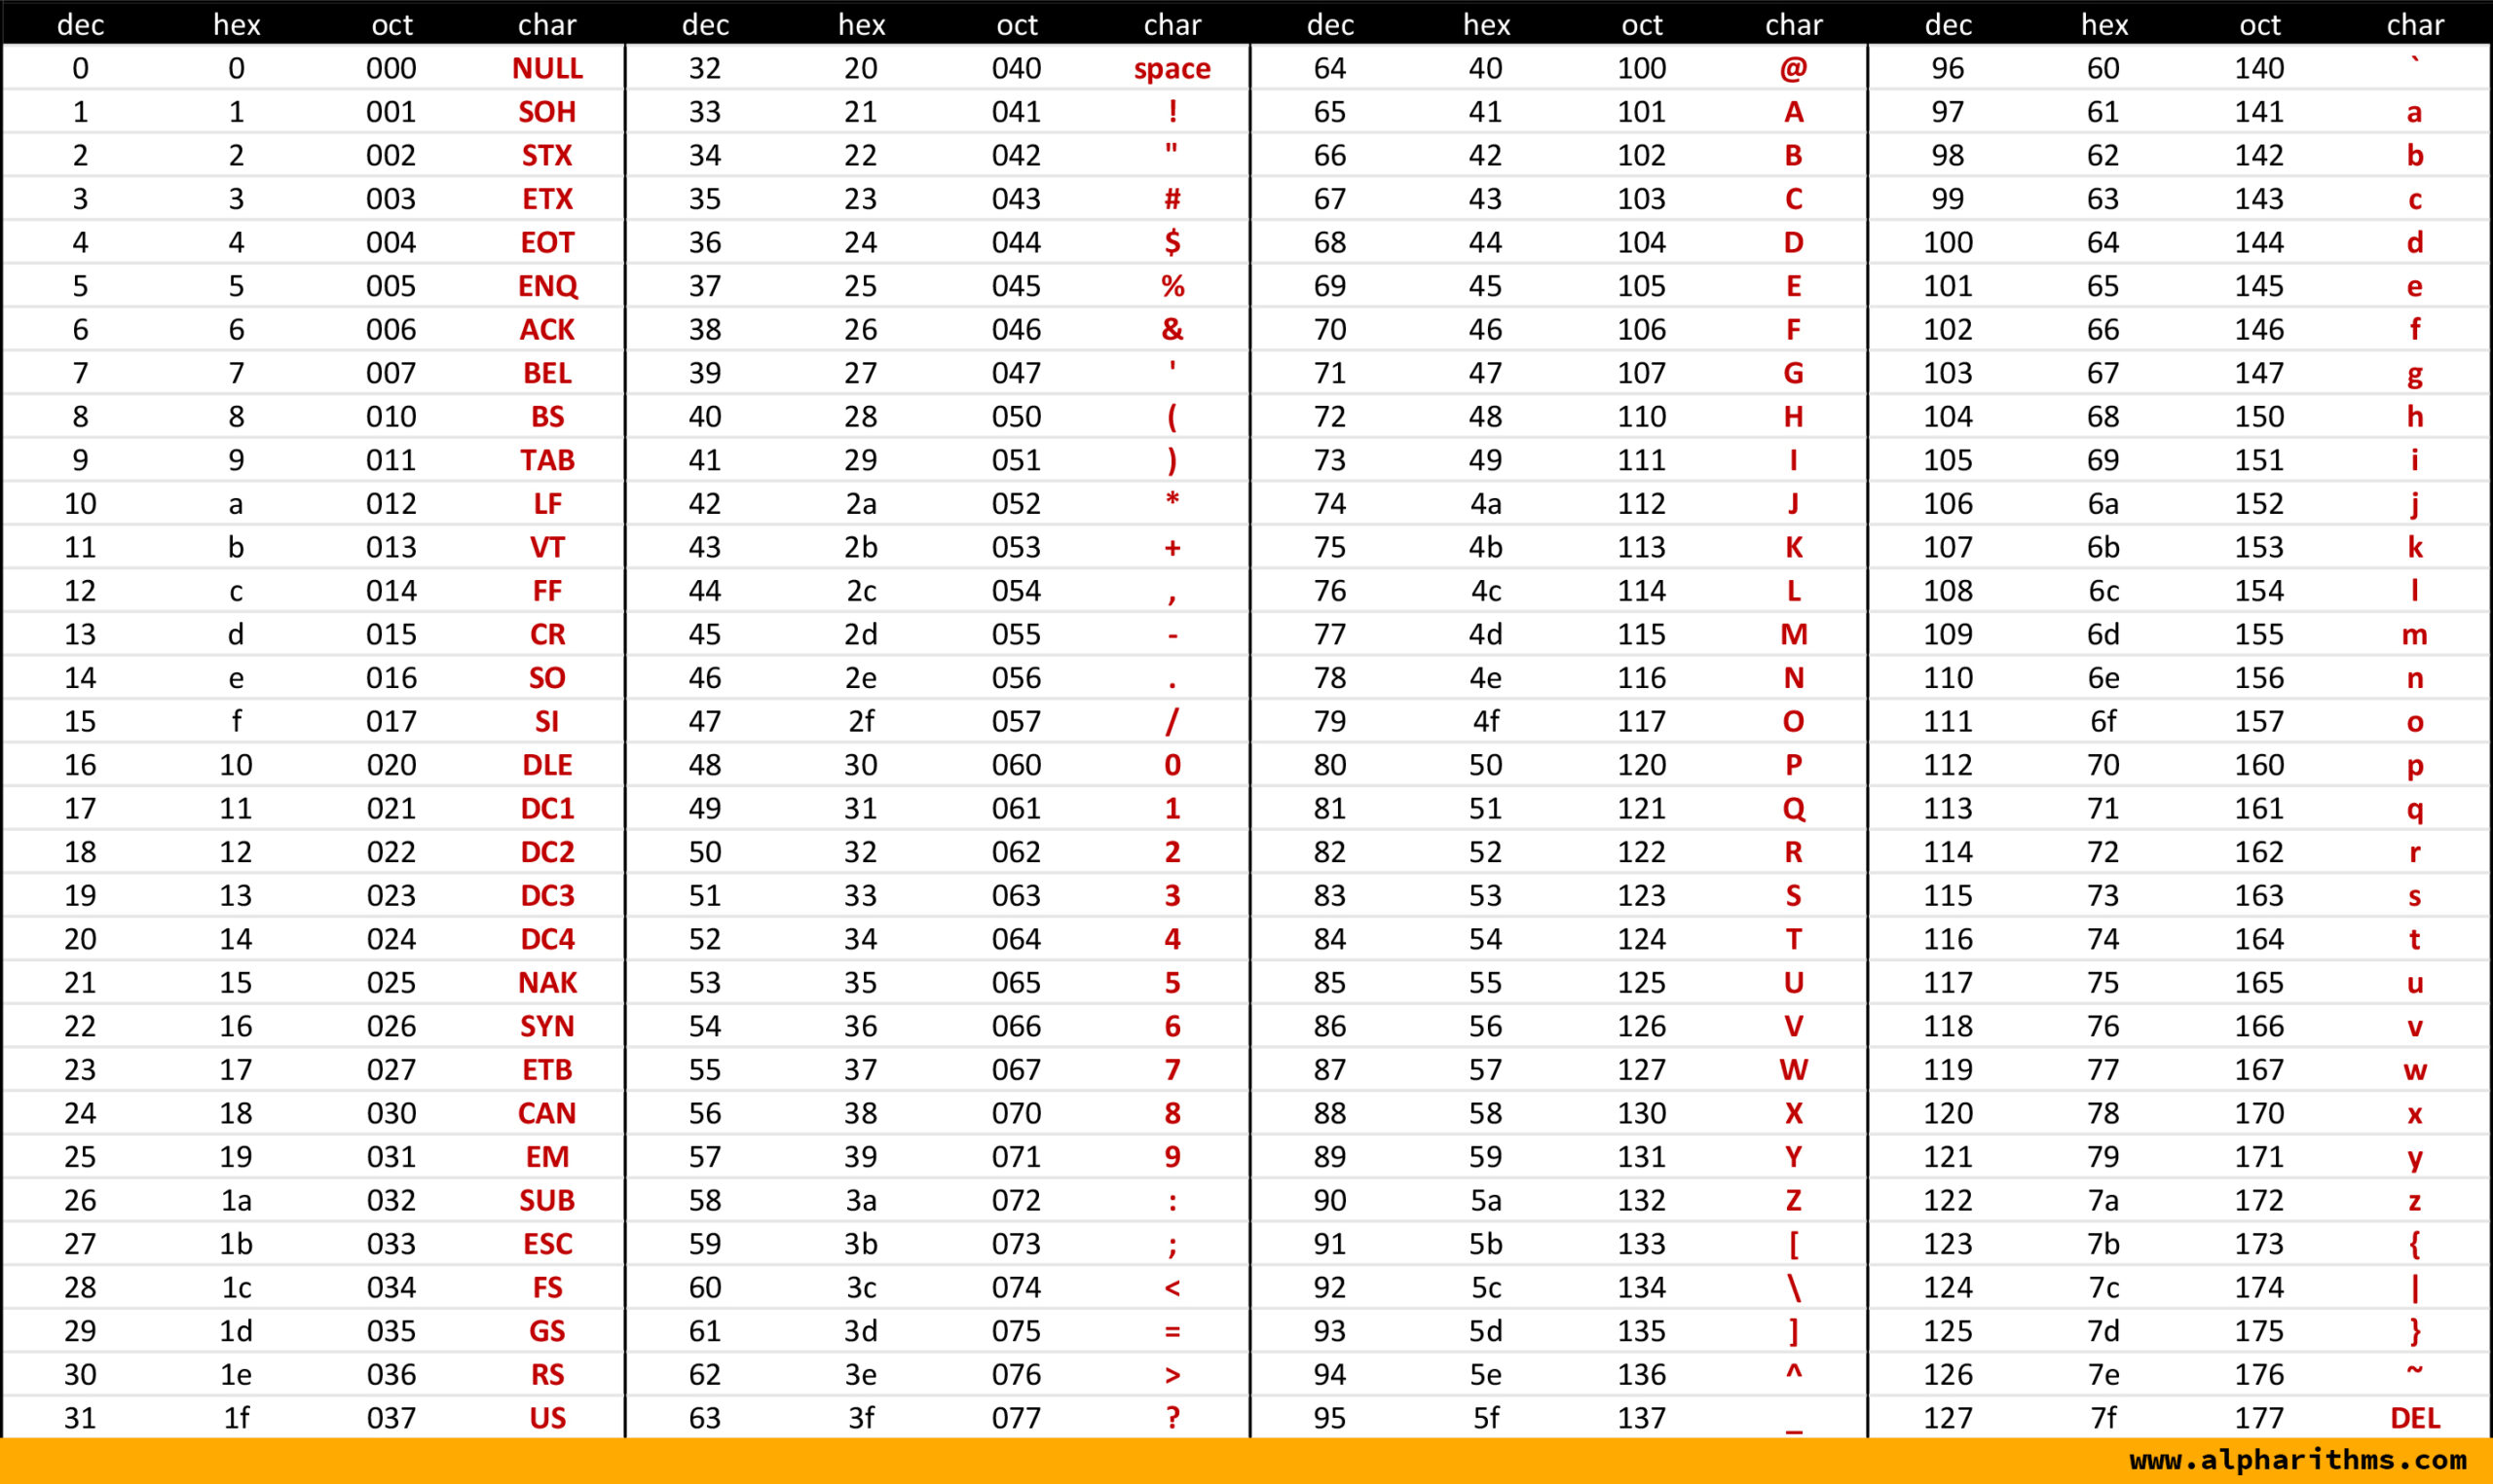
Communication with HW
ASCii table
UNI Ruby Development

Slide 27
Communication with HW
You can convert received data to string representation
  Use .pack("c*") => Pack every element as an 8-bit signed integer.
    str = dataArrayReceived.pack("c*") => „Hello, world“
  If you expect non-ascii characters – use parameter "C*"
    C* is for 8-bit unsigned (unsigned char)
Unicode characters
  .pack(„U*“)
UNI Ruby Development

Slide 28
Communication with HW
Implement IsItAnswer(dataArraySent, dataArrayReceived)
  If IsItAnswer() returns false, then frame is not passed to command waiting for the answer and frame is passed into ParseReceivedFrame() for processing as unrequested data
  common scenarios:
    All data from HW can be your answer
    return true
    Pass answers to your questions only
    if (dataArraySent == nil || dataArraySent.length == 0)
    return false
    end
    Skip specific answers
    if (dataArrayReceived[0] == 0x15)
    return false
    end
More info can be found in UNI RUBY DataApex Help - DeviceWrapper Class Reference
UNI Ruby Development

Slide 29
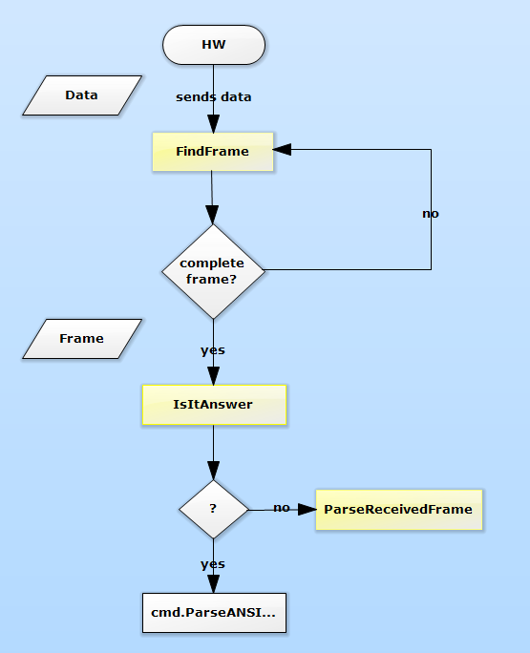
Communication with HW
Implement ParseReceivedFrame(receivedByteArray) to processes unrequested data sent by hardware
UNI Ruby Development

Slide 30
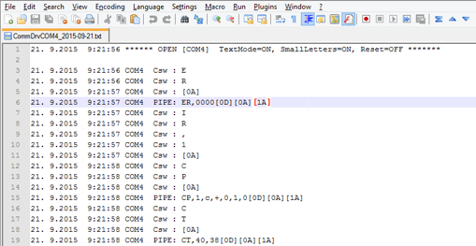
Communication with HW
Enable communication log for device
  open CommDrv.ini
  find your communication pipe (or add it) and set echo=ON
  restart Clarity for the changes to take effect
    [COM1]
    echo=ON
    textmode=ON
    filename=CommDrvCOM1_%D.txt
    reset=OFF
Send command (Csw)
Received answer (PIPE)
UNI Ruby Development

Slide 31
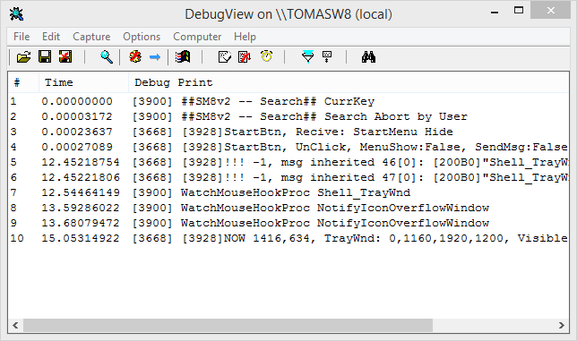
Debugging script
  TracePipe (pipeNumber, message)
    Function allowing to place specific text right into the pipe communication log when pipe logging is enabled and configured in CommDrv.ini
  Trace(message)
    sending a string to the debug monitor.
    The given string has to be less than 512 characters long. Output can be captured by DbgView.exe.
    https://technet.microsoft.com/en-us/sysinternals/debugview.aspx
    Or newer open-source https://github.com/djeedjay/DebugViewPP
UNI Ruby Development

Slide 32
Error handling
ReportError (errorSeverity, message) – show error in Clarity
  EsStopSingle_StopSeq
  Stops both current acquisition and sequence, device gets into initial/idle state. For example pipe error, detector error, auto-sampler motor error. Clarity continues in CONTROL TIME, sub-device causing this error must decide if it has sense for it to continue in CONTROL TIME itself, whatever decision is reported to Clarity via CSubDevice::GetMethodLength. When CSubDevice::GetMethodLength returns METHOD_FINISHED then CONTROL TIME is skipped.
  EsStopSingle_RunSeqIfNotCalibration
  Autosampler's error level for reporting MISSING VIAL error.
  Stops current acquisition but tries to continue with sequence if current vial is not calibration. It should be enabled in autosampler method (by some combobox) if Clarity should continue in sequence when non-calibration vial is missing. Clarity continues in CONTROL TIME, sub-device causing this error must decide if it has sense for it to continue in CONTROL TIME itself, whatever decision is reported to Clarity via CSubDevice::GetMethodLength. When CSubDevice::GetMethodLength returns METHOD_FINISHED then CONTROL TIME is skipped.
UNI Ruby Development

Slide 33
Error handling
ReportError (errorSeverity, message) – show error in Clarity
  EsStopSingle_RunSeq
  Autosampler's error level for reporting MISSING VIAL error.
  Stops current acquisition but tries to continue with sequence. It should be enabled in autosampler method (by some combobox) if Clarity should continue in sequence when whatever vial is missing. Clarity continues in CONTROL TIME, sub-device causing this error must decide if it has sense for it to continue in CONTROL TIME itself, whatever decision is reported to Clarity via CSubDevice::GetMethodLength. When CSubDevice::GetMethodLength returns METHOD_FINISHED then CONTROL TIME is skipped.
  EsLogInfo
  Information or success to be written into Clarity CDS, sequence and chromatogram log (no message box would appear on screen).
  EsLogFailure
  The least severe error, writes into Clarity CDS, sequence and chromatogram log (no message box would appear on screen).
UNI Ruby Development

Slide 34
Error handling
ReportError (errorSeverity, message) – show error in Clarity
  EsAbort
  Little less severe error than esShutDown for reporting LC pressure errors and similar.
  It is possible to customize reaction on CmdAbortRunError signal in device method, for example user wants to switch detector lamps off when running sequence over night but does not want to switch detector lamps off when running attended single runs. Clarity does not continue in CONTROL TIME but chromatogram is created.
  EsCommunication
  Indicates, that particular HW does not communicate.
  if (cmd.SendCommand($timeOut) == false)
  ReportError(EsCommunication, t("COMMAND_TIMEOUTED") % „xxx")
  return false
  end
UNI Ruby Development

Slide 35
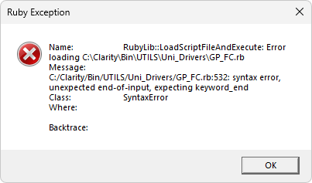
Ruby Exception
Check your script with Ctrl+shift+F7 from Notepad++ with UNI Ruby Plugin installed
When error in ruby script occurs (syntax error, wrong variable used,...), Clarity will show error message with description.
Look for a line number and message, if you have Notepad++ with script opened, the line should be automatically selected
UNI Ruby Development

Slide 36
Ruby script localization
Implement function t(stringID) - copy code to your script from other existing scripts
def t(stringID)
  $locale = GetLanguageCode() # ask Clarity about current language code
  defaultLang = "ENG" #TraceLine ("Lang:" << $locale.to_s)
  if (!$locale)
  $locale = defaultLang
  elsif (!$translation.has_key?($locale)) #Missing language - set language to default $locale = defaultLang
  end
  if ($translation.has_key?($locale) && $translation[$locale].has_key?(stringID)) return $translation[$locale][stringID]
  elsif ($locale != defaultLang && $translation.has_key?(defaultLang) && $translation[defaultLang].has_key?(stringID))
  #Chosen language does not have translation with given ID, use default language instead
  return $translation[defaultLang][stringID]
  end
  return stringID + " string not found"
end
UNI Ruby Development

Slide 37
Ruby script localization
Localized string are stored in global variable $translation at the end of script
type Hash http://ruby-doc.org/core-2.3.0/Hash.html
$translation = {
"ENG" => {
"NAME" => "LC Name",
"NAME_LONG" => "LC name too long.",
"COMMAND_TIMEOUTED" => "Command %s timeouted.",
"BAD_ANSWER" => "Command %s wrong answer",
"BAD_ANSWER2" => "Command %s wrong answer: %s",
"ERR_10" => "Command not in the specified format",
"ERR_20" => "Outside of set value limits specified„
}
}
Use in script
t(„string_ID“)
t(„string with %parameter“) % variable
t(„string with 2 % parameters) % [variable1, variable 2]
String parameters:
%s - string
%d – integer number
%.3f – float number (3 decimal places)
UNI Ruby Development

Slide 38
Uni Ruby
Devices Types

Slide 39
Thermostat (Oven)
SubDevice class
  class Thermostat < ThermostatSubDeviceWrapper
Device class Init
  @m_Thermostat=Thermostat.new
  AddSubDevice(@m_Thermostat)
Add Auxiliary signal (optional)
  AuxSignal().AddSignal("Temperature", t("TEMPERATURE"), EMeaningTemperature)
Doesn‘t have any special framework methods
Aux. signals can be added in all device types
UNI Ruby Device Types

Slide 40
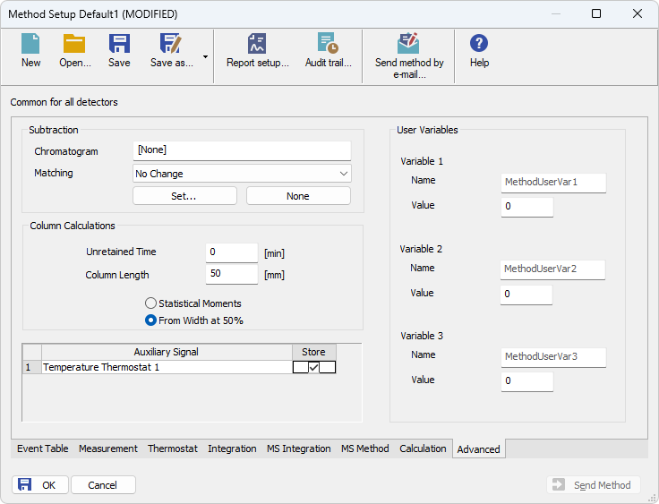
Auxiliary signal
Check signal in Method Setup > Advanced dialog
UNI Ruby Device Types

Slide 41
Pump
SubDevice class
  class LC < LCSubDeviceWrapper
Device class Init
  @m_LC=LC.new
Set Pressure limits
  SetDefaultLowerPressureLimit(...)
  SetDefaultUpperPressureLimit(...)
Auxiliary pump
    @m_LC.SetLCIsAuxiliaryEventTable(Configuration().GetInt("AuxiliaryPump")!=0)
Add Auxiliary Signals (optional)
  if the pump is auxiliary specify EMeaningAuxiliaryFlowRate
  AuxSignal().AddSignal(@m_LC,"LCFlow", t("LC_FLOW"), EMeaningAuxiliaryFlowRate)
  or standard flow rate
  AuxSignal().AddSignal(@m_LC,"LCFlow", t("LC_FLOW"), EMeaningFlowRate)
UNI Ruby Device Types

Slide 42
Pump
Write auxiliary signal in CmdTimer()
  AuxSignal().WriteSignal(string signalName, double value)
Implement framework methods for pumps
  CmdSendAuxiliaryLCFlow(lc,float)
    float in ml/min
  CmdSendLCFlow(floats)
    Use floats[0] !
Both methods do the same thing, but the have different parameters
UNI Ruby Device Types

Slide 43

AutoSampler
SubDevice class
  class Aux < SamplerSubDeviceWrapper
Device class Init
  @m_Aux=Aux.new
  AddSubDevice(@m_Aux)
Specify minimum and maximum injection volume and possible step in mL
  SetVolumeRange (double min, double max, double step)
Add Input (optional)
  Init
    Input().AddInput("Input1", EitDigital, 0, Configuration().GetString("Input1"), "")
  Sends event of specified input and given value into Clarity CDS to be processed. Change of input can be detected in CmdTimer() or ParseReceivedFrame().
    Input().WriteInput("Input1",1)
    Input().WriteInput("Input1",0)
More info can be found in UNI RUBY DataApex Help - DeviceWrapper Class Reference
UNI Ruby Device Types

Slide 44
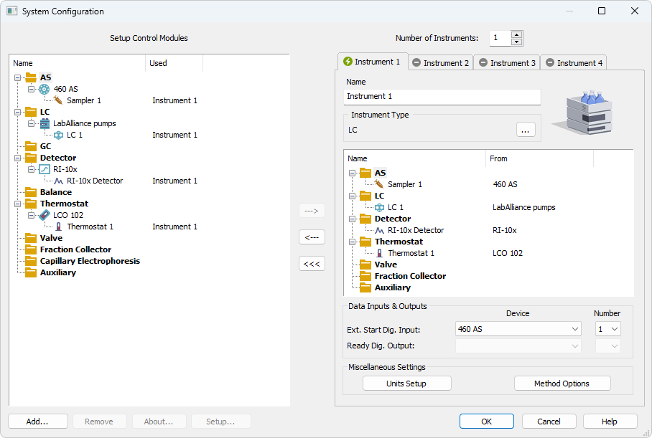
AutoSampler - Inputs
UNI Ruby Device Types

Slide 45
AutoSampler
Add Output (optional)
  see UNI Ruby help
  CmdWriteOutputInt
  CmdWriteOutputDouble
  CmdWriteOutputString
Implement CmdSendMethod – get vial number from Clarity and set vial for AutoSampler
  Method().GetVial()
Implement
  CmdPerformInjection - Indicates into samplers, that injection should be performed
  CmdByPassInjection
UNI Ruby Device Types

Slide 46
Detector
SubDevice class
  class Detector < DetectorSubDeviceWrapperDevice
Decice class Init
  @m_Detector = Detector.new
  @m_Detector.SetName(Configuration().GetString('DetectorName')
  AddSubDevice(@m_Detector)
Set Rate and Range after AddSubDevice
  @m_Detector.SetRate (double sampleRate)
  @m_Detector.SetRange (double range)
  @m_Detector.SetYUnits (strBaseUnit, strAxisName, bool bScalable, double nCoefToBase)
@m_Detector.SetYUnits('µRIU', t("REFRACTIVE_INDEX"), false, 1.0)
UNI Ruby Device Types

Slide 47
Detector
It can be constant, or you can use parameter to read values from method table:
method.Get.....
Implement framework methods:
  GetMethodRate(method)
  GetMethodRange(method)
Set Rate and Range at the beginning of CmdSendMethod
  @m_Detector.SetRate(...)
  @m_Detector.SetRange(...)
Read data from detector and write it to Clarity
  @m_Detector.WriteSignal (value)
  usually in CmdTimer()
  you can write multiple values in one period of CmdTimer
UNI Ruby Device Types

Slide 48
Fraction Collector
SubDevice class
  class FRC < FRCSubDeviceWrapper
Device class Init
  @m_FRC=FRC.new
  AddSubDevice(@m_FRC)
Initialize vial range - default FRC start/end vial number to be shown in UI, interesting for FRC methods only.
  SetDefaultFRCStartVial (int vialNumber)
  SetDefaultFRCEndVial (int vialNumber)
Implement framework methods:
  CmdFRCCollect() - change FRC to collect mode
  CmdFRCWaste() - change FRC to waste mode
UNI Ruby Device Types

Slide 49
Fraction Collector
CmdNextFRCPosition() - Send request to go to next valve position. Called by FC in UNI Ruby during automatic collection
CmdGetFRCPosition() (optional – some collectors do not report their position)
Fraction collector manual control
from Monitor() - button
notify framework that FRC changed its state and vial position
  OnFRC(state, vialPosition)
    OnFRC(FrcConfirmVial, Position)
    OnFRC(FrcManualWaste,NOVIAL)
    OnFRC(FrcManualCollect,NOVIAL)
    OnFRC(FrcManualNext,NOVIAL)
    OnFRC(FrcManualChangeVial,setPosition)
UNI Ruby Device Types

Slide 50
Fraction Collector
FrcConfirmVial
Confirm current vial number, can be called from Resume Method button
FrcManualWaste
Notify, that FRC started collecting as a reaction to user request from monitor, should be called from button click event handler. CmdFRCWaste() will get called from framework!
FrcManualCollect
Notify, that FRC started collecting as a reaction to user request from monitor, should be called from button click event handler. CmdFRCCollect() will get called from framework!
UNI Ruby Device Types

Slide 51
Fraction Collector
FrcManualNext
Notify, that FRC shifted to next vial as a reaction to user request from monitor, should be called from button click event handler. CmdNextFRCPosition() will get called from framework. If collecting and ‚Waste during vial change‘ is checked, also CmdFRCWaste() and CmdFRCCollect().
FrcManualChangeVial
Notify, that FRC changed vial as a reaction to user request from monitor, should be called from button click event handler. If collecting and ‚Waste during vial change is checked‘, also CmdFRCWaste() and CmdFRCCollect().
option in Method Setup dialog
UNI Ruby Device Types

Slide 52
Fraction Collector
Important FRC functions
  method.GetFRCStartVial() – obtain default start vial set in method
  method.GetFRCEndVial() – obtain default end vial
  Method().GetFRCResetCondition()
    ErcStartRun set hardware position to GetFRCStartVial() after start of method run - implement in CmdStartSequence()
      if Method().GetFRCResetCondition()==ErcStartRun #CmdFRCWaste() CmdSetFRCPosition(Method().GetFRCStartVial())
      end
    ErcStartSequence set hardware position to GetFRCStartVial() after start of sequence - implement in
      if Method().GetFRCResetCondition()==ErcStartSequence CmdSetFRCPosition(Method().GetFRCStartVial())
      end
    ErcOpenInstrument - set hardware position to FRCStartVial() after Instrument window is opened – implement in CmdSendMethod, when method is send for the first time
UNI Ruby Device Types

Slide 53
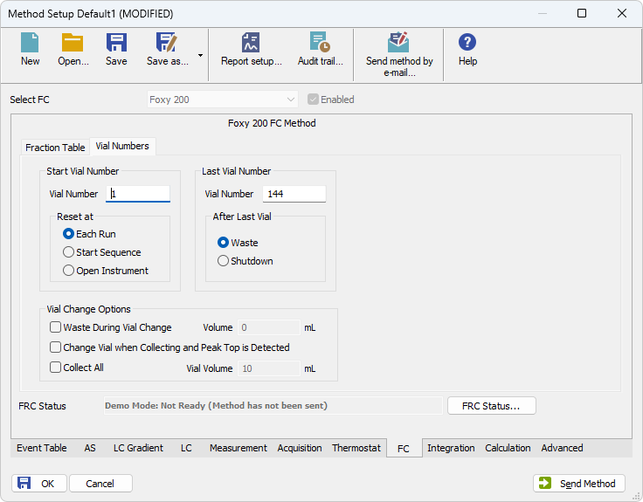
Fraction Collector
Method().GetFRCStartVial()
Method().GetFRCEndVial()
  Method().GetFRCResetCondition()
UNI Ruby Device Types

Slide 54
Thank you for your attention

