Slide 1
P051/80A
15.04.2019
Clarity 8.2
WHAT'S NEW

Slide 2
What is new in Clarity 8.2
Instrument status in Main Clarity window
New GLP option
Improvements in MS extension
Prohibition of unauthorized control modules
New and updated control modules

Slide 3
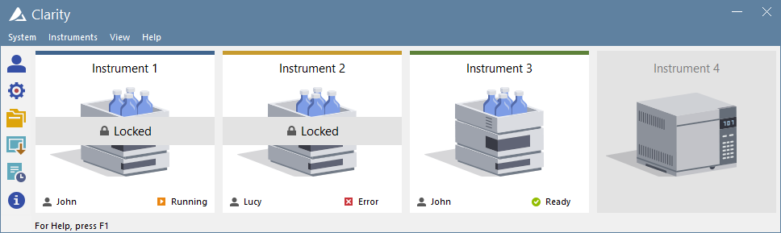
Instrument
Status
GLP
MS
Unauthorized
Controls
New Control Modules
Each logged in Instrument displays the corresponding status in the Main window – eg. Running, Error, Ready, etc.

Slide 4
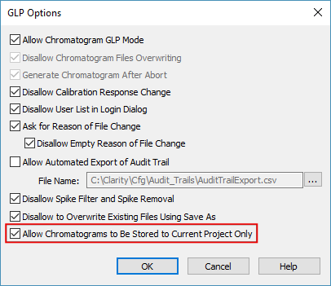
Instrument
Status
GLP
MS
Unauthorized
Controls
New Control Modules
New GLP option allowing to store measured data into current project directory

Slide 5
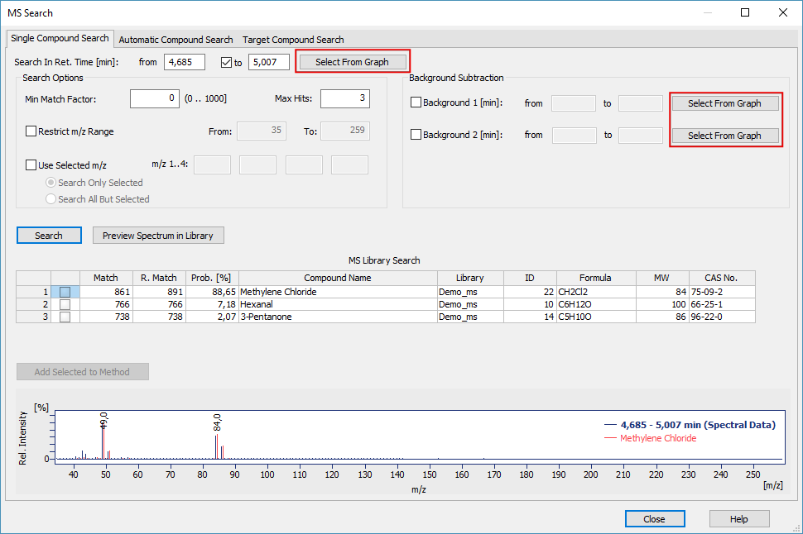
Instrument
Status
GLP
MS
Unauthorized
Controls
New Control Modules
New Select From Graph button allows for a more convenient input of Retention Time

Slide 6
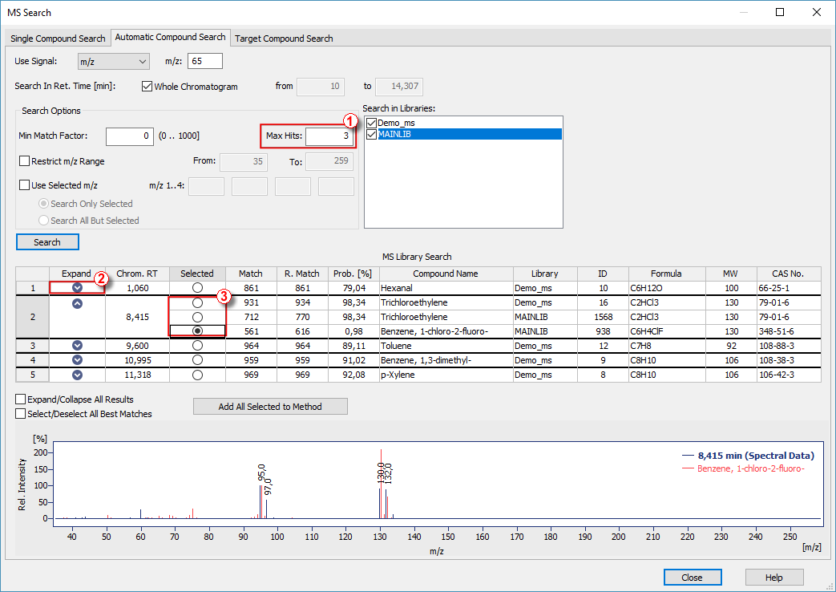
Instrument
Status
GLP
MS
Unauthorized
Controls
New Control Modules
① Specify number of max hits which can be returned
② Expand the row to view more results
③ Choose the desired compound

Slide 7
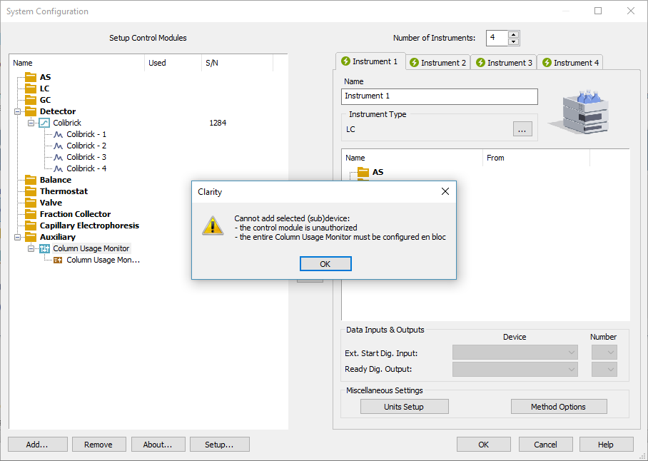
Instrument
Status
GLP
MS
Unauthorized
Controls
New Control Modules
Unauthorized control modules will:
Be removed from configured Instrument
Not be possible to configure to any Instrument

Slide 8
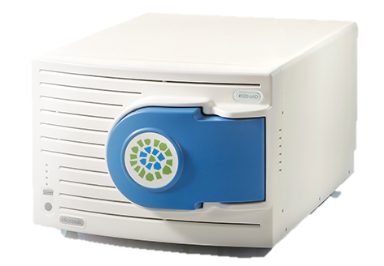
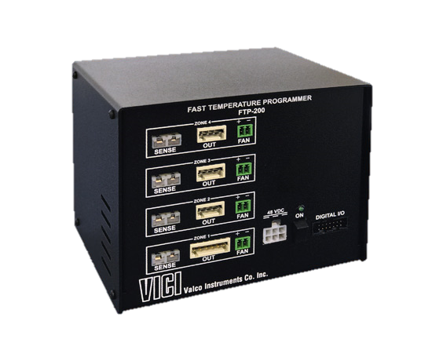
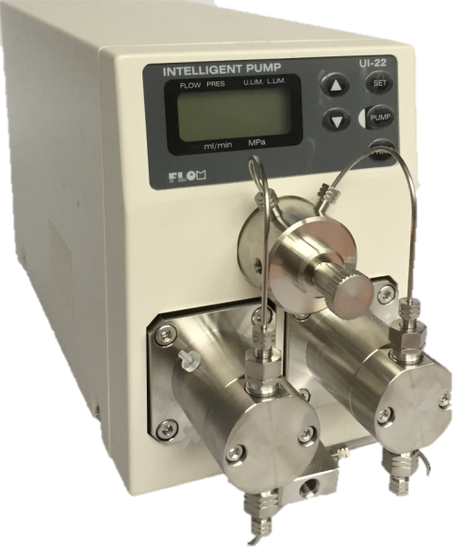
Instrument
Status
GLP
MS
Unauthorized
Controls
New Control Modules
Flom – UI-22 pump
Microsaic – 4500 MiD
VICI Valco – Fast Temperature Programmer
… and many other control modules have been updated

