Slide 1
Clarity 8.4
WHAT‘S NEW
P055/80A 09/2020

Slide 2
What is new in Clarity 8.4?
WHAT‘S NEW → OVERVIEW
Method info divided to info on acquisition method and last processing method
Audit Trail improvements:
  Corrupted audit trails can be open for inspection
  Report printing now recorded in Daily Audit Trail
  Improved Audit trail logging for sequence
A lot of other small improvements and fixed bugs
New and updated control modules

Slide 3
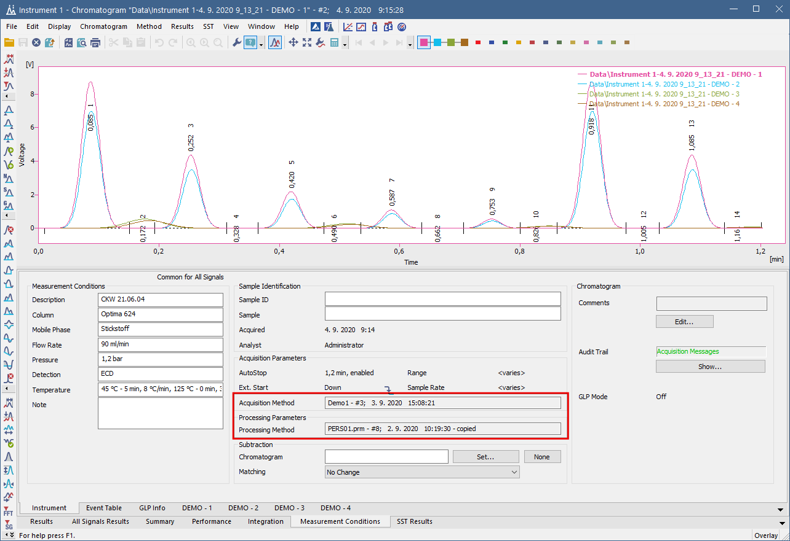
WHAT‘S NEW → CHROMATOGRAM
Method info divided to info on Acquisition Method and last Processing Method.

Slide 4
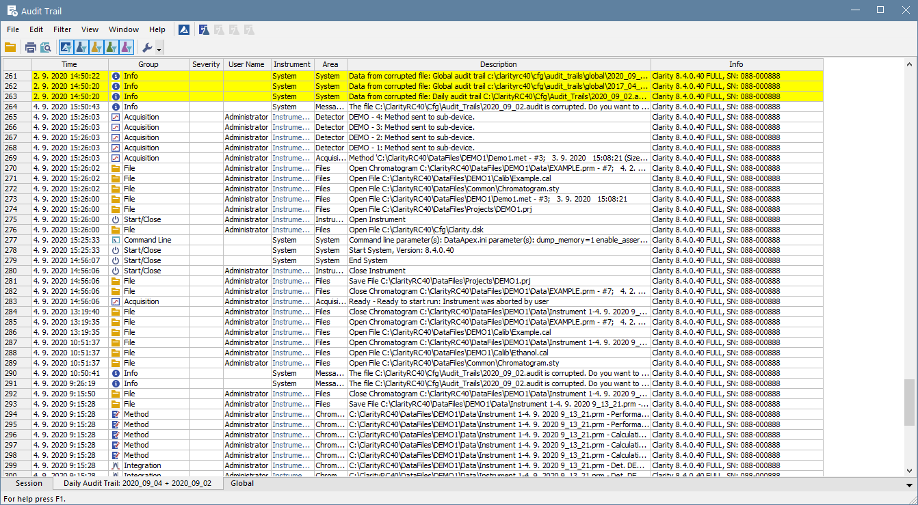
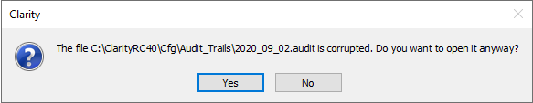
WHAT‘S NEW → AUDIT TRAIL IMPROVEMENTS
Corrupted Audit Trail can be now opened for inspection
Report printing now recorded in Daily Audit Trail
Improved Audit trail logging for sequence

Slide 5
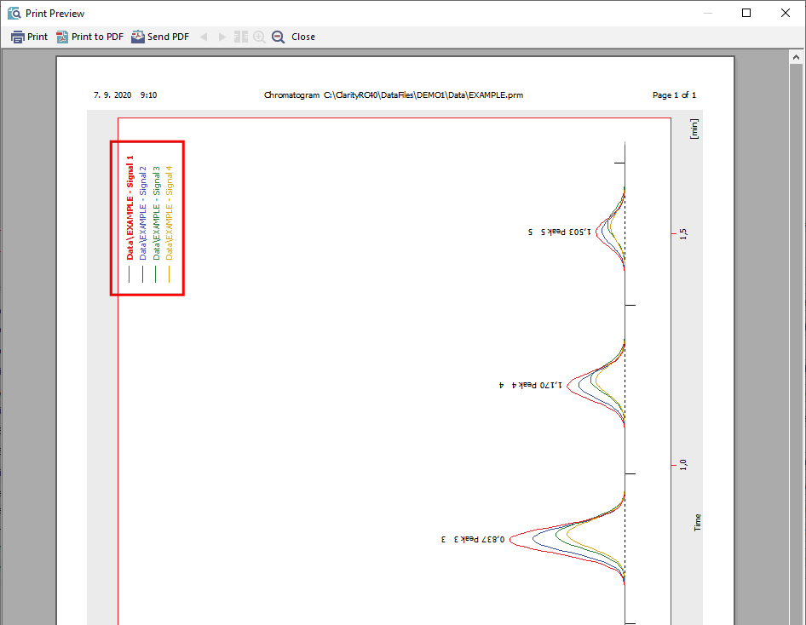
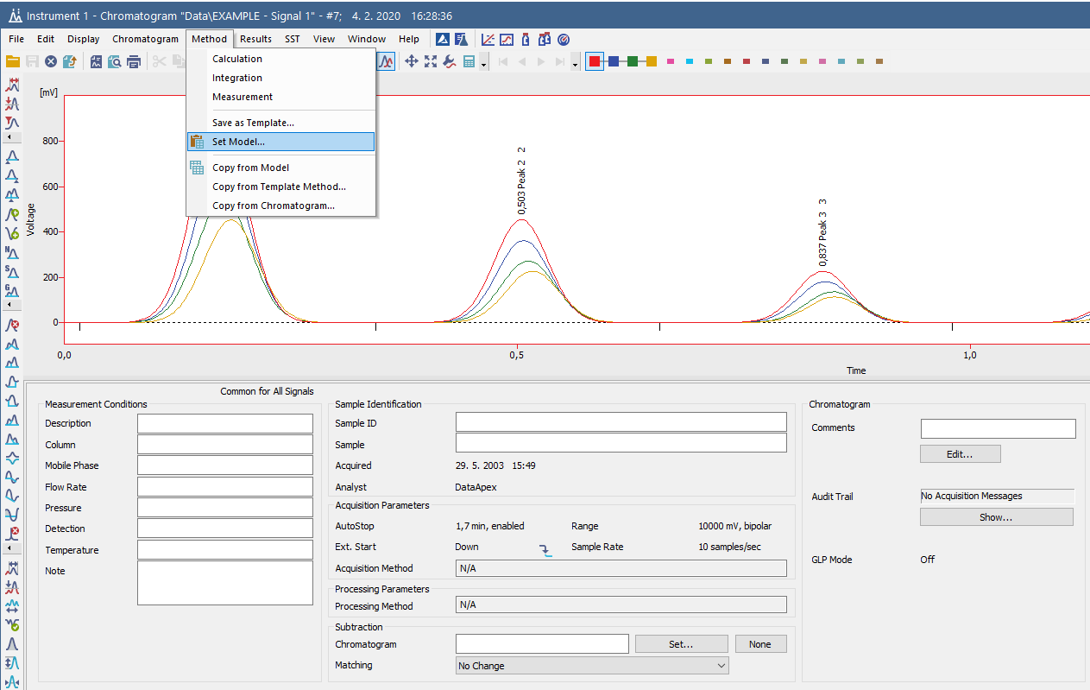
WHAT‘S NEW → OTHER IMPROVEMENTS AND FIXED BUGS
Signal names are printed in Landscape orientation now too
Set model function has been improved

Slide 6
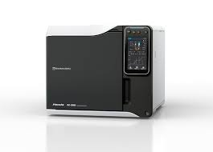
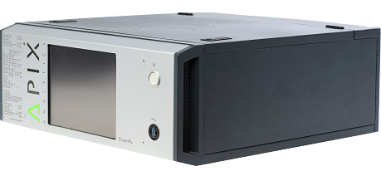
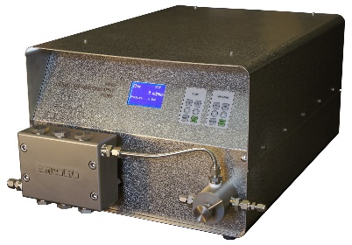
New control modules
WHAT‘S NEW → CONTROL MODULES
Apix – ChromPix2/TwinPix
EST Analytical – AS120/Cobra
Marion Research – Fixed Wavelength detector
Separlab – Separtrix PP03 pump
Shimadzu – GC-2030 *
... many control modules have been updated and improved
* Available in selected territories through companies approved by Shimadzu company.

Slide 7
…THANK YOU FOR YOUR TIME

