Slide 1
P036/70B
6.6.2017
Clarity 7.3
WhaT‘s new

Slide 2

What is new in Clarity 7.3
Enhanced GLP options
Improved Experimental Integration Algorithm
Export of Auxiliary signals
Discontinued support for Windows Vista
Installation under Windows 8 requires 8.1 update
New control modules

Slide 3
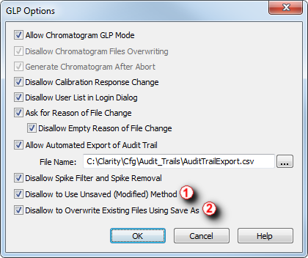
GLP
Improved IA
Experimental
Auxiliary
Signals
Windows Vista
Windows 8.1
New Control Modules
We take Good Laboratory Practice (GLP) seriously and respond to GLP issues with the utmost importance.
Enhanced GLP options:
① Prevent measuring with unsaved method
② Overwriting of existing files can be prohibited

Slide 4
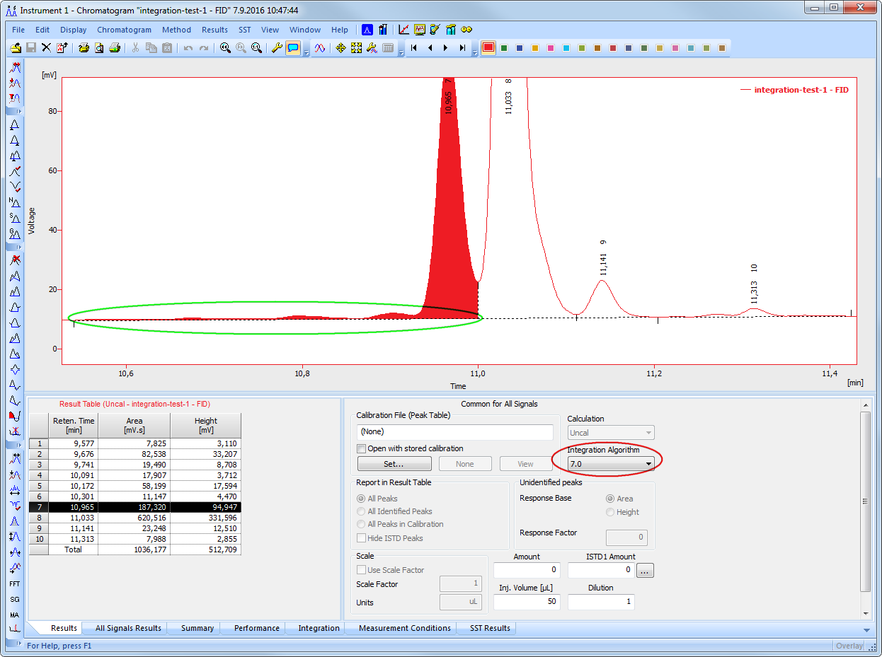

GLP
Improved IA
Experimental
Auxiliary
Signals
Windows Vista
Windows 8.1
New Control Modules
Further improvements in the IA Experimental - better detection of peaks
Incorrect integration: peaks were not separated

Slide 5
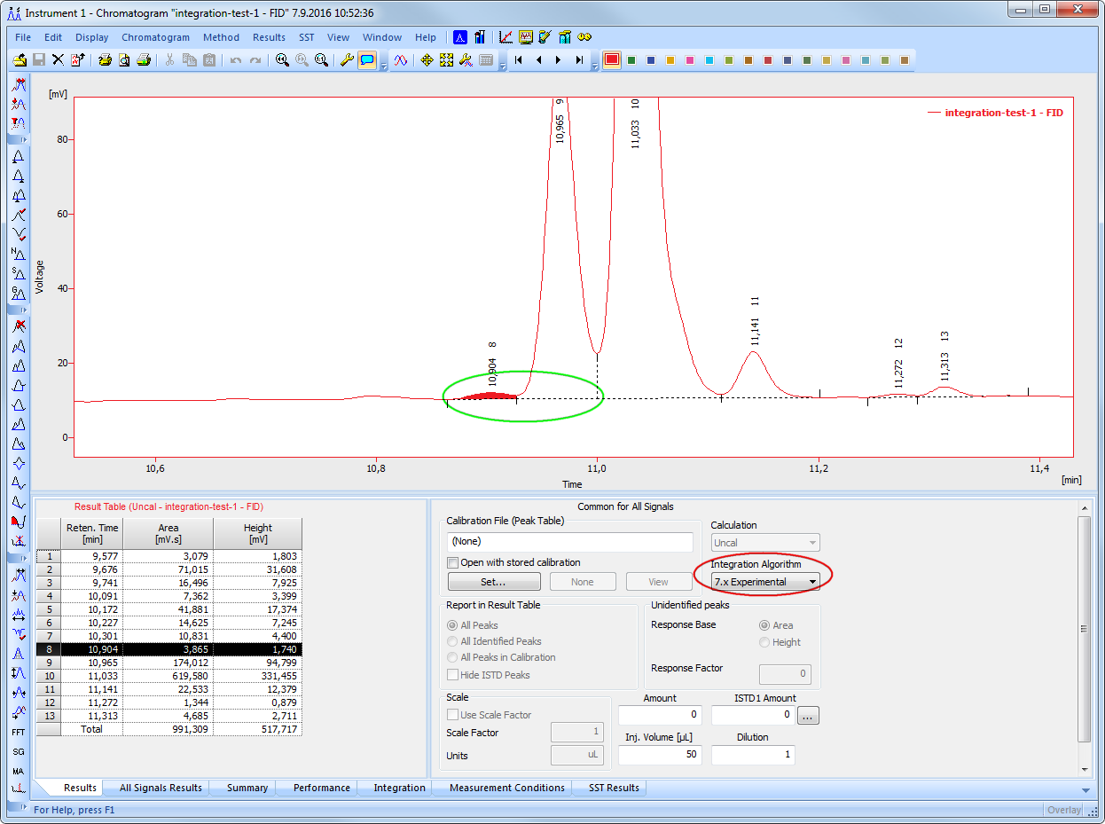
GLP
Improved IA
Experimental
Auxiliary
Signals
Windows Vista
Windows 8.1
New Control Modules
Further improvements in the IA Experimental - better detection of peaks
IA Experimental resolved it as two separate peaks

Slide 6
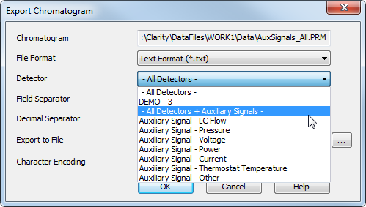
GLP
Improved IA
Experimental
Auxiliary
Signals
Windows Vista
Windows 8.1
New Control Modules
Auxiliary signals can now be exported into *.txt format
  You can further process the exported data such as evaluate the course of pressure or flow

Slide 7


GLP
Improved IA
Experimental
Auxiliary
Signals
Windows Vista
Windows 8.1
New Control Modules
Support for Windows Vista and Windows 8 ended:
  Use supported Windows: 7, 8.1 or 10
  Update from Windows 8 to 8.1 is offered free of charge directly from Microsoft
Compatibility overview of Clarity 7.3:
Windows
XP ^{SP3} | Vista | 7 ^{SP1} | 8 | 8.1 | 10

Slide 8
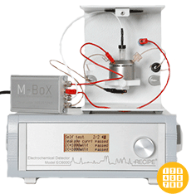
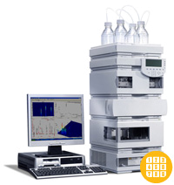
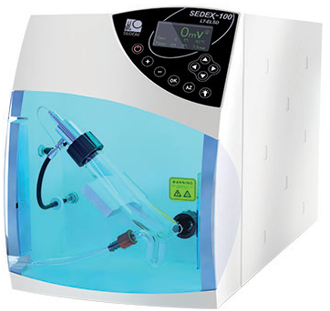
GLP
Improved IA
Experimental
Auxiliary
Signals
Windows Vista
Windows 8.1
New Control Modules
Sedere – Sedex 100LT
Recipe – EC6000
Elysia Raytest – Gabi Nova and Ramona Star
Agilent – 7820 and various ICF control modules
… and many other control modules have been updated

Slide 9

Download your Clarity 7.3 directly from your station or from our website
More information about Clarity and DataApex at:
www.dataapex.com
For technical support contact us at:
support@dataapex.com

