Slide 1
P042/70A
4.10.2017
Clarity 7.4
WhaT‘s new

Slide 2
What is new in Clarity 7.4
GLP – Improved logging to Audit Trail
Calibration on All Signals/Active Signal
Agilent Instrument Control (ICF) – changes
Various improvements – see Whatsnew
New and updated control modules

Slide 3
GLP
Calibration
ICF
Various Changes
New Control Modules
We continually work on maintaining Clarity compliant ready and thus introduced a more detailed logging to Audit Trails:
Closing a chromatogram is recorded in the Station Audit Trail
Creating a new sequence is recorded in the Station Audit Trail
Changes on the PDA method are recorded in the Method Audit Trail
Option Ask for Reason of File Change is now applicable in the System Configuration

Slide 4
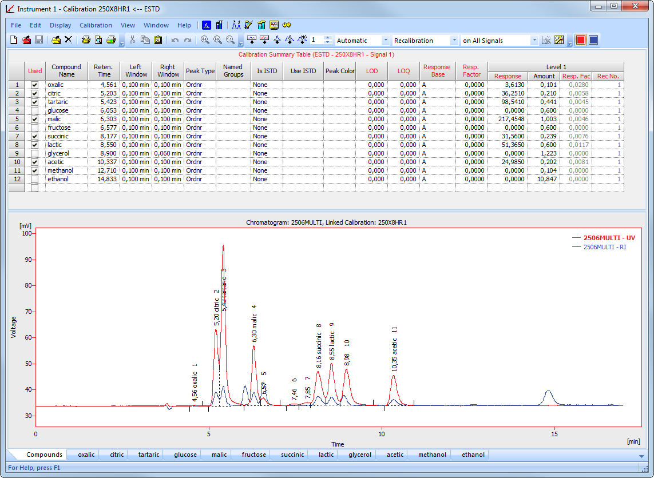
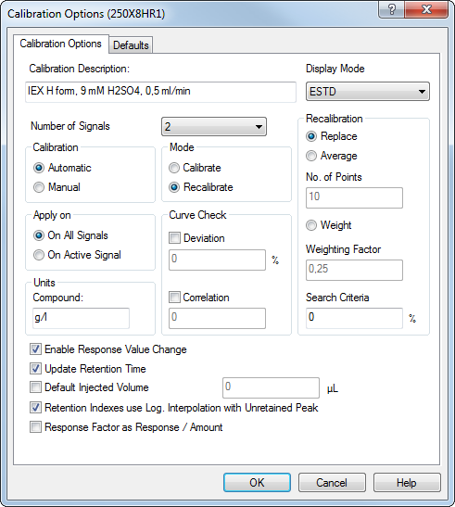
GLP
Calibration
ICF
Various Changes
New Control Modules
New option to (re)calibrate on All Signals/on Active Signal has been implemented

Slide 5

GLP
Calibration
ICF
Various Changes
New Control Modules
With option
on All Signals, we are (re)calibrating
on both signals

Slide 6

GLP
Calibration
ICF
Various Changes
New Control Modules
With option
on Active Signal, we are (re)calibrating on 2506Multi – UV only

Slide 7
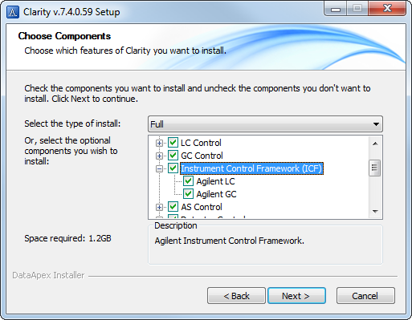
GLP
Calibration
ICF
Various Changes
New Control Modules
Listing of ICF control modules in the installer has been reorganized – ICF has its own section

Slide 8


GLP
Calibration
ICF
Various Changes
New Control Modules
ICF can no longer be installed on Windows XP nor Windows Vista – Agilent itself does not support them
Windows & ICF compatibility
XP | Vista | 7 ^{SP1} | 8 | 8.1 | 10

Slide 9
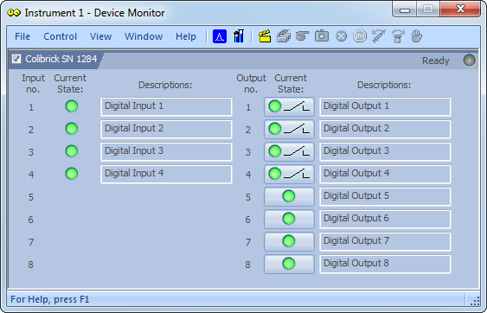
GLP
Calibration
ICF
Various Changes
New Control Modules
Check against invalid filenames and paths
Renaming of fields in several extensions to better suit the used terminology
Graph Properties, Verify Signatures and Device Monitor windows are all now resizable

Slide 10
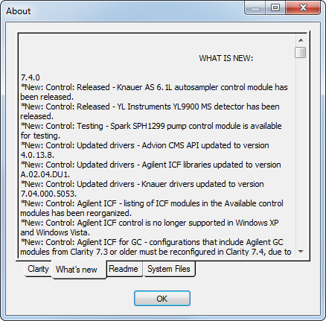
GLP
Calibration
ICF
Various Changes
New Control Modules
Added support for Y-axis name in the import / export of ASCII files
New variables that can be used in the Event Table of the Method Setup
For further information see What’s new in the About dialog of your Clarity

Slide 11
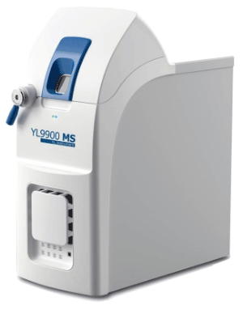
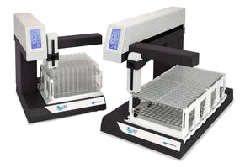
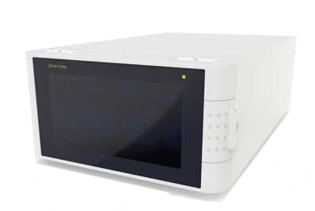
GLP
Calibration
ICF
Various Changes
New Control Modules
Spark – SPH1299 pump
YL Instruments – YL9900 MS detector
Knauer – drivers for Fraction Collectors
… and many other control modules have been updated

Slide 12

Download Clarity 7.4 directly from your station or from our website
More information about Clarity and DataApex at:
www.dataapex.com
For technical support contact us at:
support@dataapex.com

