Slide 1
P048/80B
15.7.2018
Clarity 8.0
WhaT‘s new

Slide 2
What is new in Clarity 8.0
Graphically enhanced user interface
Improvements to GLP compliance
Increased number of ISTD‘s
Improvements in MS extension
Various changes and bug fixes
New and updated control modules

Slide 3
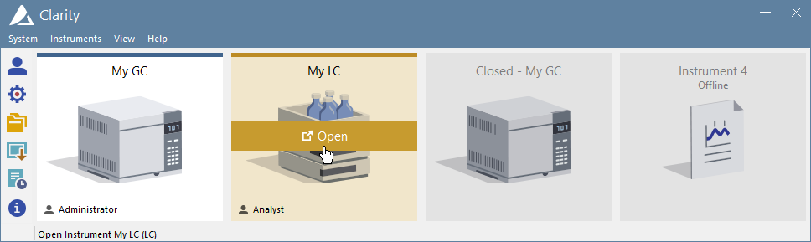
GUI
GLP
ISTD
MS
New Control Modules
It‘s finally here, Clarity 8.0 has undergone a major graphical change – completely new look and feel.
New Clarity Main window:
Opened Instruments
Closed Instrument
Offline Instrument

Slide 4
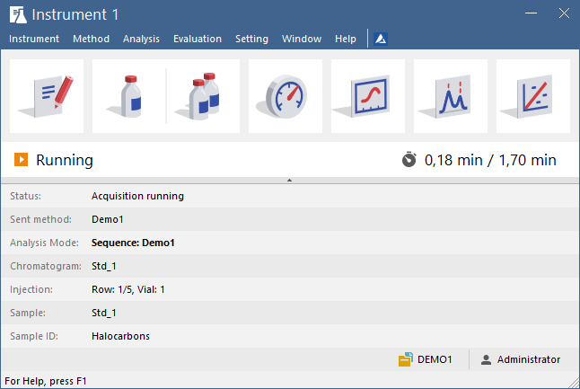
GUI
GLP
ISTD
MS
New Control Modules
New Instrument window:
New user interface with proven workflow
Method
Setup
Single
Analysis
Sequence
Device
Monitor
Data
Acquisition
Status Line
Chromatogram
Calibration
Analysis Time
InformationTable

Slide 5
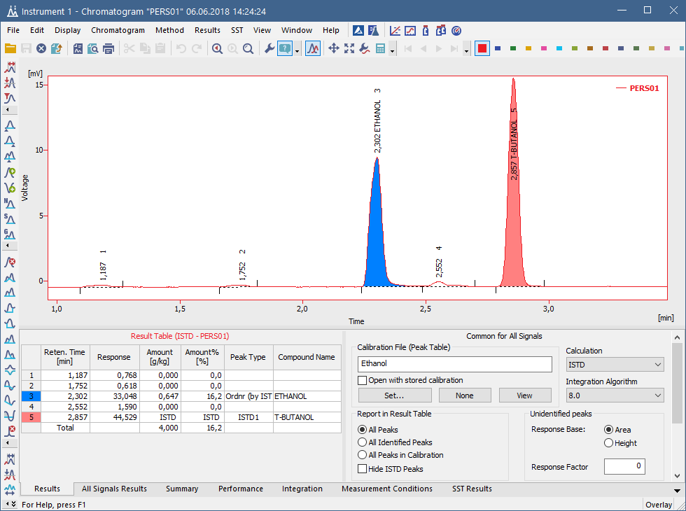
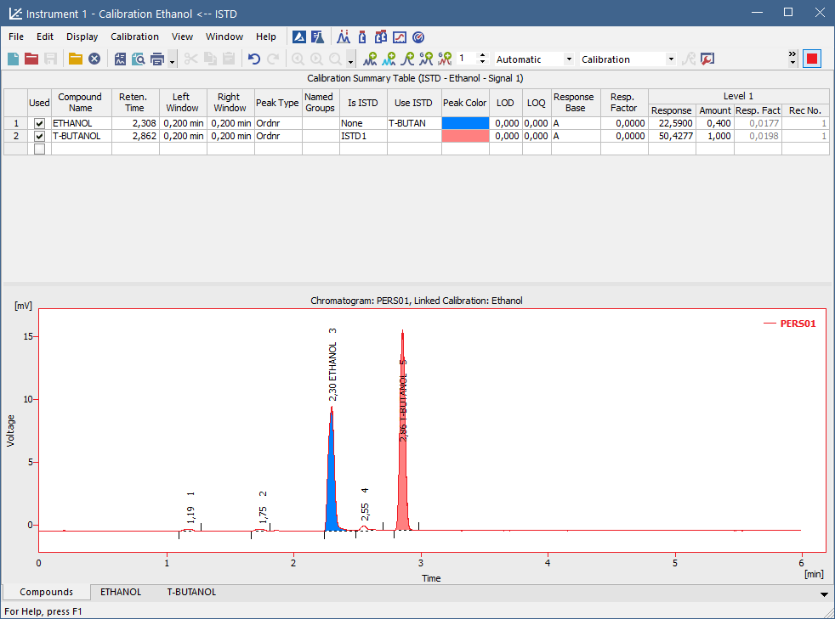
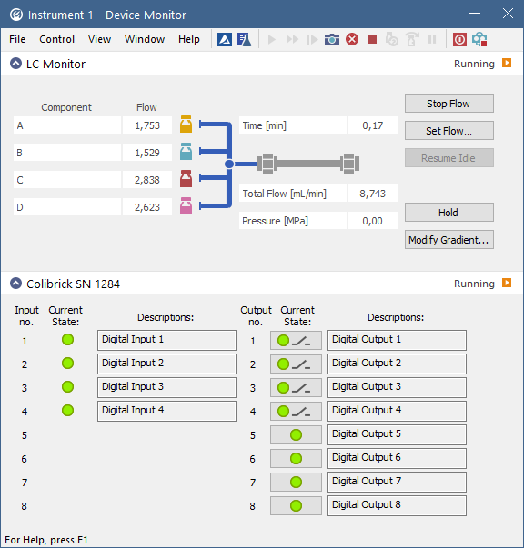
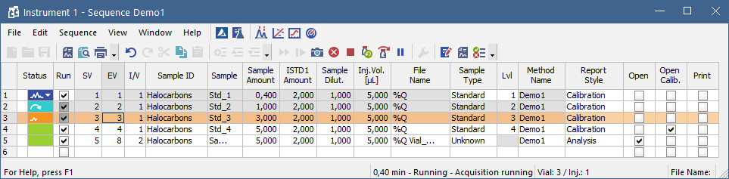
GUI
GLP
ISTD
MS
New Control Modules
Fresh new icons:

Slide 6
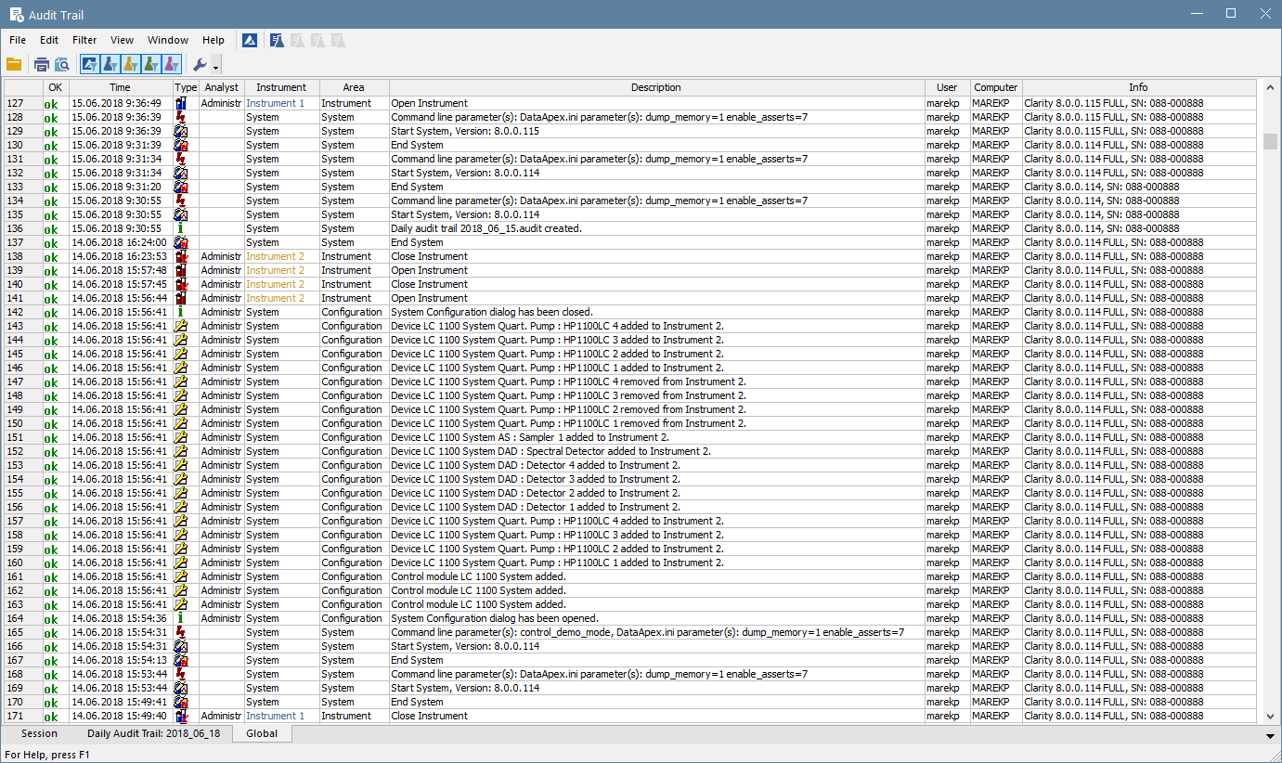
GUI
GLP
ISTD
MS
New Control Modules
New Global Audit Trail – located on a separate tab in the Station Audit Trail window
Logs critical station operations

Slide 7
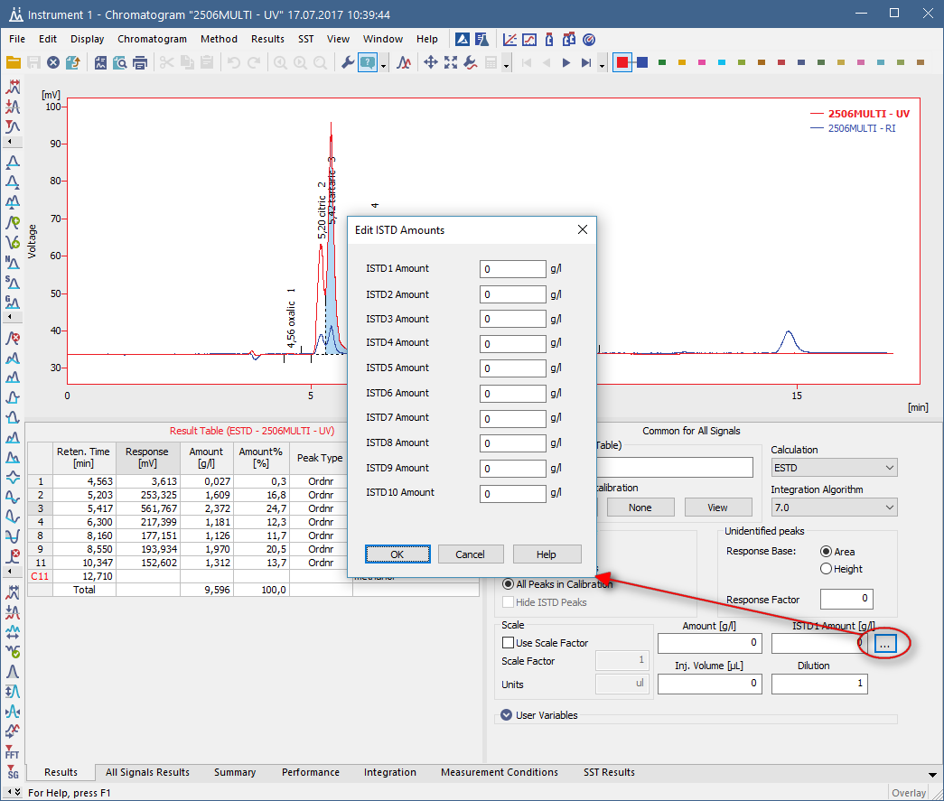
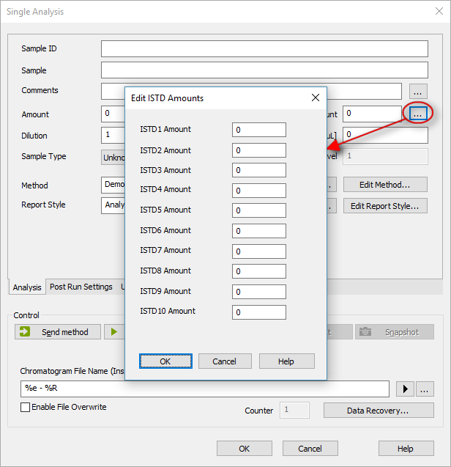
GUI
GLP
ISTD
MS
New Control Modules
Number of ISTD‘s increased from 5 to 10
Support added to all relevant places

Slide 8
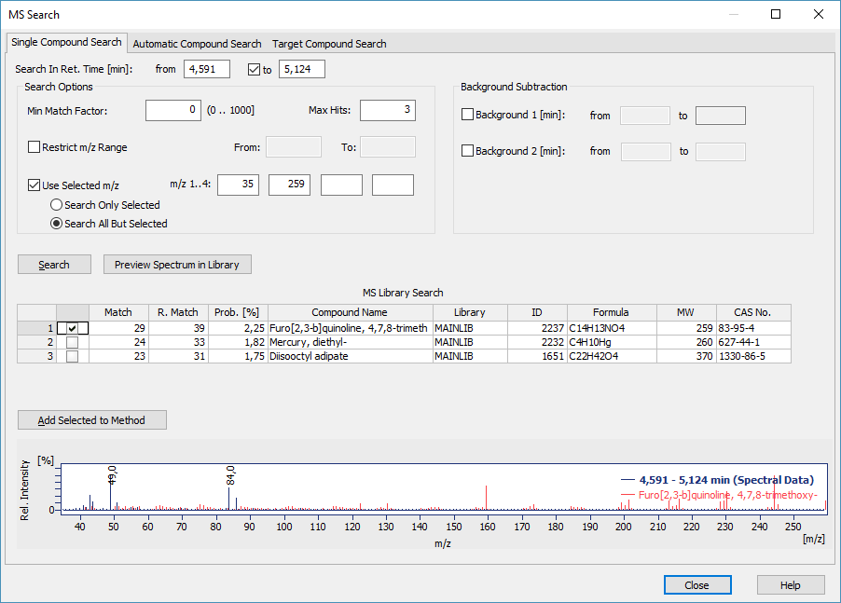
GUI
GLP
ISTD
MS
New Control Modules
Redesigned MS search
Unified Search Options group
  Added support to Search All But Selected m/z range to omit m/z range from the search

Slide 9
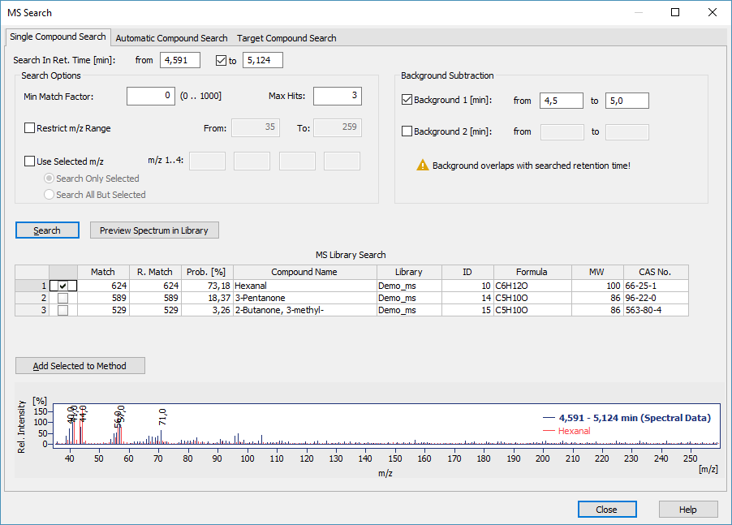
GUI
GLP
ISTD
MS
New Control Modules
Single Compound Search
  Added support to subtract background
  Detection of overlaps

Slide 10
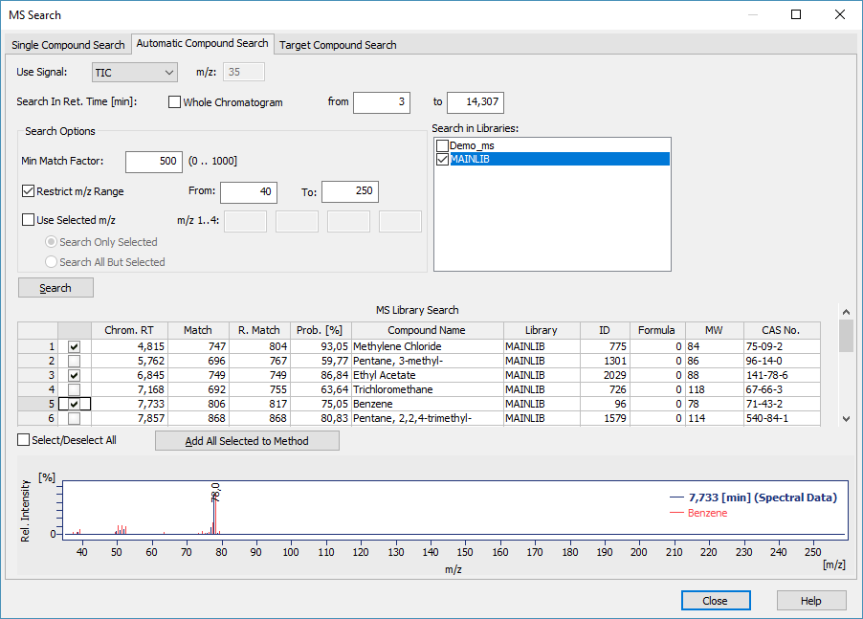
GUI
GLP
ISTD
MS
New Control Modules
Automatic Compound Search
  Checkboxes for easier selection of multiple compounds
  Improved labels for better understanding

Slide 11
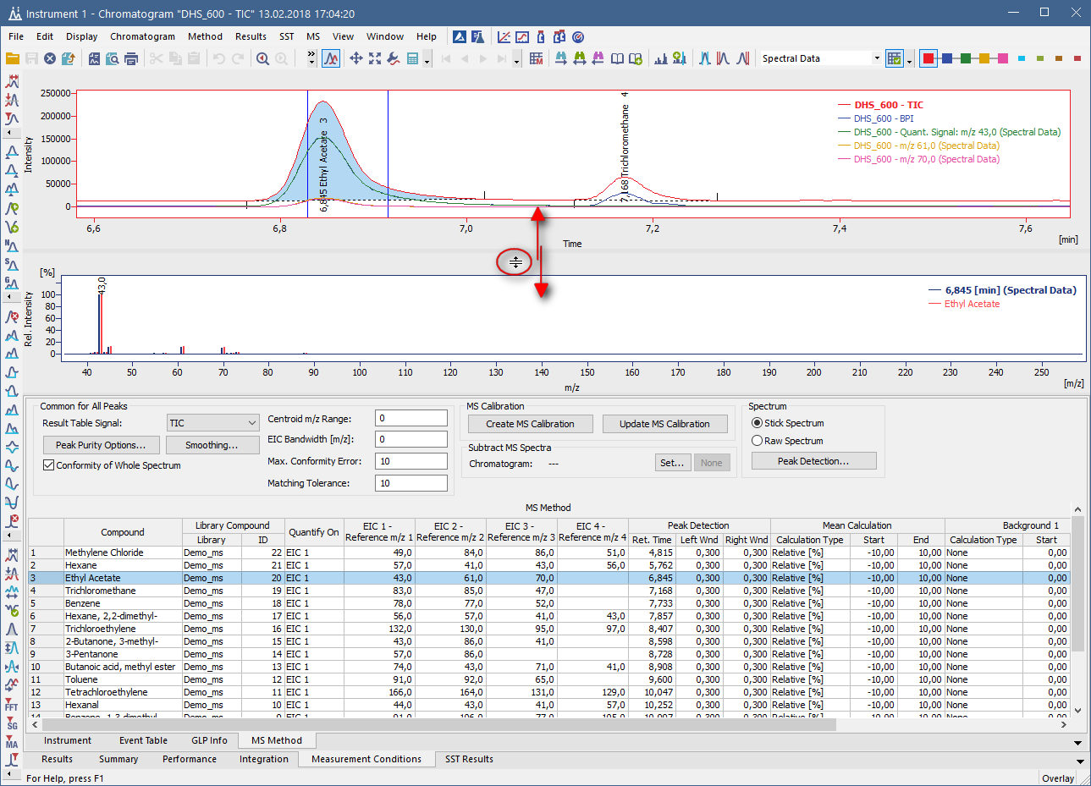
GUI
GLP
ISTD
MS
New Control Modules
Chromatogram graph and spectrum graph can now be resized independently

Slide 12
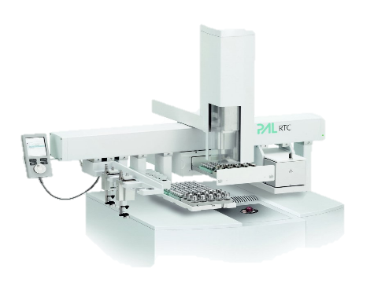
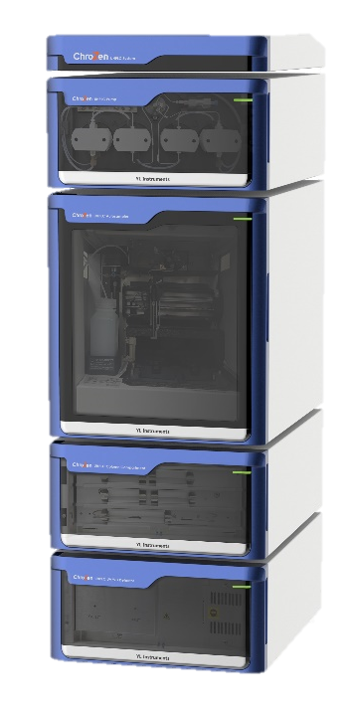
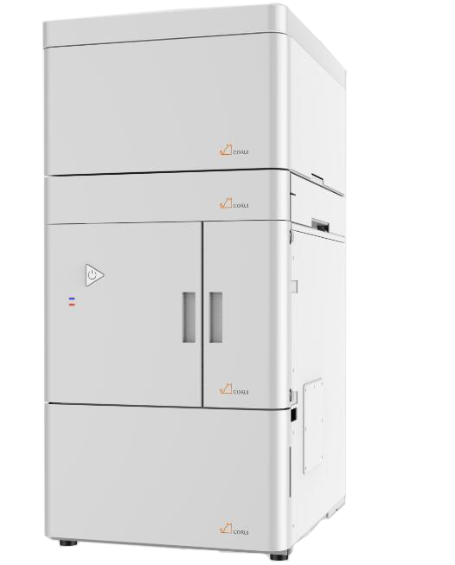
GUI
GLP
ISTD
MS
New Control Modules
CTC – CTC PAL3 System
YL Instruments – ChroZen UHPLC System
CoruiTech – RainbowC HPLC and Rainbow HPLC
… and many other control modules have been updated

Slide 13

Download Clarity 8.0 directly from your station or from our website
More information about Clarity and DataApex at:
www.dataapex.com
For technical support contact us at:
support@dataapex.com

