Slide 1
ClaRity tour
Notes:
Aim:
- Introduction of Clarity application from very brief technical point of view
Introduction of Clarity termininology
Workstation – single PC installation, Clarity is 32bit application, can be used on 64-bit Windows standard versions, no iOS or Linux version
- Clarity is not DB or client/server solution, It is file based application
Multi Window application – Clarity provides multi window environment, each window has unique name and provides tool for support different tasks and goals

Slide 2
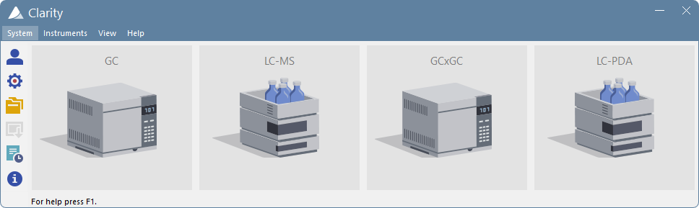
Main window
Access to Instruments
General Settings for whole Clarity station
Access to Information about Clarity station
CLARITY TOUR / MAIN WINDOW
Notes:
Main Window
Entrance into Clarity
Access to Instrument(s)
equals to chromatograph. Each Chromatograph can consist of multiple modules, like in HPLC (Detector, Pump, Autosampler). Each Instrument corresponds to individual time base. Clarity synchronizes all module configured under one Instrument
Access to general setting valid for whole Clarity station
Access to general information about respective Clarity station through Help section
- Controls – Based on purchased configuration it is possible to control from one up to four individual chromatographs (GCs, LCs) from single Clarity installation from single PC

Slide 3
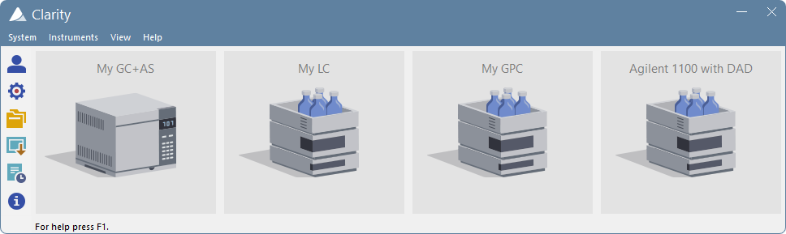
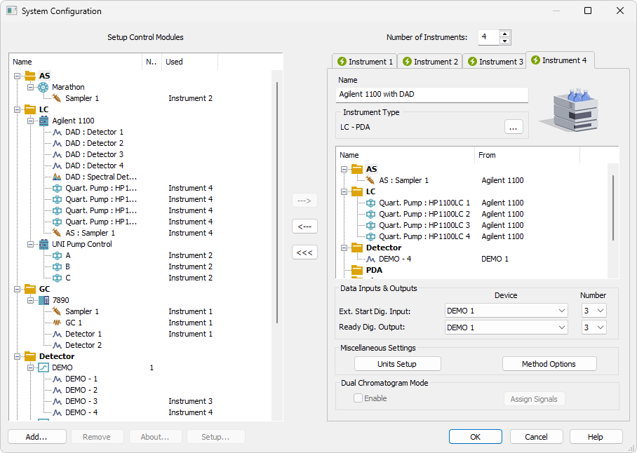
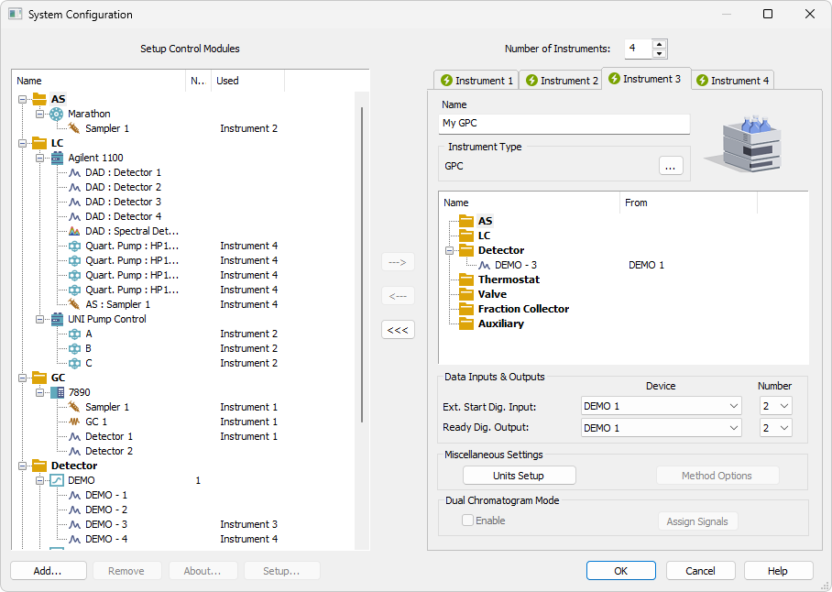
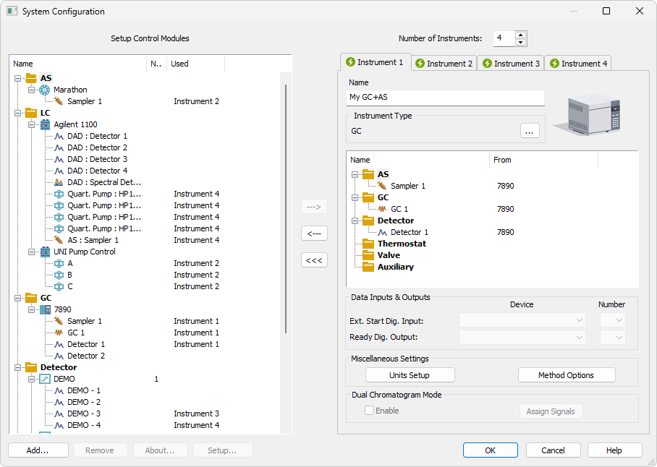
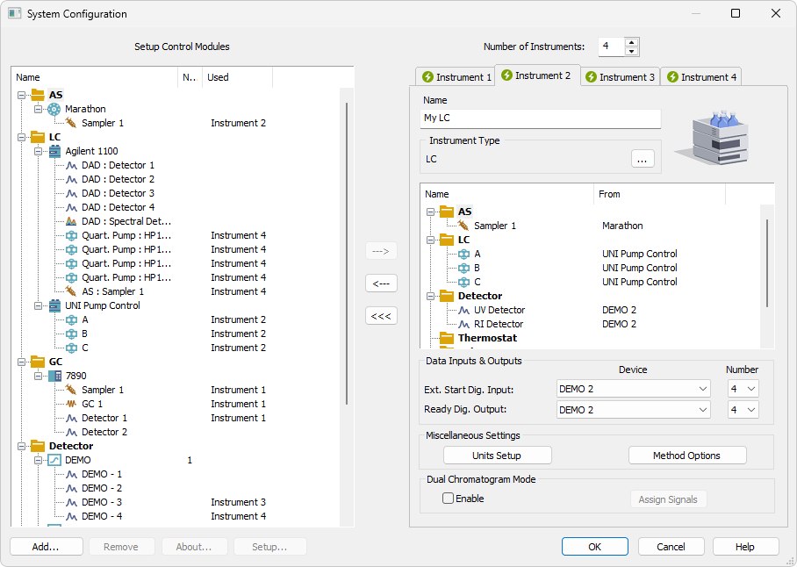
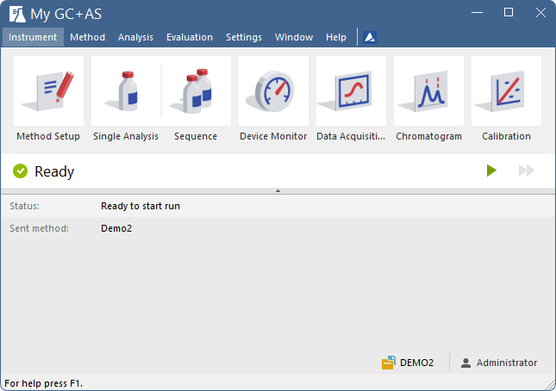
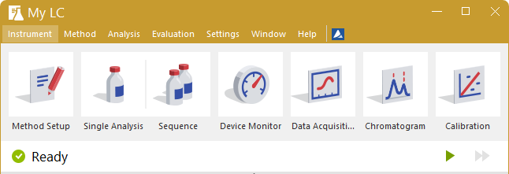
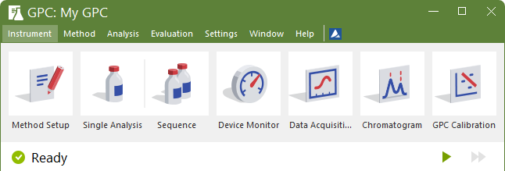
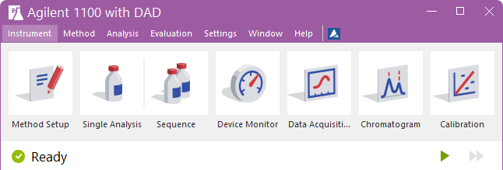
NavigaTion within clarity
Main window
System configuration
Instrument window
CLARITY TOUR / NAVIGATION WITHIN CLARITY

Slide 4
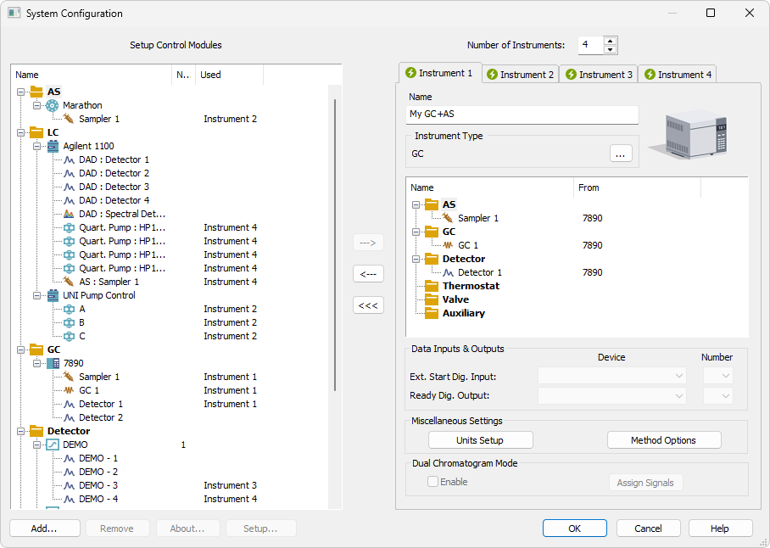
SYSTEM CONFIGURATION WINDOW
Setting up communication between Clarity and connected hardware
Assignment of hardware to Clarity Instruments
CLARITY TOUR / CLARITY WINDOWS / SYSTÉM CONFIGURATION WINDOW

Slide 5
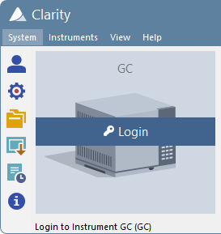
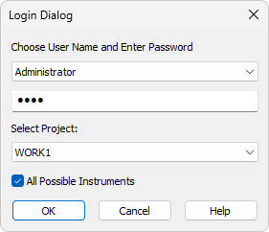
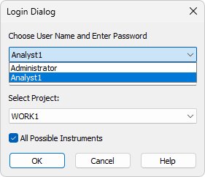
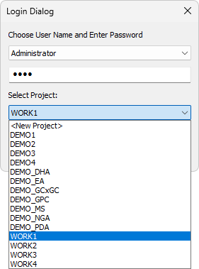
Login dialog
User authentication
  Possibility to set individual privileges
Project selection
Project workspace – all data from one project are stored together
CLARITY TOUR / CLARITY WINDOWS / LOGIN WINDOW
Notes:
System Configuration window
Setting of communication between Clarity and connected chromatographic hardware
If Multi Instrument stations - Assignment of Hardware respective Instrument

Slide 6
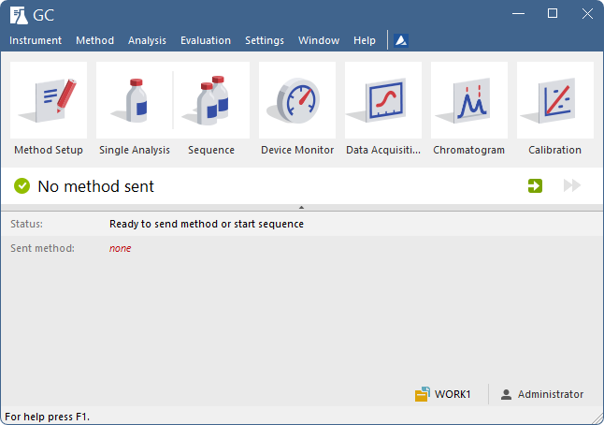
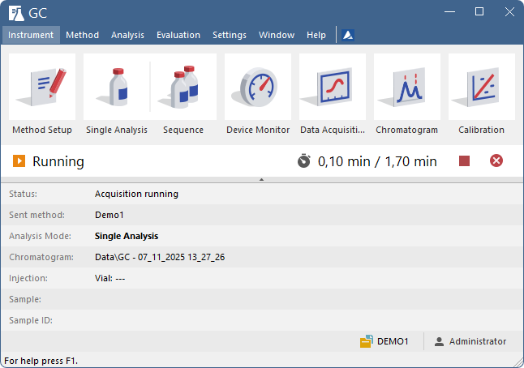
INSTRUMENT WINDOW
Central workspace for instrument control and data processing
Displays instrument status and control options
Provides access to all other windows
Icons arranged by proposed workflow
Acqusition
controls
Status line
CLARITY TOUR / CLARITY WINDOWS / INSTRUMENT WINDOW

Slide 7
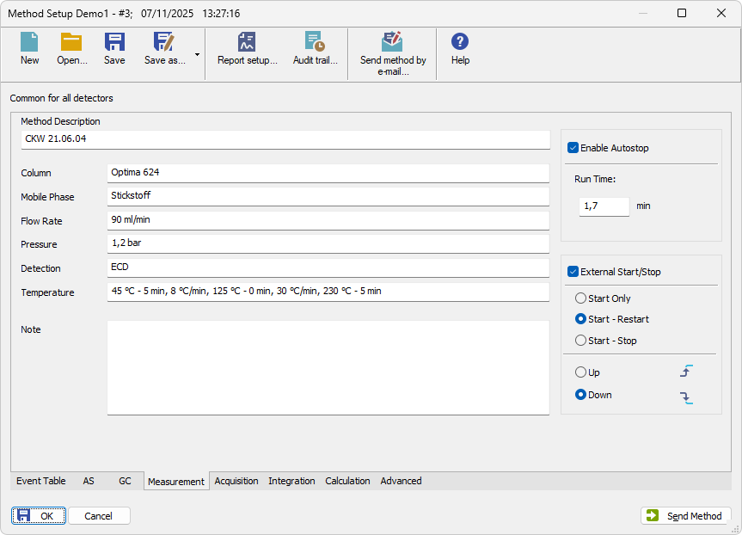
METHOD SETUP
Configuration of method parameters across multiple tabs
Reads from and saves to .met files
Layout depends on System Configuration
CLARITY TOUR / CLARITY WINDOWS / METHOD SETUP

Slide 8
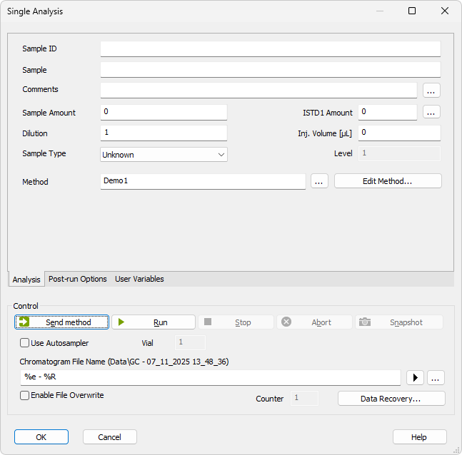
Single analysis
Defines parameters for a single run and post-run actions
CLARITY TOUR / SINGLE ANALYSIS

Slide 9
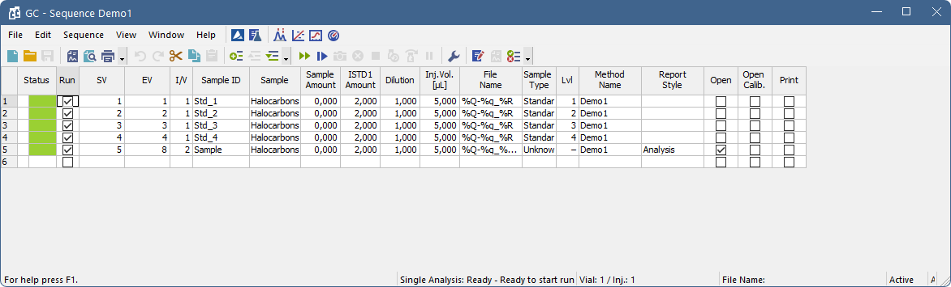
Sequence window
Defines multiple injections organized in a sequence table
Sequence configuration saved as a .seq file
CLARITY TOUR / SEQUENCE WINDOW

Slide 10
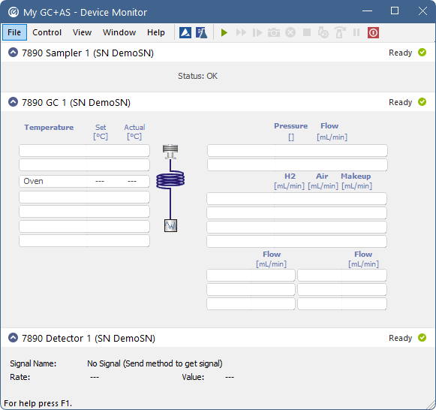
DEVICE monitor
Direct instrument control
Real-time status and value display
CLARITY TOUR / DEVICE MONITOR

Slide 11
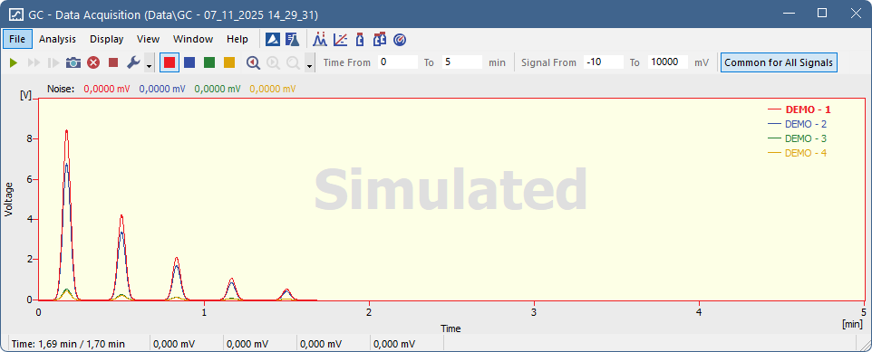
DATA ACQUISITION WINDOW
Real time monitoring of signal(s)
CLARITY TOUR / DATA ACQUISITION WINDOW

Slide 12
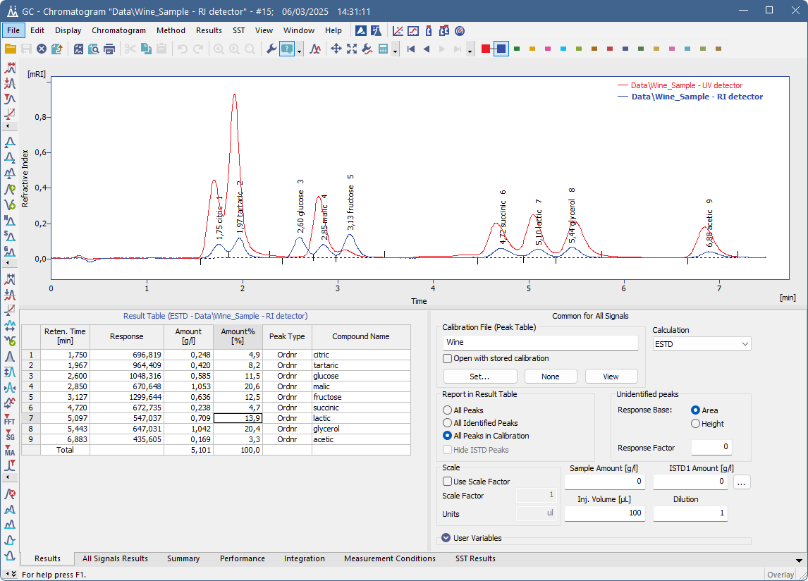
CHROMATOGRAM WINDOW
Displays and compares chromatograms
Adjust integration, evaluate results
View results in multiple tables
Saves to .prm files
CLARITY TOUR / CHROMATOGRAM WINDOW

Slide 13
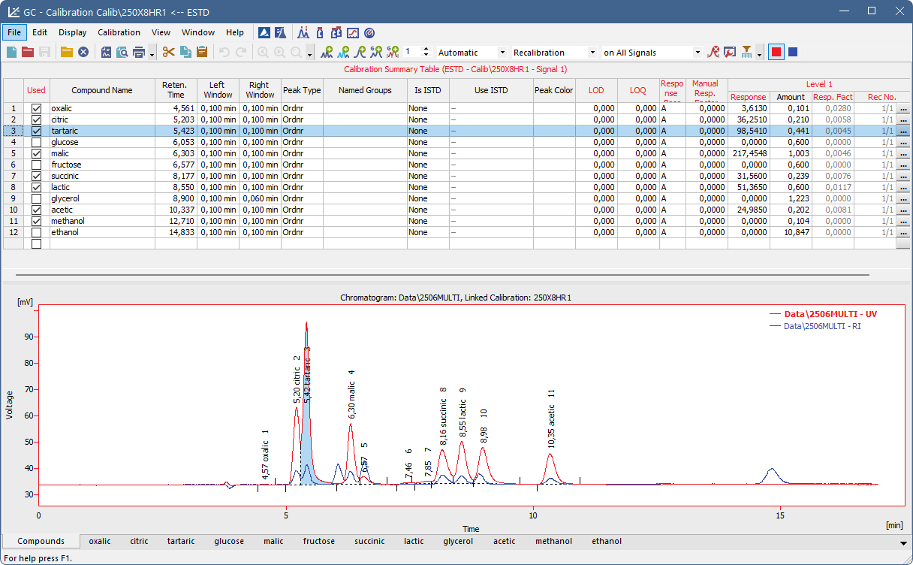
CALIBRATION WINDOW
Essential for quantitative result calculation
Create, adjust, and review calibration
Reviews calibration data and component curves in tabs
Saves to .cal files
CLARITY TOUR / CALIBRATION WINDOW

Slide 14
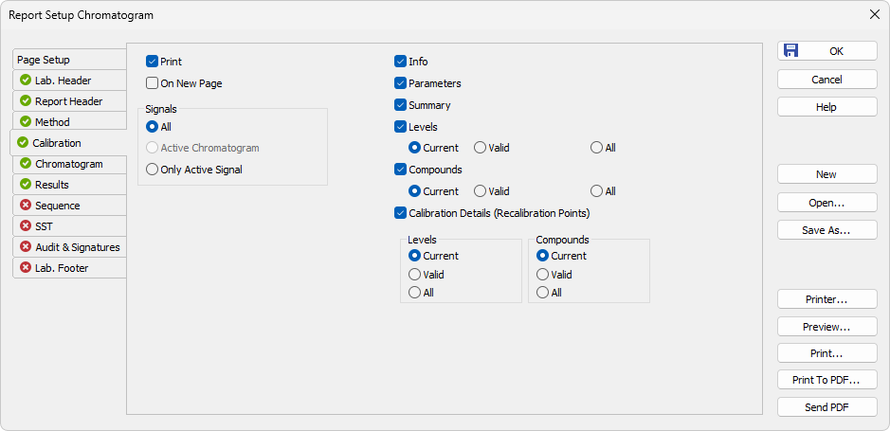
Report setup dialog
Preview and print reports
Select report style for printing, saves to .sty files
Common editor for customizing report templates from various windows
CLARITY TOUR / REPORT SETUP DIALOG

Slide 15
Summary
Windows application
File-based system with clear data structure
  Data organized in projects
Multi-window interface
Control of 1–4 independent chromatographs
Calibration up to 20 levels
Multi-language support
CLARITY TOUR / SUMMARY

Slide 16
Thank you for your attention
Next training on February 15, 2023

