Slide 1
SST – SYSTEM SUITABILITY TEST
CLARITY EXTENSION

Slide 2
System suitability test
Overview
Statistical evaluation of selected values (Average, RSD)
Comparison to pre-set criteria (Pass/Fail testing)
Actions based on Pass/Fail results
Accessible from the menu in the Chromatogram window
For identified compounds only (based on calibration)
SST is enabled by User Code with p/n A22 purchased
https://www.dataapex.com/product/extensions-sst
SST Extension / Overview

Slide 3
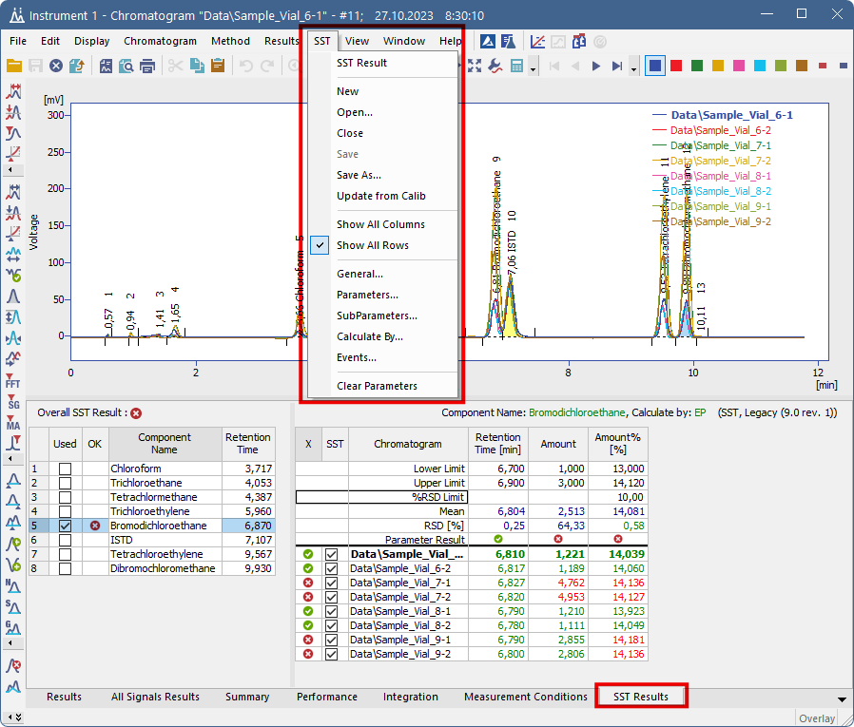
Chromatogram window
Dedicated SST menu
SST Results tab for the sole purpose of the SST calculations
SST Extension / Chromatogram window

Slide 4
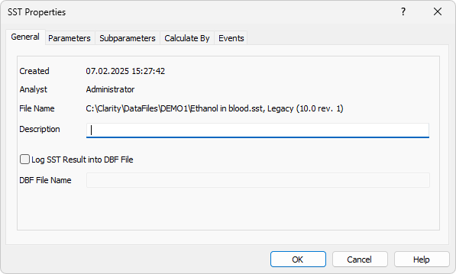
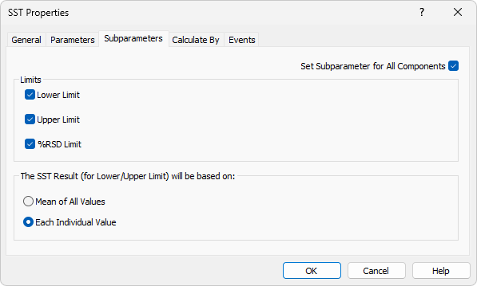
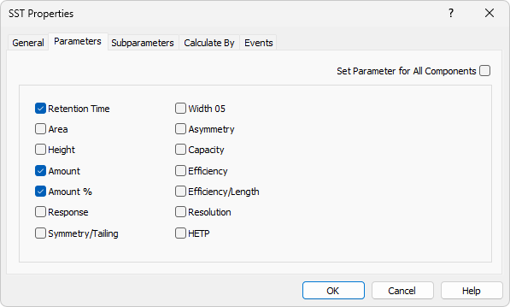
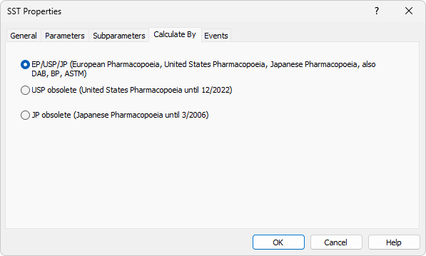
SST properties
SST properties allow further set additional parameters and conditions for evaluation
SST Extension / SST Properties

Slide 5
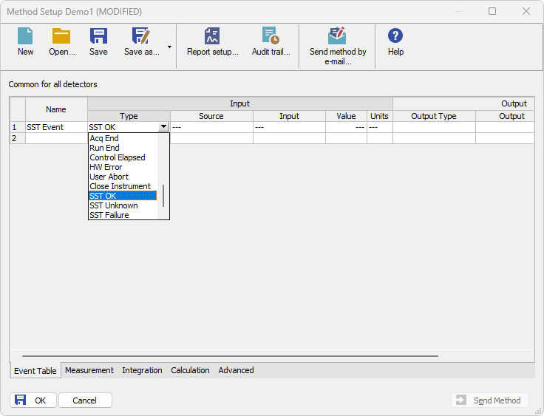
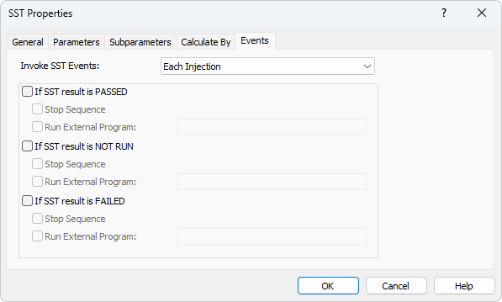
SST Events
Specify event reactions when SST is Passed/Not Run/Failed
Possible to determine actions also in Method Event Table
Wide range of possibilities with the Run external program option
SST Extension / SST Events

Slide 6
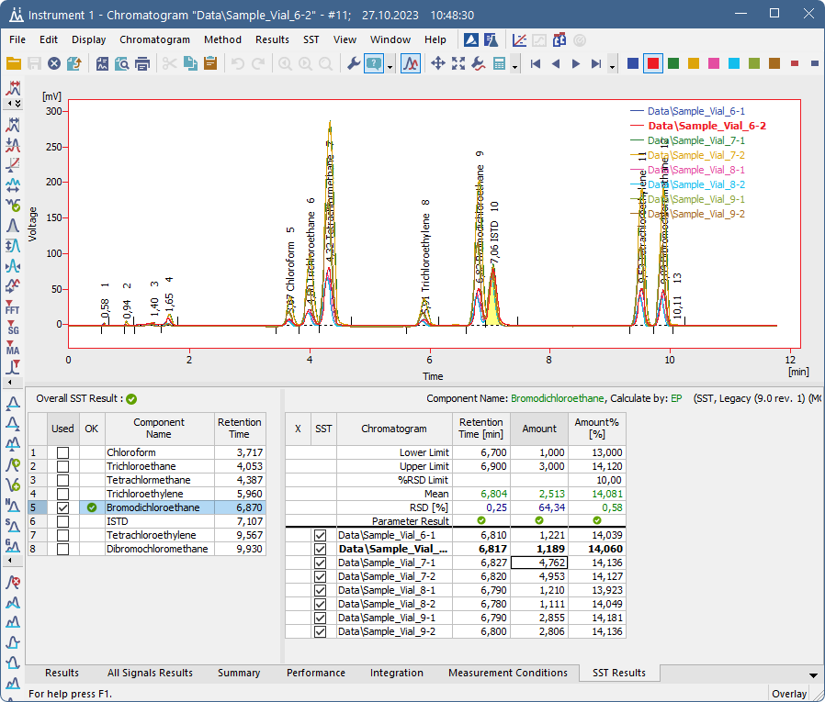
SST Results
Select which component (compound from the calibration) is to be checked
Define the limits of the values and/or the maximum tolerable RSD (%)
SST Extension / SST Results

Slide 7
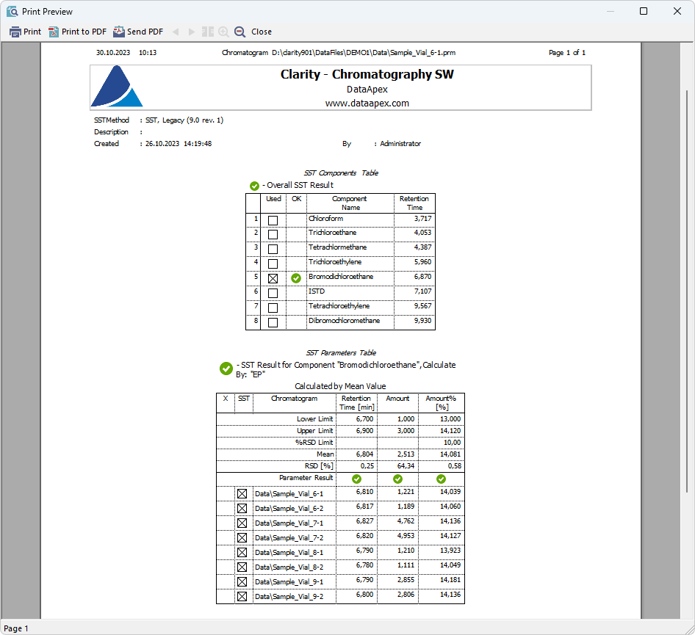
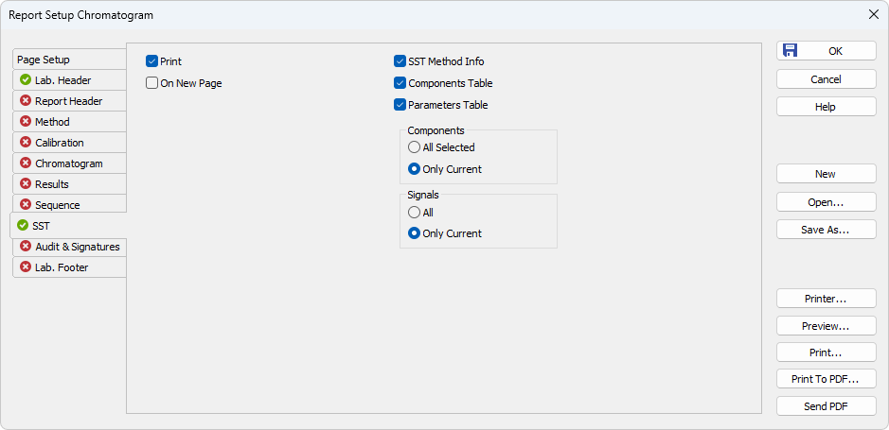
SST Report Setup
Option what to print on dedicated SST tab
SST Extension / SST Report Setup

Slide 8
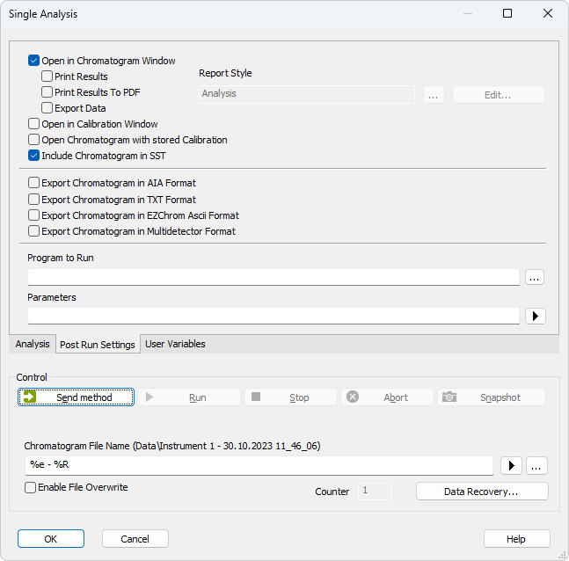
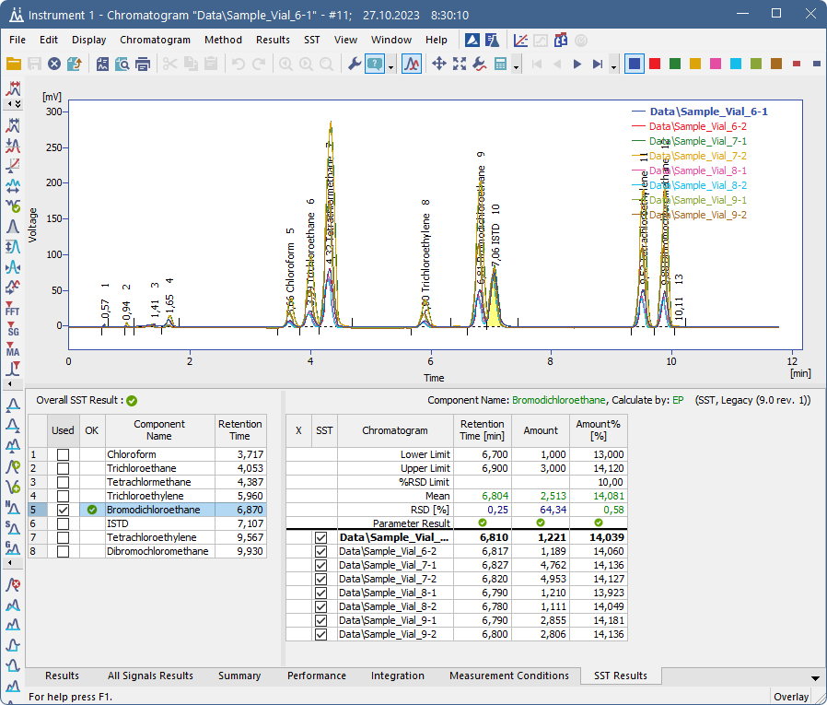
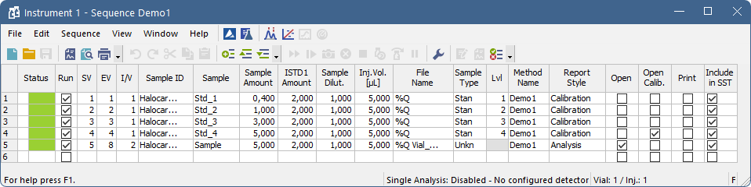
Include in SSt
Option in Single Analysis and Sequence
SST Extension / Include in SST

Slide 9
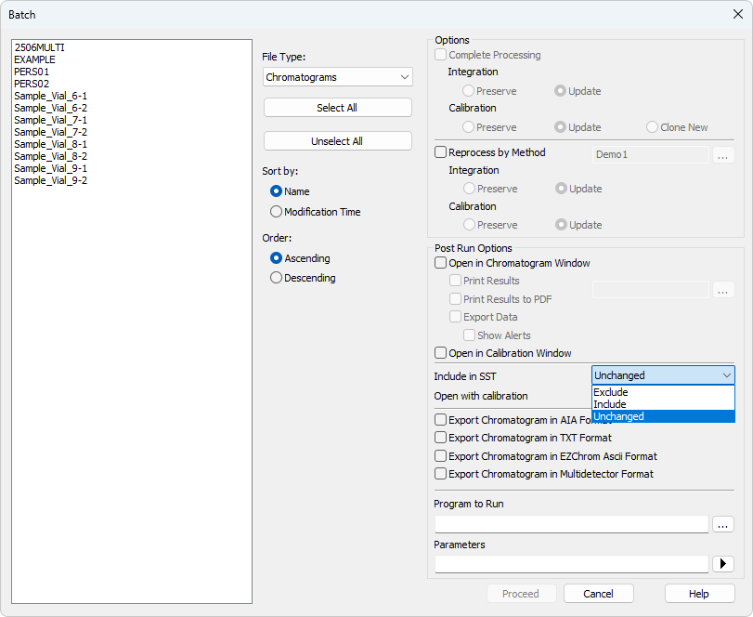
Include in SSt
Option can be changed later
  in SST tab one-by-one
  In Batch dialog for multiple chromatograms
SST Extension / Include in SST

Slide 10
Thank you for your attention

