Slide 1
Clarity 8.3
WHAT‘S NEW
P054/80A 04/2020

Slide 2
What is new in Clarity 8.3?
WHAT‘S NEW → OVERVIEW
Method versioning
Redesigned tab of a specific compound in Calibration
New icons and groups in Audit Trail
Improvements in the MS extension
New and updated control modules

Slide 3
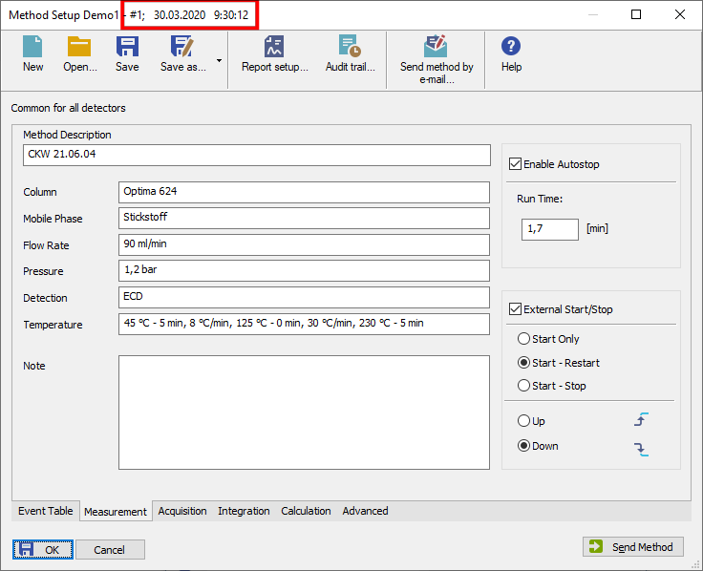
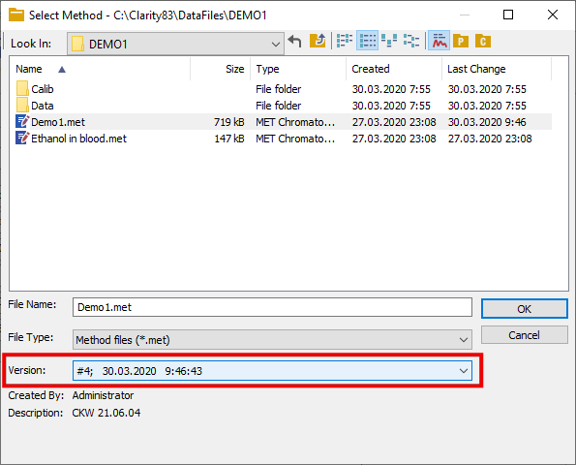
WHAT‘S NEW → METHOD SETUP
Info about method version and last save is displayed in the header
After each save, the version is incremented
Previous versions can be opened from the File Open dialog

Slide 4
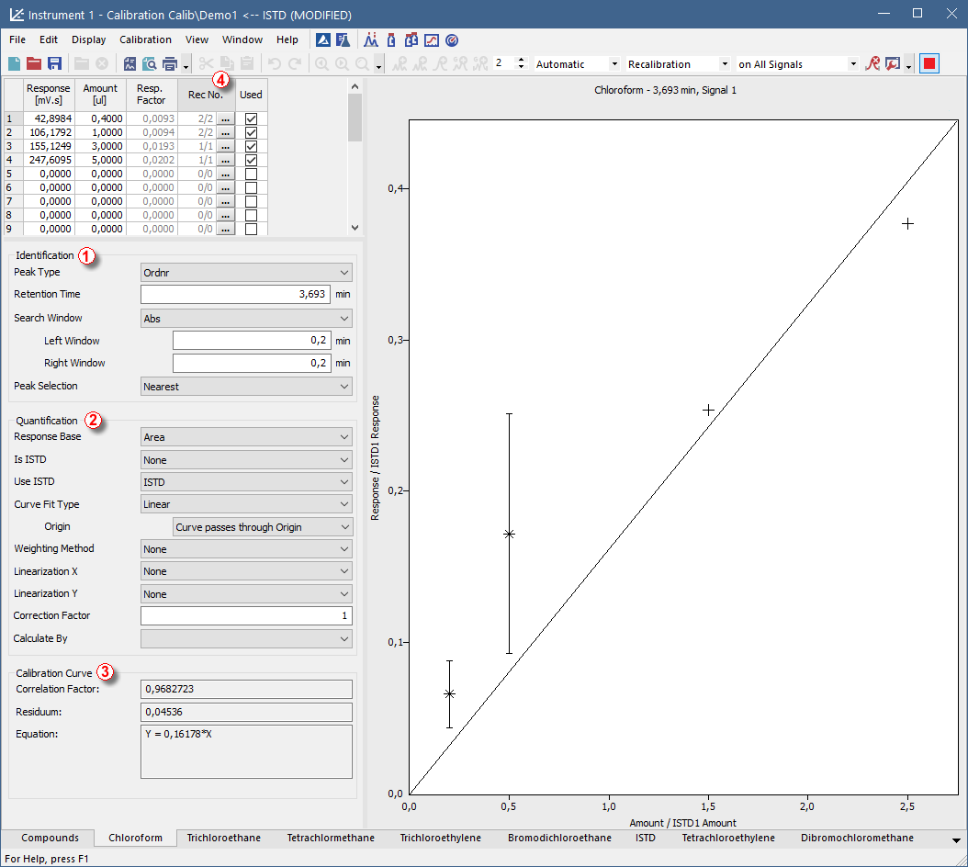
WHAT‘S NEW → CALIBRATION
Compound parameters are rearranged into groups – Identification ①, Quantification ② and Calibration Curve ③
Rec No. ④ column displays both used and total recalibrations on the respective level

Slide 5
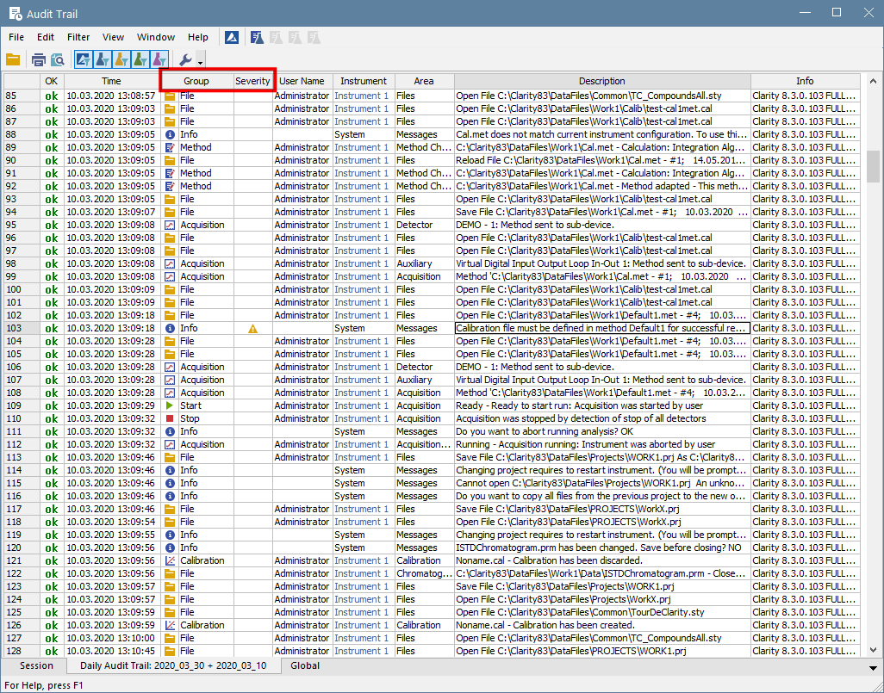
WHAT‘S NEW → AUDIT TRAIL
New columns Group and Severity
New Group icons
Prepared ground for filtering options in some future version

Slide 6
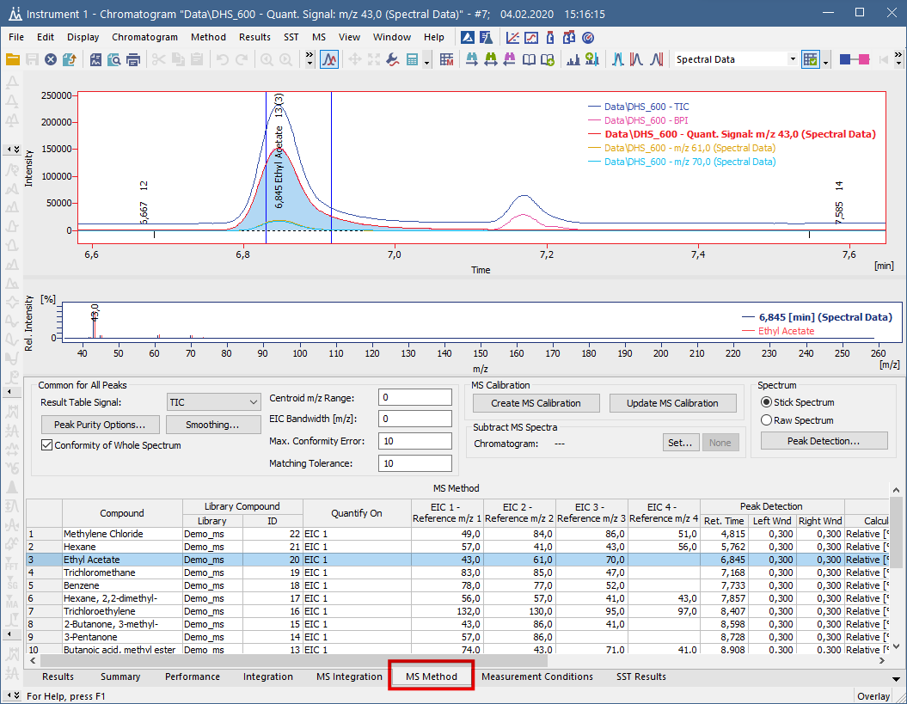
WHAT‘S NEW → EXTENSION MS → CHROMATOGRAM
MS Method tab is now faster accesible
MS Method tab is on the same level such as Results tab (previously it was hidden on the Measurement Conditions tab)

Slide 7
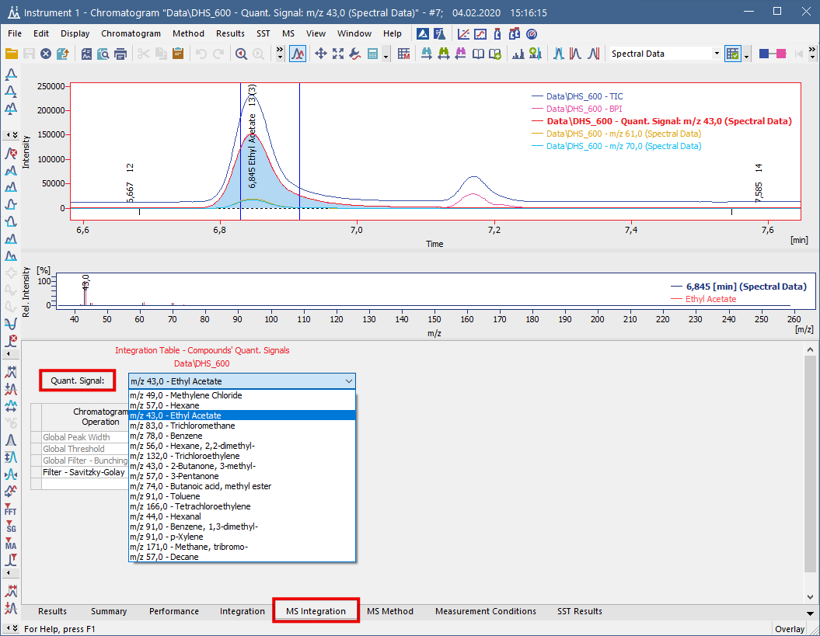
WHAT‘S NEW → EXTENSION MS → CHROMATOGRAM
MS Integration tab is now independent tab of Integration tab
It allows to integrate only MS Quantification signals

Slide 8
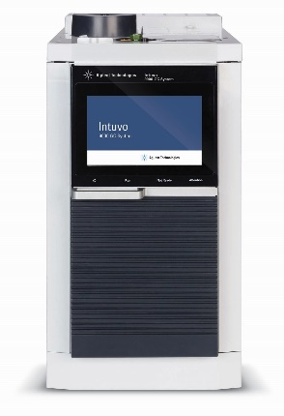
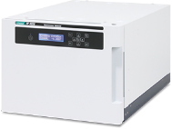
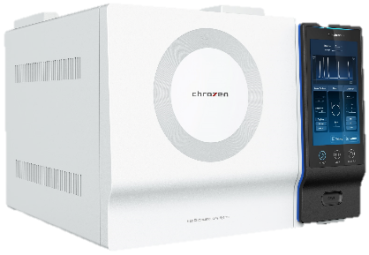
New control modules
WHAT‘S NEW → CONTROL MODULES
Agilent – 8860, 8890 and Intuvo 9000 GC
JASCO – FP-4020/4025 detector
Young In Chromass – ChroZen GC
... many control modules have been updated

Slide 9
…THANK YOU FOR YOUR TIME

