Slide 1
DHA – DETAILED HYDROCARBON ANALYSIS
CLARITY EXTENSION

Slide 2
DHA Extension
Overview
Determination of individual components in spark ignition engine fuel
Calculation of % Area/Weight/Volume
  Particular compounds – DHA Results
  Hydrocarbon groups – DHA Group Results (PONA, PIONA, …)
ASTM D-6730
  Preinstalled standard test method
Custom method development
https://www.dataapex.com/product/extensions-DHA
DHA Extension / Overview

Slide 3
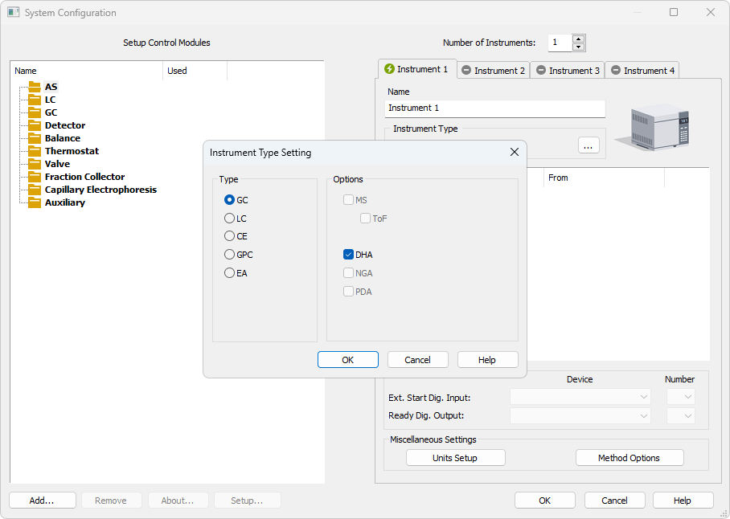
System Configuration
DHA Instrument is configured in the System Configuration window
DHA can be enabled on station where p/n A33 is purchased
DHA Extension / System Configuration

Slide 4
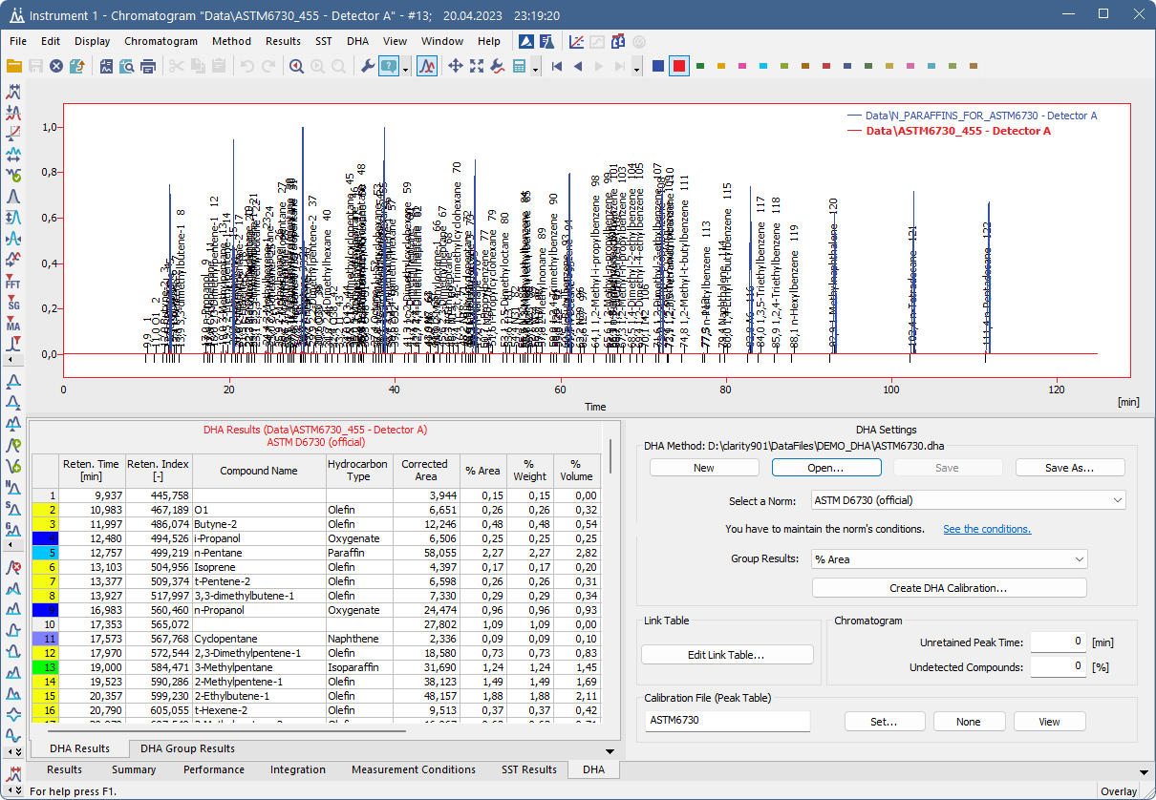
Chromatogram Window
DHA tab for specific DHA result calculations
DHA Extension / Chromatogram window

Slide 5
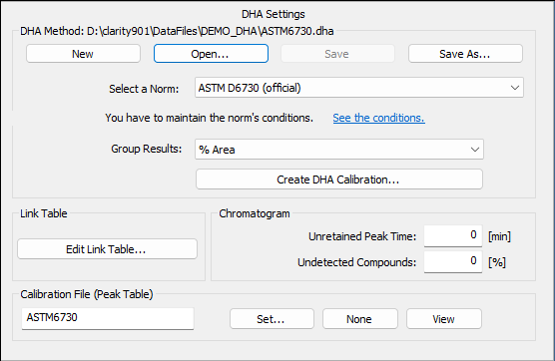
Settings on the DHA tab
DHA Settings are located on the DHA tab
Create DHA Calibration
Display DHA Result from chromatogram
Edit Link Table: custom compound names
DHA Extension / Settings on the DHA tab

Slide 6
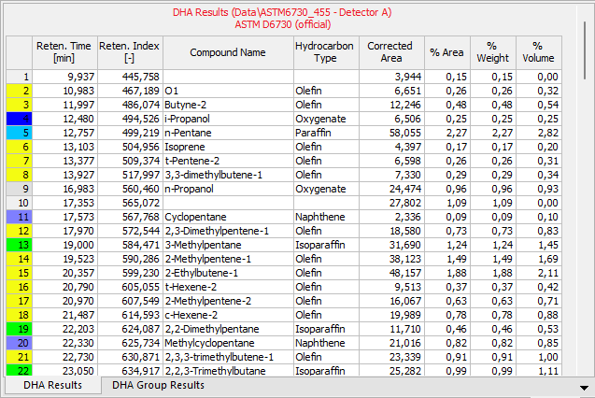
DHA results
Shows the calculated results
DHA Method and DHA Calibration from Chromatogram must match with DHA Settings
DHA Extension / DHA Results

Slide 7
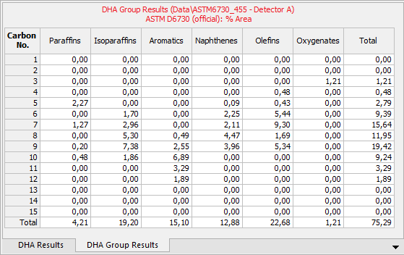
DHA Group results
Display Group Results (PIONA, PONA)
Units according to DHA Settings – Corrected Area, % Area, % Weight or % Volume
Selected units are displayed in the table header
DHA Extension / DHA Group Results

Slide 8
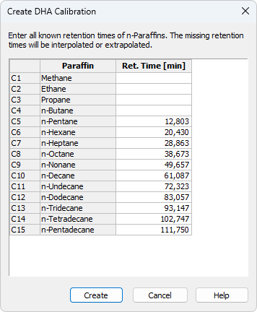
DHA Calibration
Open from DHA Settings – Create DHA Calibration
The standard chromatogram must contain from 6 to 11 calibrated peaks from the n-Paraffins standard sample
Manually enter the measured C1...C4 retention times
DHA Extension / DHA Calibration

Slide 9
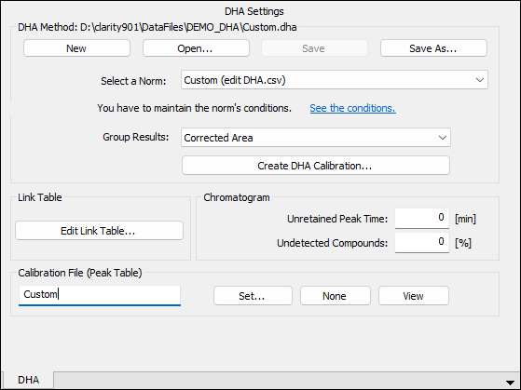
Custom DHA method
Possibility to adjust DHA Method and Calibration according to your needs
Develop method based on a specific laboratory instrumentation
DHA Extension / Custom DHA Method

Slide 10
Thank you for your attention

