Slide 1
GPC – Gel Permeation Chromatography
CLARITY EXTENSION

Slide 2
GPC Extension
Overview
Extension for SEC/GPC data evaluation
GPC and normal mode
Multiple GPC calibration types
Flow Rate Correction
Specific GPC Results
Graphs of MW Distribution and Cumulative MW Distribution
GPC Slice Table and Ranges
https://www.dataapex.com/product/extensions-gpc
GPC Extension / Overview

Slide 3
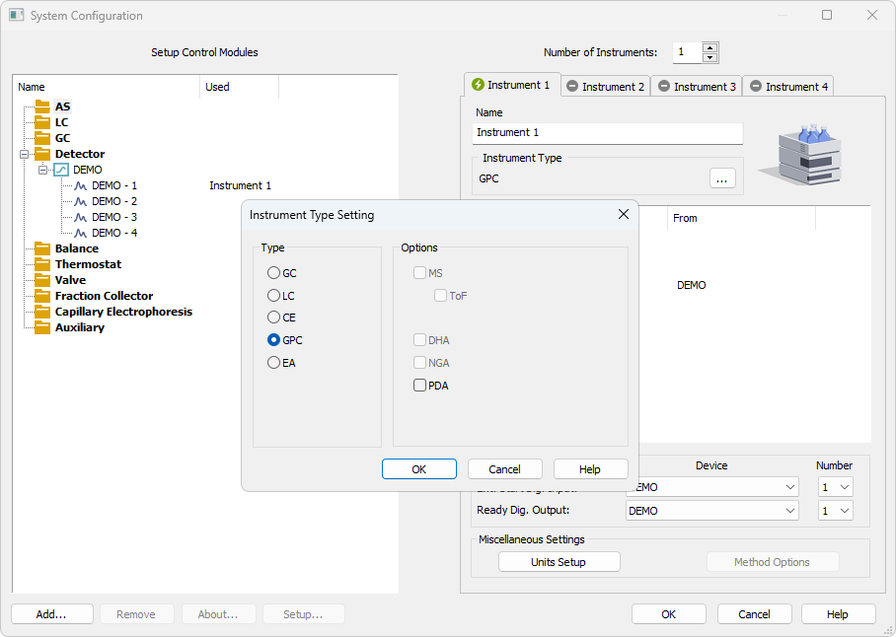
System Configuration
GPC Instrument is configured in the System Configuration window
GPC can be enabled on a station where p/n A28 is purchased
GPC Extension / System Configuration

Slide 4
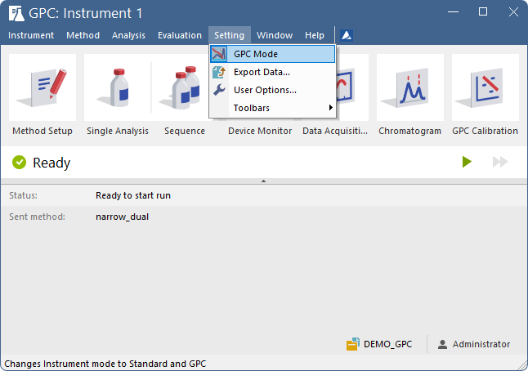
GPC Mode
GPC Mode or Standard Mode can be selected in the Setting menu on the GPC Instrument
Type of mode is then indicated by GPC inscription in the header of each window
GPC Extension / GPC Mode

Slide 5
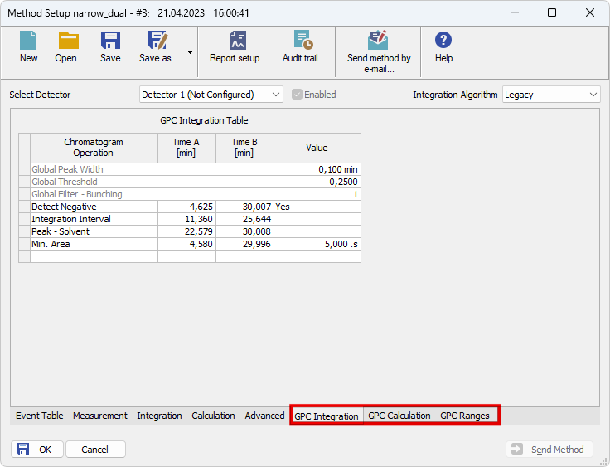
Method Setup
GPC related tabs in the method
Chromatograms can be evaluated in GPC or standard mode
GPC Extension / Method Setup

Slide 6
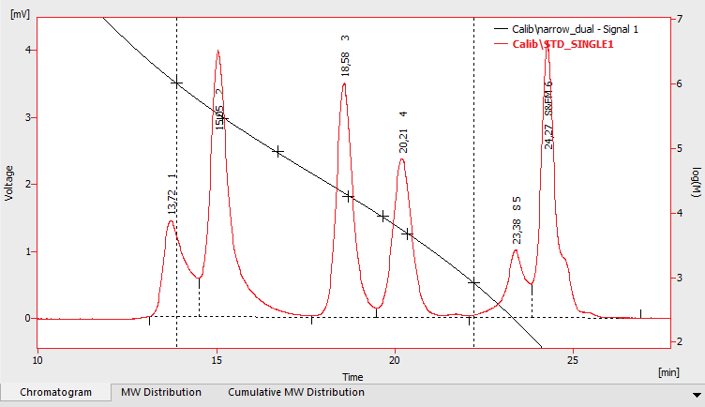
GPC Calibration
Options
Molecular weight as a function of elution volume
Narrow standards
Flow rate correction
Universal calibration
Broad calibration
Multiple linear (Hamielec) fit
Multiple integral standard
Broad on narrow
GPC Extension / GPC Calibration / Options

Slide 7
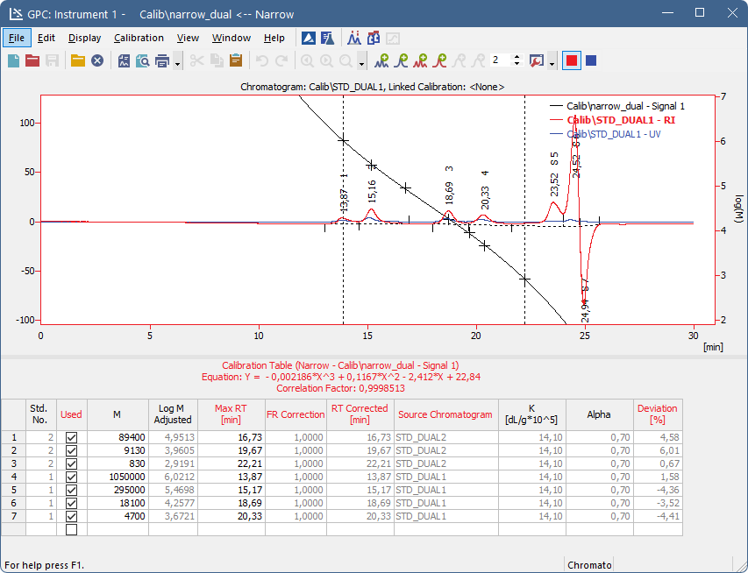
GPC Calibration
Narrow Standard
GPC Extension / GPC Calibration / Narrow Standard

Slide 8
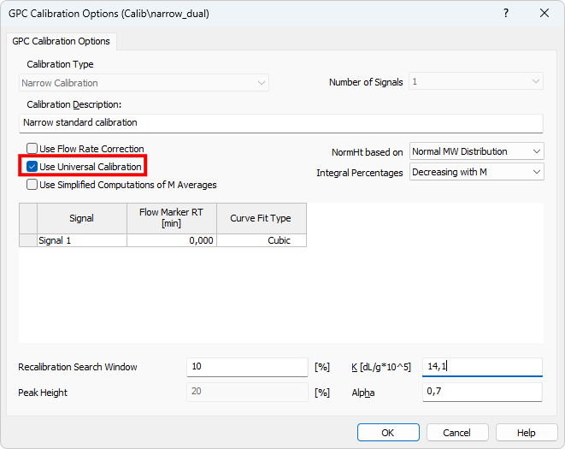
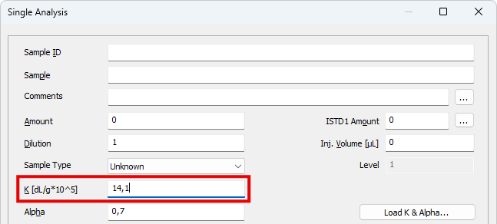
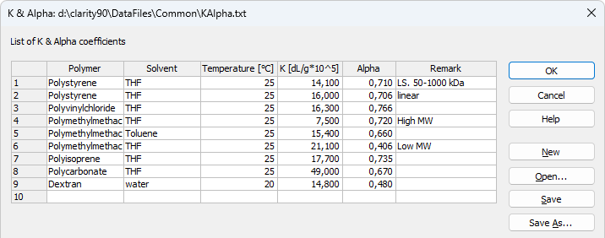
GPC Calibration
Universal Calibration
Universal Calibration option used along with Mark-Houwink parameters
GPC Extension / GPC Calibration / Universal Calibration

Slide 9
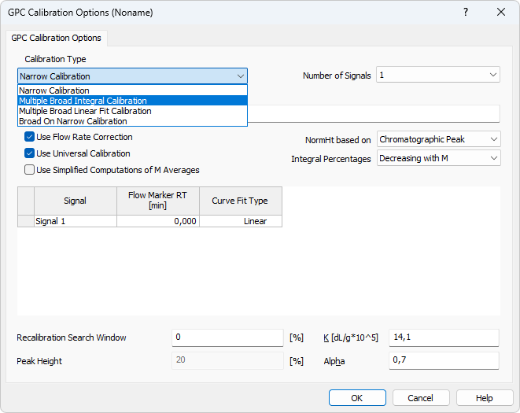
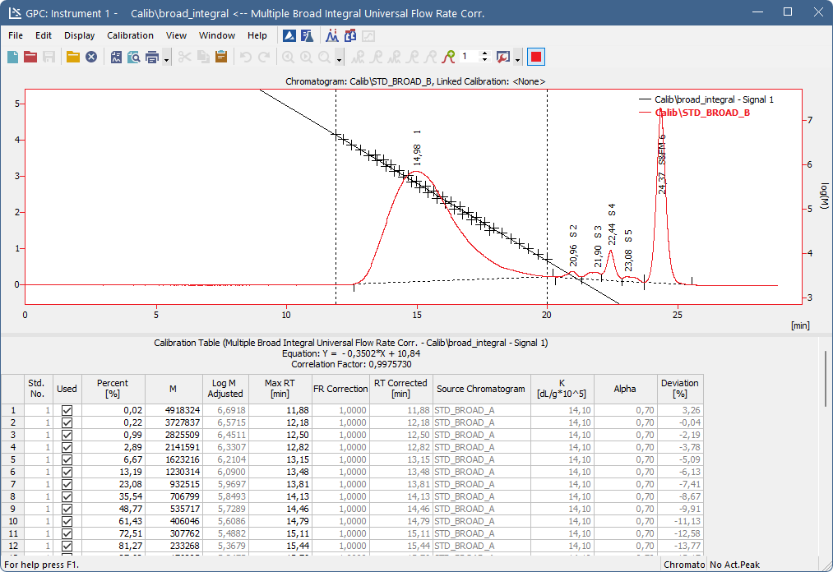
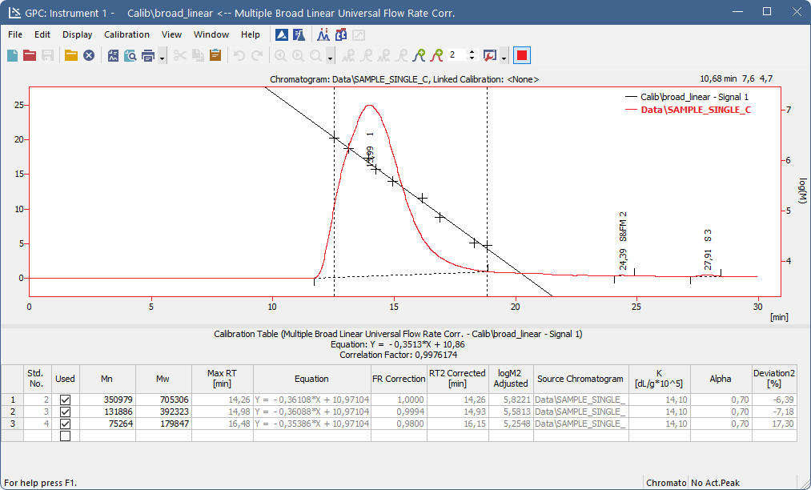
GPC Calibration
Broad Standard
GPC Extension / GPC Calibration / Broad Standard

Slide 10
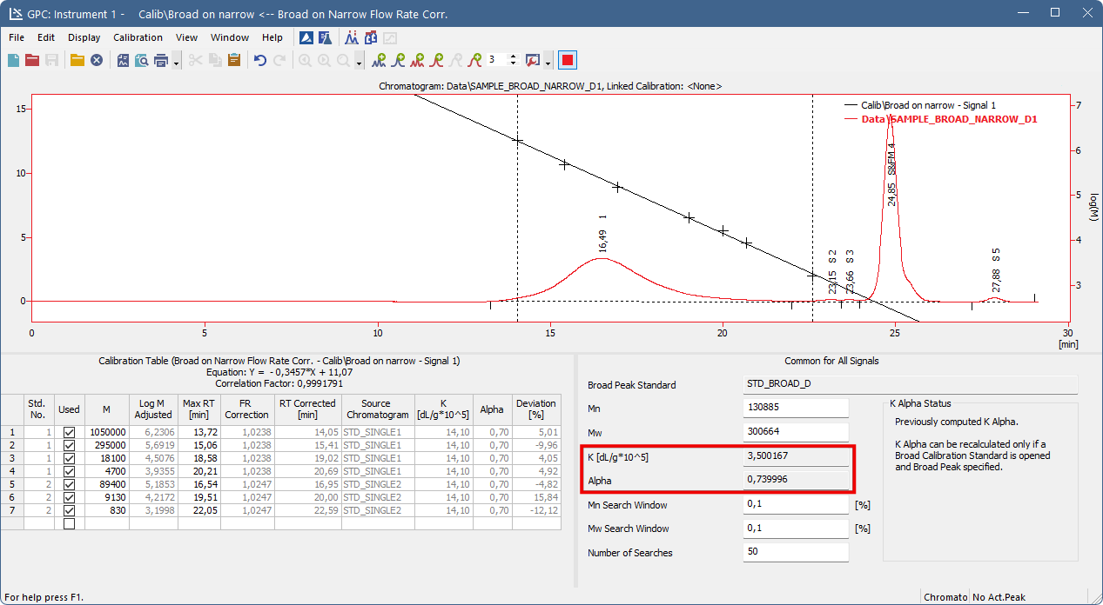
GPC Calibration
Broad On Narrow
GPC Extension / GPC Calibration / Broad on Narrow

Slide 11
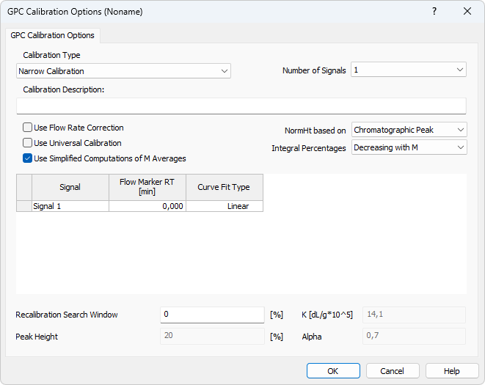
GPC Calibration
SIMLIFIED CALCULATIONS
Standard Calculations
Averaging is per fixed MW interval
Used in PL Cirrus
Simplified Calculations
Averaging is per fixed time (volume) interval
Used in EzChrom
Equations listed in manual/help
GPC Extension / GPC Calibration / Simplified Calculations

Slide 12
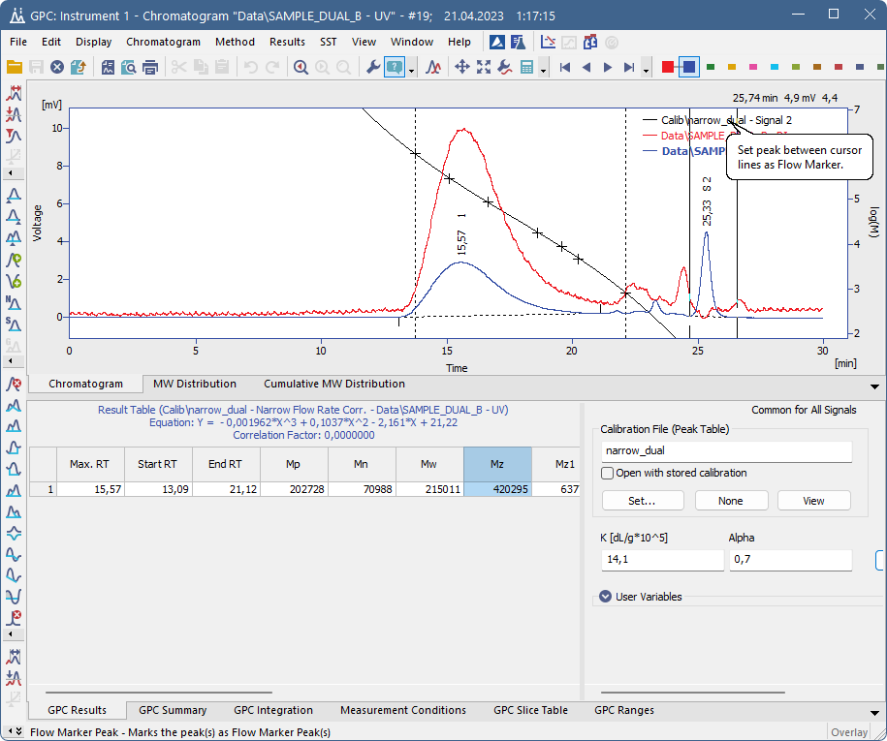
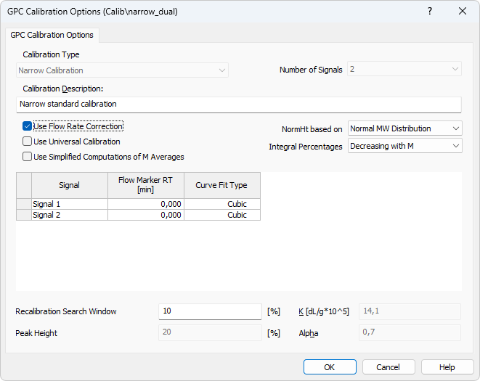
Flow Rate Correction
Chromatogram
Menu Chromatogram – Peak – Flow Marker Peak
GPC Calibration must be set to Use Flow Rate Correction
GPC Extension / Flow Rate Correction / Chromatogram

Slide 13
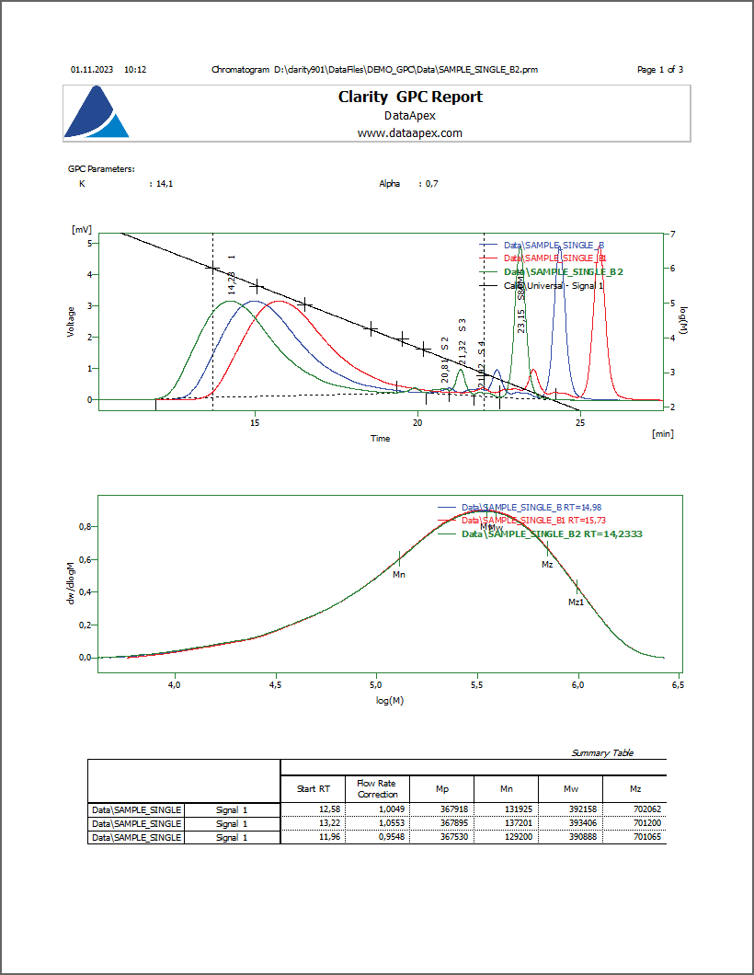
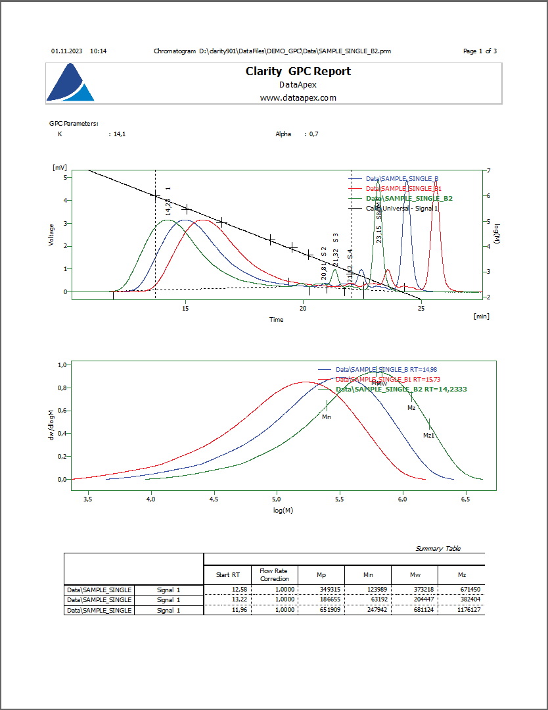
Flow Rate Correction
Report Setup
Flow Rate Correction is applied in the first chromatogram report
GPC Extension / Flow Rate Correction / Report Setup

Slide 14
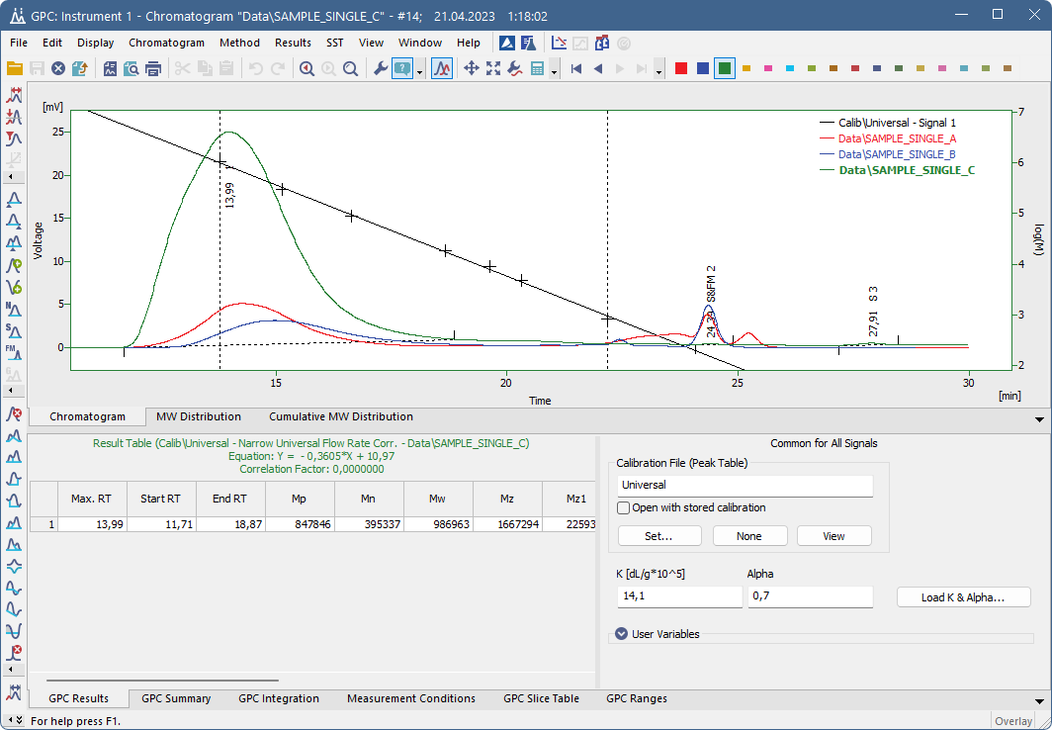
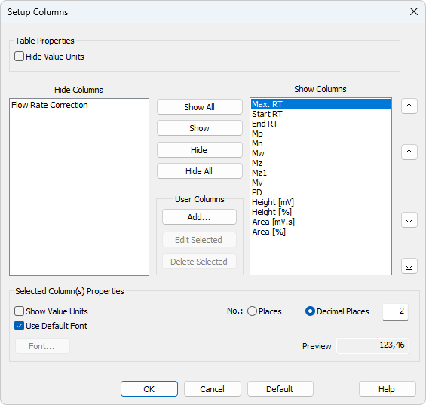
Chromatogram
GPC results
Hide/Show GPC-related columns in the Result Table
GPC Extension / Chromatogram / GPC Results

Slide 15
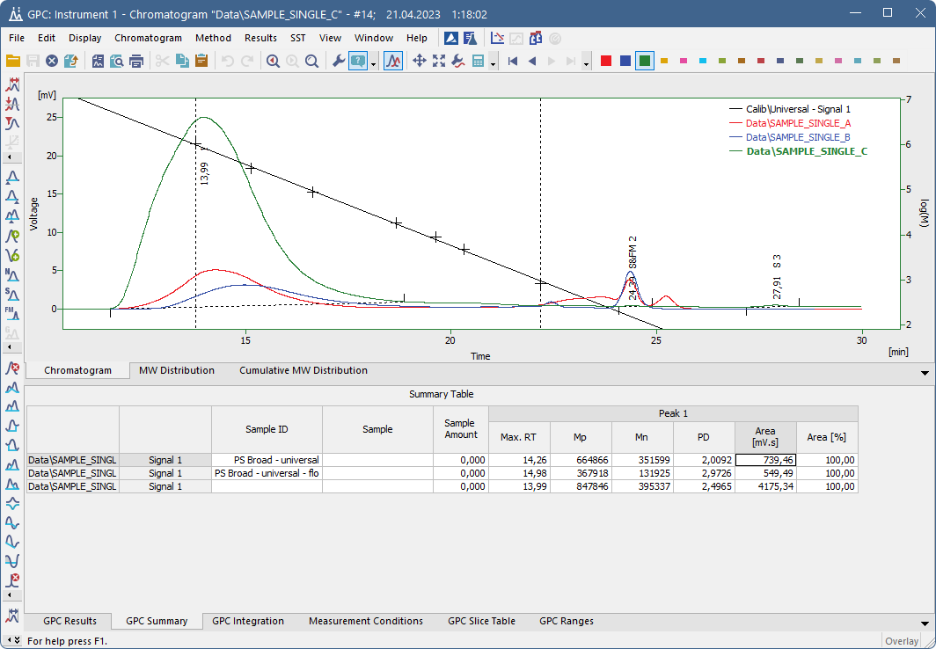
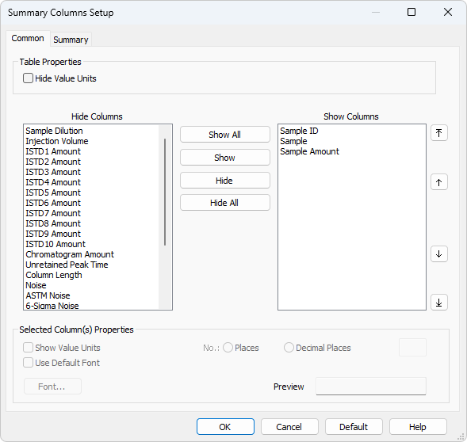
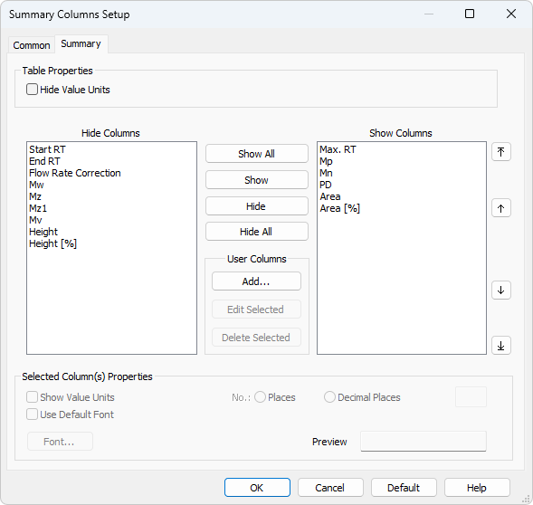
Chromatogram
GPC summary
Hide/Show GPC-related columns in the Summary Table
GPC Extension / Chromatogram / GPC Summary

Slide 16
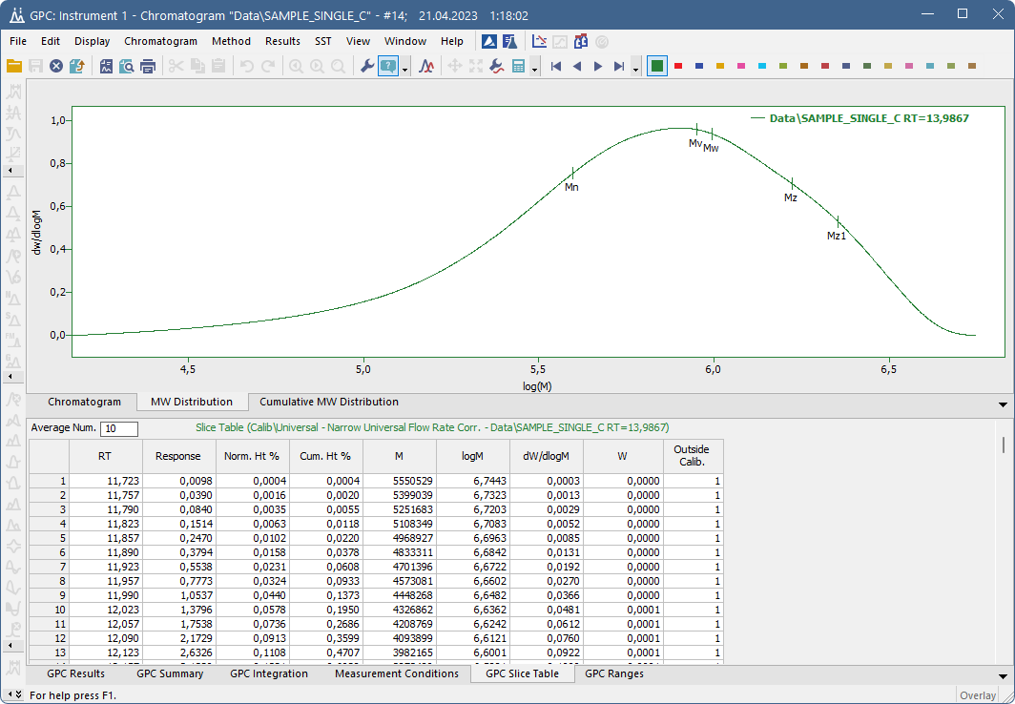
Chromatogram
GPC SLIce table
GPC Slice Table shows cumulative molecular weight distribution
GPC Extension / Chromatogram / GPC Slice Table

Slide 17
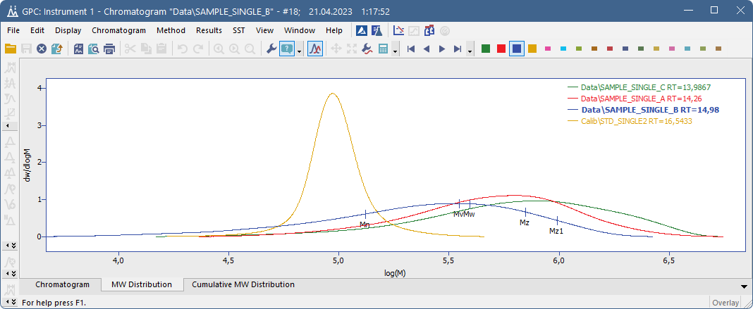
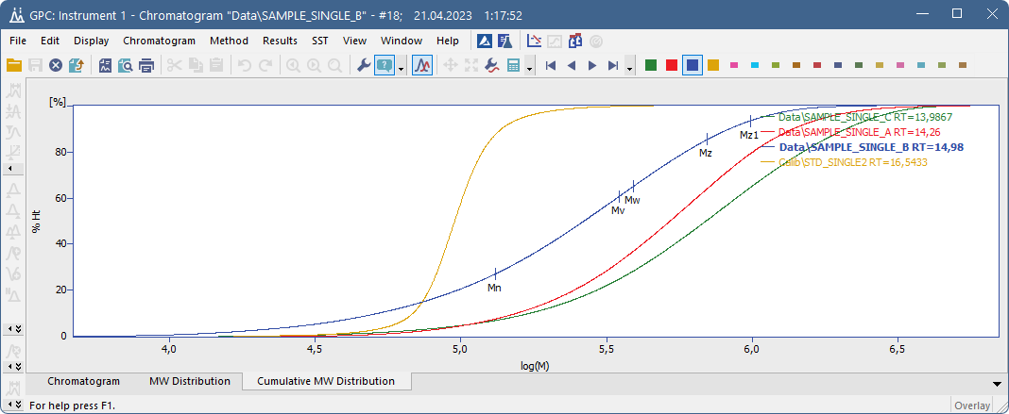
Chromatogram
MW DISTRIBUTION, CUMULATIVE MW DISTRIBUTION
MW distribution shows molecular weight distribution of active peaks
Cumulative MW distribution shows cumulative molecular weight distribution in %
GPC Extension / Chromatogram / MW Distribution, Cumulative MW Distribution

Slide 18
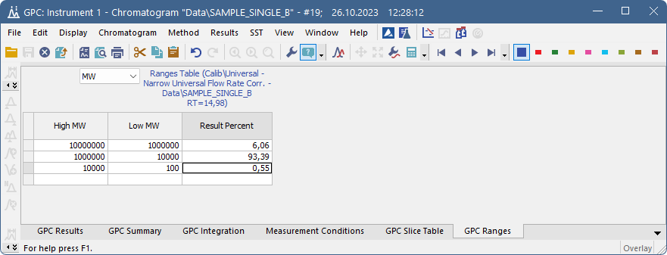
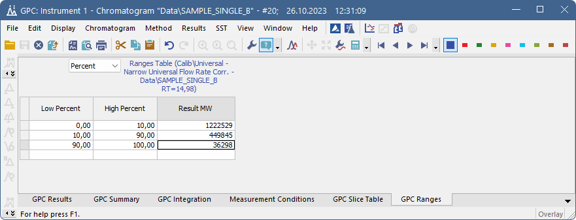
Chromatogram
GPC ranges
Percentages for selected MW ranges
MW averages for selected percentage ranges
GPC Extension / Chromatogram / GPC Ranges

Slide 19
Thank you for your attention

