Slide 1
PDA – PHOTO DIODE ARRAY
CLARITY EXTENSION

Slide 2
PDA Extension
Overview
Spectral data acquisition from selected detectors
Import and export of spectral data in text format
Isoplot and 3D plot for spectral data evaluation
Peak purity evaluation
Spectral library and spectral library search
https://www.dataapex.com/product/extensions-pda
PDA Extension / Overview

Slide 3
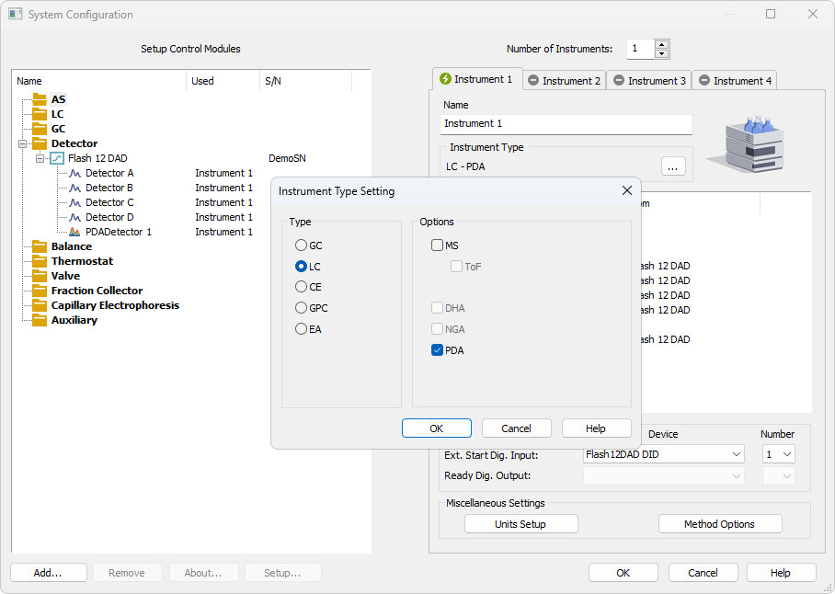
System Configuration
PDA option is configured in the System Configuration window
PDA can be enabled on a station where p/n A29 is purchased
PDA Extension / System Configuration

Slide 4
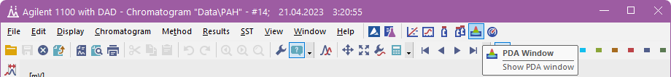
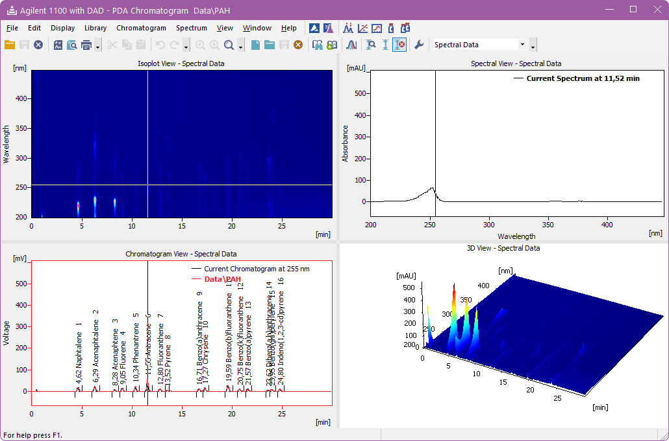
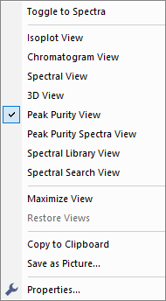
PDA window
PDA window is accessible from the Chromatogram window
8 different views could be selected in the 4 panes
PDA Extension / PDA Window

Slide 5
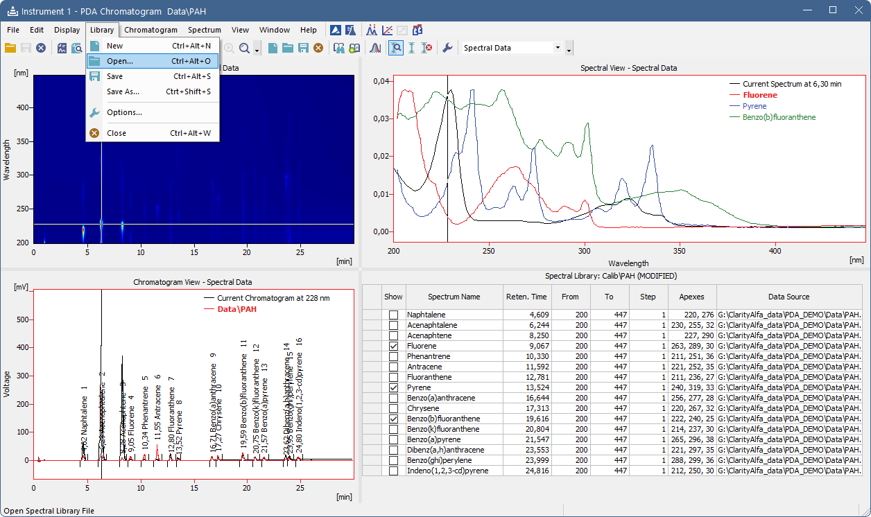
PDA Window
Spectral Library
Library menu allows you to open or create a new Spectral library.
By default, the Library is stored in the Calib subdirectory of the current Project
Spectral Library pane display details for the spectra in library and allows to display them in Spectral View
PDA Extension / PDA Window / Spectrum Library

Slide 6
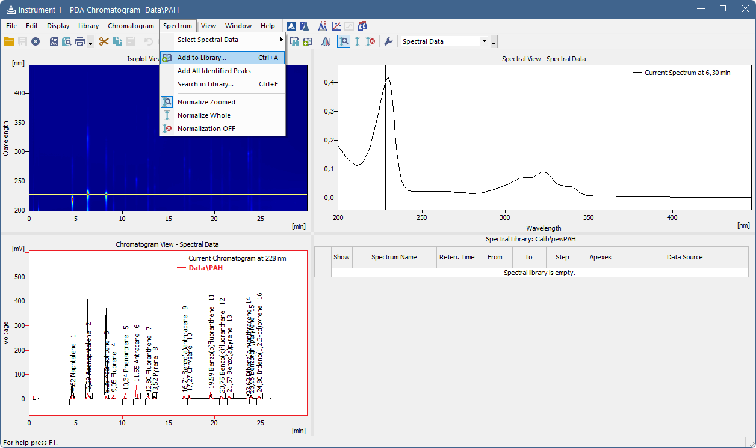
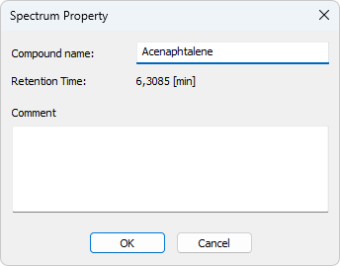
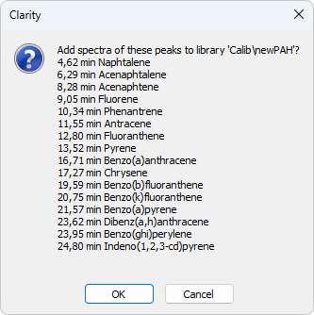
PDA window
Spectral Library
Spectra to the library could be added individually using the Add to Library... command
Multiple spectra could be added from a chromatogram with identified peaks using the Add All Identified Peaks command
PDA Extension / PDA Window / Spectral Library

Slide 7
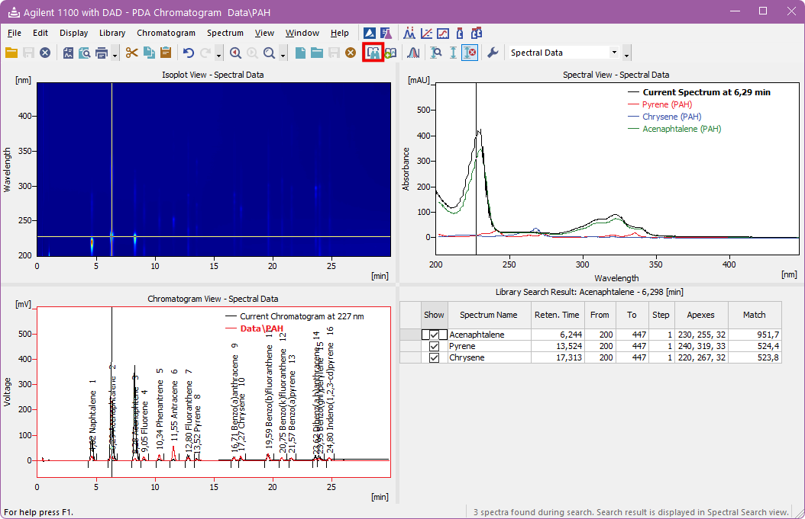
PDA view
Spectrum search
Library search results are displayed as an overlay in Spectral View or as a table in Library Search Result
PDA Extension / PDA View / Spectrum Search

Slide 8
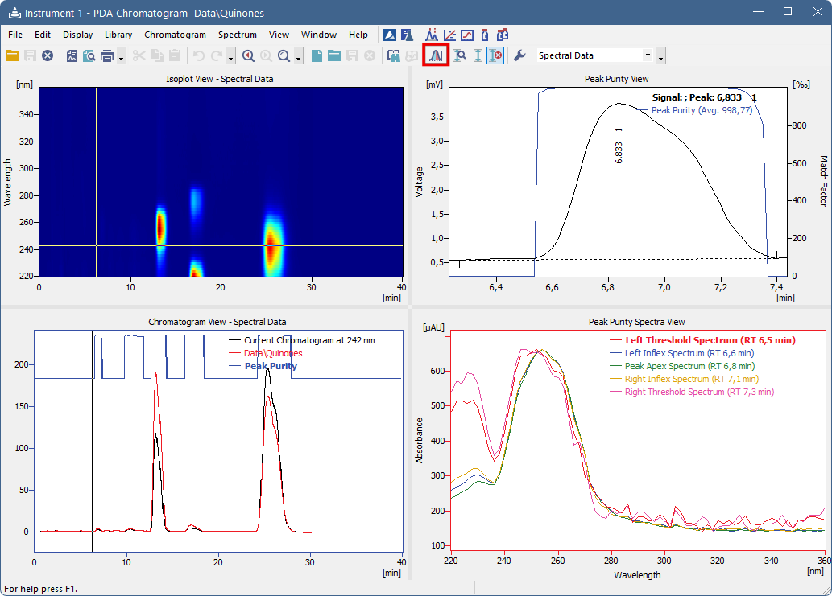
PDA view
Peak purity
View peak purity for entire chromatogram or a single peak
Spectra for peak start, end, inflection and apex are compared in the Peak Purity Spectra View
PDA Extension / PDA View / Peak Purity

Slide 9
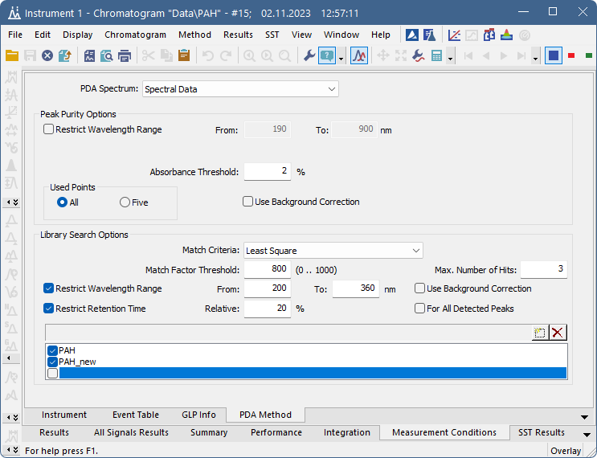
PDA Method
Measurement Conditions
Peak Purity and Library Search Options are set on the PDA Method tab
Multiple PDA libraries could be set in the method
PDA Extension / PDA Method

Slide 10
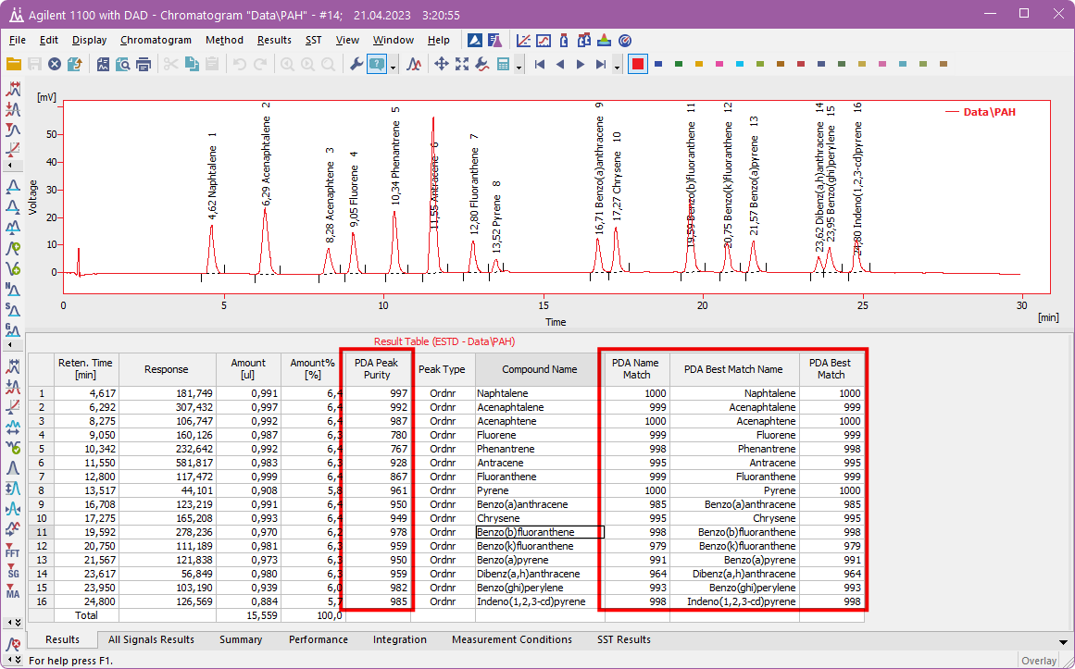
PDA Results
Library search results are displayed as an overlay in Spectral View or as a table in Library Search Result
PDA Name Match belongs to the compound identified by the calibration found in the first PDA library
PDA Best Match Name and PDA Best Match are based on all PDA libraries set in the PDA Method
PDA Extension / PDA Results

Slide 11
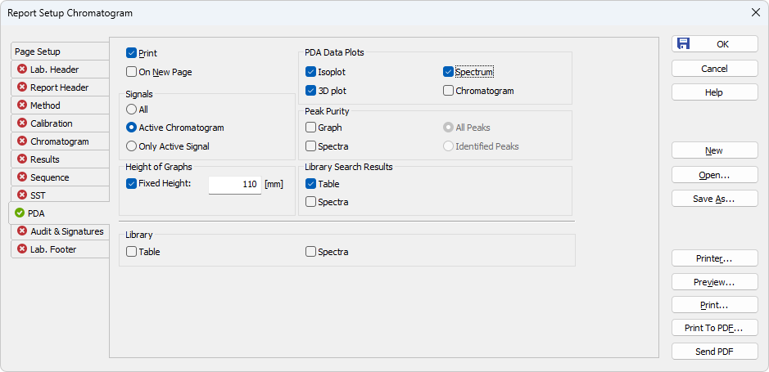
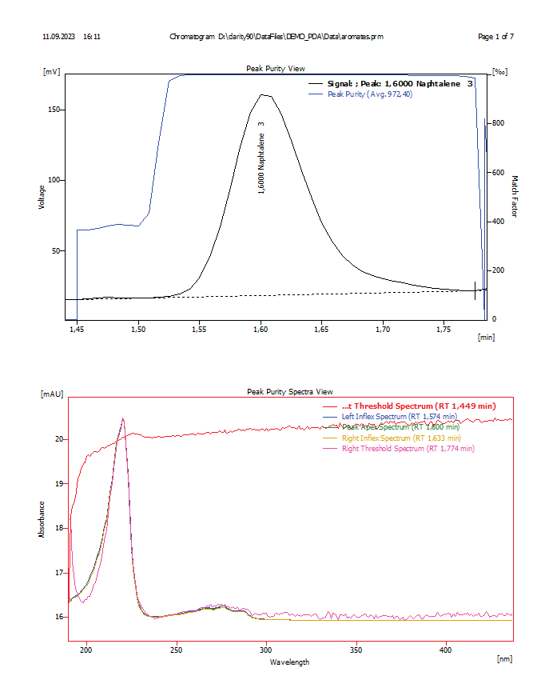
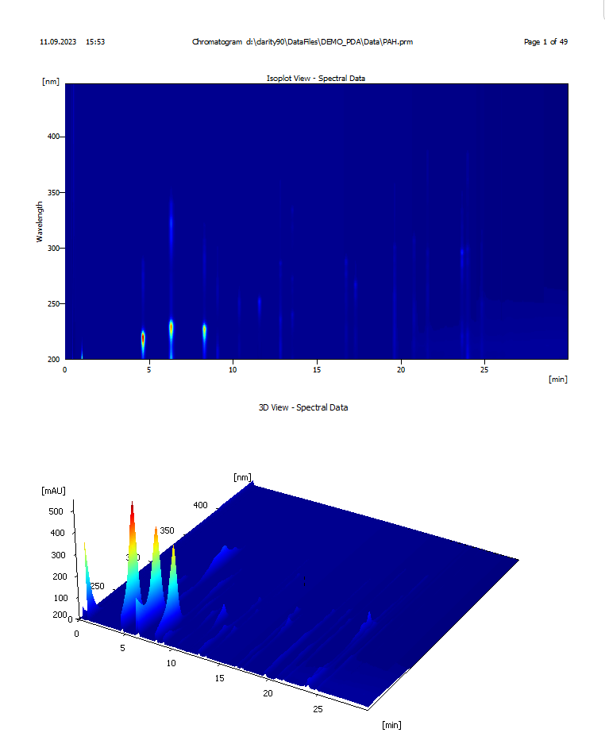
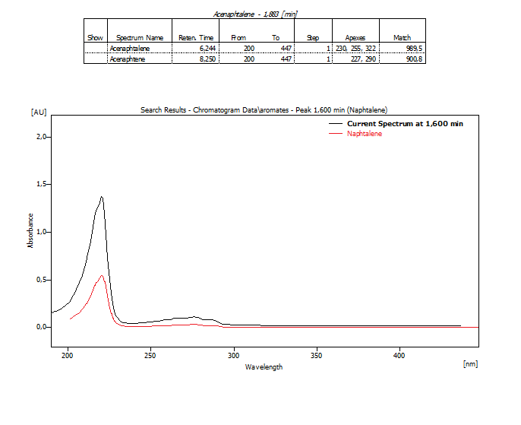
PDA Report
Customize PDA Report to display desired results
PDA Extension / PDA Report

Slide 12
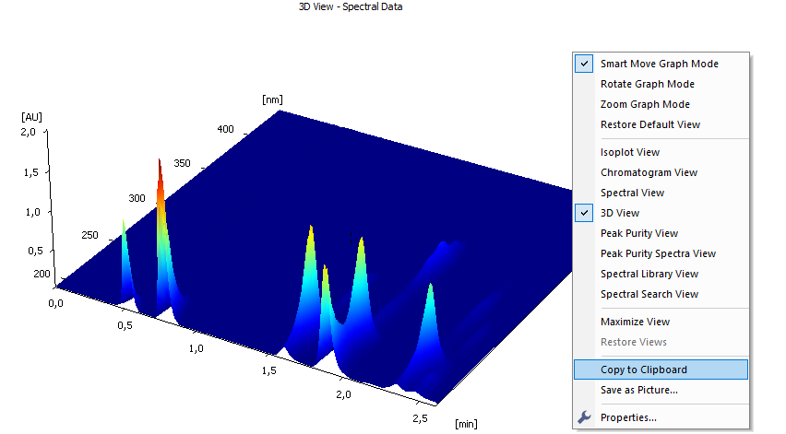
Export of Graphs
Export graphs into clipboard or save them as a picture (*.emf)
PDA Extension / Export of Graphs

Slide 13
Thank you for your attention

