Slide 1
P050/80A
16.11.2018
Clarity 8.1
WHAT'S NEW

Slide 2
What is new in Clarity 8.1
Control analysis directly from Instrument window
Instrument window tooltips for fast overview
Improvements in MS extension
Documentation at your fingertips
New and updated control modules

Slide 3
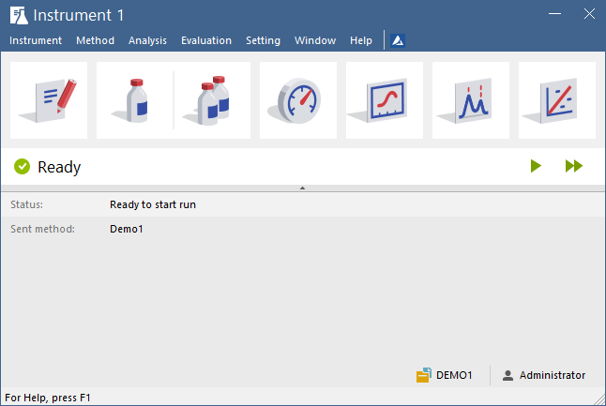
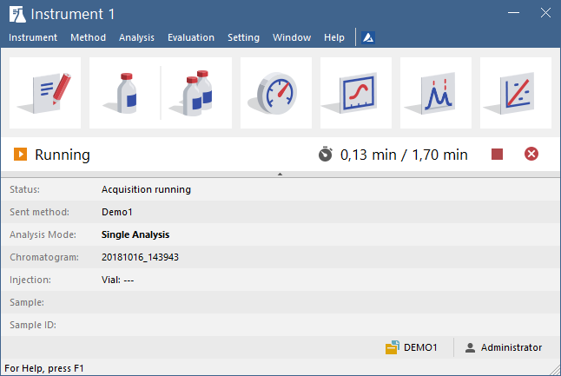
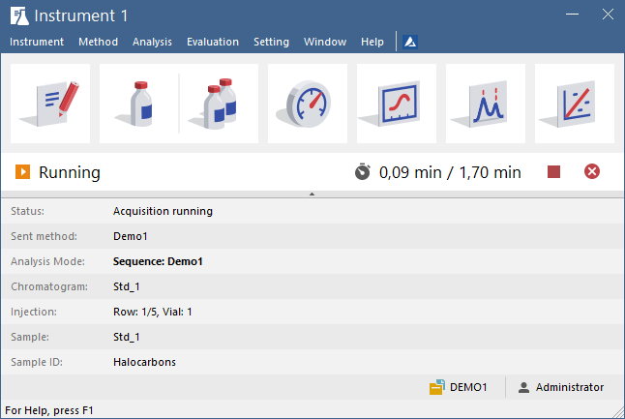

Analysis Control
Tooltips
MS
Documentation
New Control Modules
Clarity allows to control analysis directly from the Instrument window
Stop Analysis
Start Single Analysis
Start Opened Sequence

Slide 4
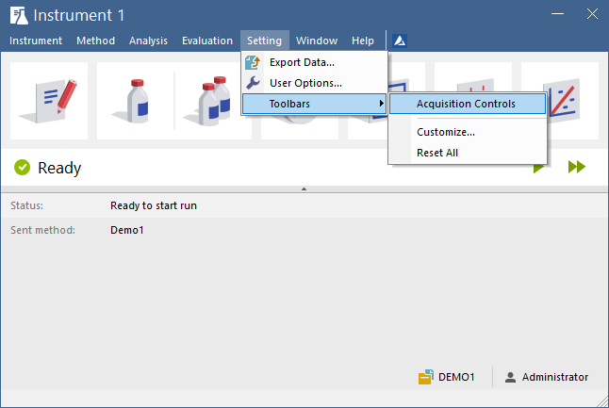
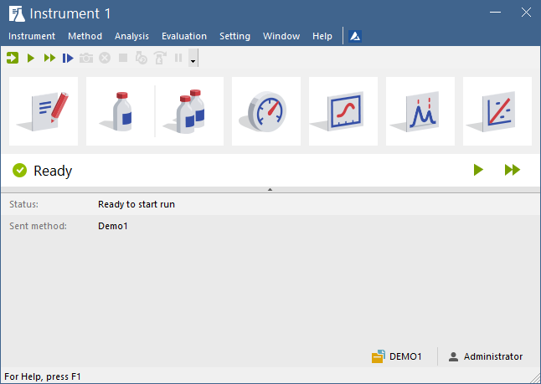
Analysis Control
Tooltips
MS
Documentation
New Control Modules
Additional Acquisition Controls toolbar may be added into the Instrument window
  Go to menu Settings – Toolbars – Acquisition Controls

Slide 5
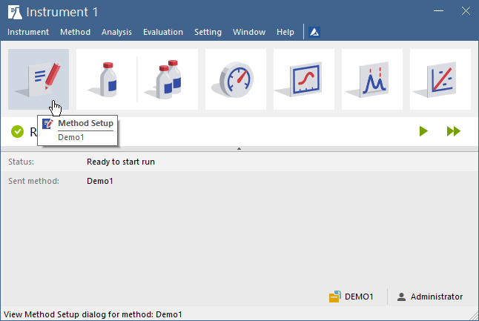
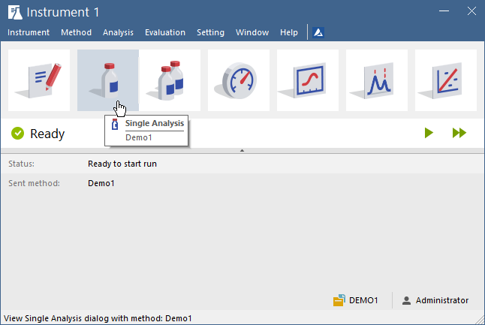
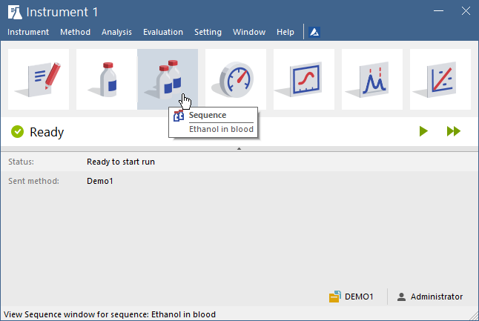
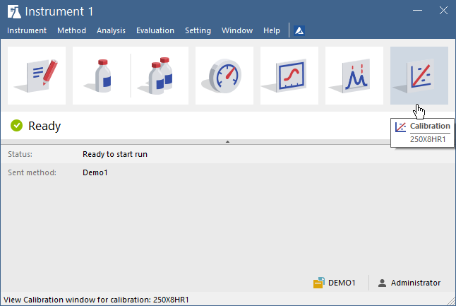
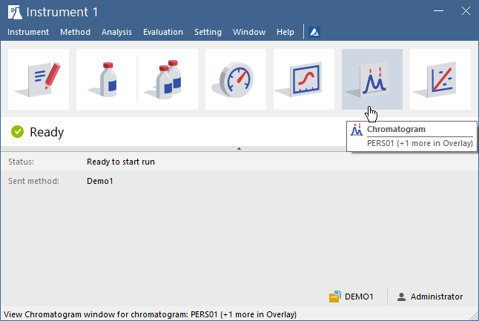
Analysis Control
Tooltips
MS
Documentation
New Control Modules
Quickly overview files opened in different places
  Just move mouse cursor over large tile icons

Slide 6
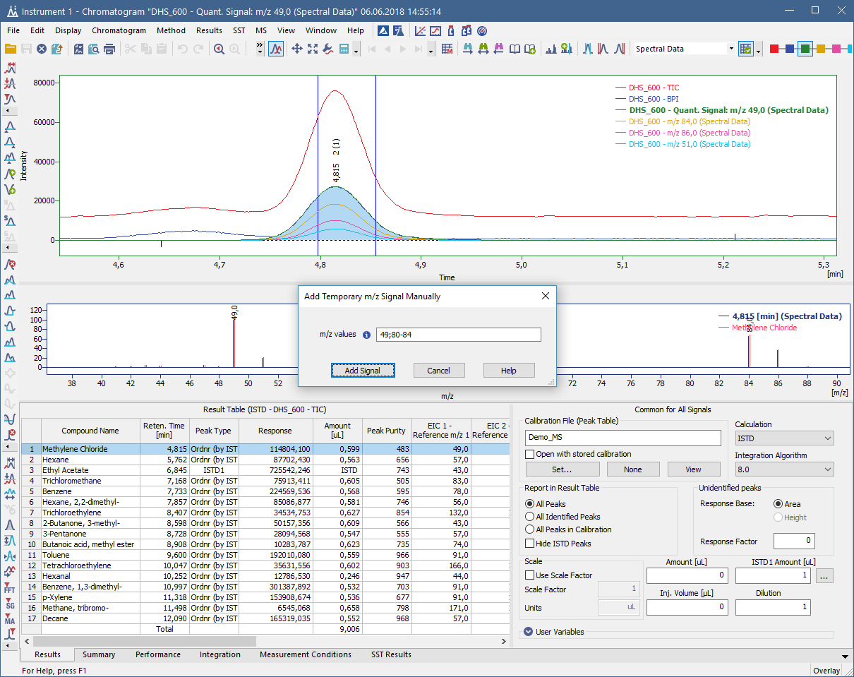
Analysis Control
Tooltips
MS
Documentation
New Control Modules
Support to add temporary m/z signal manually in order to create a new signal with user defined m/z values

Slide 7
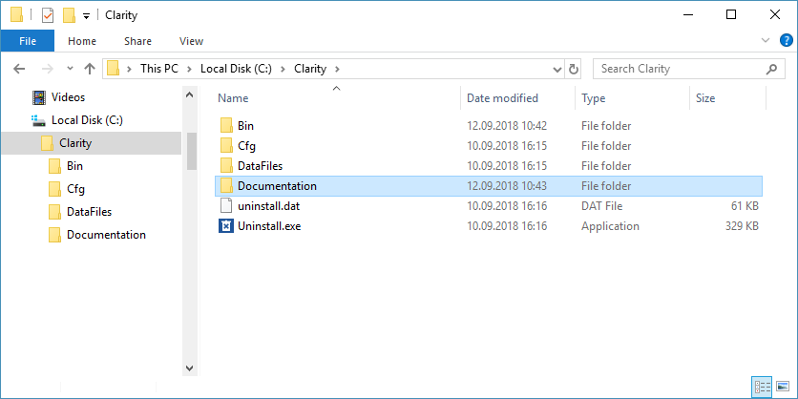
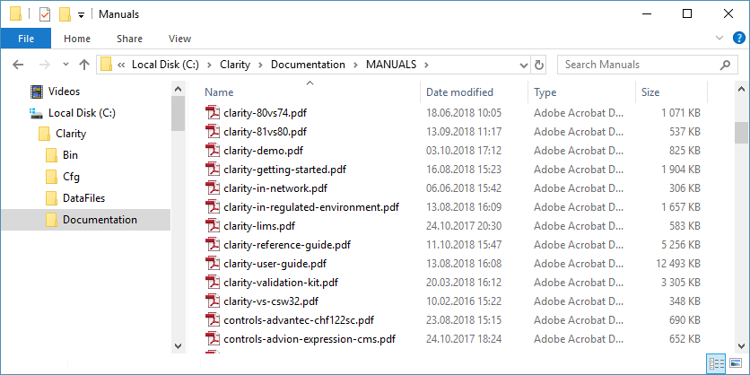
Analysis Control
Tooltips
MS
Documentation
New Control Modules
New Documentation directory in the Clarity installation
  - Place with all PDF documentation

Slide 8
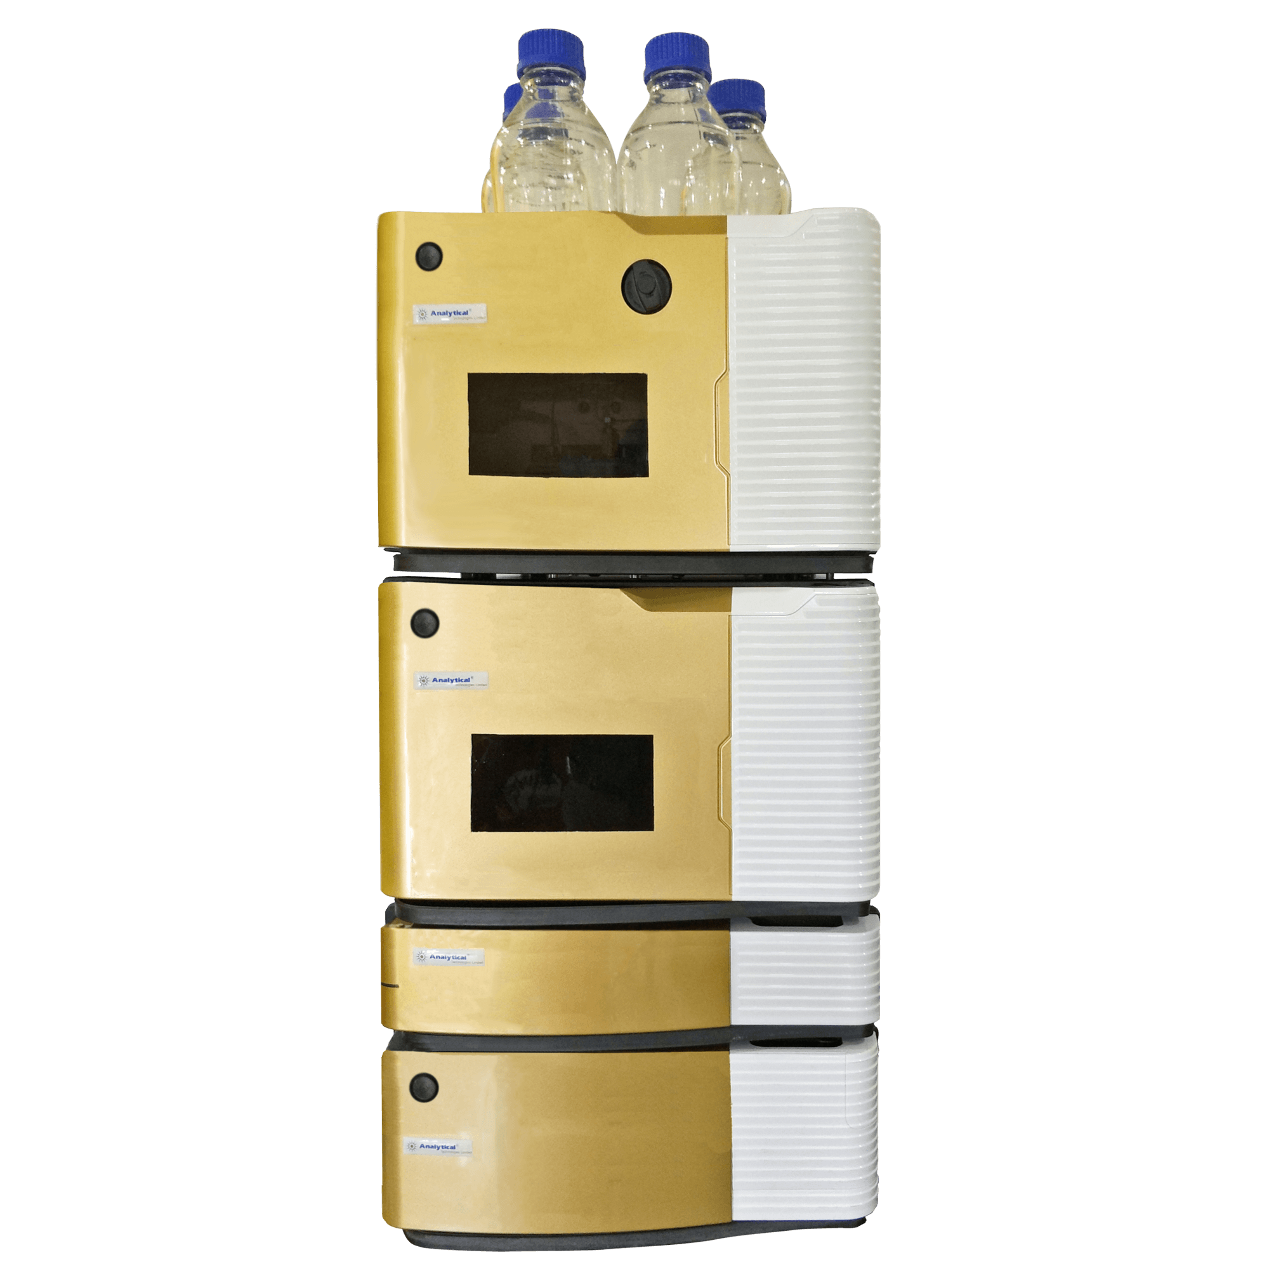
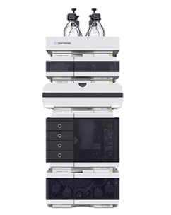
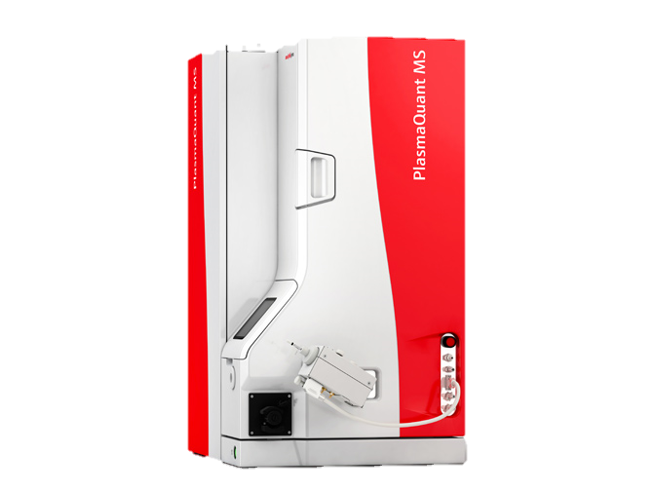
Analysis Control
Tooltips
MS
Documentation
New Control Modules
Analytik Jena – PlasmaQuant MS
Analytical Technologies– iHPLC 3000 Plus
Agilent ICF – support for overlap injection for selected samplers
… and many other control modules have been updated

