Slide 1
MS – mass spectrometry
Clarity extension

Slide 2
MS extension
Overview
Acquisition & evaluation of MS data
MS chromatogram window with spectral view
MS Method: quantification + reference ions
Spectral library and spectral library search
  NIST compatible
  User-defined
https://www.dataapex.com/product/extensions-ms
MS Extension / Overview

Slide 3
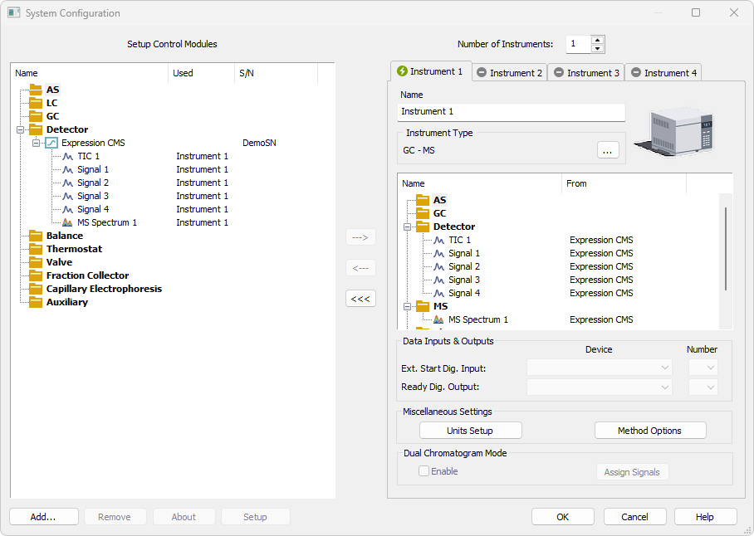
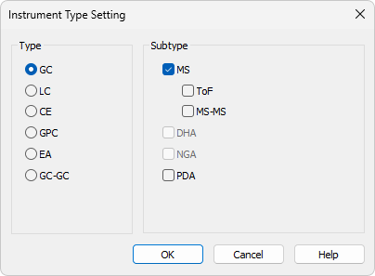
System configuration
MS extension can be enabled
on stations with p/n A38
Set in the System Configuration window
MS EXTENSION/ System configuration

Slide 4
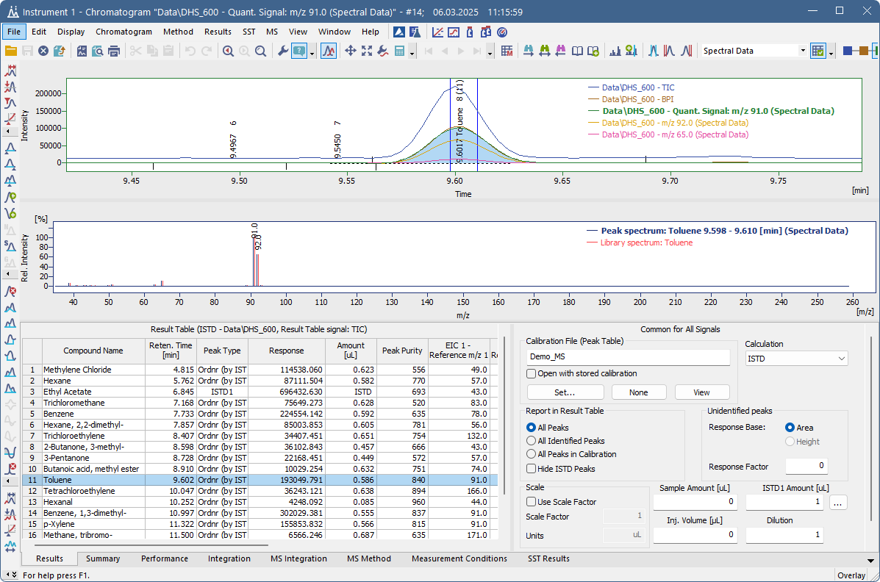
MS CHROMATOGRAM WINDOW
Divided into three parts
Interactive spectrum display
Matching library spectrum (if defined)
Up to 32 signals can be displayed
MS EXTENSION/ MS Chromatogram window

Slide 5
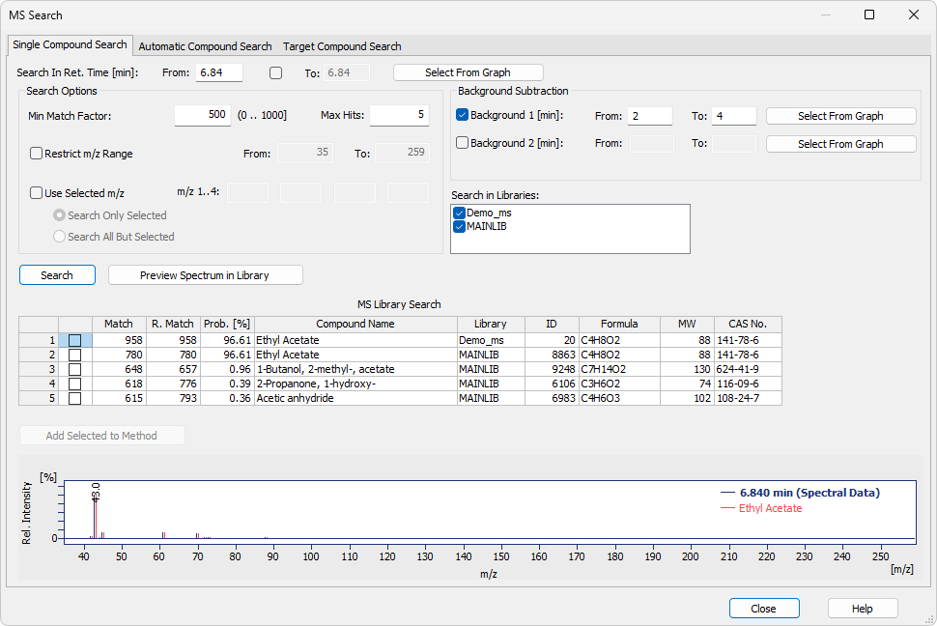
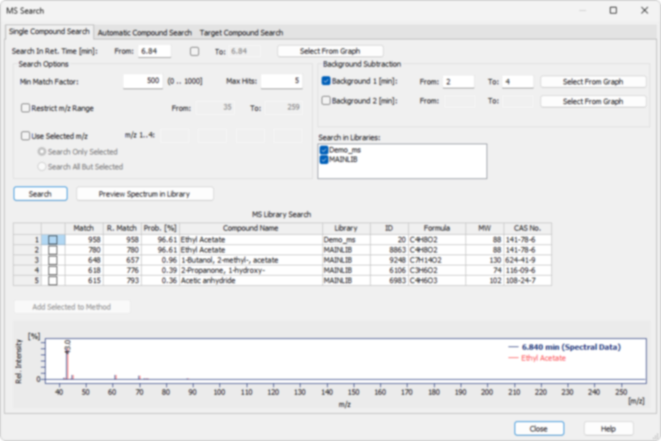
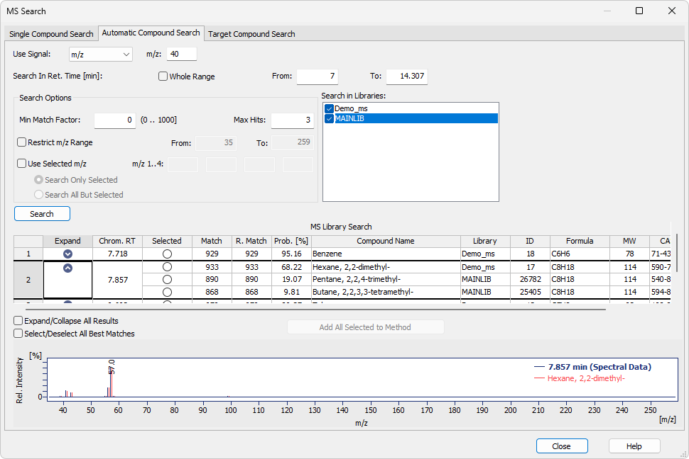

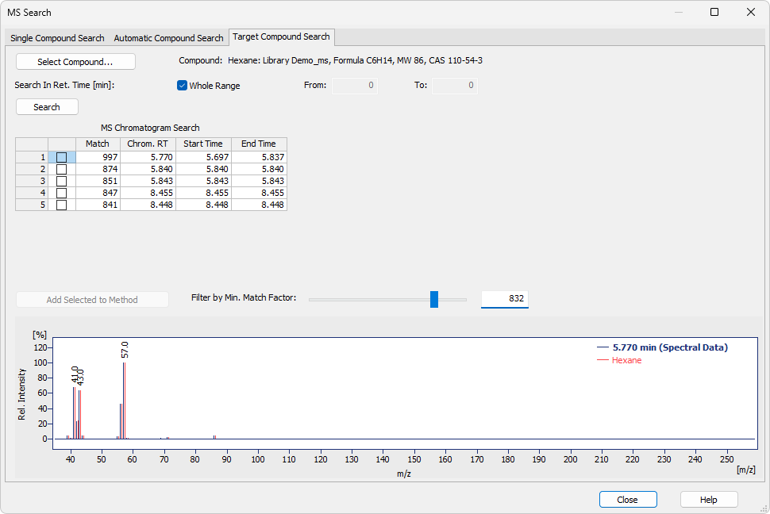
MS chromatogram window
MS menu – Compound search
Target Compound Search – checks for the presence of specific compound in the chromatogram.
Automatic Compound Search – searches the spectra of all peaks found on selected signal
Single Compound Search – compares the selected spectrum against the spectral library.
MS EXTENSION/ MS Chromatogram window/ MS Menu

Slide 6
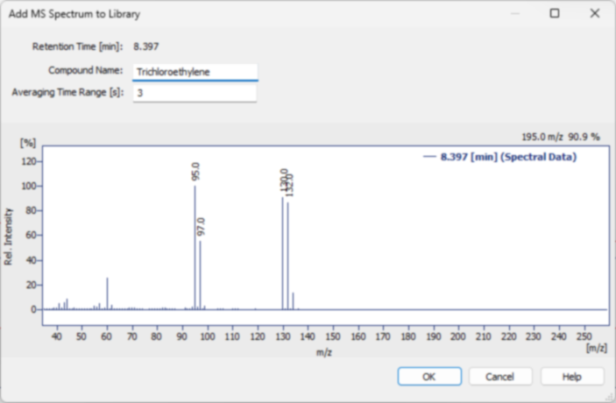
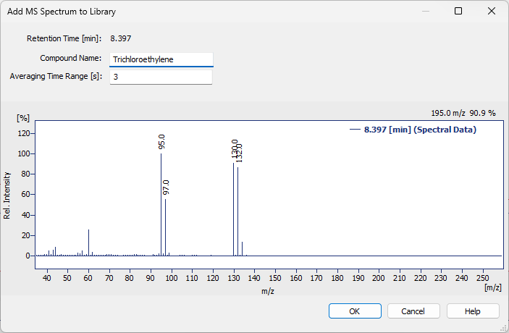
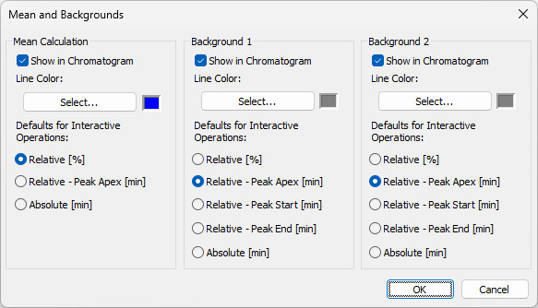
MS chromatogram window
MS menu
Spectrum Processing: Mean & Backgrounds – custom definition of peak spectrum by using different spectrum averaging and background subtraction.
Add to Library – Save measured spectra directly into user-defined MS spectral libraries.
MS EXTENSION/ MS Chromatogram window/ MS Menu

Slide 7
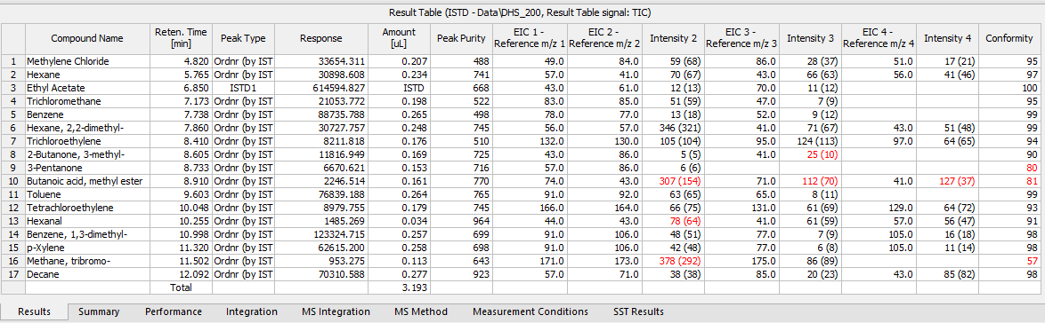
MS chromatogram window
Results table
Reference m/z values – defined in MS Method, displayed in Result Table.
Conformity column – % match between measured spectrum and reference library spectrum.
MS EXTENSION/ MS Chromatogram window/ Results table

Slide 8
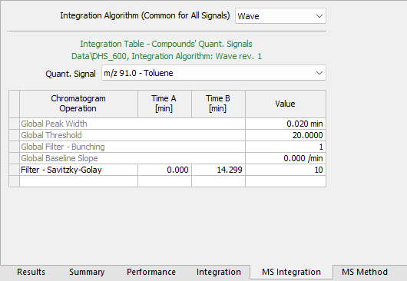
MS chromatogram window
MS integration
Quantification signal selection – specific integration parameters for each detected compound.
Algorithm choice – different integration algorithms available (e.g., Wave).
MS EXTENSION/ MS Chromatogram window/ MS Integration

Slide 9
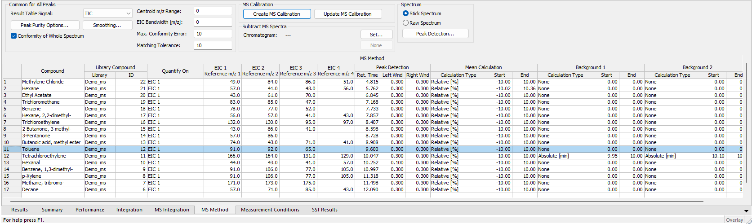
MS chromatogram window
MS method
Reference m/z values – up to four ions can be entered for each compound.
Peak Purity / Smoothing Options
Direct link to Calibration – MS Method parameters are transferred into MS Calibration.
MS EXTENSION/ MS Chromatogram window/ MS Method

Slide 10
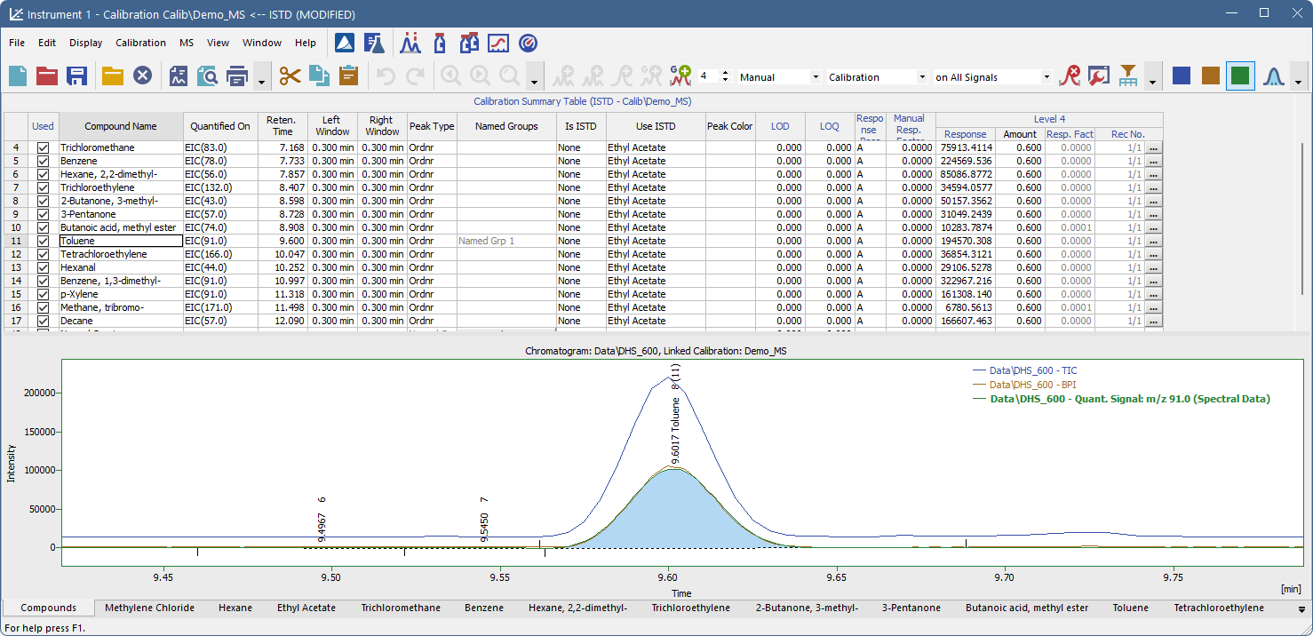
MS Calibration
Directly created or updated based on information defined in the MS Method.
Quantified On column – specifies which signal is used for quantification of each compound.
Fill All Responses from Quant. Signals – automatically fills calibration responses from defined quantification signals.
MS EXTENSION/ MS Calibration

Slide 11
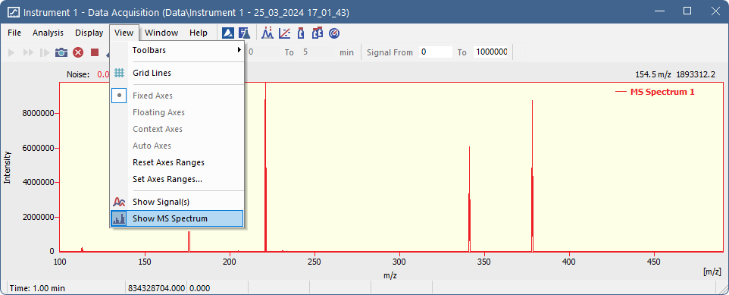
Data acquisitions
MS Spectrum view – toggle spectrum display during acquisition.
Flexible display options – show/hide signals, adjust axes, overlay spectra.
MS EXTENSION/ Data Acquisition

Slide 12
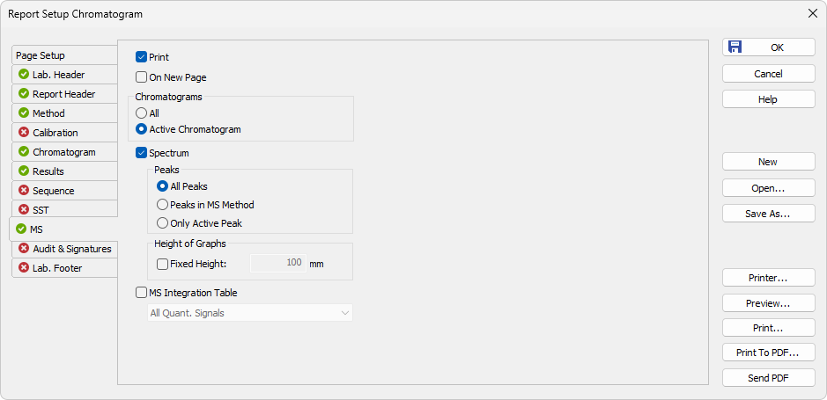
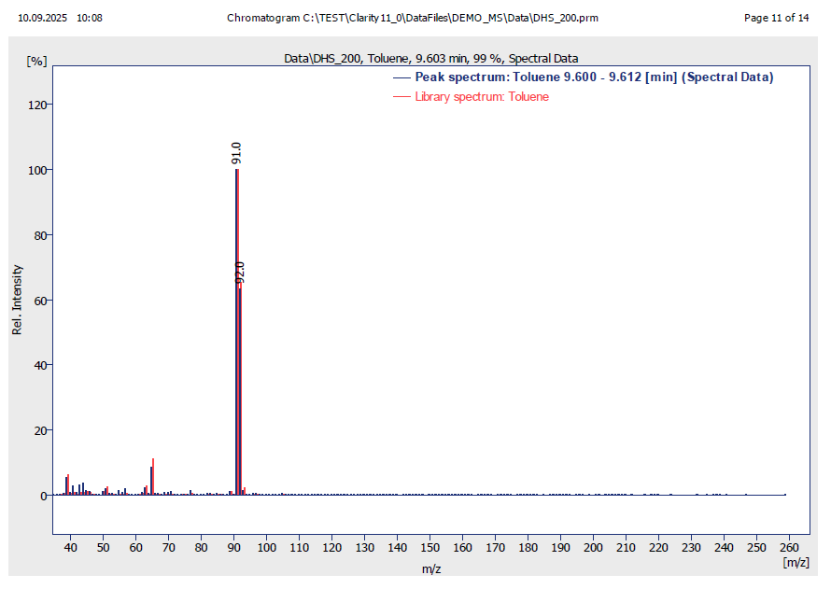
MS REPOrt
Spectrum options – choose to display all peaks, only peaks defined in the MS Method, or just the active peak.
MS EXTENSION/ MS Report

Slide 13
Thank you for your attention

