Slide 1

Clarity 10.1
What‘s new
Notes:
Hello, we’re excited to introduce the latest version of the Clarity Chromatography software. Lets take a quick look at what’s new and how it can make your work faster, easier, and more flexible.

Slide 2
What is new in Clarity 10.1
Use of ISTD from a different signal
Determination Coefficient (R²) for calibration
Signature handling improvements
Run IQ directly from the main window
New and updated control modules
Notes:
Clarity 10.1 lets you use internal standards from a different signal - perfect for more complex workflows. You’ll also get a brand-new R-squared value in calibration for better data insight.
We’ve made signing chromatograms more robust and reliable. Installation Qualification is now just one click away, right from the main window. And of course, you’ll find new and updated control modules ready to support your hardware.

Slide 3
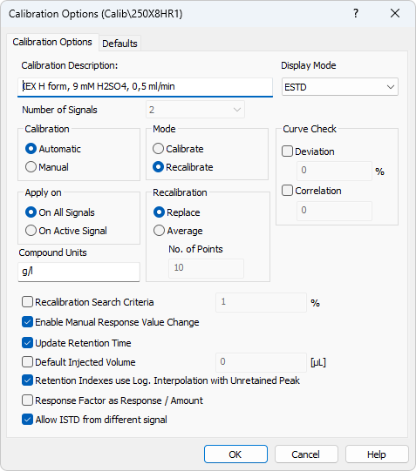
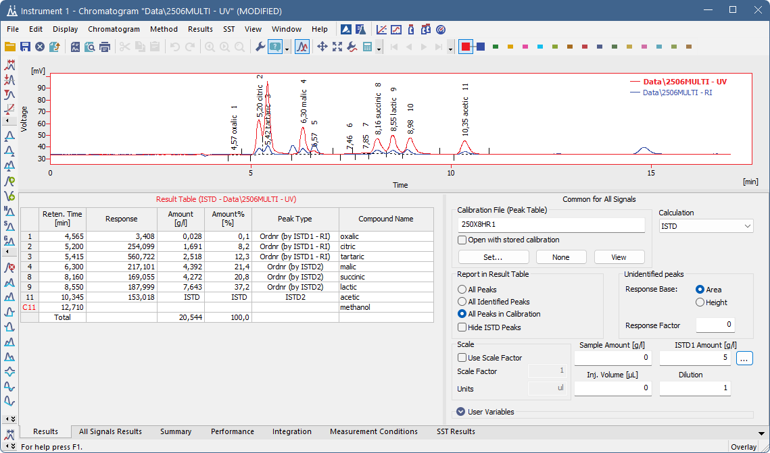
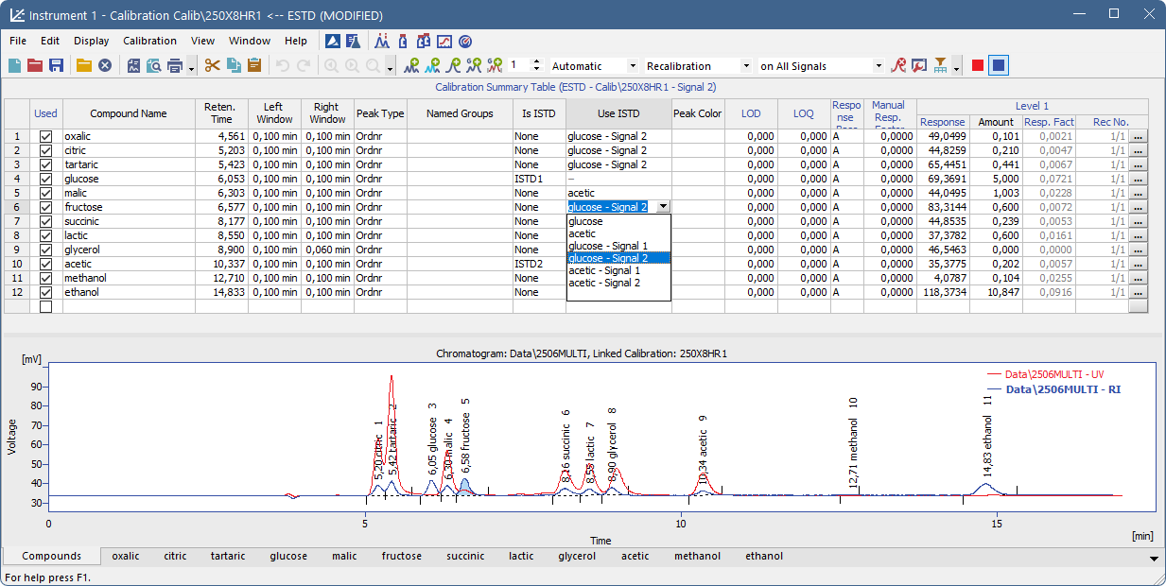
ISTD from a Different Signal
New Calibration Option allow using ISTD peaks from other signals.
This enables flexibility in applications like ICP-MS.
Result Table and Calibration Summary Table show signal-specific ISTD usage.
Notes:
In workflows like ICP-MS speciation, some signals don’t contain an ISTD peak. Clarity 10.1 lets you assign internal standards from another signal in the same chromatogram. This option is enabled in the Calibration Options dialog. Once set, it becomes available in the Calibration Summary Table—and applied ISTDs are clearly shown in the chromatogram’s Results tab.

Slide 4
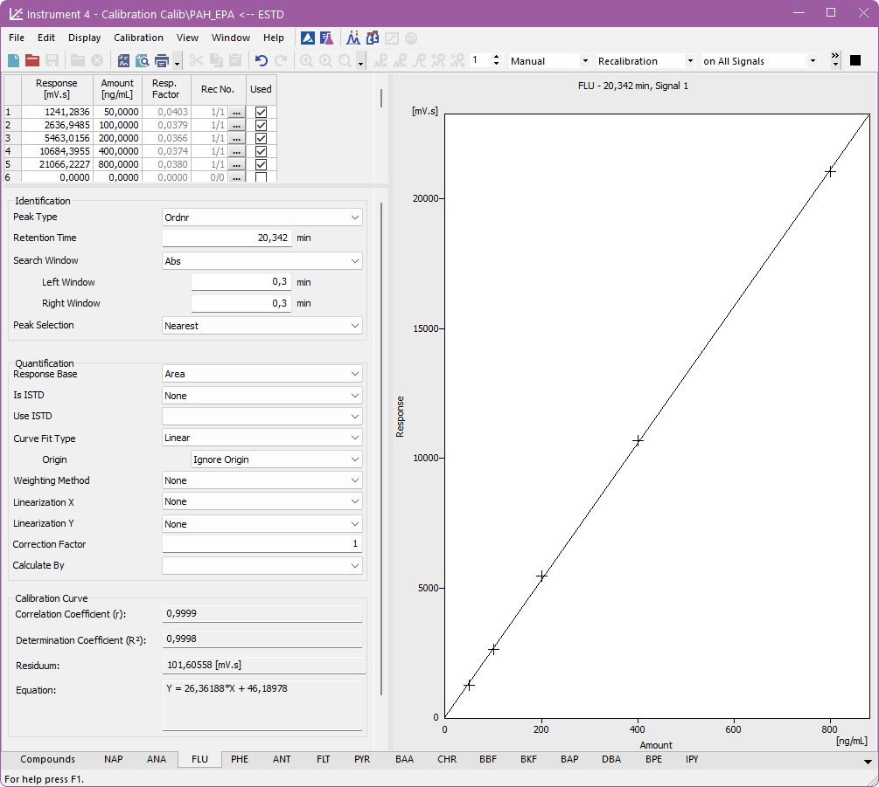

Determination Coefficient (R²)
New coefficient describes how well the calibration curve fits.
Complements correlation coefficient for clearer data interpretation.
Helpful for validation and method development.
xi - The actual (measured) response at level i.
yi - The calculated (predicted) response at level i.
X - The mean of all actual responses (including the zero point if Compute with Origin or Curve passes through Origin is selected).
Notes:
We’ve added the Determination Coefficient—R squared—alongside the existing Correlation Coefficient. Both values are available in the calibration curve section of each compound tab in the calibration window. The R² value gives you deeper insight into how well your curve fits the data, and is especially useful for validation and method development. It’s calculated automatically using the formula shown on screen.

Slide 5
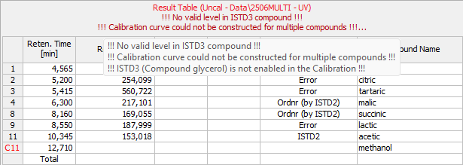
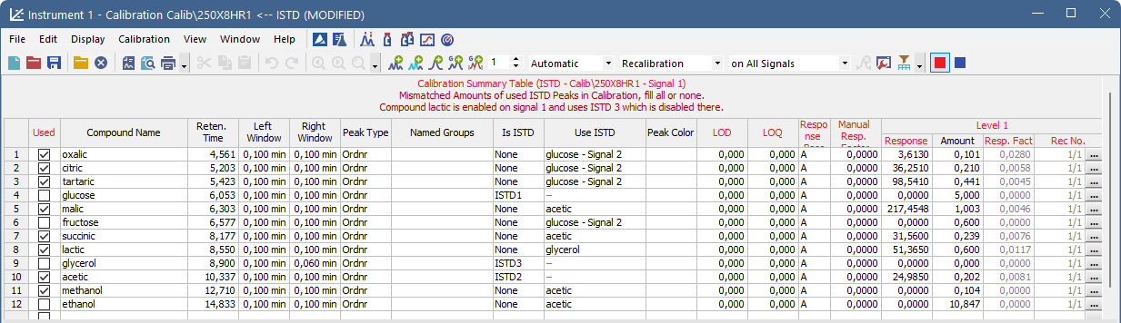
Calibration Warnings and Blank Handling
More detailed warning messages in Calibration Summary and Result Table.
If all warning messages don’t fit above the table, they can be viewed in a tooltip.
Notes:
We’ve improved how Clarity communicates calibration setup issues. Relevant warning messages are now displayed also above the Calibration Summary Table, not just above the Results Table. These messages are more specific and informative than before. If more than two warnings need to be shown, you’ll see an ellipsis—and all details are available by hovering over the warning area as a tooltip.

Slide 6
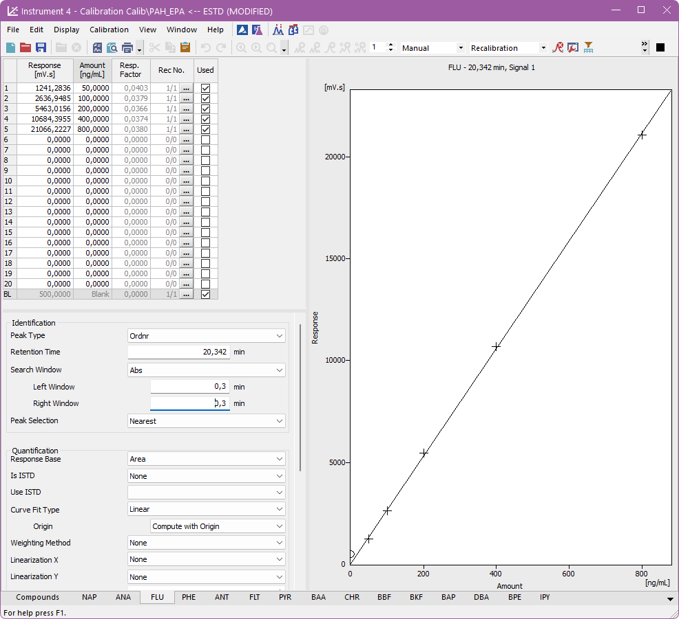
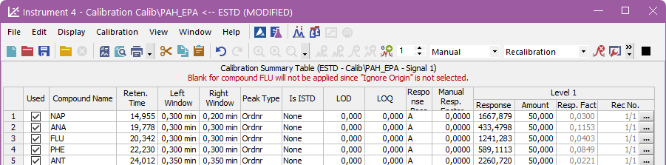
Calibration Warnings and Blank Handling
Blank is ignored with "Compute with Origin" or "Curve passes through Origin" options.
Notes:
We’ve also improved how Clarity communicates the use of blanks during calibration. Blanks are only included when "Ignore Origin" is selected, and ignored when using "Compute with Origin" or "Curve passes through Origin" options. When you manually set a conflicting configuration, Clarity now displays a warning to clearly indicate that the blank won’t be used. This ensures that the calibration behavior is more transparent and easier to understand.

Slide 7
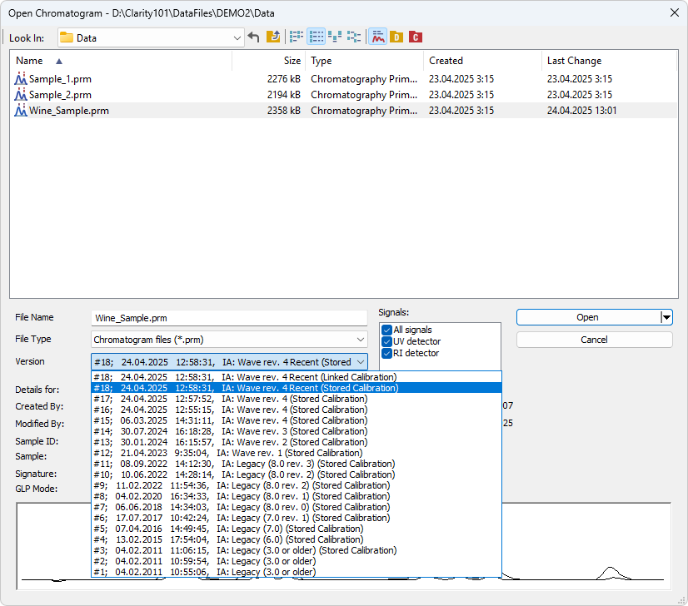
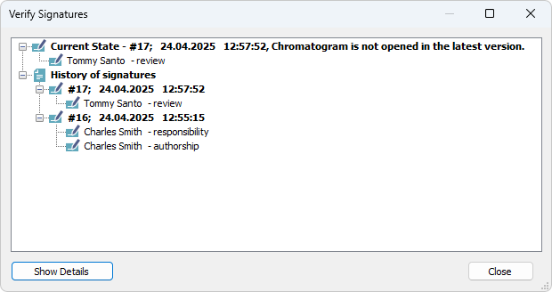
Signature Improvements
Chromatograms with linked calibration always open as "Not Signed".
After signing, default open mode is "Stored Calibration".
Historical versions reflect correct signature states.
Notes:
In Clarity 10.1, working with signed chromatograms is now much clearer. Chromatograms opened with a linked calibration are always shown as 'Not Signed'. Once you sign the chromatogram, Clarity automatically switches the opening mode to 'Stored Calibration'— making sure you always see the signed version first. Even when opening a historical version, the software now correctly shows whether it was signed at the time, together with all the signature details.

Slide 8
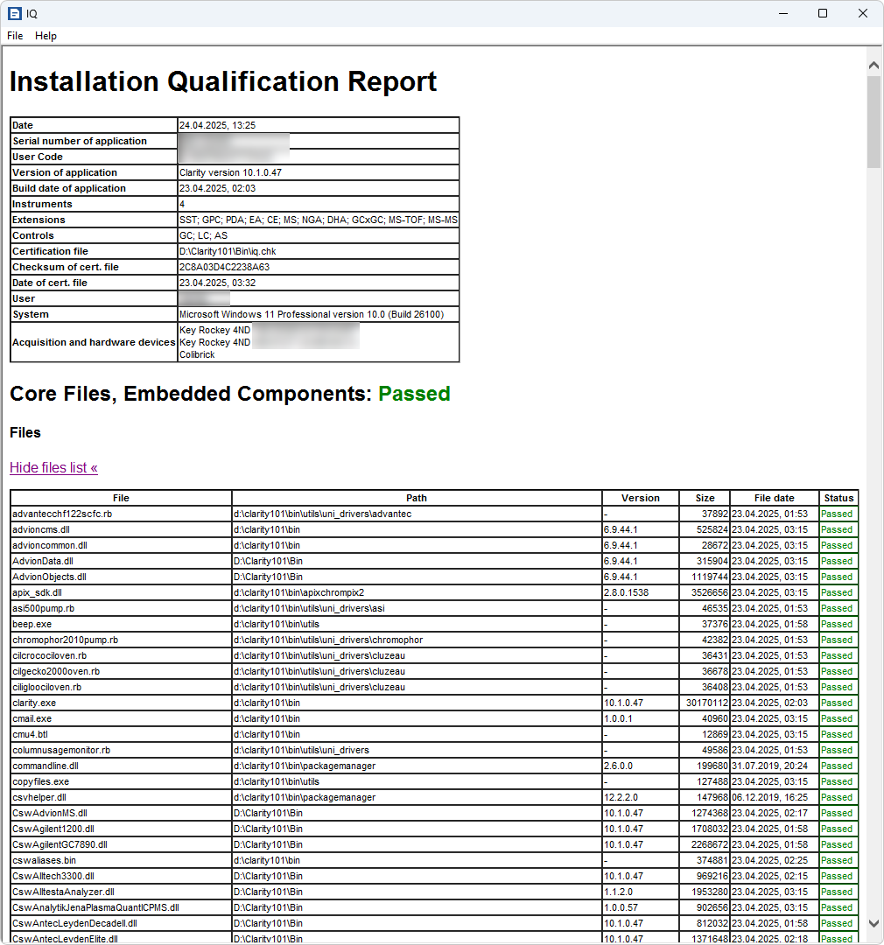
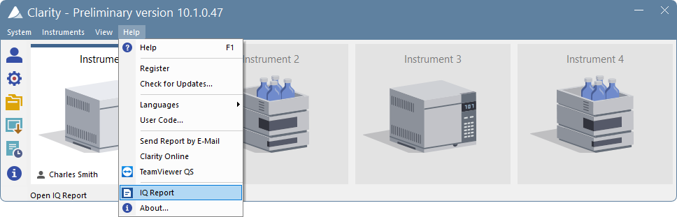
IQ from Main Window
IQ can now be launched directly from Help menu in Clarity main window.
Simplifies qualification and ensures proper setup after first run.
IQ link removed from installer to improve reliability.
Notes:
Installation Qualification is now just one click away. You can run IQ directly from the main Clarity window—no need to go search the installation folder.

Slide 9
New and Updated Control Modules
New Axcend FocusArray and updated Axcend Focus LC
New Ecom ECLM2000, FRC ECVA2000 and LED20
New Testa Analytical Flowmeter
Updated Agilent ICF
Updated Sykam S1130, S4120, S5300 and S6510
Updated Young In Chromass ChroZen Pump and GC
… and more
For a complete list of changes, see What’s New in the Help - About... menu of the Clarity main window.
Notes:
This version also includes new and updated control modules from Axcend, Ecom, Testa Analytical, Agilent, Sykam, and Young In Chromass.
For a full list of changes, see What’s New in the About box available from the Help menu of the main Clarity window.

Slide 10
Thank you for your interest in clarity
Notes:
Thank you for your interest in Clarity! Try Clarity 10.1 and unlock its full potential in your lab workflows. If you’d like to learn more, feel free to contact us — we’re always happy to help!

