Slide 1

Clarity 10.0
What‘s new

Slide 2
What Is new in Clarity 10.0?
Dual Chromatogram Mode
Improvements for GLP mode
Real time isoplot in Data Acquisition window
Method adaptation message extended by reason of adaptation
Improvements for MS extension
NGA calculations according to Natural gas norm EN ISO 6976:2016
External control module installer
New and updated control modules
WHAT‘S NEW / OVERVIEW

Slide 3
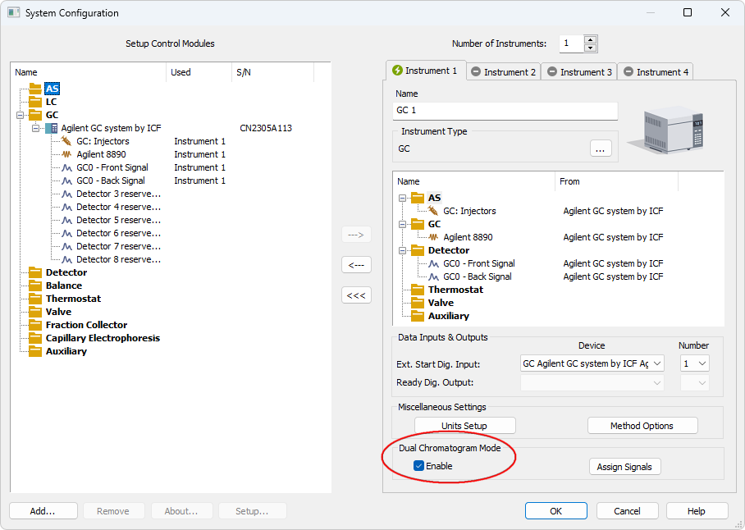
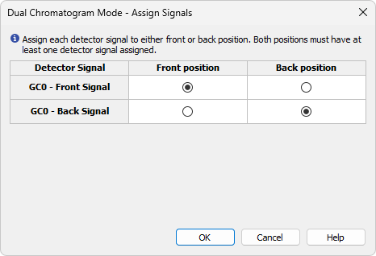
Dual chromatogram mode – system configuration
Creates separate chromatograms of 2 samples from one analysis
GC with dual tower sampler or LC with dual loop sampler
Requires at least 2 detector signals on Instrument - one set as Front, one as Back
WHAT‘S NEW / DUAL CHROMATOGRAM MODE – SYSTEM CONFIGURATION

Slide 4
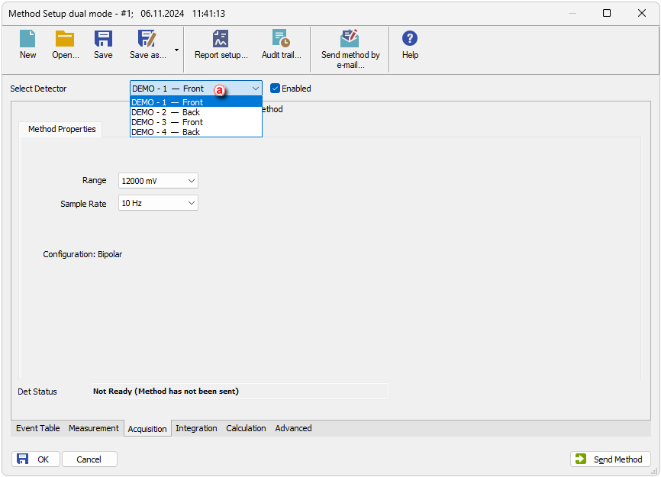
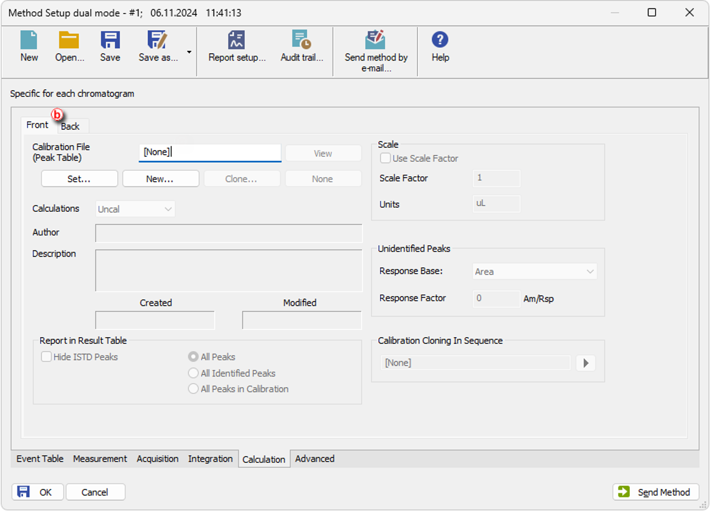
Dual chromatogram mode - method
Each signal is identified with assigned Front or Back position ⓐ
Calculation and Advanced tabs are divided into 2 sub-tabs ⓑ
WHAT‘S NEW / DUAL CHROMATOGRAM MODE - METHOD

Slide 5
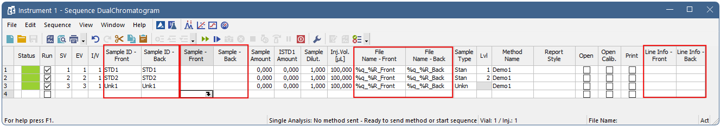
Dual chromatogram mode - sequence
Duplicated columns: Sample ID, Sample, File Name, Line Info
Back vial position is derived from the front position by a fixed offset
For more see M251-Dual Chromatogram Mode manual on our website in section Downloads.
WHAT‘S NEW / DUAL CHROMATOGRAM MODE - SEQUENCE

Slide 6
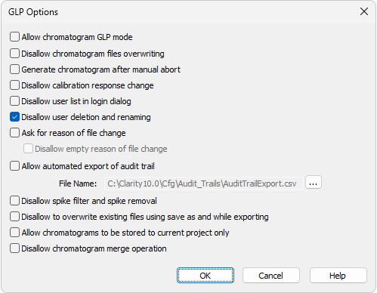
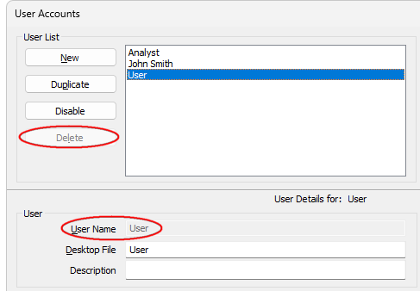
Improvements in glp
A new item to prevent any user account from being deleted or renamed
Renaming is possible only before initial saving of the new user account
WHAT‘S NEW / IMPROVEMENTS IN GLP

Slide 7
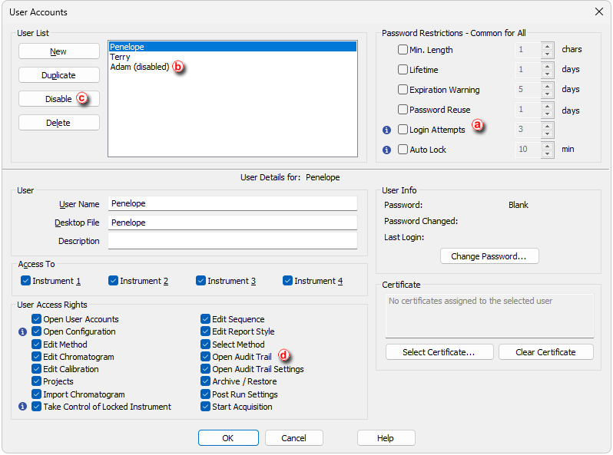
Improvements in glp – User Accounts
Automatic disabling of user account
A new checkbox Login Attempts ⓐ
After reaching the set limit account is disabled: ⓑ
=> account with access to User Accounts - for 1 h
=> regular account - permanently
Manual disabling of user account
A new button Disable ⓒ
To enable account again press the same button
Audit Trail
A new Access Right for opening audit trails ⓓ
WHAT‘S NEW / IMPROVEMENTS IN GLP - USER ACCOUNTS

Slide 8
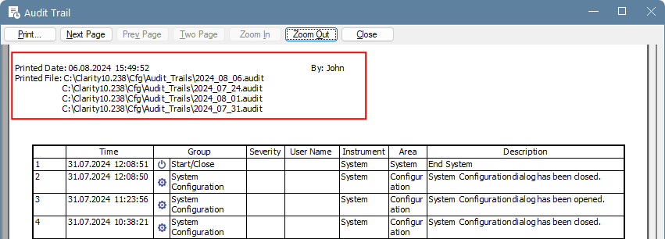
Improvements in glp – Audit trail
A new header in Print Preview
Basic information about report: Printed Date, Printed File(s) and Printed By
WHAT‘S NEW / IMPROVEMENTS IN GLP – AUDIT TRAIL

Slide 9
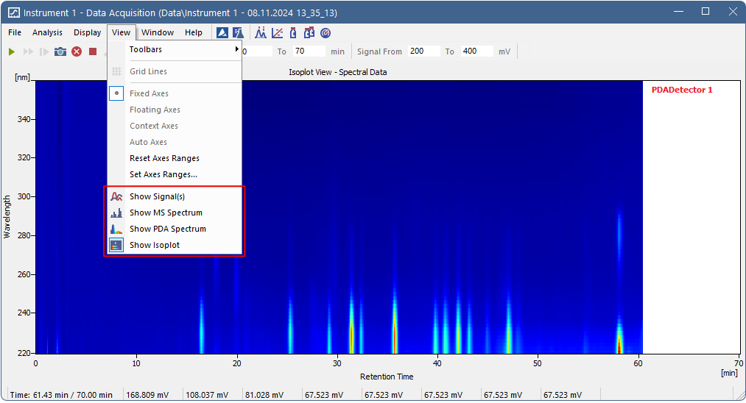
Real time isoplot in data acquisition window
View menu: Show Signal(s) = displays signal(s)
Show MS Spectrum = displays a real time MS spectrum during analysis
Show PDA Spectrum = displays a real time PDA spectrum during analysis
Show Isoplot = displays a real time isoplot view for PDA
WHAT‘S NEW / REAL TIME ISOPLOT IN DATA ACQUISITION WINDOW

Slide 10
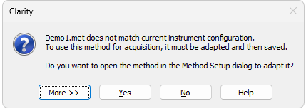
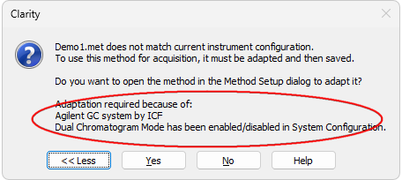
Method adaptation
Message extented by reasons for adaptation
Displayed after pressing More button
WHAT‘S NEW / METHOD ADAPTATION

Slide 11
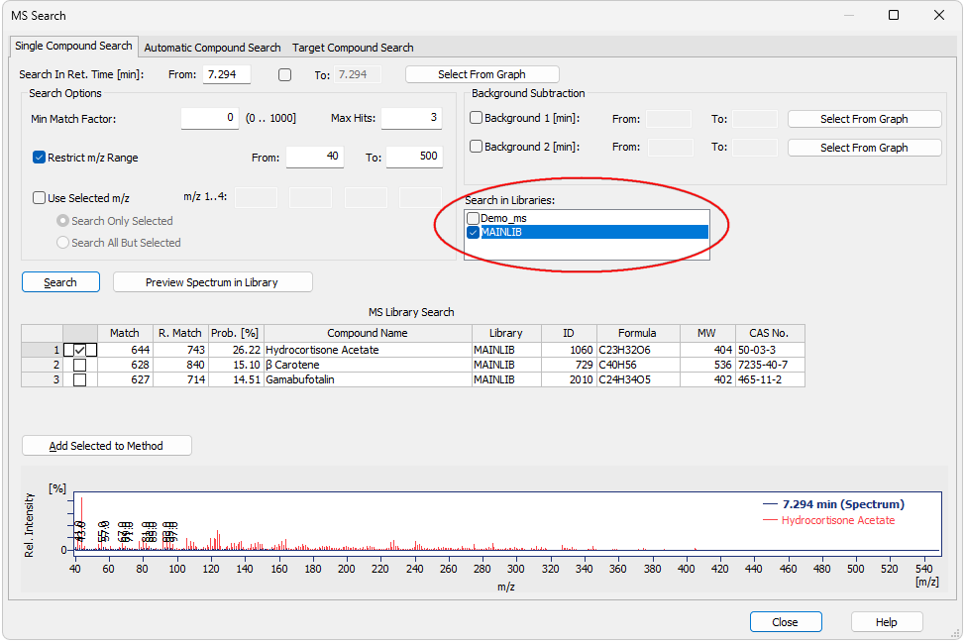
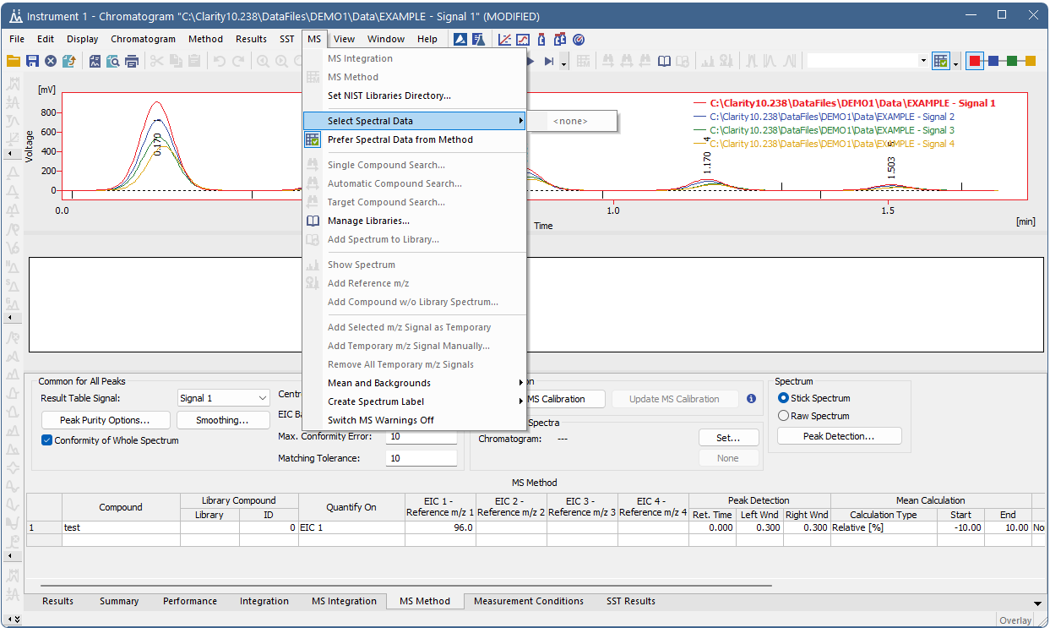
Improvements in MS extension
Library selection in Single Compound Search
MS Method tab available in chromatogram without spectral data
WHAT‘S NEW / IMPROVEMENTS IN MS EXTENSION

Slide 12
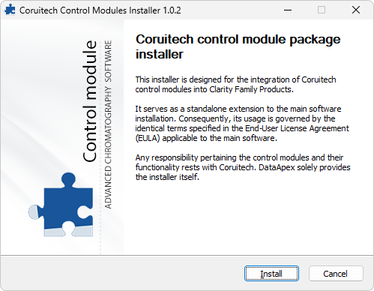
External control module installer
A custom-made package installer
To update/add control modules outside the official Clarity release schedule
All control modules must be approved by DataApex
Distributed by instrument producer
Requires its own installation qualification (IQ)
WHAT‘S NEW / EXTERNAL CONTROL MODULE INSTALLER

Slide 13
Other improvements and fixed bugs
Colored infobars in main window for better indication of Clarity installation type (Clarity Demo, Clarity Offline)
NGA: Calculations of heating values (ASTM D 3588-98 and GPA 2172-09) and calculations on wet basis (ISO 6976-95) refined
NGA: Support of calculations according to the Natural gas norm EN ISO 6976:2016
Improvements in printing from sequence
... and a lot more
For more see What‘s New accessible from Help - About... menu of your Clarity station main window.
WHAT‘S NEW / OTHER IMPROVEMENTS AND FIXED BUGS

Slide 14
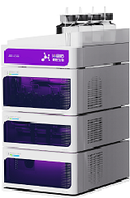
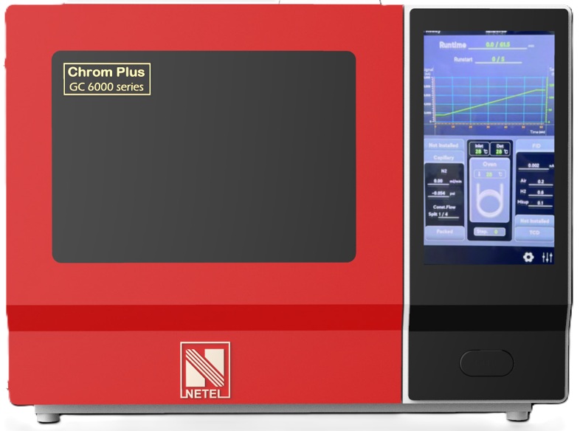
New control modules (version 9.0.1 - 10.0)
Agilent 8697 XL
Agilent 8850 GC
Chromsystems HPLC system modules CLC 200, CLC 320, CLC 330, CLC 340, CLC 420
CXTH P3000, P6000, UV1000, UV3000, UV6000
Ecom ECVA2000, ECA Amino 500 and CDM2000
Haosi Bio ARIES LC 2400
Knauer FC6.1 and P4.2S, UAD 6.1L and UAD 6.1L Prep
Netel Chrom Plus 6000
WHAT‘S NEW / NEW AND UPDATED CONTROL MODULES
Notes:
.

Slide 15
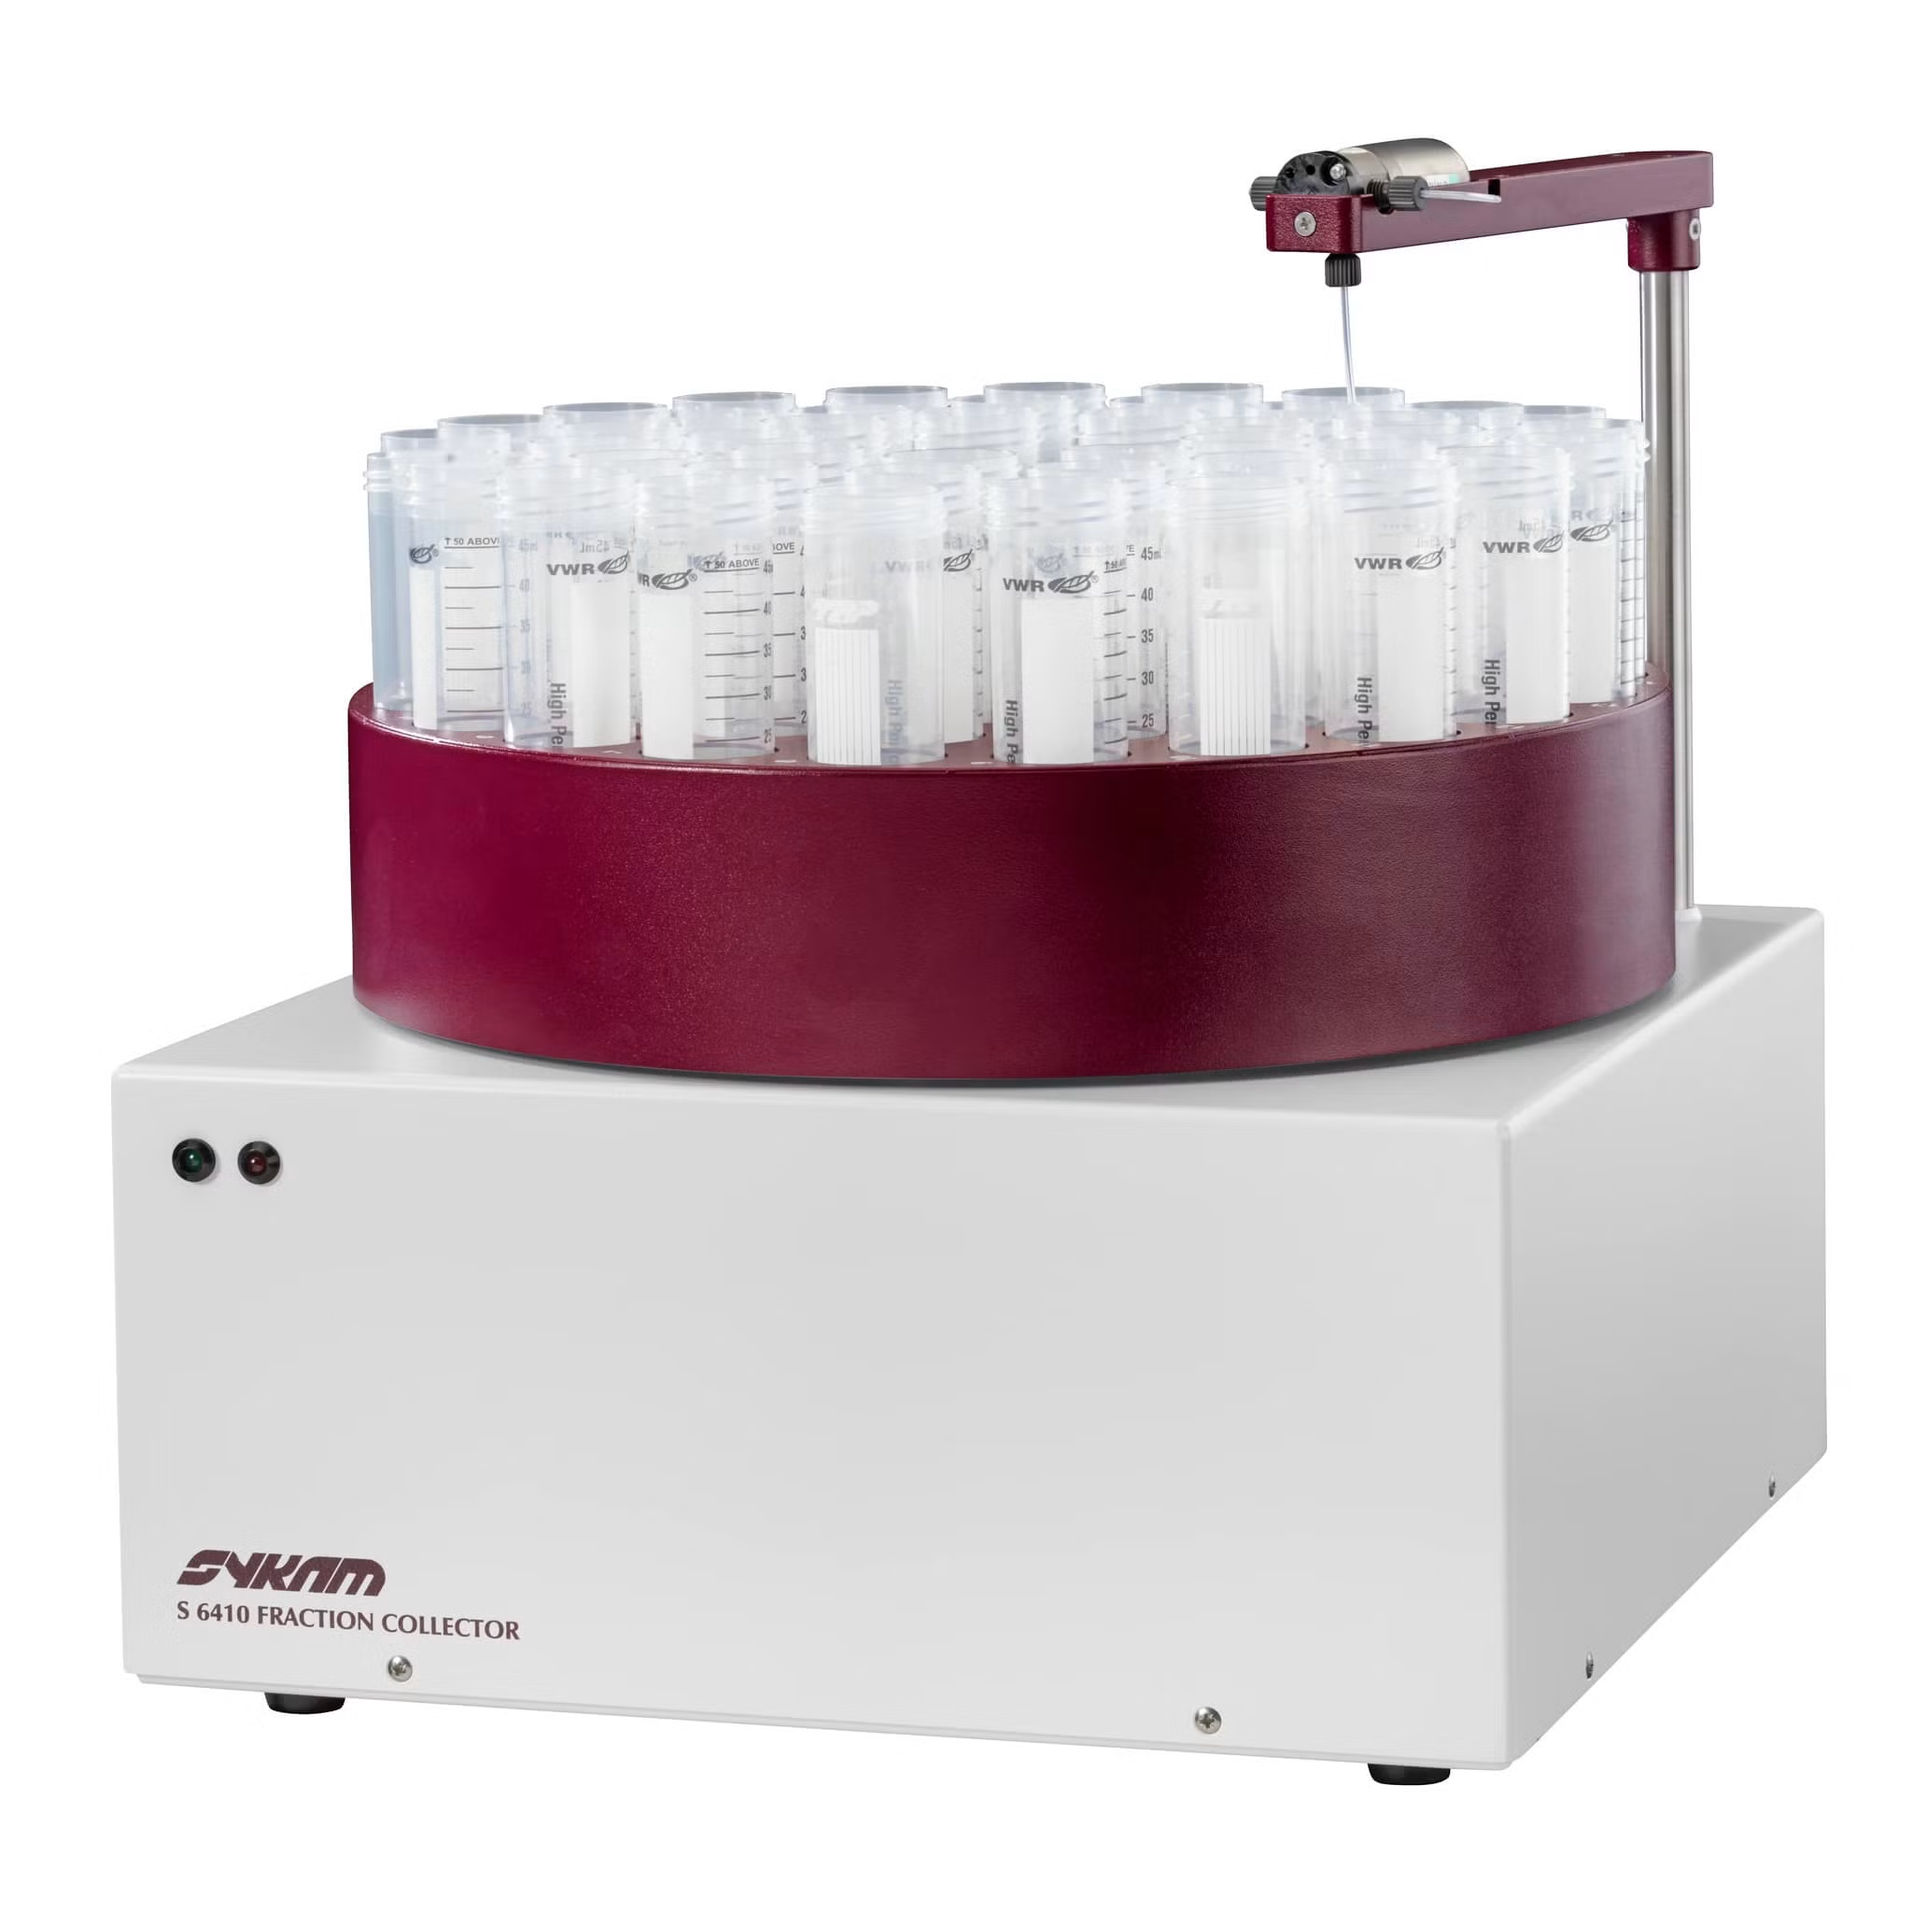
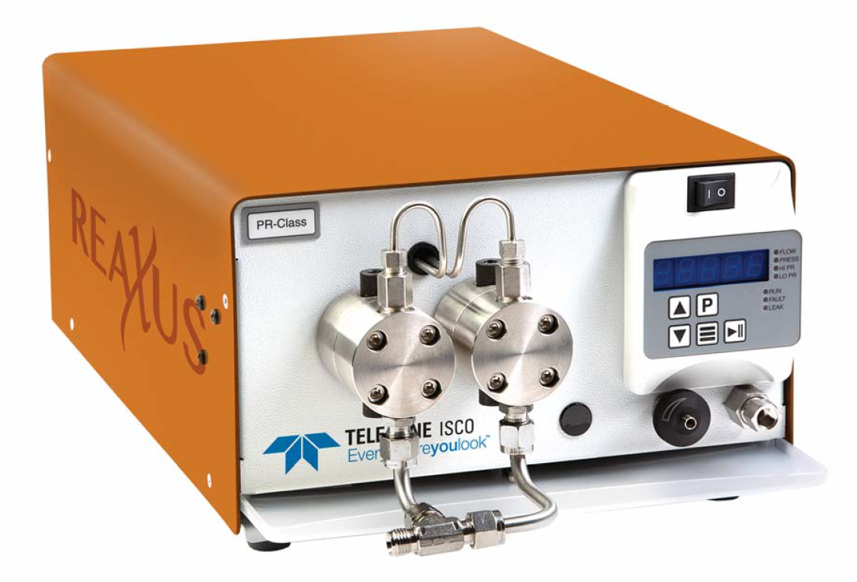
New control modules (version 9.0.1 - 10.0)
Sykam S6410
Teledyne ReaXus pumps
VWR ELSD
Welch WelNova 6110 Isocratic pump, 6120 High Pressure Gradient pump, 6140 Low Pressure Gradient pump, 6210 Autosampler
... and many control modules have been updated and improved.
For more see What‘s New accessible from Help - About... menu of your Clarity station main window.
WHAT‘S NEW / NEW AND UPDATED CONTROL MODULES

Slide 16
Thank you for your interest in clarity

