Slide 1
Introduction to clarity
Chromatography software

Slide 2
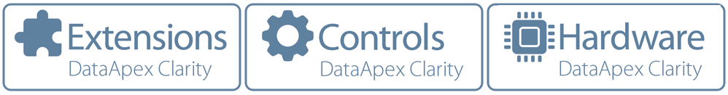
clarity
Compatible with “any“ chromatograph
Multiple instrument version
Tools for CFR 21 Part 11 compliance included
Modular
Scalable
INTRODUCTION TO CLARITY

Slide 3
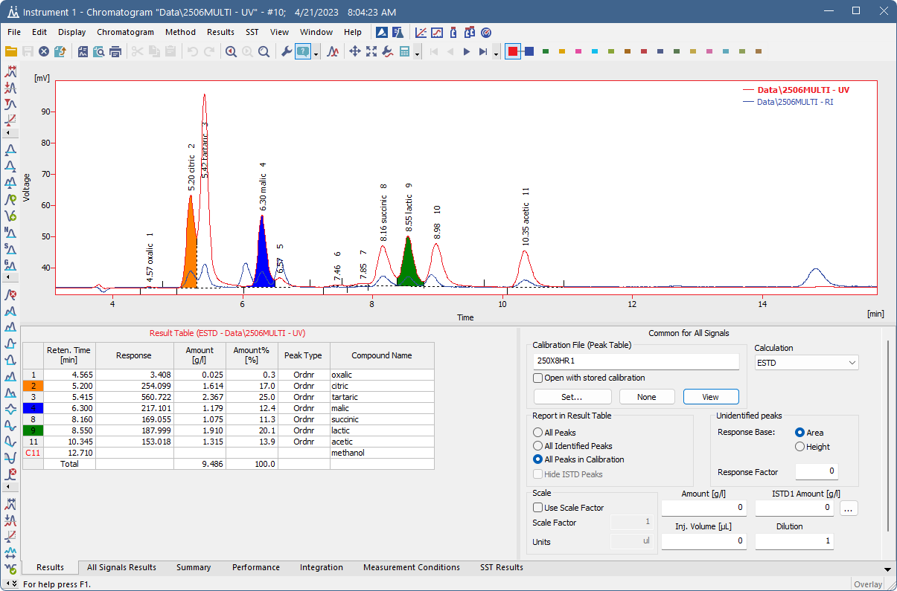
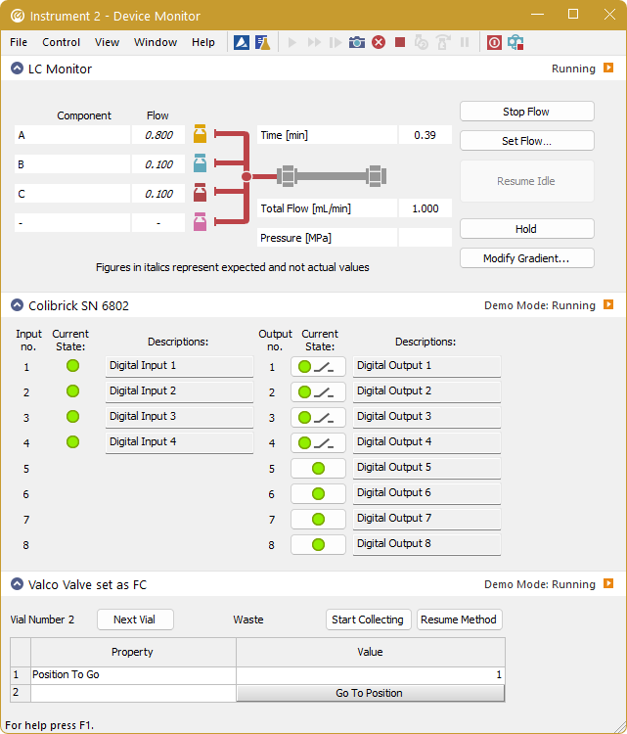
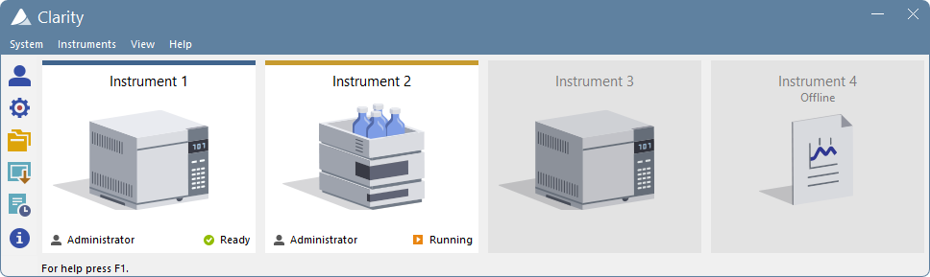
clarity
INTRODUCTION TO CLARITY

Slide 4
clarity
Up to 4 independent Instruments
Up to 32 signals on each Instrument
Optional Extensions
Optional Control modules
Offline version for data processing
Multilingual: English, German, Spanish, Chinese, French, Russian
INTRODUCTION TO CLARITY

Slide 5

Control in clarity
Over 1000 controlled instruments
We can control almost anything
  Advion
  Agilent
  Antec
  CTC Analytics
  ECOM
  Ellutia
  Gilson
  Hitachi
  HTA
  Knauer
  Teledyne SSI
  PerkinElmer
  Sedere
  Shimadzu
  Shodex
  Spark
  Sykam
  YoungIn Chromass
  VICI – Valco
  and many many more...
INTRODUCTION TO CLARITY / CONTROL IN CLARITY

Slide 6
Clarity extensions
Optional Extensions increasing application capabilities
  MS Mass Spectrometry
  GPC Gel Permeation Chromatography
  PDA Photodiode Array Detectors
  DHA Detailed Hydrocarbon Analysis
  NGA Natural Gas Analysis
  CE Capillary Electrophoresis
  EA Elemental Analysis
  SST System Suitability Test
INTRODUCTION TO CLARITY / CLARITY EXTENSIONS

Slide 7
Ready for regulated environment
Validation Kit for Operational Qualification (OQ)
Tools for CFR 11 Part 11 and GLP compliance
Complete audit trail
Logging reasons for changes
Electronic signatures
IQ & OQ procedures
INTRODUCTION TO CLARITY / CLARITY IN GLP

Slide 8
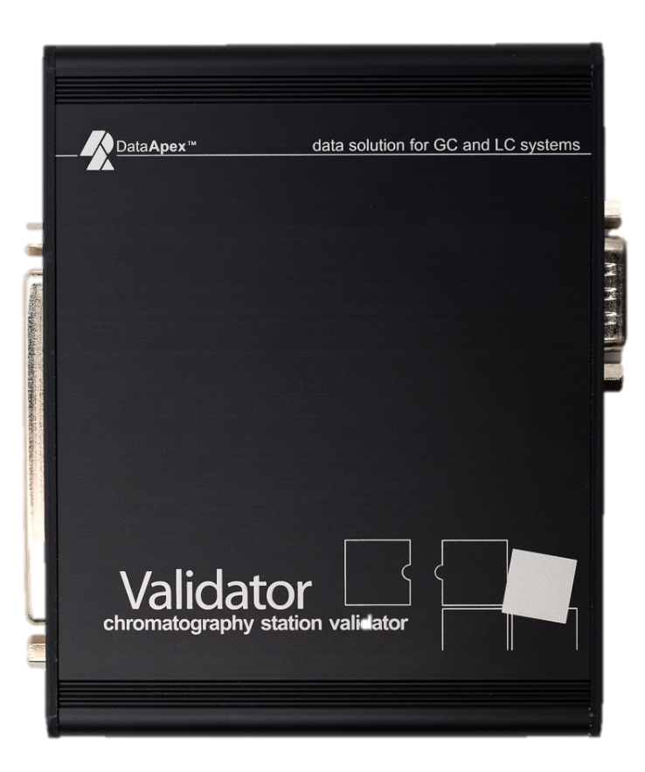
Validation kit
Designed for Clarity with Colibrick, U-PAD1/2, Net-PAD and INT7/9 cards
Includes a Validator, predefined methods, manual, cables
OQ Clarity Validation Wizard
SST extension is compulsory for data evaluation
INTRODUCTION TO CLARITY / CLARITY IN GLP / VALIDATION KIT

Slide 9
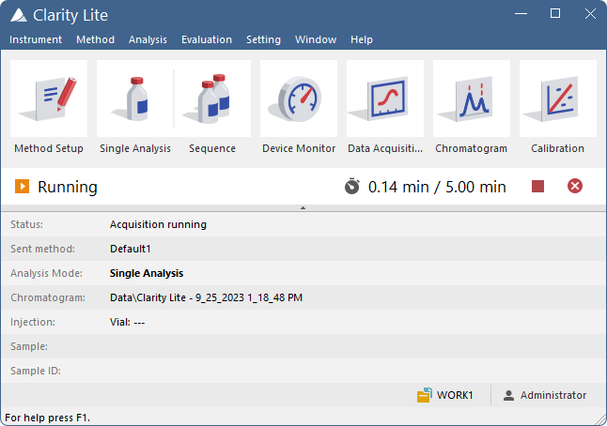
Clarity lite
Simplified Clarity version
Low-cost single Instrument solution
For chromatographs where
direct control is not available
Easily upgradable to full Clarity
INTRODUCTION TO CLARITY / CLARITY LITE

Slide 10
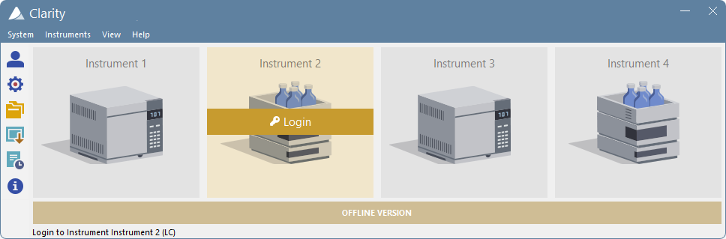
Clarity offline
Clarity version for offline data processing on second computer
Supports data import/export and extensions
INTRODUCTION TO CLARITY / CLARITY OFFLINE

Slide 11
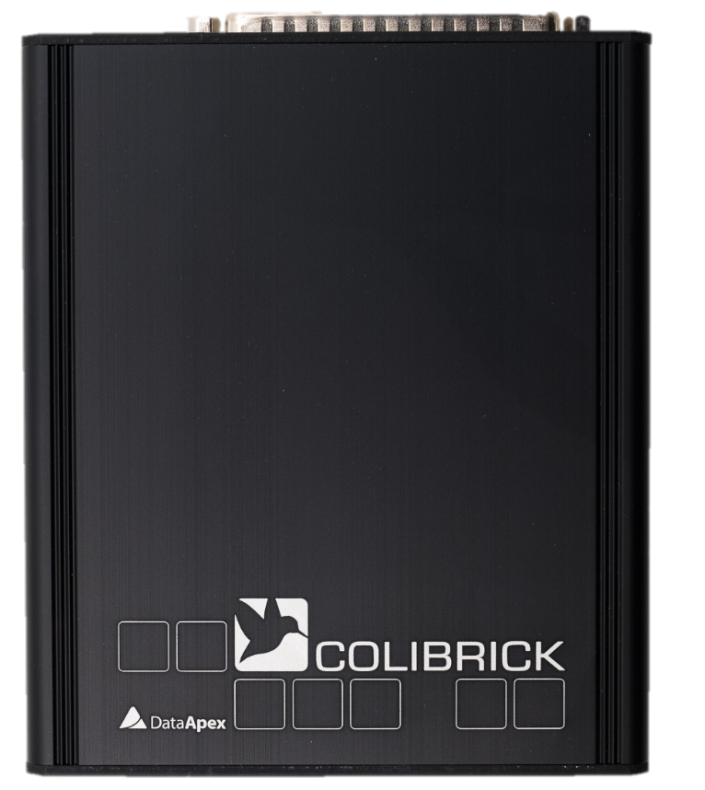
COLIBRICK A/D CONVERTER
Solution for legacy/not controlled chromatographs and detectors
Supports 1, 2 or 4 channels
USB interface
Cables included
3-year warranty
INTRODUCTION TO CLARITY / COLIBRICK

Slide 12
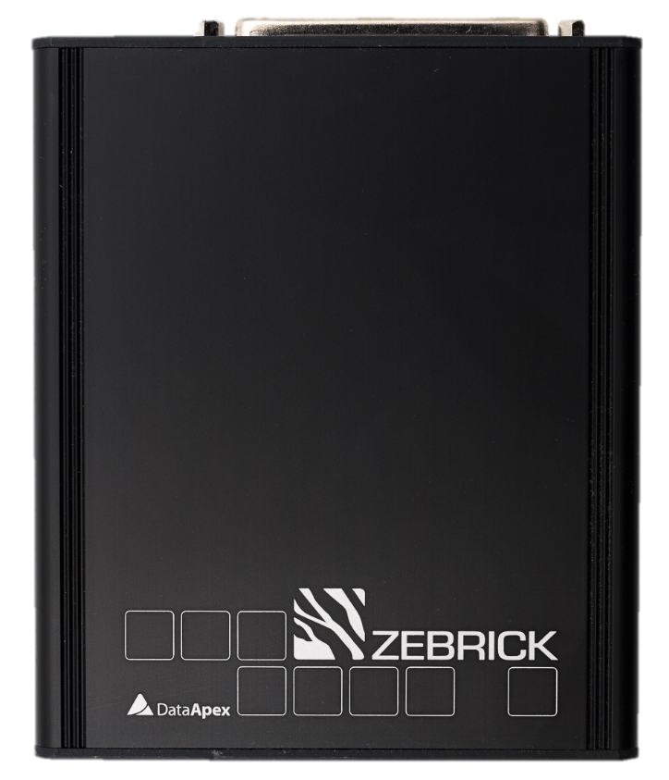
Zebrick d/a and d/f converter
Solution for control of LC pumps driven by frequency or voltage
4 D/A and 4 D/f converters and 8 auxiliary logical inputs and outputs
USB interface
Cables included
3-year warranty
INTRODUCTION TO CLARITY / ZEBRICK

Slide 13

Proficient technical support
Online support for registered users
Fast response time
Remote service via TeamViewer utility
Wide range of online trainings
Regular software updates
INTRODUCTION TO CLARITY / TECHNICAL SUPPORT

Slide 14
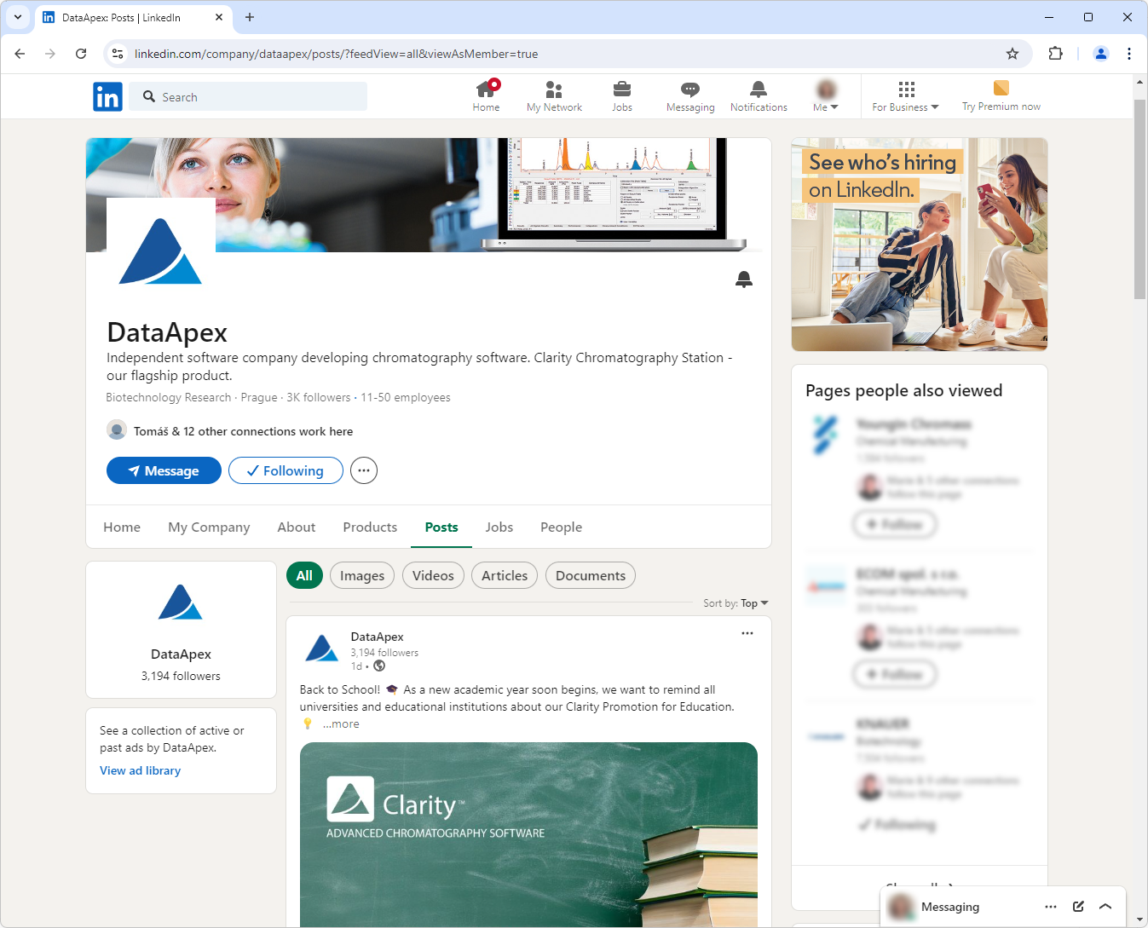



Dataapex on social media
Product highlights
Company events and news
Tips & Tricks videos
INTRODUCTION TO CLARITY / SOCIAL MEDIA

Slide 15
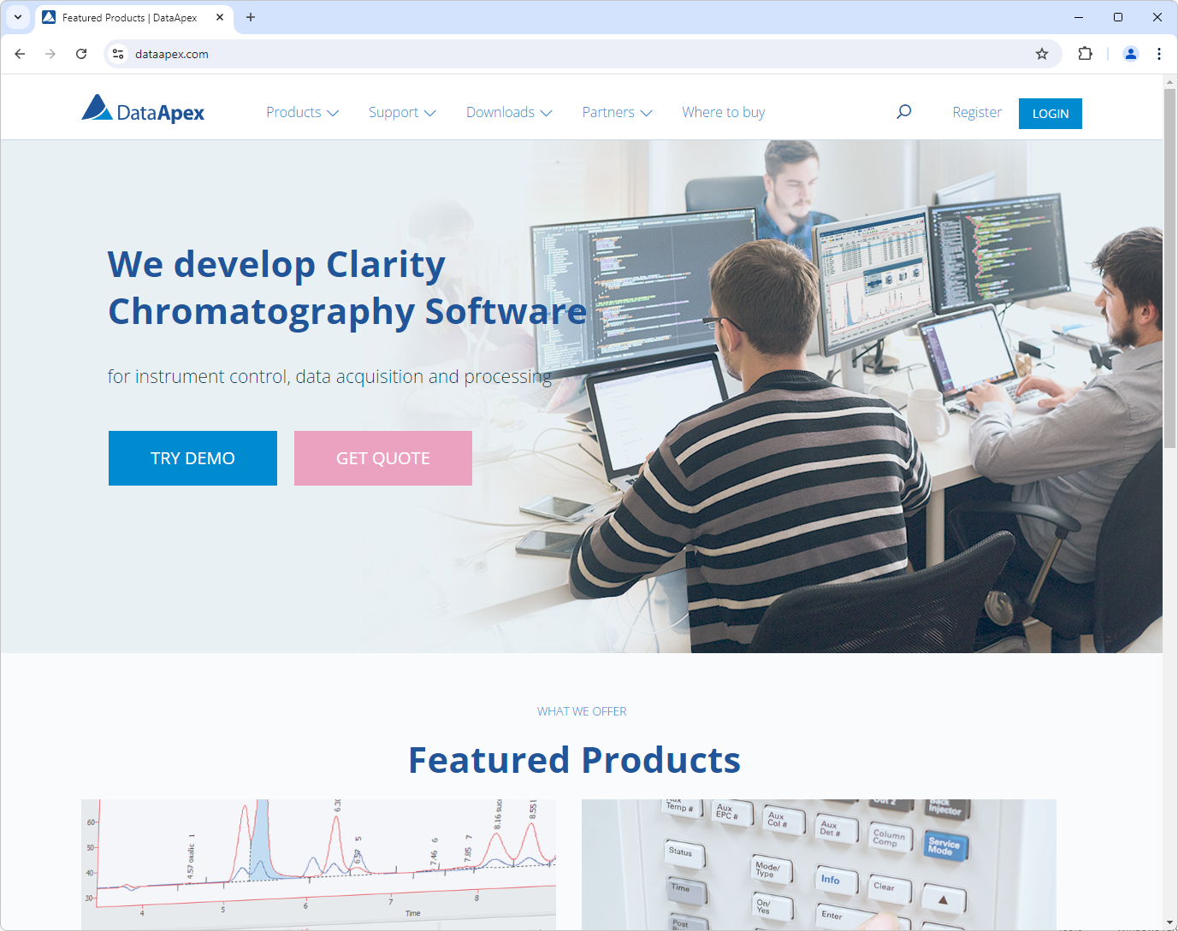
Information resources
Website
Manuals
Datasheets
Social Media
Online distributor materials
INTRODUCTION TO CLARITY / INFORMATION

Slide 16

Dataapex supports education
Educational discount
Clarity Offline SW free of charge for every purchased Clarity or Clarity Lite SW
INTRODUCTION TO CLARITY / EDUCATION

Slide 17
Why choose clarity?
Compatible with any chromatograph
Extremely reliable and easy to use
Modular and scalable solution
Top-selling independent SW provider
36 000+ users in 100+ countries
Competitive pricing
Proficient technical support
Regular software updates

Slide 18
Thank you for your attention
sales@dataapex.com
www.dataapex.com

