Slide 1
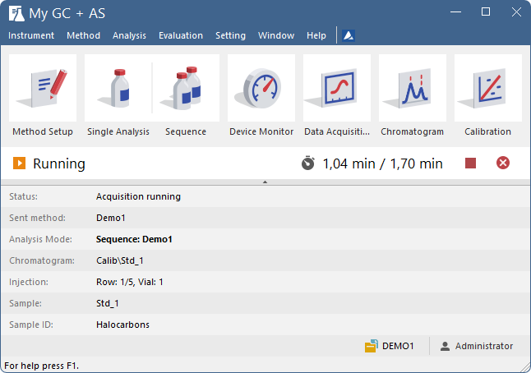
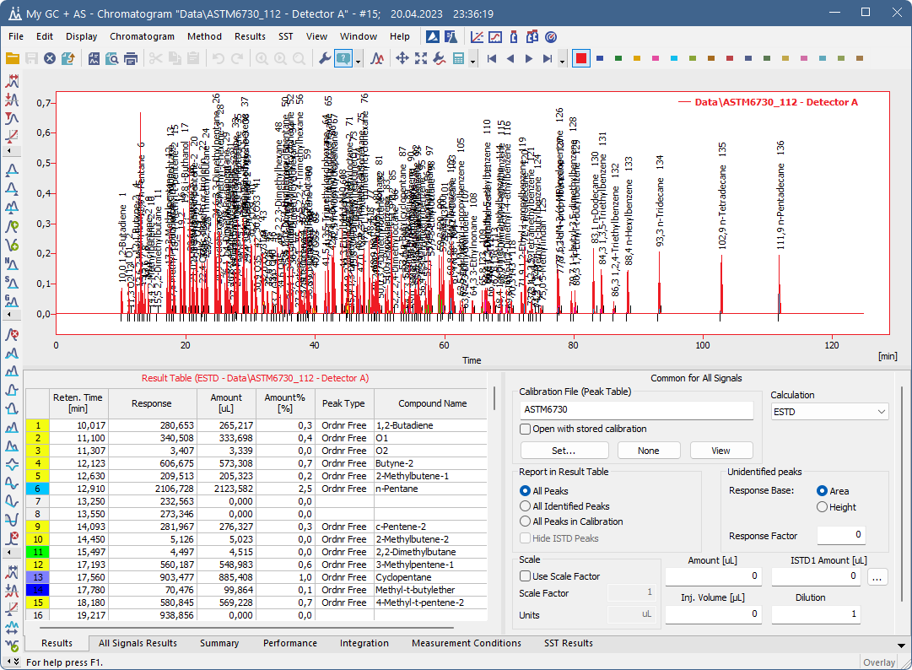

Why Clarity Chromatography Software?
Compatible with any chromatograph
Extremely reliable and easy to use
Versatile and scalable solution
Top-selling independent SW provider
36 000+ users from 100+ countries
Competitive pricing
Extended user support
Regular software updates

Slide 2
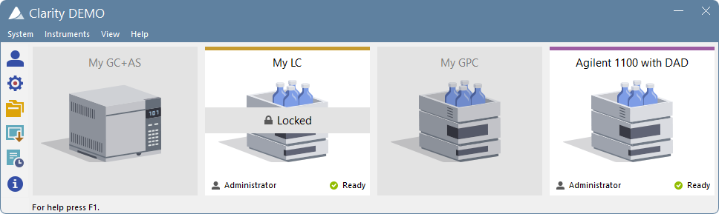

Main features of Clarity Chromatography Software
PDA, GPC, MS, SST, NGA, DHA, CE, EA
1000+ directly controlled instruments
Reliable A/D and D/A converters
and HW accessories
Customized cables and accessories
Rich Import/Export options
LIMS connection
Multi-instrument, multi-detector system
Up to 4 instruments, up to 32 signals each
21 CFR Part 11 Compliance
IQ/OQ Validation
WWW.DATAAPEX.COM
SALES@DATAAPEX.COM

